Slide 1
ShotProof
Image comparison with
reviewable evidence
Creative quality control for product-content teams
Actual AMD MI300X image inference, synthetic fixtures
ShotProof 1/5
Notes:
ShotProof helps product-content reviewers compare a candidate against a selected reference. On 2026-10-17, the official AMD One-Click OCR Notebook provided one MI300X VF. Cached Qwen2-VL-7B ran offline through PyTorch/ROCm. The existing ShotProof UI made actual paired-image GPU requests through the private authenticated Jupyter proxy. Raw results and image hashes are retained. This is a synthetic demonstration, not a model-quality benchmark.

Slide 2
The review problem
A changed product detail can slip into creative content
Reviewers need to see the reference, inspect the candidate and retain the reason for their decision.
Occlusion needs an uncertain answer. A concealed component cannot be counted as absent.
ShotProof 2/5
Notes:
The intended user is a product-content reviewer checking synthetic or edited creative assets before handoff. This is a proposed workflow and business hypothesis, not a measured customer or revenue claim. The earlier research STOP remains unchanged. No natural-product accuracy benchmark is claimed.

Slide 3
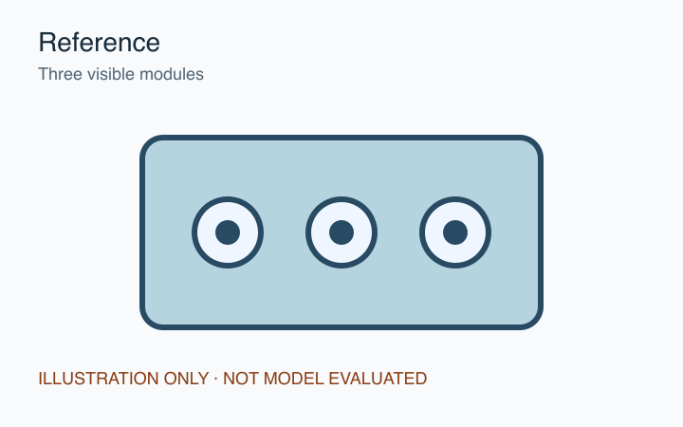
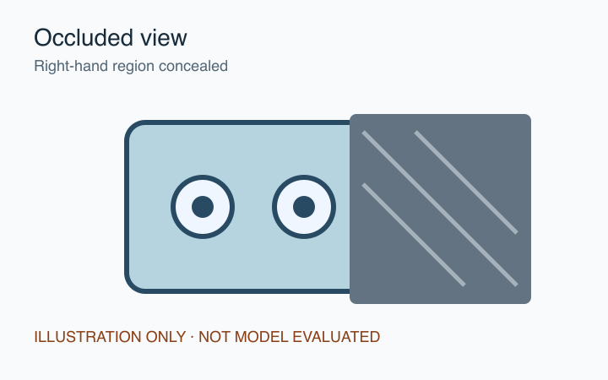
Original images, explicit uncertainty
Selected reference
Candidate with occlusion
A reviewer records what is visible and what remains unverifiable
ShotProof 3/5
Notes:
Original synthetic illustrations from the restored ShotProof-original-review-flow-2026-10-16.zip, assets/reference.svg and assets/occlusion.svg. Provenance and hashes are in asset-manifest.json. These are demonstration fixtures, not independent evaluation labels. No model authored the images or the observation shown in the engineering preview.

Slide 4
The paired-image workflow
01
Two images
The gateway sends the reference and candidate pixels together.
02
Model proposal
Structured findings preserve uncertainty and visible limitations.
03
Evidence record
Hashes, model, request status and usage identify the actual call.
04
Reviewer decision
A reviewer records a reason. Agent demo annotations carry a separate identity.
ShotProof 4/5
Notes:
Implementation: server.py, notebook_backend.py and inference.js. The private AMD backend sends both original image pixels through Qwen2-VL on the observed MI300X VF. It validates fields, retains raw output and marks invalid responses for review. Only an outer Markdown JSON fence may be removed. Source and transmitted PNG hashes bind the evidence. Agent demo decisions are distinct from human approval. Hardware identity comes from runtime observations, not signed attestation.

Slide 5
Actual AMD execution and remaining limits
Qwen2-VL-7B on AMD MI300X VF
Three interactive image pairs completed. Their single-request generation times were 1.40, 1.28 and 1.57 seconds.
Synthetic examples, human review required
These single requests establish a working GPU path. They do not establish accuracy or customer benefit.
ShotProof 5/5
Notes:
Current execution evidence: output/shotproof-three-live-amd-evidence.json. Addition 1398 ms, occlusion 1282 ms, lighting 1566 ms, measured around synchronized GPU generation; not end-to-end benchmark latency. First warm-up took 13902 ms. Earlier nonconforming outputs are retained. The UI export contains exact PNG bytes, hashes, raw model text and agent_demo annotations. No owner approval is inferred. Engineering evidence: tests/test_core.cjs (70 checks), tests/test_ui.cjs (40 checks), tests/test_inference.py (9 tests), output/playwright/browser-results.json (1440x1000, 768x1024 and 390x844). Engineering checks do not measure model quality. AMD Token Factory signed-in page after successful team creation: email still not registered for API distribution. Discord connected, community joined and Closed solo ShotProof team created. The separate official One-Click OCR Notebook already provides a working private GPU path, so demonstration no longer depends on Token Factory. The real-time URL requires the owner AMD login. Public judge access remains unresolved. Official event https://lablab.ai/ai-hackathons/amd-developer-hackathon-act-iii, observed 2026-10-17, states submission deadline October 18 06:00 EDT. No final submission, public deployment or licensing change has occurred.

