Slide 1

AWR1642
4RX
Calibration, Monitoring Engine
R4F
CANFD
USB/UART
C674x
CAN
2TX
Synth
1.5MB
SPI
Processing Chain
GUI Visualizer
Radar Data Capture
1D FFT (Range)
Clutter Removal
Heatmap Generation
Detection and Vital Signs

Slide 2
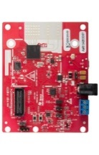
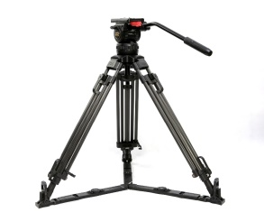
Lab Test Setup
AWR1642
Floor distance to seat back 45.5”
Cushion Height 18”
Zone 1
Zone 2
Center to center distance 36”

