Slide 1
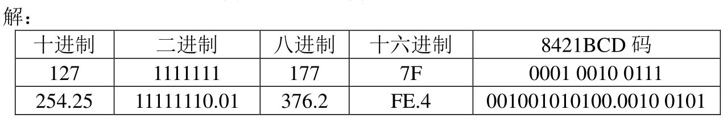
$${(1010.1011)}_{2}=1×2^{3}+0×2^{2}+1×2^{1}+0×2^{0}+1×2^{−1}+0×2^{−2}+1×2^{−3}+1×2^{−4}={(10.6875)}_{10}$$
$${(2E5.3)}_{16}=2×{16}^{2}+14×{16}^{1}+5×{16}^{0}+3×{16}^{−1}={(741.1875)}_{10}$$
$${(35.36)}_{8}=3×8^{1}+5×8^{0}+2×8^{−1}+6×8^{−2}={(29.34375)}_{10}$$

Slide 2
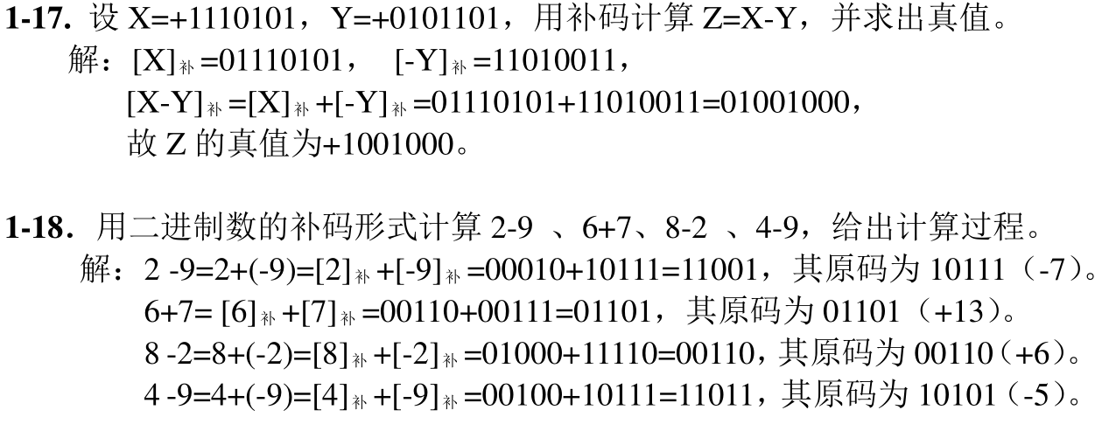

Slide 3
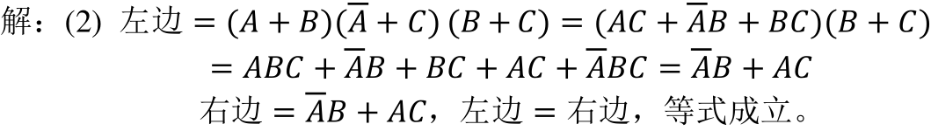
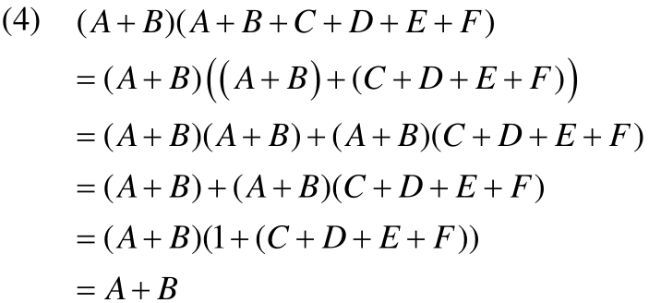

Slide 4
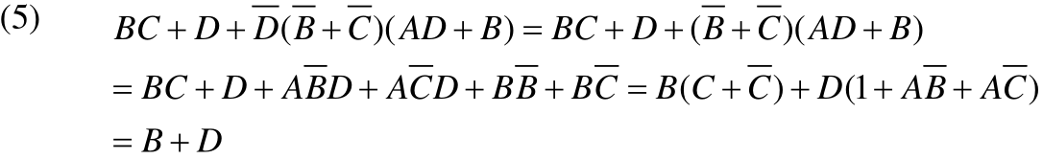



Slide 5
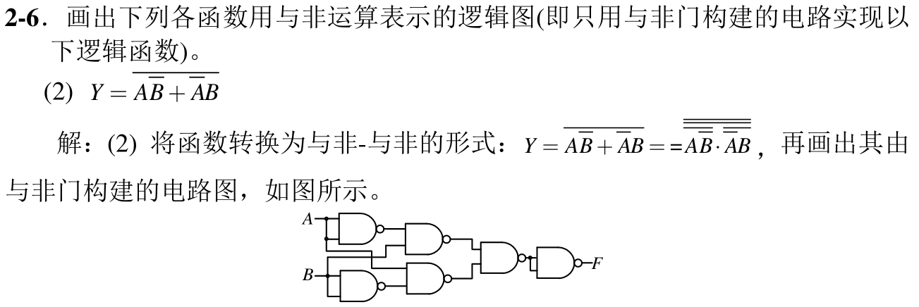

Slide 6

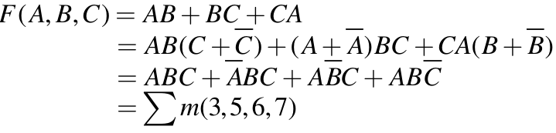

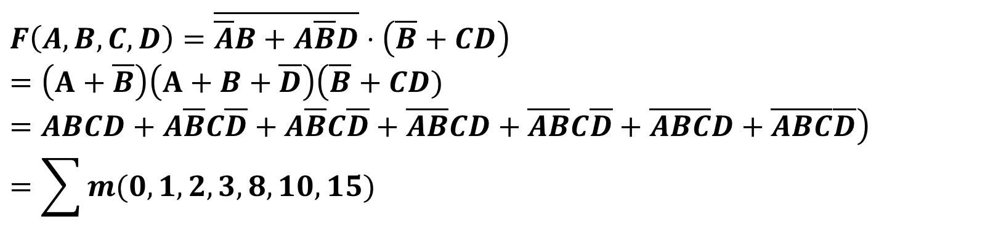
$$F\left(A,B,C,D\right)=\overline{\overline{A}B+A\overline{B}D}⋅\left(\overline{B}+CD\right)$$
$$=\left(A+\overline{B}\right)\left(A+B+\overline{D}\right)\left(\overline{B}+CD)=ABCD+A\overline{B}C\overline{D}+A\overline{B}C\overline{D}+\overline{A}\overline{B}CD+\overline{A}\overline{B}C\overline{D}+\overline{A}\overline{B}\overline{C}D+\overline{A}\overline{B}\overline{C}\overline{D}\right)$$
$$=\sum{m(0,1,2,3,8,10,15)}$$

Slide 7

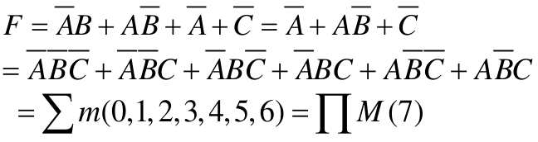

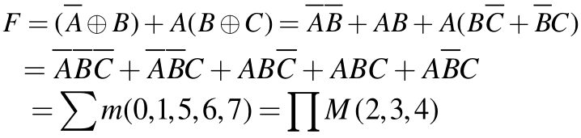

Slide 8


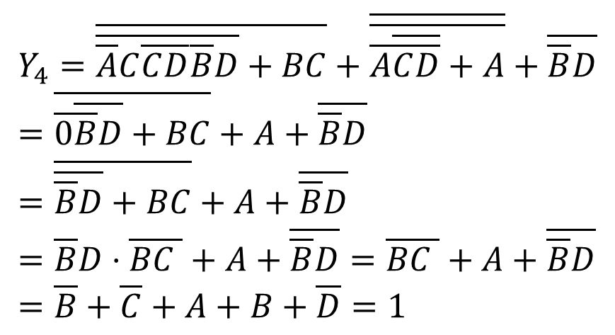
$$Y_{4}=\overline{\overline{\overline{A}C\overline{C}\overline{D}}\overline{\overline{B}D}+BC}+\overline{\overline{\overline{A}\overline{\overline{C}\overline{D}}+A}}+\overline{\overline{B}D}=\overline{\overline{0}\overline{\overline{B}D}+BC}+A+\overline{\overline{B}D}=\overline{\overline{\overline{B}D}+BC}+A+\overline{\overline{B}D}=\overline{B}D⋅\overline{BC }+A+\overline{\overline{B}D}=\overline{BC }+A+\overline{\overline{B}D}=\overline{B}+\overline{C}+A+B+\overline{D}=1$$

Slide 9
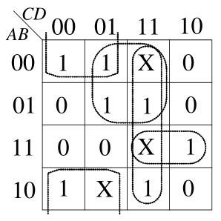


Slide 10
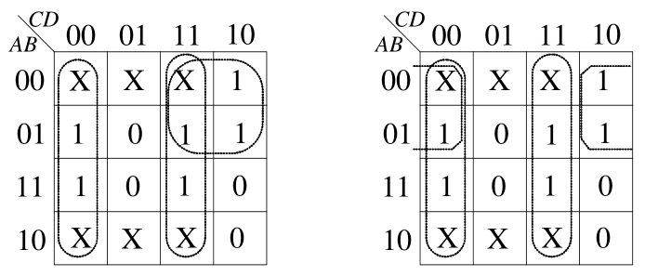
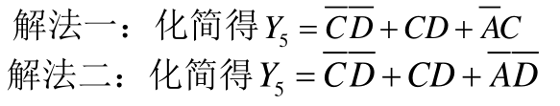

Slide 11
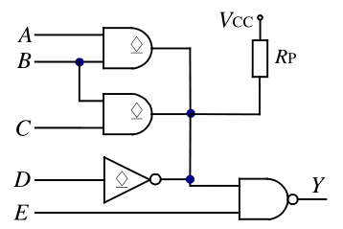

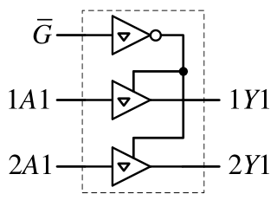


Slide 12
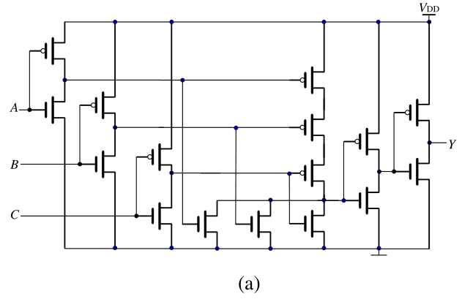

Slide 13
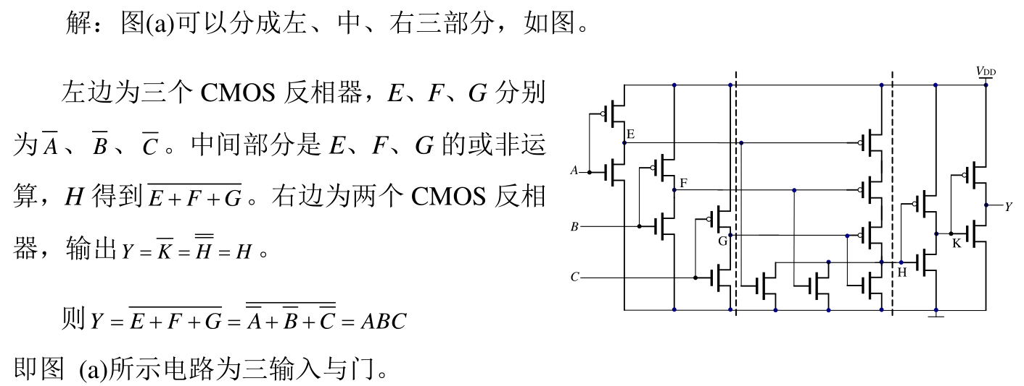

Slide 14
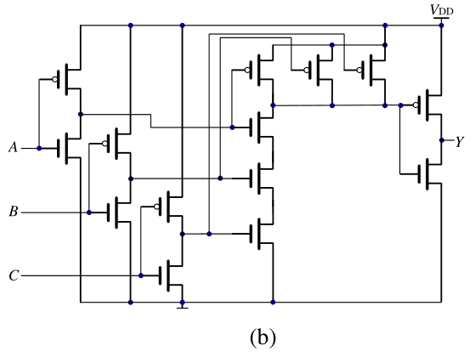

Slide 15
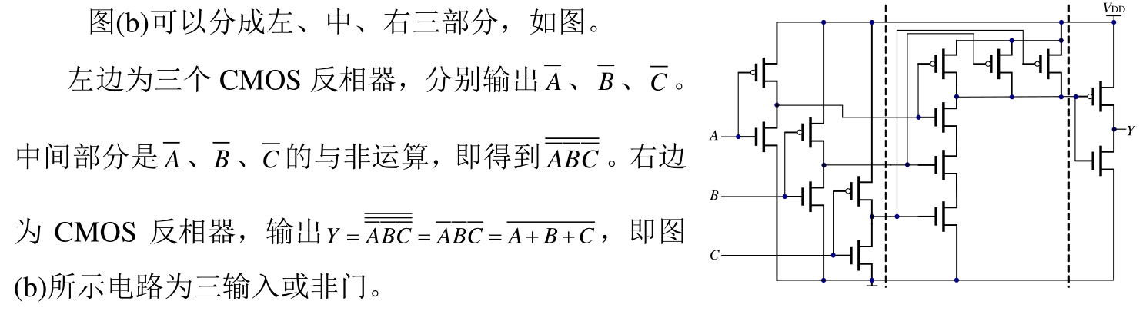

Slide 16
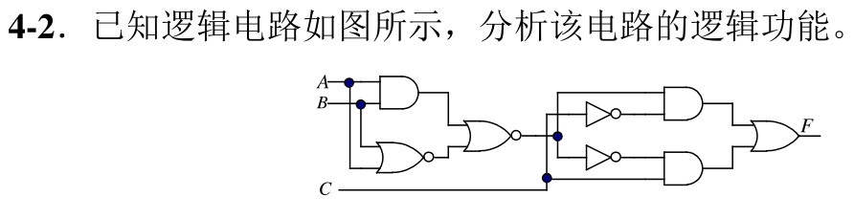
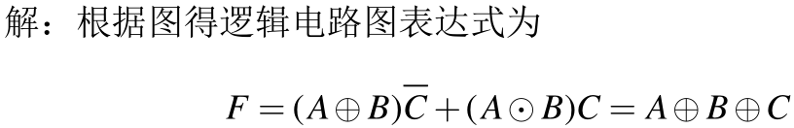
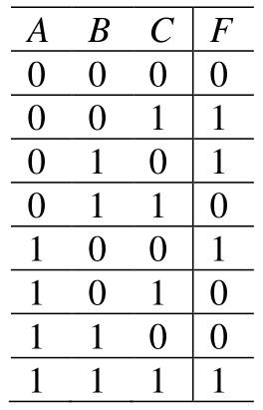


Slide 17
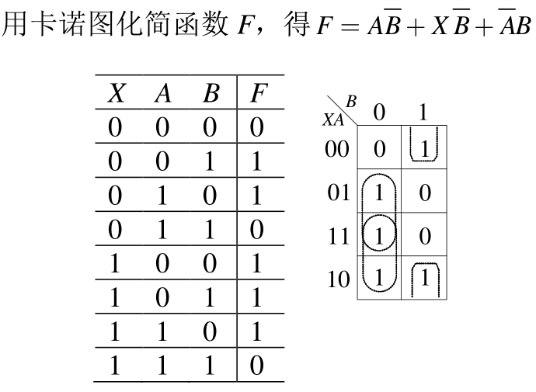

Slide 18
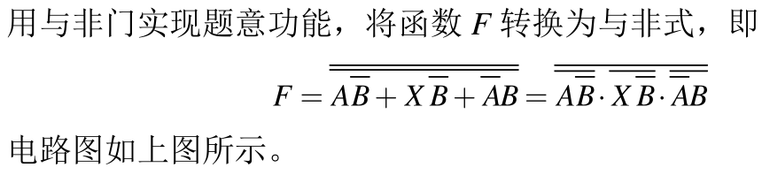
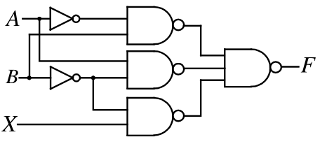

Slide 19
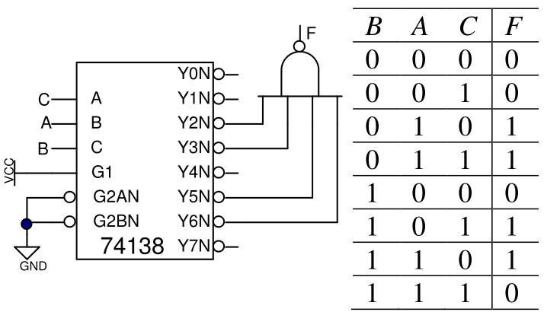

Slide 20
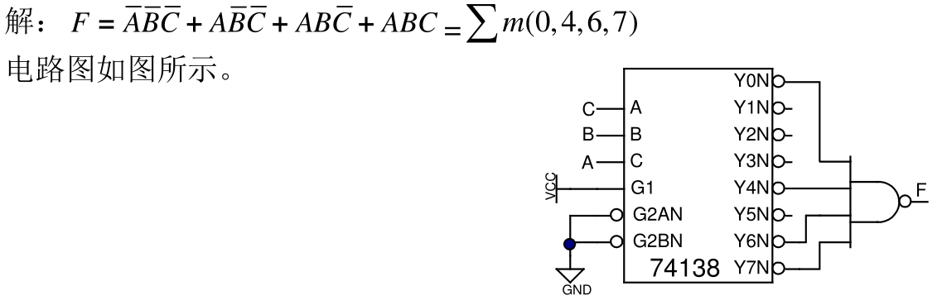

Slide 21
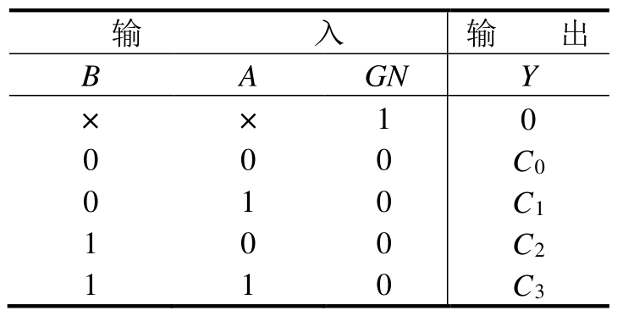
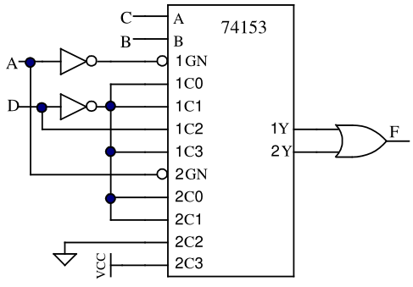
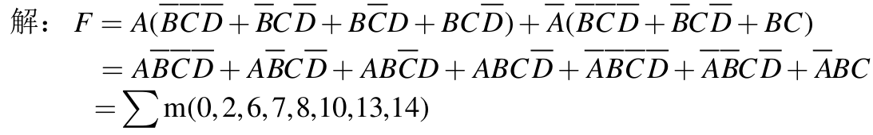

Slide 22
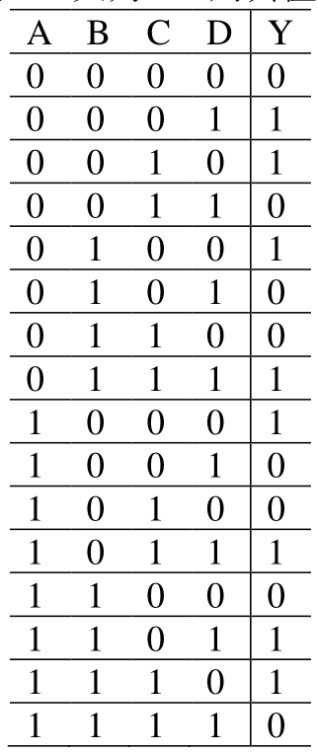
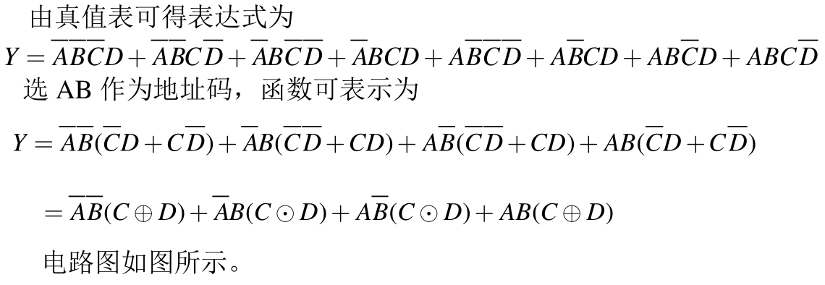
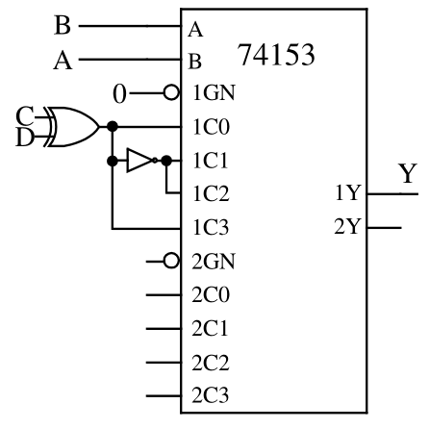

Slide 23

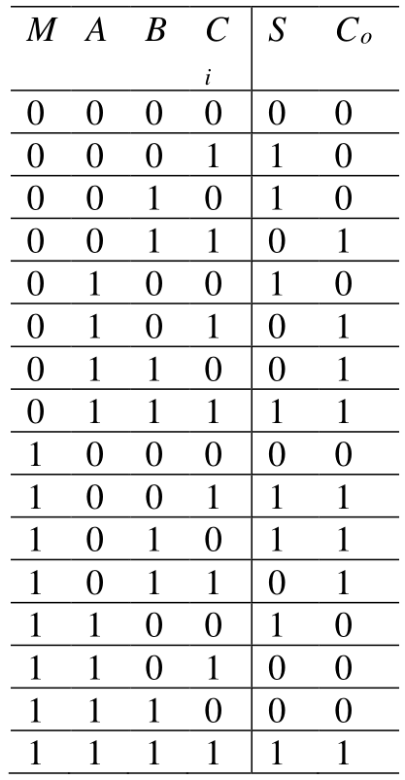
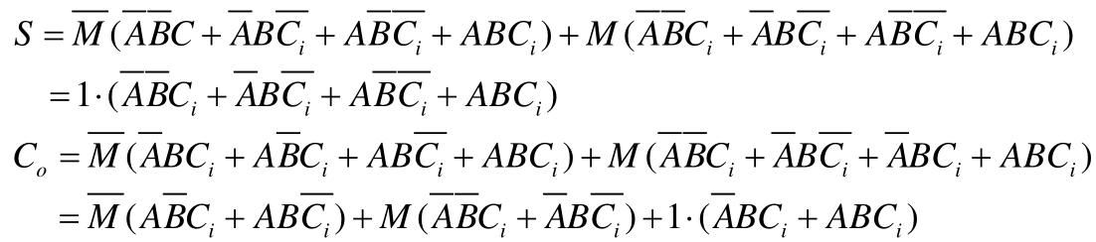

Slide 24
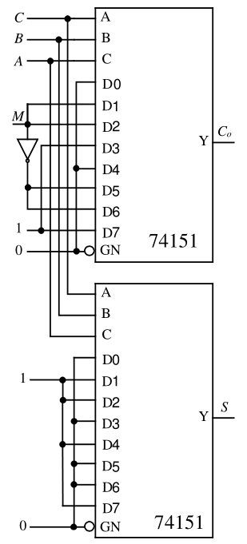

Slide 25
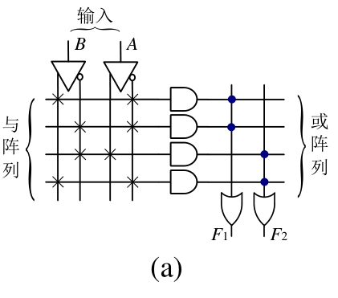

Slide 26
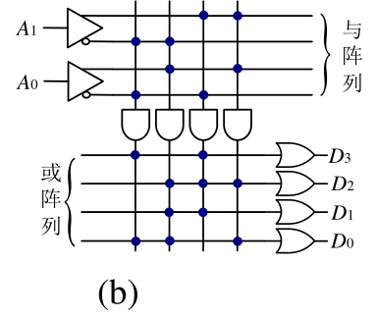

Slide 27
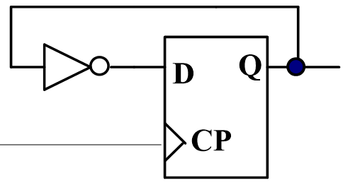
+5V
D
Q₁
CP
CP
C1
Q₁
(a)
Q₁
D
Q₂
CP
C1
Q₂
Q₂
(b)
Q₃
Q₃
(c)

Slide 28
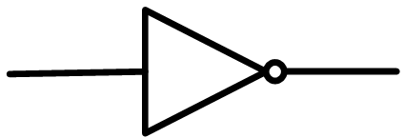
+5V
J
Q₄
CP
CP
C1
K
Q₄
+5V
J
Q₅
CP
C1
Q₅
K
Q₆
J
Q₆
CP
C1
Q₇
K
J
Q₇
CP
C1
+5V
K

Slide 29
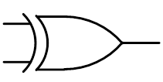
CP
T
Q₈
Q₈
1
CLK
J
S
Q
B
CP
A
C1
B
A
K
Q

Slide 30
C
CLK
A
J
R_{D}
Q
A
CP
C1
B
K
Q
C
B
Q

Slide 31
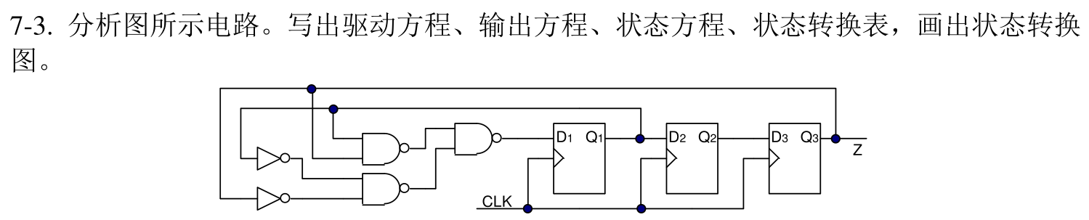











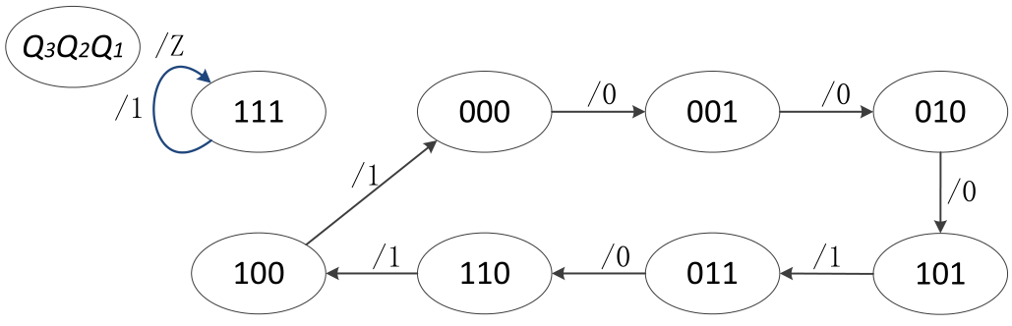
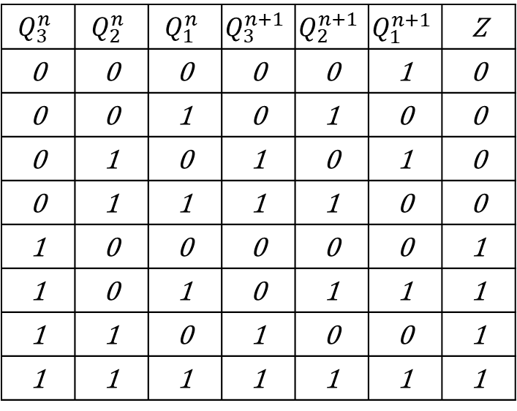
$$Q_{3}^{n}$$ | $$Q_{2}^{n}$$ | $$Q_{1}^{n}$$ | $$Q_{3}^{n+1}$$ | $$Q_{2}^{n+1}$$ | $$Q_{1}^{n+1}$$ | Z
0 | 0 | 0 | 0 | 0 | 1 | 0
0 | 0 | 1 | 0 | 1 | 0 | 0
0 | 1 | 0 | 1 | 0 | 1 | 0
0 | 1 | 1 | 1 | 1 | 0 | 0
1 | 0 | 0 | 0 | 0 | 0 | 1
1 | 0 | 1 | 0 | 1 | 1 | 1
1 | 1 | 0 | 1 | 0 | 0 | 1
1 | 1 | 1 | 1 | 1 | 1 | 1

Slide 32
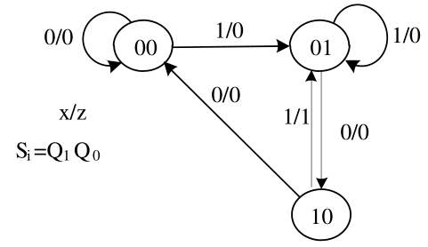








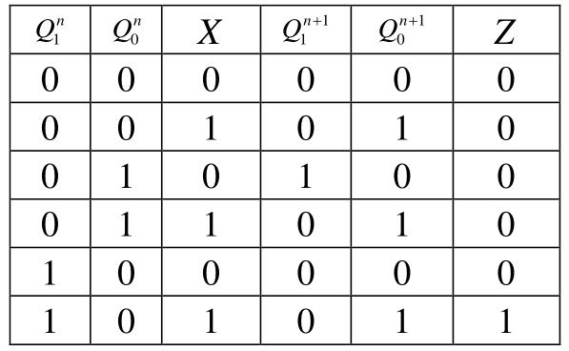
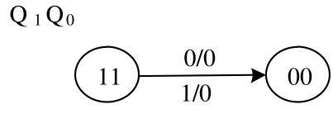

Slide 33
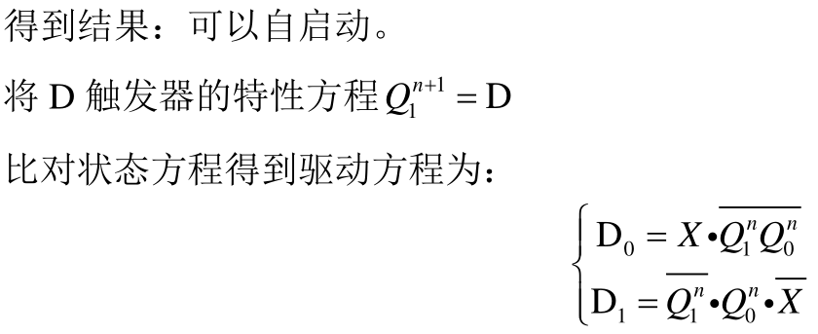
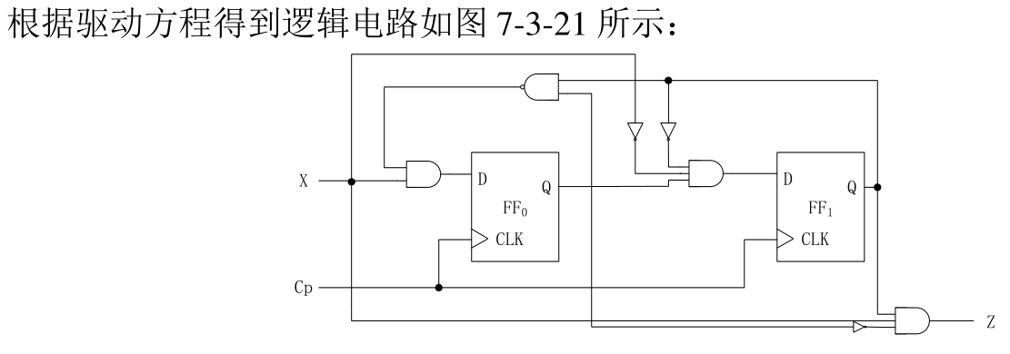

Slide 34











4
$$X$$ | $$Q_{1}^{n}$$ | $$Q_{0}^{n}$$ | $$Q_{1}^{n+1}$$ | $$Q_{0}^{n+1}$$ | Y₀ | Y1
0 | 0 | 0 | 0 | 1 | 0 | 0
0 | 0 | 1 | 1 | 0 | 0 | 0
0 | 1 | 0 | 0 | 0 | 1 | 0
0 | 1 | 1 | X | X | X | X
1 | 0 | 0 | 0 | 1 | 0 | 0
1 | 0 | 1 | 1 | 0 | 0 | 0
1 | 1 | 0 | 1 | 1 | 0 | 0
1 | 1 | 1 | 0 | 0 | 0 | 1
M/Y₁Y₀
$$Q_{1}^{n}Q_{2}^{n}$$
0/00
1/00
01
00
0/01
0/00
1/00
1/10
$K_{1}=\overline{x}$+$Q_{0}$
11
10
1/00

Slide 35


Slide 36




Slide 37

计数顺序
计 数 器 状 态
预置数：1010
Q₃
Q₂
Q₁
Q₀
0
0
0
0
0
0
1
0
0
0
1
1
2
0
0
1
0
0
3
0
0
1
1
1
4
0
1
0
0
5
0
1
0
1
6
0
1
1
0
7
0
1
1
1
/Z
8
1
0
0
0
/0
/0
9
1
0
0
1
Q_{D}Q_{C}Q_{B}Q_{A}
1010
1011
1100
10
1
0
1
0
11
1
0
1
1
/0
/1
12
1
1
0
0
/0
13
1
1
0
1
/0
1111
1110
1101
14
1
1
1
0
15
1
1
1
1
16
0
0
0
0

Slide 38



Slide 39



Slide 40




Slide 41
9-3
需要8片

Slide 42

10-7
$$V_{0}=−\frac{V_{REF}R_{F}}{2^{n}R}\left(\sum_{i=0}^{n−1}{2^{i}d_{i}}\right)=−\frac{8}{2^{4}}\left(2^{0}∙1+2^{1}∙1+2^{2}∙0+2^{3}∙1\right)=5.5 V$$

