Slide 1
When AI Forgets
Percolation and functional robustness
of knowledge graph retrieval
Network failure
Retrieval reliability
Knowledge restoration
PC5253 / Group 17
E / 01
Notes:
Knowledge graphs connect facts that a retrieval task may need to combine.
We ask what happens when some of those connections disappear. Our experiments
compare how the graph fragments, which semantic queries still work, and how a
limited restoration budget can recover the lost function. We use one shared
PrimeKG graph and fixed damage orders throughout the group project.
Source: G17_Work_Plan.md.

Slide 2
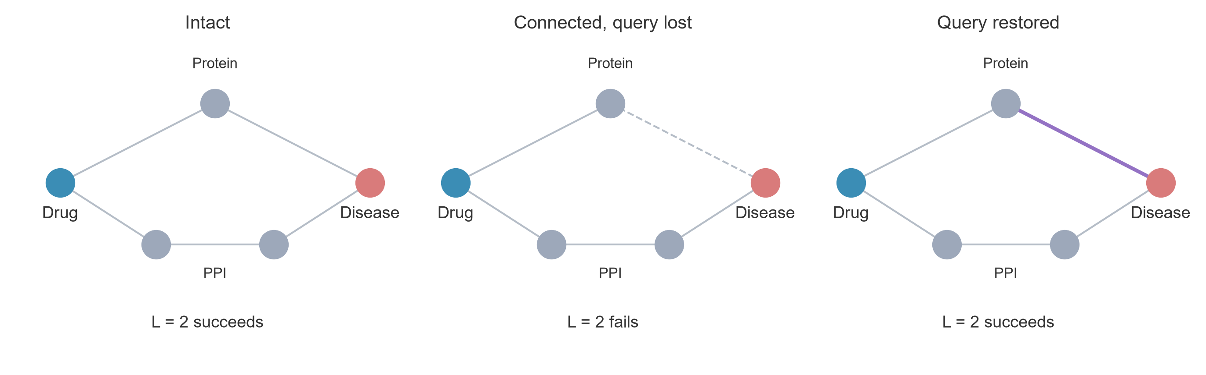
Connectivity and retrieval
The allowed path length changes which relations can help.
E / 02
Notes:
The upper route answers a two-hop drug–protein–disease query. Delete one edge
and that query fails, even though a longer route still connects the endpoints.
Restoring the upper edge repairs the two-hop query. If we allow an extra hop,
the lower route can also become useful. This small example shows why a
connectivity measure and a retrieval metric can respond differently to damage.
Concept schematic, not an observed PrimeKG case.

Slide 3
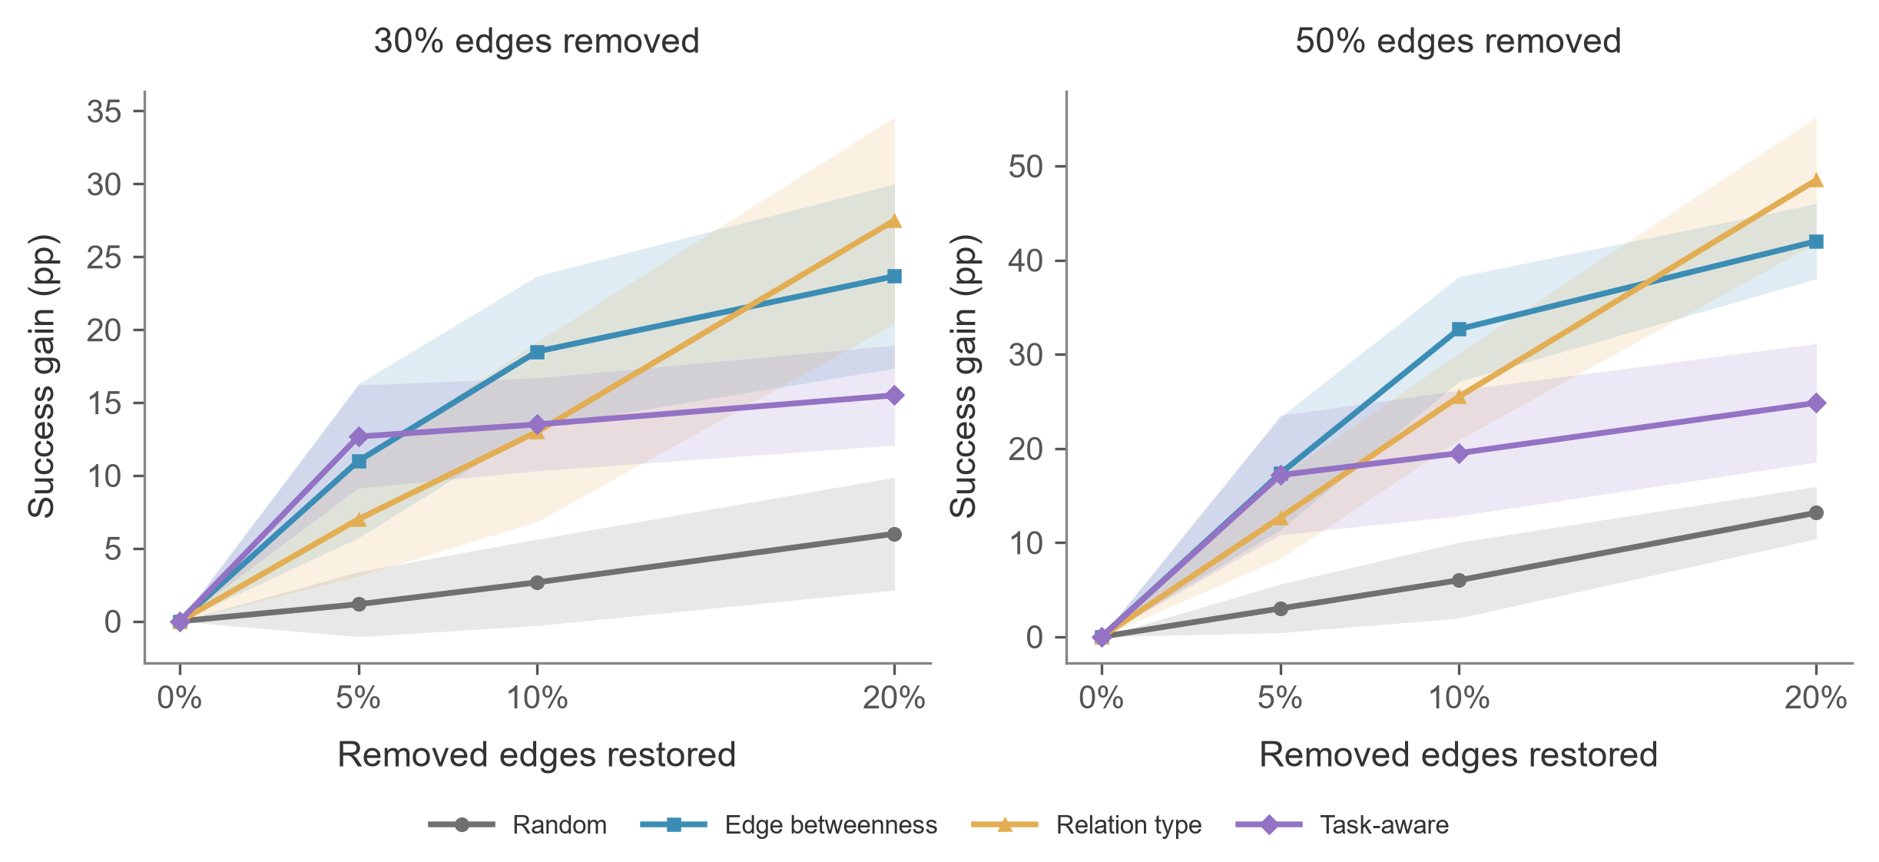
Restoration for two-hop queries
A small positive-score set limits the static task-aware policy.
E / 12
Notes:
All policies start from matching damaged masks. At fifty-percent damage and a
twenty-percent restoration budget, relation-type selection gains 48.5 percentage
points, edge betweenness 42.0, static task-aware 24.8 and random selection 13.2.
Task-aware selection starts well at the smaller budget, but its positive-score
set contains only a few dozen edges. After selecting those edges, the static
rule spends most additional budget on randomly ordered zero-score candidates.
Source: results/ws5/final/primekg_5000_bfs_v1 and report/E_static_score_diagnostics.csv. Formal C Retriever; B edge ranking included.

Slide 4
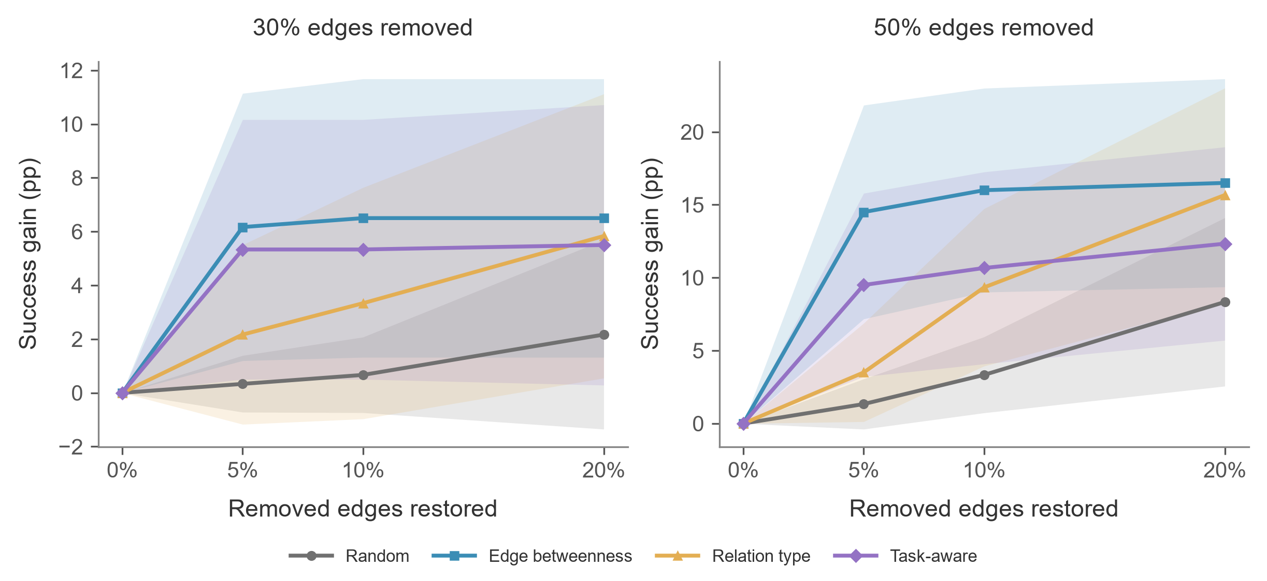
Restoration for three-hop queries
At 50% damage, 20% budget: 16.5 pp vs 15.7 pp.
E / 13
Notes:
The same restored graphs give a different comparison when a query can use one
protein–protein interaction. At fifty-percent damage and twenty-percent budget,
the mean gains are 16.5 points for edge betweenness and 15.7 for relation-type
selection, followed by 12.3 for static task-aware and 8.3 for random restoration.
The first two means are close relative to their seed variation. These curves
describe the horizon and budget dependence without establishing significance.
Source: results/ws5/final/primekg_5000_bfs_v1. The displayed gains are paired within seed and shaded by sample SD. No significance claim.

Slide 5
Robustness depends on the task
Structure
Function
Intervention
Global connectivity
Allowed semantic paths
Query horizon and budget
Largest structural and two-hop gains can favor different policies.
Scope: BFS subgraph, positive queries, shared entities across query splits.
E / 14
Notes:
The policy with the largest structural gain can differ from the policy with
the largest two-hop retrieval gain. We therefore need to specify the task and
the damage budget when discussing robustness. Our measurements concern a BFS
subgraph and selected positive queries. The query split may share entities.
D's theory pages still need integration before the complete group presentation
and the fourteen-minute rehearsal can be finalized.
E report Sections 1 and 7. Full-group theory narrative awaits D. The full fourteen-minute rehearsal has not been measured.

