Slide 1
When AI Forgets
Percolation and functional robustness
of knowledge graph retrieval
Network failure
Retrieval reliability
Knowledge restoration
PC5253 / Group 17
E / 01
Notes:
Knowledge graphs connect facts that a retrieval task may need to combine.
We ask what happens when some of those connections disappear. Our experiments
compare how the graph fragments, which semantic queries still work, and how a
limited restoration budget can recover the lost function. We use one shared
PrimeKG graph and fixed damage orders throughout the group project.
Source: G17_Work_Plan.md.

Slide 2
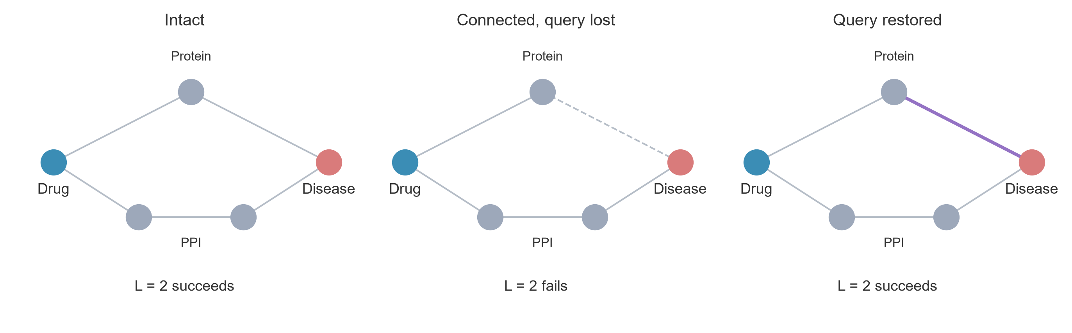
Connectivity and retrieval
The allowed path length changes which relations can help.
E / 02
Notes:
The upper route answers a two-hop drug–protein–disease query. Delete one edge
and that query fails, even though a longer route still connects the endpoints.
Restoring the upper edge repairs the two-hop query. If we allow an extra hop,
the lower route can also become useful. This small example shows why a
connectivity measure and a retrieval metric can respond differently to damage.
Concept schematic, not an observed PrimeKG case.

Slide 3
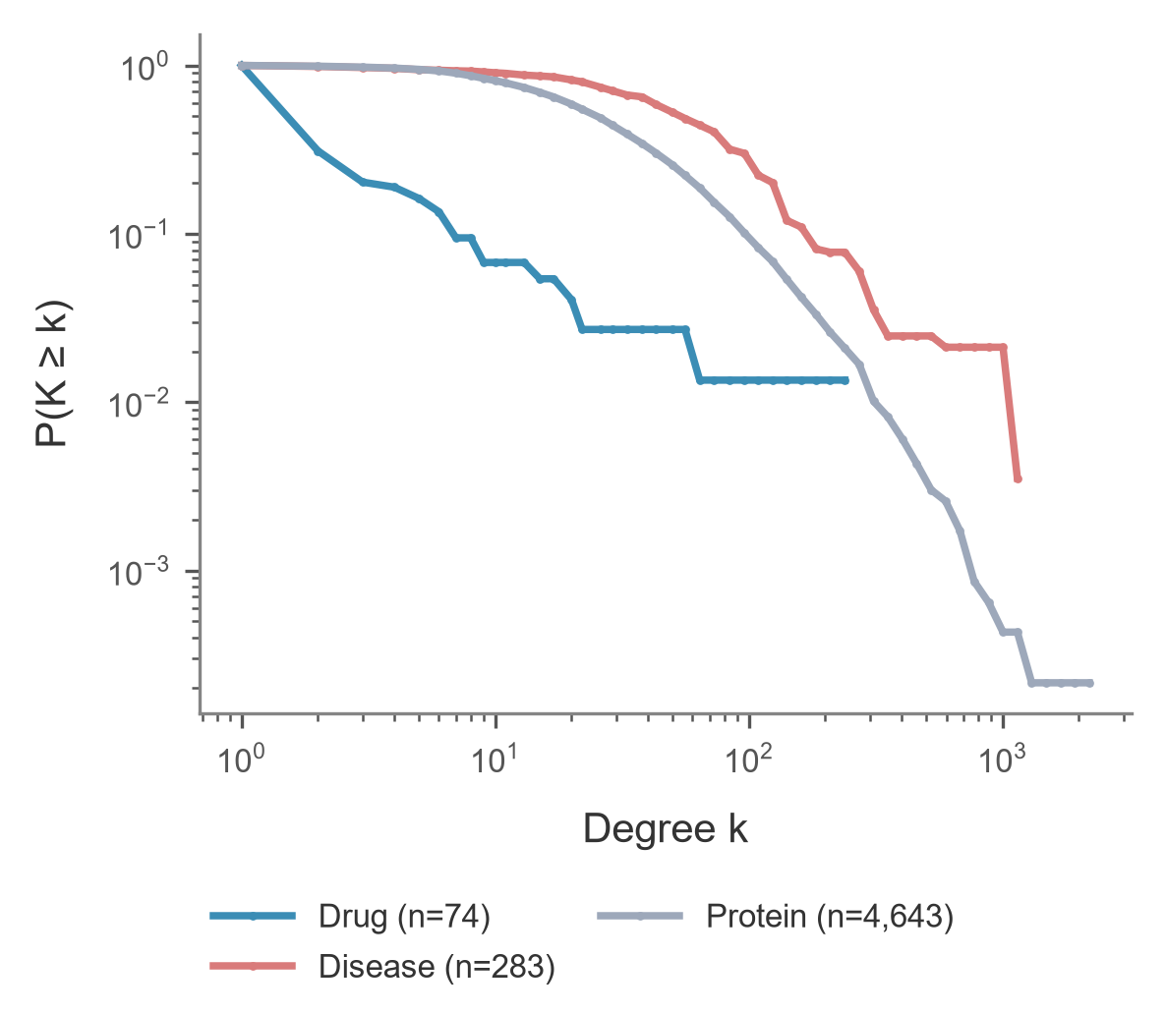
PrimeKG and the shared protocol
5,000 nodes
117,891 semantic edges
200 selected queries
Fixed deletion orders
10 random damage seeds
70% / 30% query split
A / 03
Notes:
Source: A DATA_CONTRACT, nodes, edges and queries for primekg_5000_bfs_v1. The benchmark contains selected initially successful association paths. Counts are local to this graph. Drug and disease paths do not establish therapeutic efficacy. The degree CCDF is descriptive and does not establish a power law. A owns final wording for this page.

Slide 4
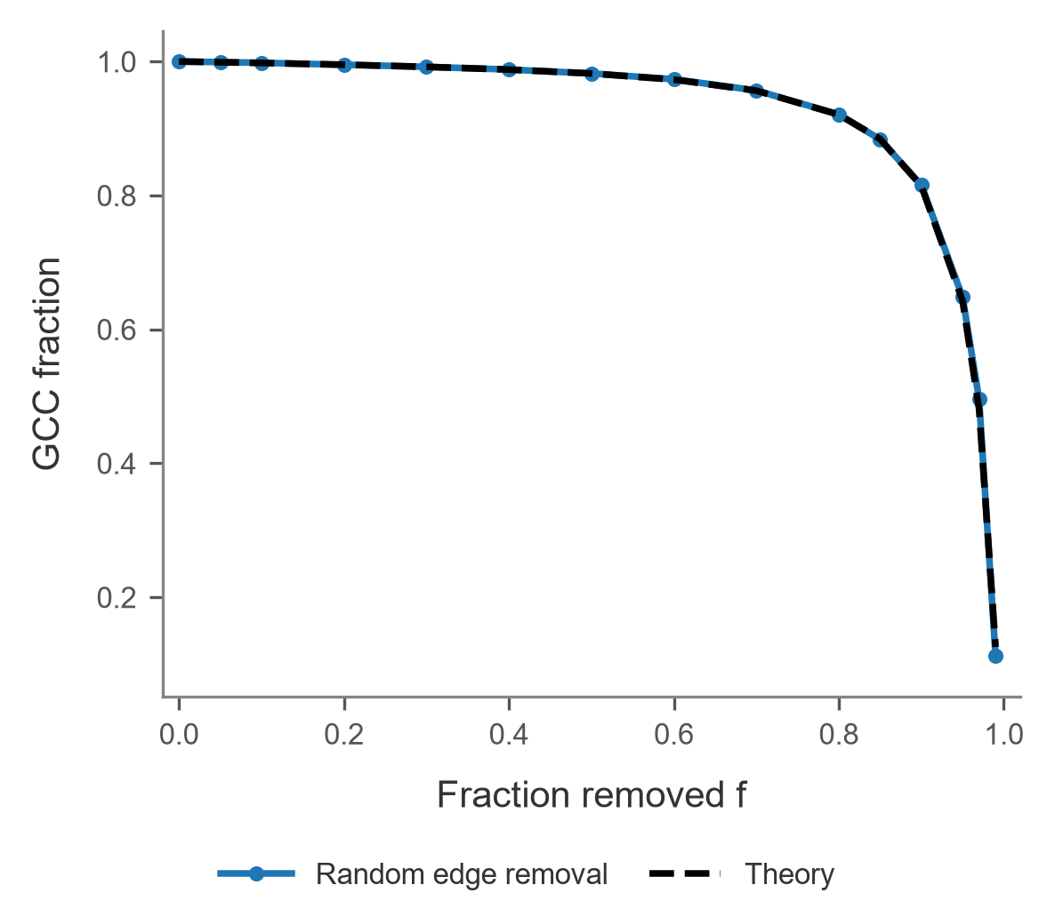
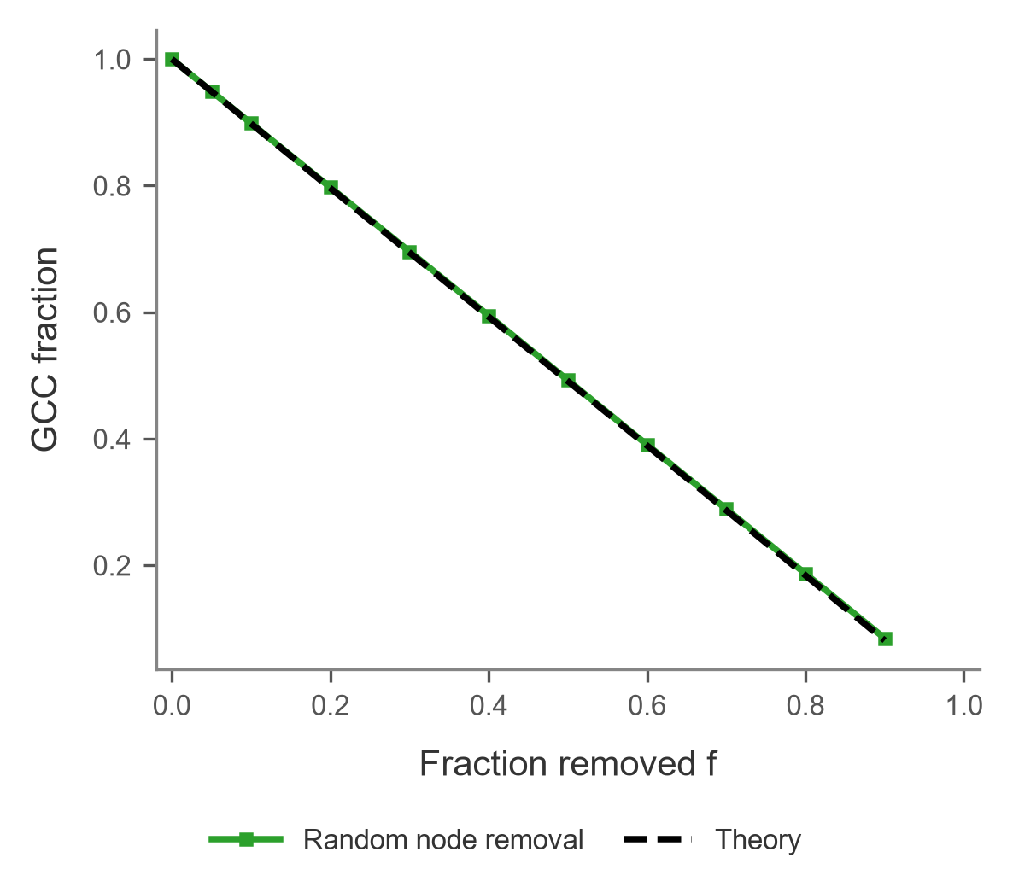
Random network failure
GF curves are configuration-model references.
A / 04
Notes:
Source: results/ws1/primekg_5000_bfs_v1__random.csv. Structural fraction divides by original N. Random curves show ten-seed mean and sample SD. Black dashed GF is A’s configuration-model reference pending D’s final implementation. Node removal also deletes endpoints and adjacent edges; equal f does not imply equal lost-edge counts.

Slide 5
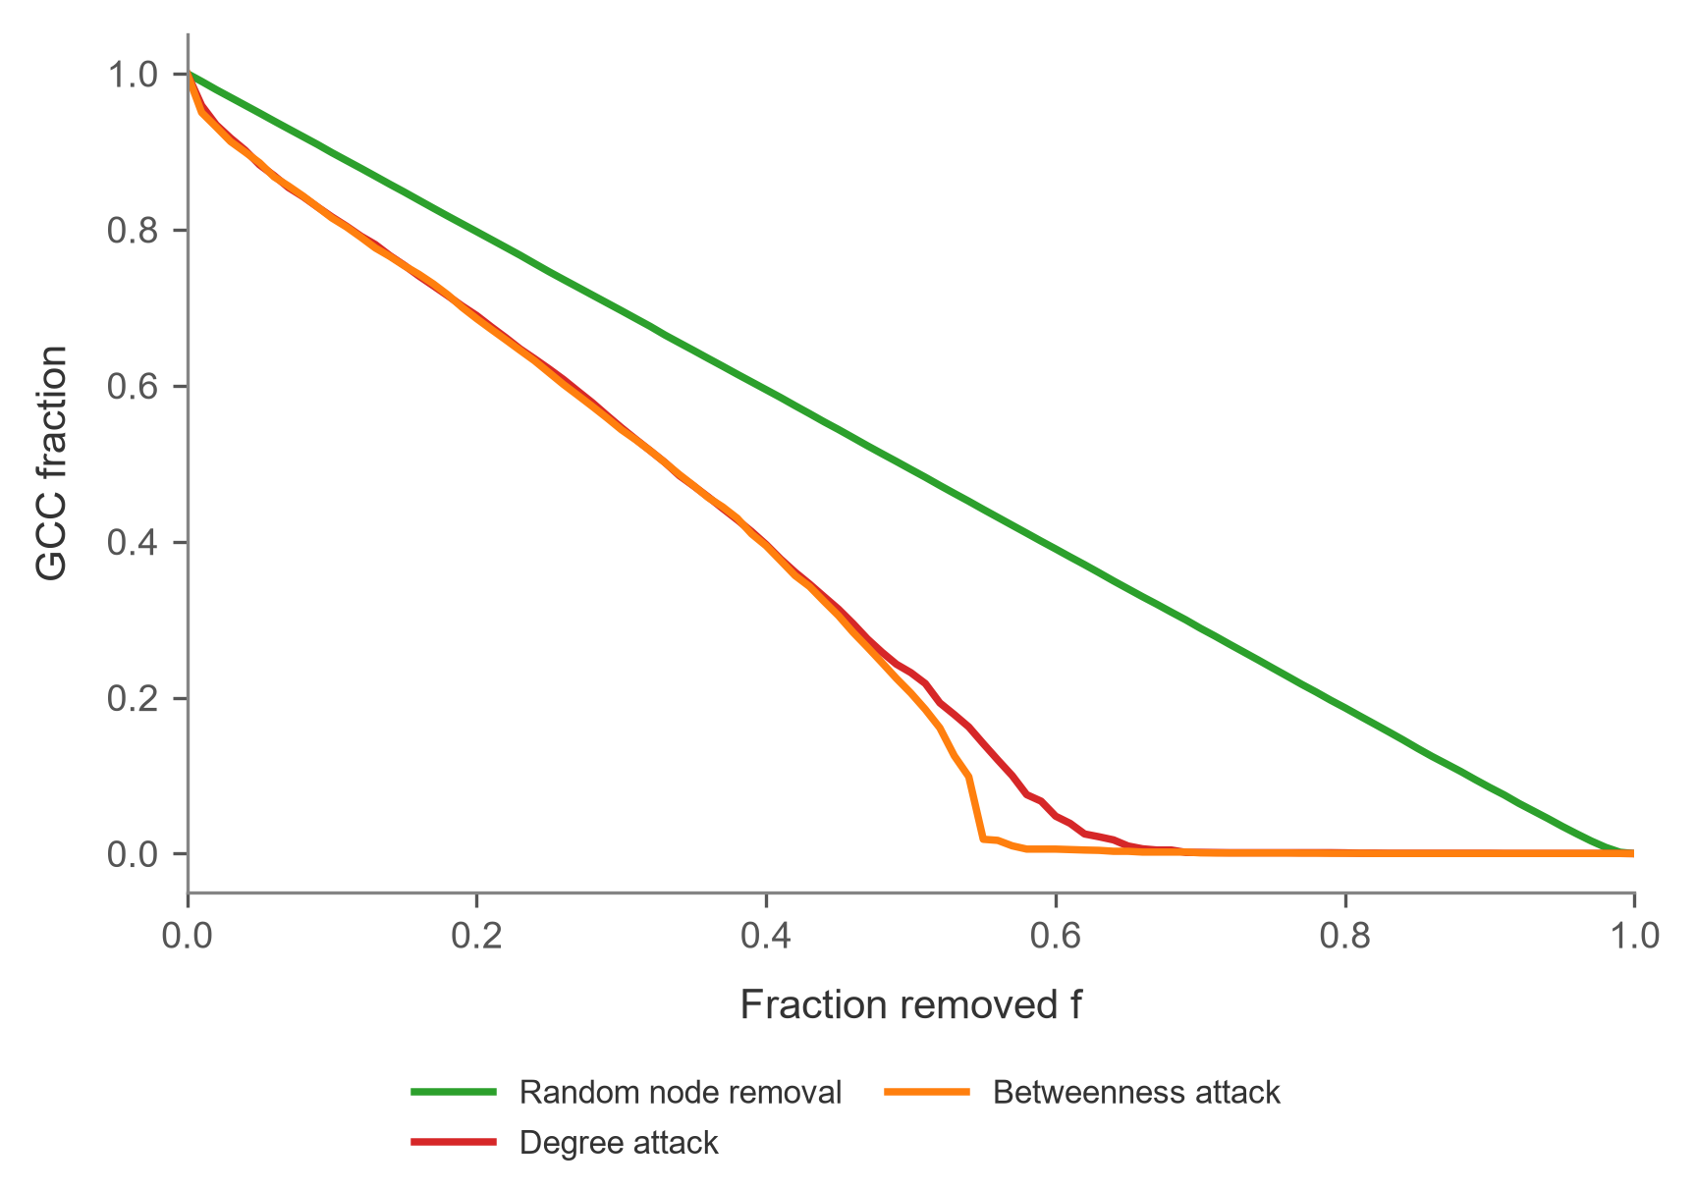
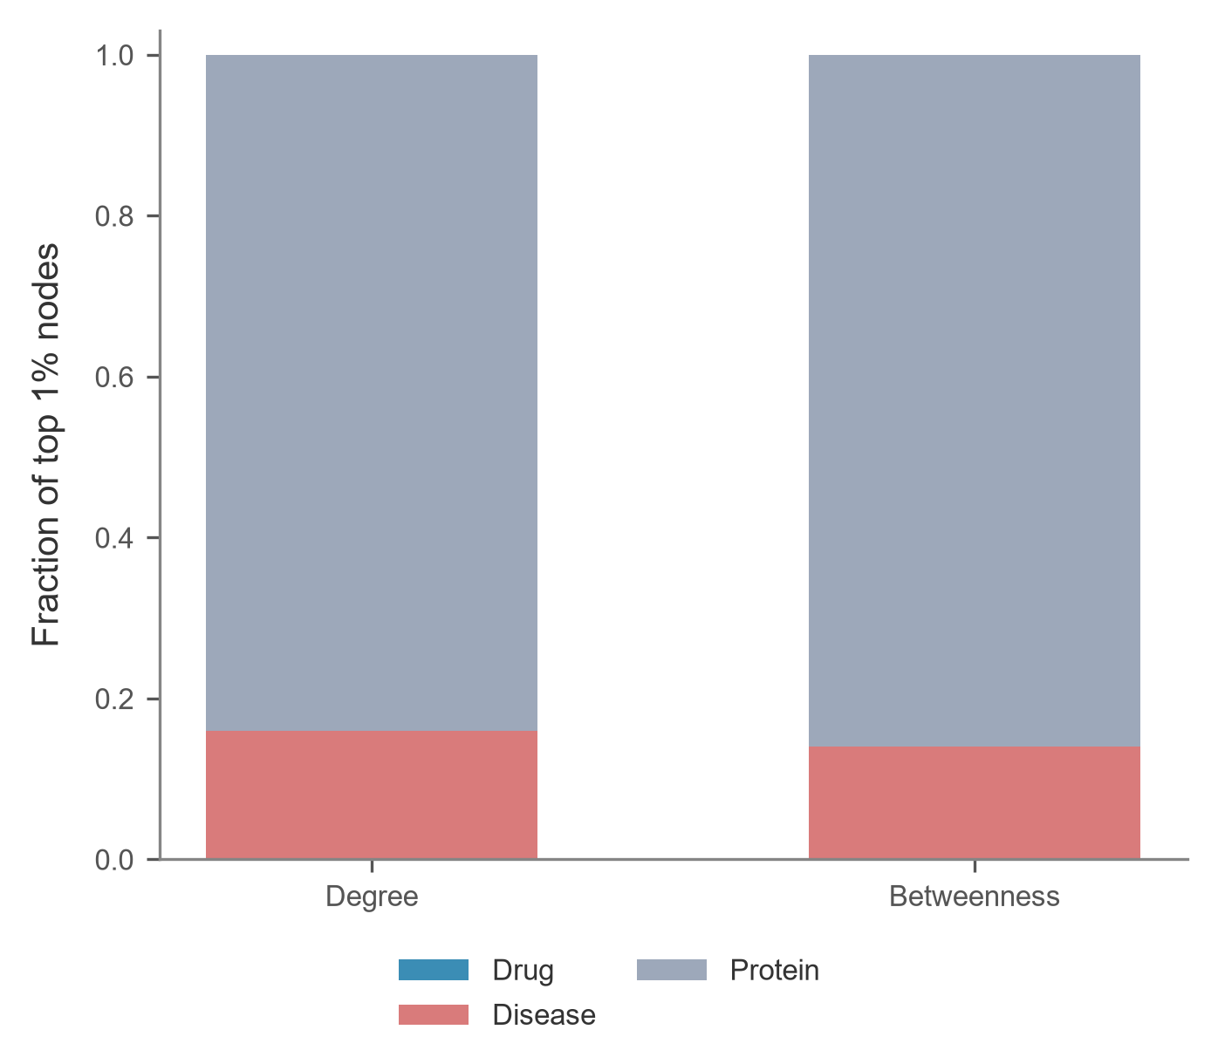
Targeted failure and central nodes
At 50% node loss: GCC ≈ 49% random, 23% degree, 21% betweenness.
B / 05
Notes:
Source: B ws2_attack_results_long.csv and ws2_hub_composition.csv. At f=.5, GCC fractions are {"node_betweenness":0.2058,"node_degree":0.232,"node_random":0.49252}. Attack curves use one fixed original ranking. B stores construction seeds 0 and 42 on fixed curves; the display treats those as deterministic, without an error band. The random curve has ten-seed SD. The top-1% composition is descriptive. D’s degree-attack theory overlay remains pending.

Slide 6
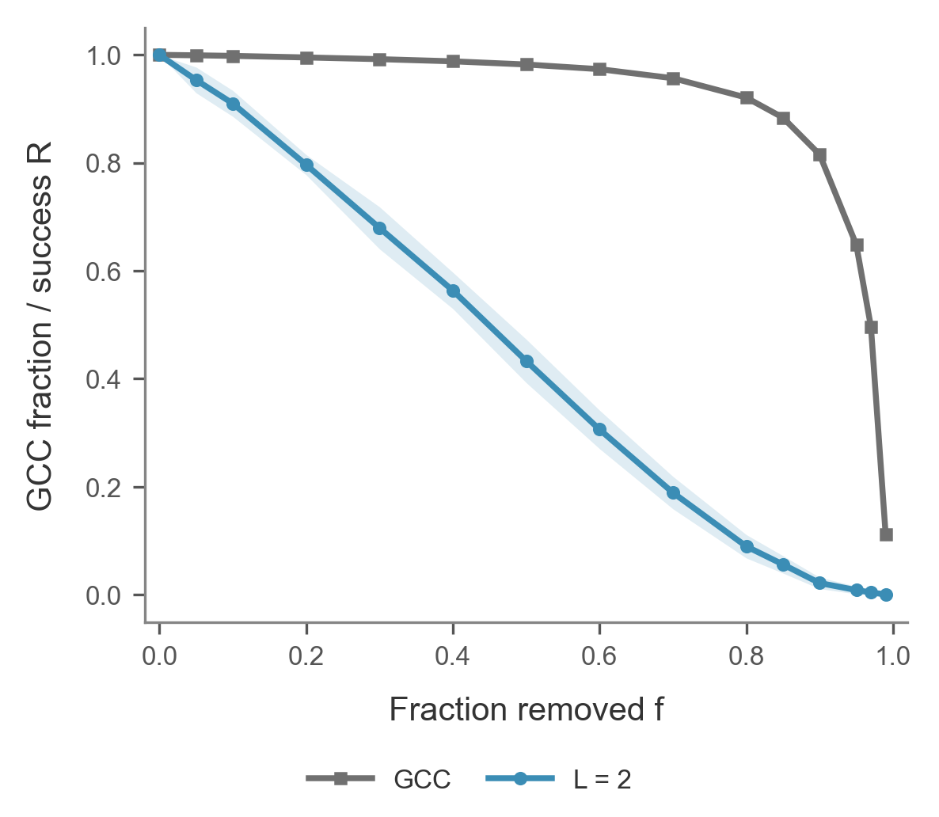
Structural and functional robustness
54.9 pp
GCC–retrieval gap
at 50% edge loss
Same queries and damage states; 10 seeds.
C / 06
Notes:
**Figure:** `fig_S_vs_R`
- S measures how many original nodes remain in the largest component.
- R measures how many of the 200 original queries still have an allowed path.
- At 50% edge loss, the two metrics differ by 54.9 percentage points.
**Script:** We used the same deletion order for the structural and functional measurements. After random removal of half the edges, the largest connected component still contains 98.2 percent of the original nodes, averaged over ten seeds. Only 43.3 percent of the selected queries still have a two-hop path. Protein–protein edges can sustain the connected component, while a two-hop query needs one protein connected to both endpoints.
**Likely question:** Why are the curves so far apart?
**Answer:** The largest component can be held together by protein–protein links. A two-hop query specifically needs two surviving terminal links incident to the same protein.
Source: results/ws1 and results/ws3 matching edge damage states.

Slide 7
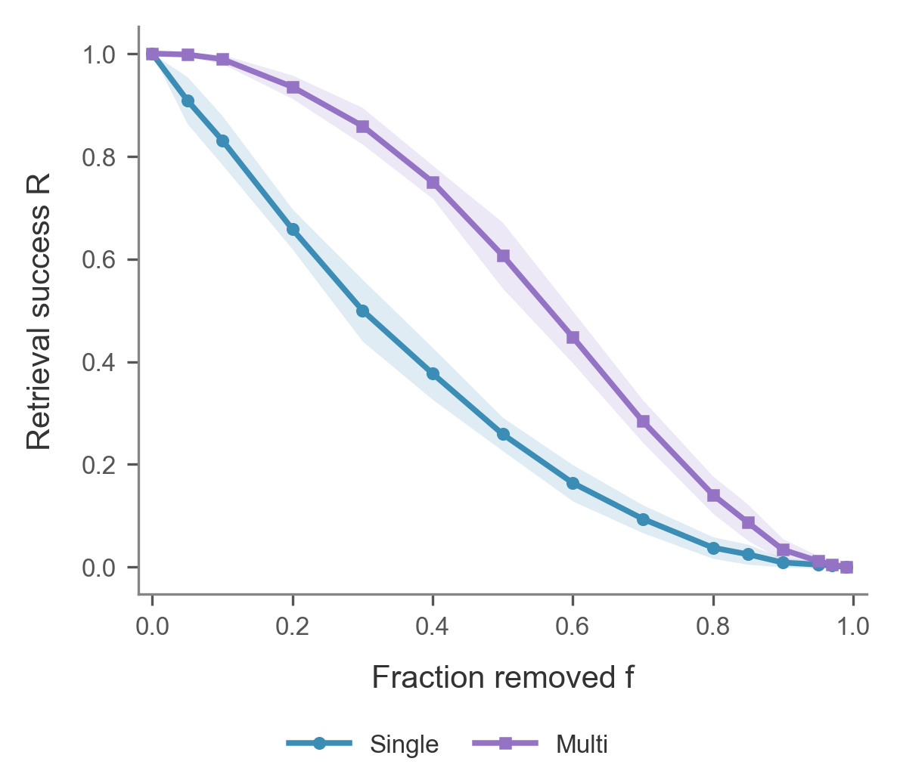
Path redundancy and retrieval
At 50% edge loss
60.7%
Multi-path queries
25.9%
Single-path queries
C / 07
Notes:
**Figure:** `fig_R_by_group`
- Each group contains 100 queries.
- The groups use the intact graph's path counts.
- At 50% edge loss the success rates are 60.7% and 25.9%.
**Script:** We grouped queries by the number of shared proteins in the intact graph. Each group contains 100 queries. When half the edges are removed, 60.7 percent of queries with multiple paths still work, compared with 25.9 percent of single-path queries. A query can survive the loss of one shared protein route if both edges of another route remain.
**Likely question:** Is redundancy measured again after each deletion?
**Answer:** We keep the original group labels fixed. Each damaged state tells us how many of the original routes remain.
Source: results/ws3/primekg_5000_bfs_v1__retrieval.csv.

Slide 8
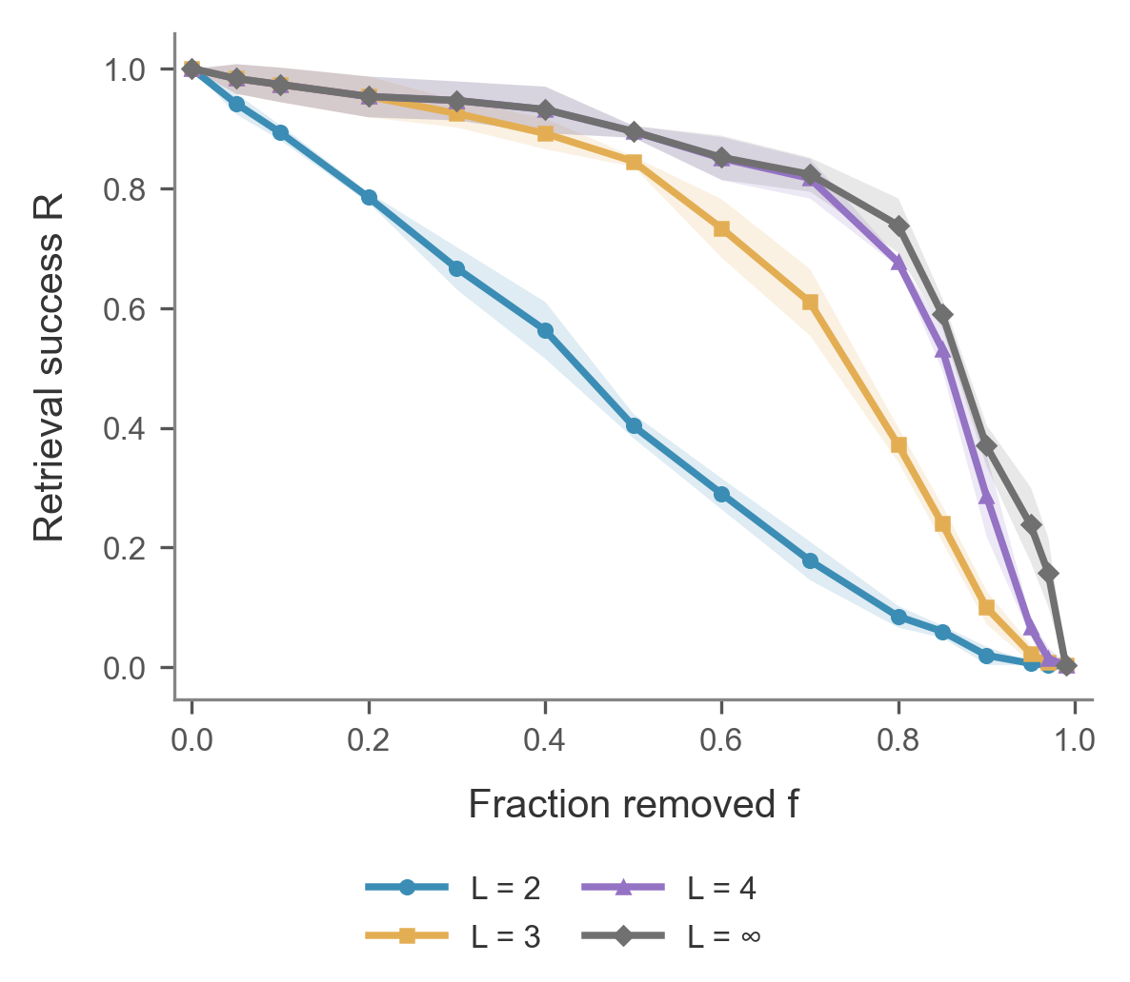
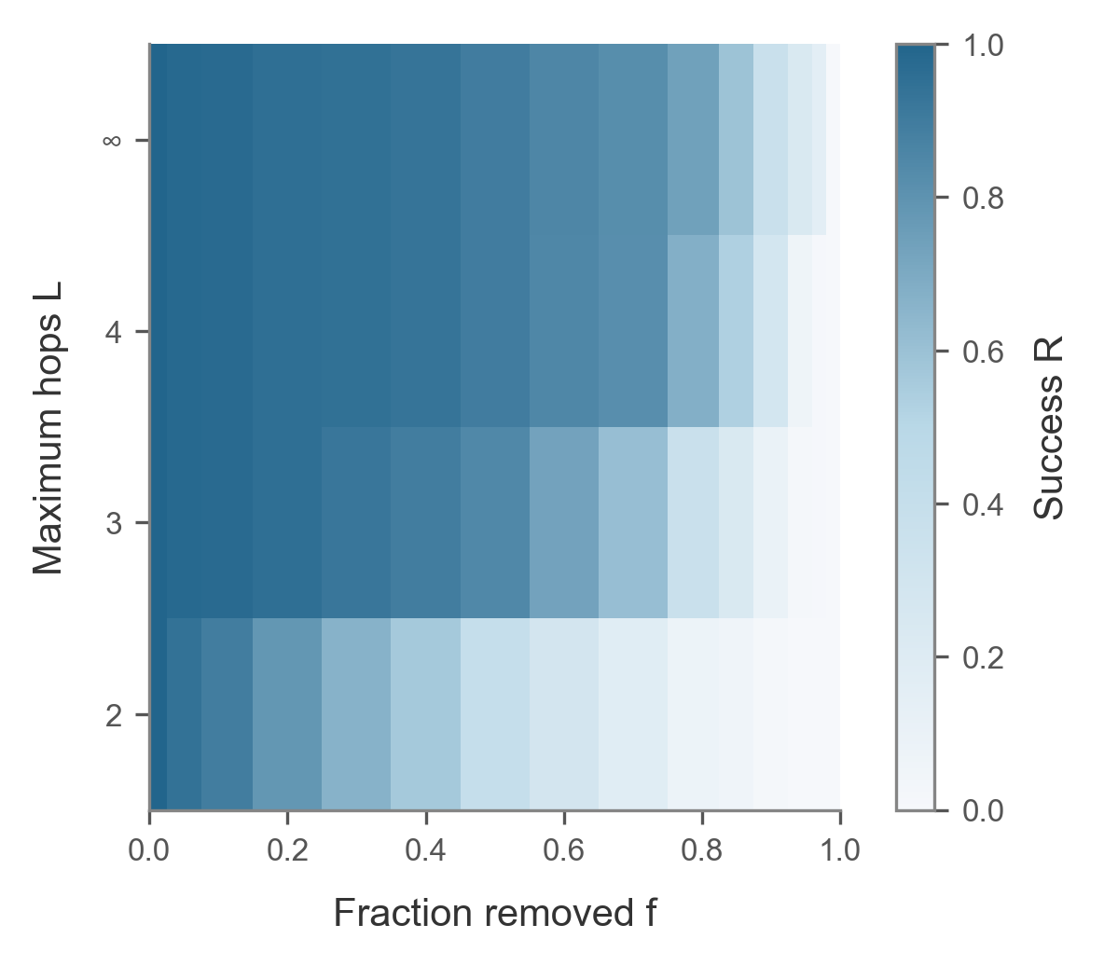
The retrieval horizon
Matched three-seed comparison at every hop limit.
C / 08
Notes:
**Figures:** `fig_R_L_curves` and `fig_R_L_heatmap`
- Every hop limit uses the same three damage seeds.
- One extra hop allows one protein–protein link.
- At 90% edge loss, four-hop and unlimited success are 28.7% and 37.0%.
**Script:** For this comparison, we use the same three damage seeds for every hop limit. At 50 percent edge removal, allowing one protein–protein step increases mean success from 40.3 to 84.5 percent. Four hops reach 89.5 percent. At more severe damage, the four-hop and unlimited curves separate. The heatmap shows how retrieval changes with both the deletion fraction and the allowed path length.
**Likely question:** Why is two-hop success 40.3% here and 43.3% on slide 6?
**Answer:** The hop scan uses seeds 0–2 for every curve, while slide 6 uses all ten seeds. Both use the same frozen query set.
All displayed horizons use damage seeds 0–2.

Slide 9
Two-hop survival theory
Awaiting D’s final theory contribution
fig_R_theory_vs_sim
Relate path redundancy to the independent-edge survival model.
D / 09
Notes:
Reserved for D’s final theory contribution. Required figure: fig_R_theory_vs_sim. Relate path redundancy to the independent-edge survival model. No theory result is supplied on this page.

Slide 10
Dependence under targeted attacks
Awaiting D’s final theory contribution
fig_corr_penalty
Compare the random-removal model with targeted-attack observations.
D / 10
Notes:
Reserved for D’s final theory contribution. Required figure: fig_corr_penalty. Compare the random-removal model with targeted-attack observations. No theory result is supplied on this page.

Slide 11
Retrieval across task scales
Awaiting D’s final theory contribution
fig_phase_diagram
Combine C’s hop scan with D’s two theoretical limits.
D / 11
Notes:
Reserved for D’s final theory contribution. Required figure: fig_phase_diagram. Combine C’s hop scan with D’s two theoretical limits. No theory result is supplied on this page.

Slide 12
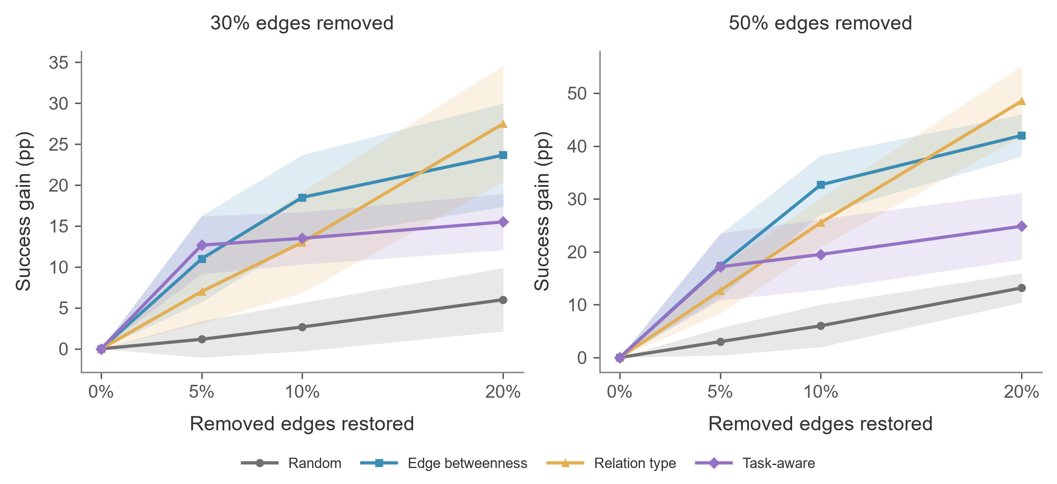
Restoration for two-hop queries
A small positive-score set limits the static task-aware policy.
E / 12
Notes:
All policies start from matching damaged masks. At fifty-percent damage and a
twenty-percent restoration budget, relation-type selection gains 48.5 percentage
points, edge betweenness 42.0, static task-aware 24.8 and random selection 13.2.
Task-aware selection starts well at the smaller budget, but its positive-score
set contains only a few dozen edges. After selecting those edges, the static
rule spends most additional budget on randomly ordered zero-score candidates.
Source: results/ws5/final/primekg_5000_bfs_v1 and report/E_static_score_diagnostics.csv. Formal C Retriever; B edge ranking included.

Slide 13
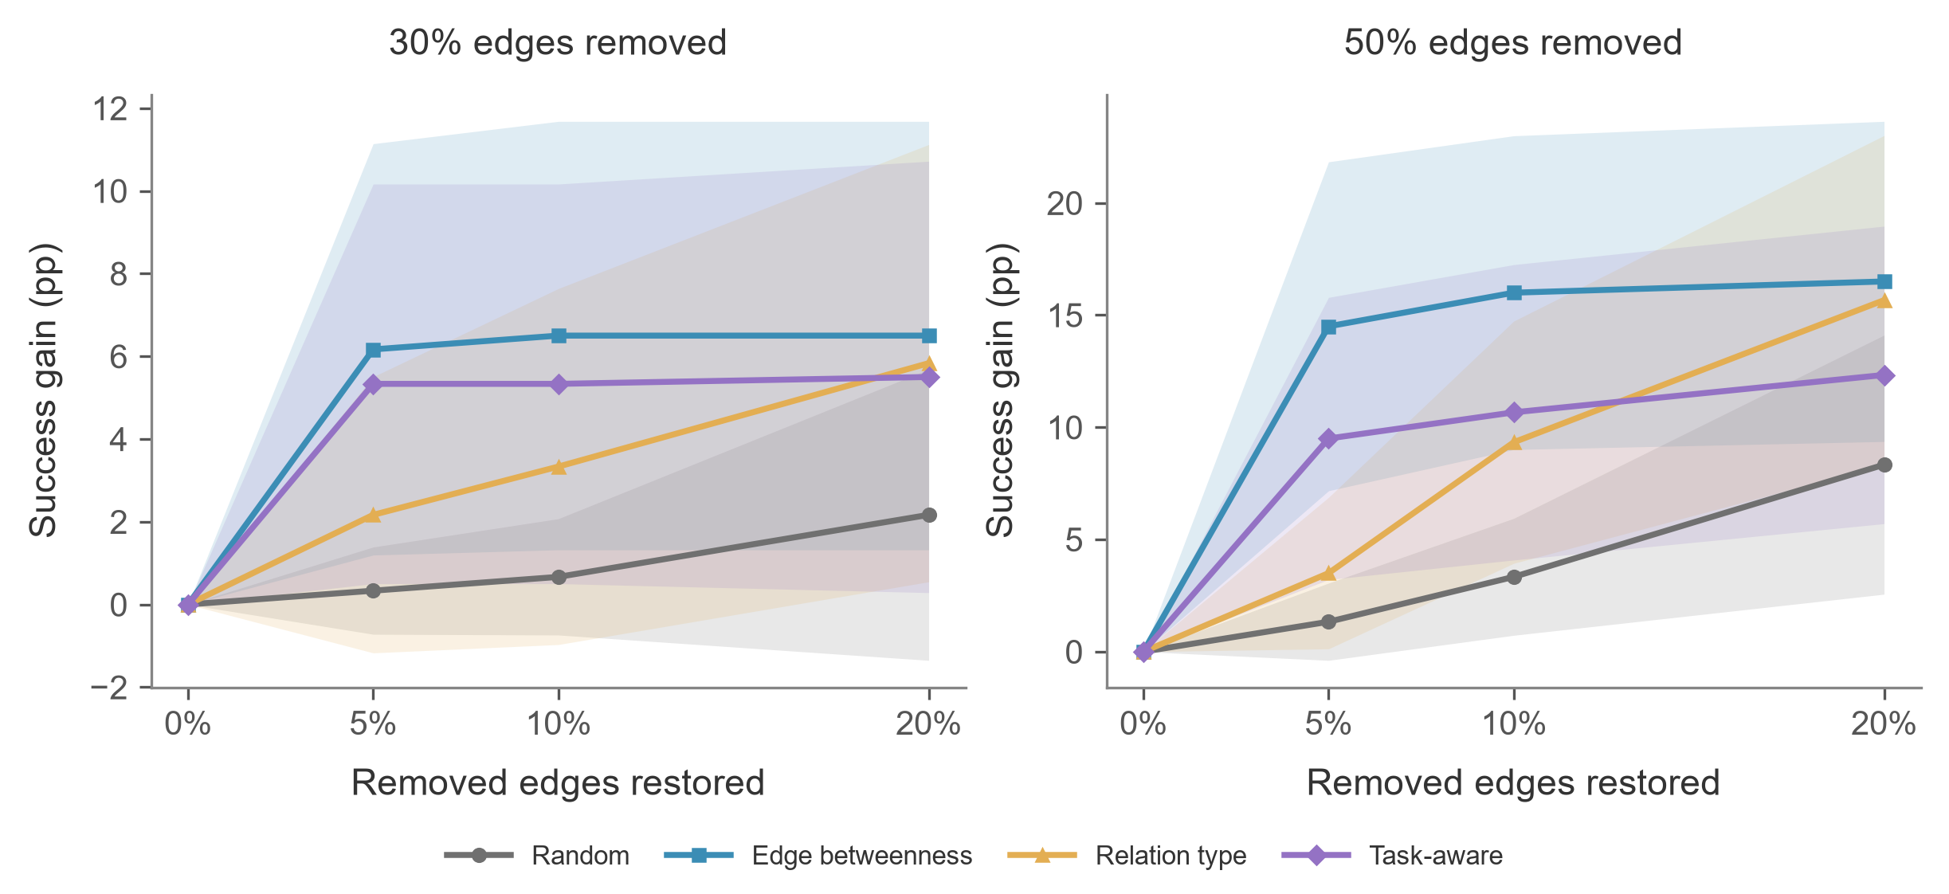
Restoration for three-hop queries
At 50% damage, 20% budget: 16.5 pp vs 15.7 pp.
E / 13
Notes:
The same restored graphs give a different comparison when a query can use one
protein–protein interaction. At fifty-percent damage and twenty-percent budget,
the mean gains are 16.5 points for edge betweenness and 15.7 for relation-type
selection, followed by 12.3 for static task-aware and 8.3 for random restoration.
The first two means are close relative to their seed variation. These curves
describe the horizon and budget dependence without establishing significance.
Source: results/ws5/final/primekg_5000_bfs_v1. The displayed gains are paired within seed and shaded by sample SD. No significance claim.

Slide 14
Robustness depends on the task
Structure
Function
Intervention
Global connectivity
Allowed semantic paths
Query horizon and budget
Largest structural and two-hop gains can favor different policies.
Scope: BFS subgraph, positive queries, shared entities across query splits.
E / 14
Notes:
The policy with the largest structural gain can differ from the policy with
the largest two-hop retrieval gain. We therefore need to specify the task and
the damage budget when discussing robustness. Our measurements concern a BFS
subgraph and selected positive queries. The query split may share entities.
D's theory pages still need integration before the complete group presentation
and the fourteen-minute rehearsal can be finalized.
E report Sections 1 and 7. Full-group theory narrative awaits D. The full fourteen-minute rehearsal has not been measured.

