Slide 1
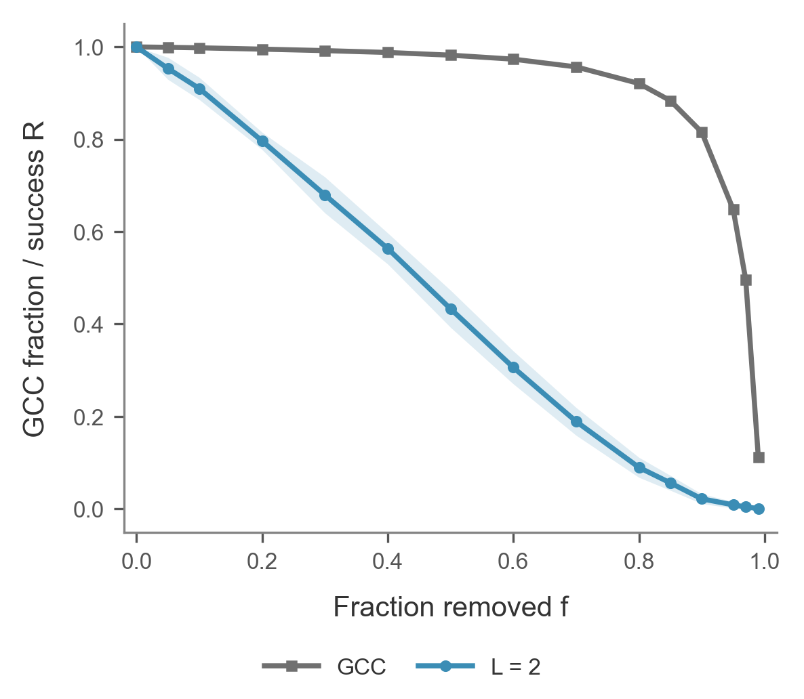
Connectivity outlasts two-hop retrieval
98.2% vs 43.3%
Largest connected component vs two-hop success after removing half the edges.
PrimeKG, 5,000 nodes and 200 queries. Mean across 10 edge-removal seeds.
C / 06
Notes:
We used the same deletion order for the structural and functional measurements. After random removal of half the edges, the largest connected component still contains 98.2 percent of the original nodes, averaged over ten seeds. Only 43.3 percent of the selected queries still have a two-hop path. Protein–protein edges can sustain the connected component, while a two-hop query needs one protein connected to both endpoints. Sources: results/ws1 and results/ws3, primekg_5000_bfs_v1.

Slide 2
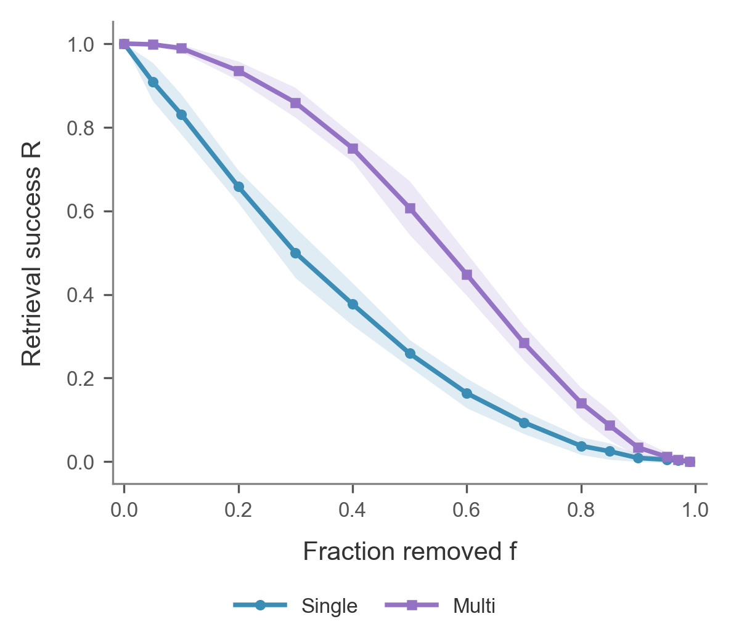
Queries with backup paths survive more often
60.7% vs 25.9%
Two-hop success for queries with multiple original paths vs one original path at 50% edge removal.
100 queries per group. Mean across 10 edge-removal seeds.
C / 07
Notes:
We grouped queries by the number of shared proteins in the intact graph. Each group contains 100 queries. When half the edges are removed, 60.7 percent of queries with multiple paths still work, compared with 25.9 percent of single-path queries. A query can survive the loss of one shared protein route if both edges of another route remain. Sources: results/ws1 and results/ws3, primekg_5000_bfs_v1.

Slide 3
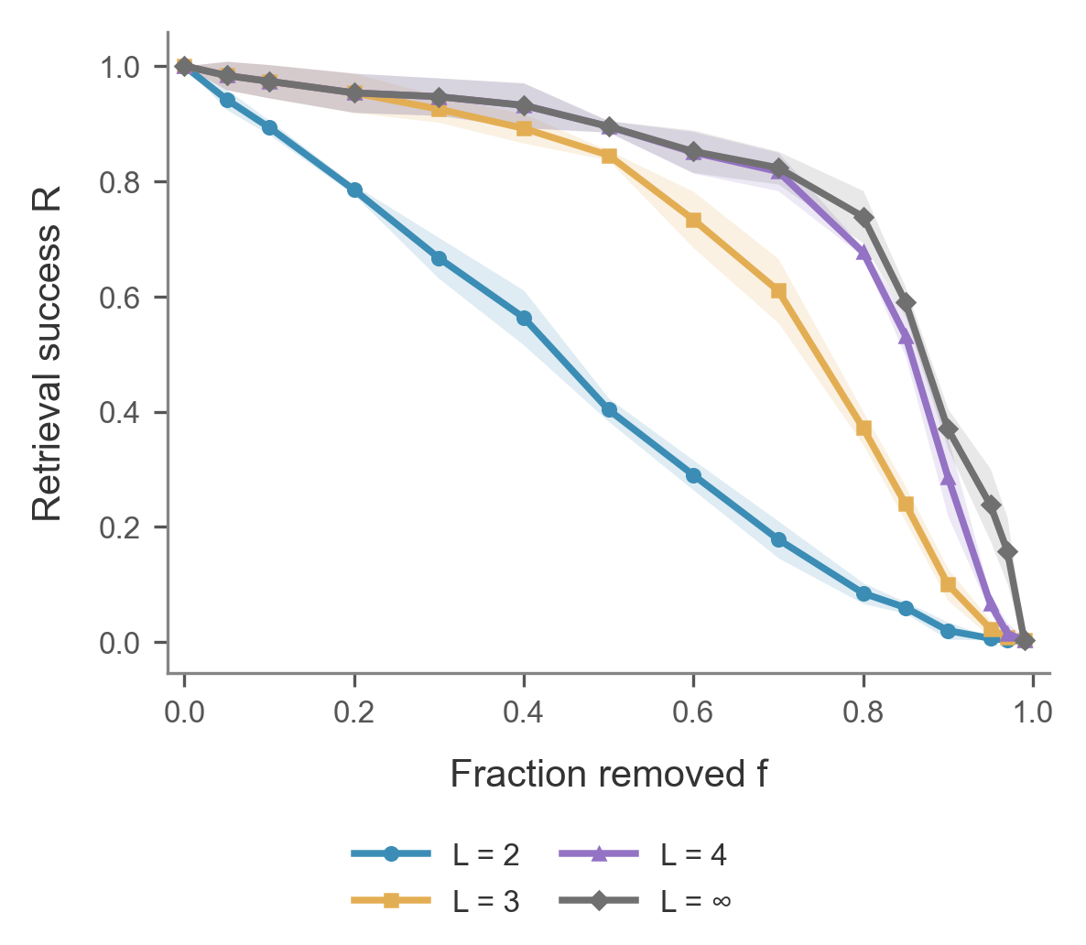
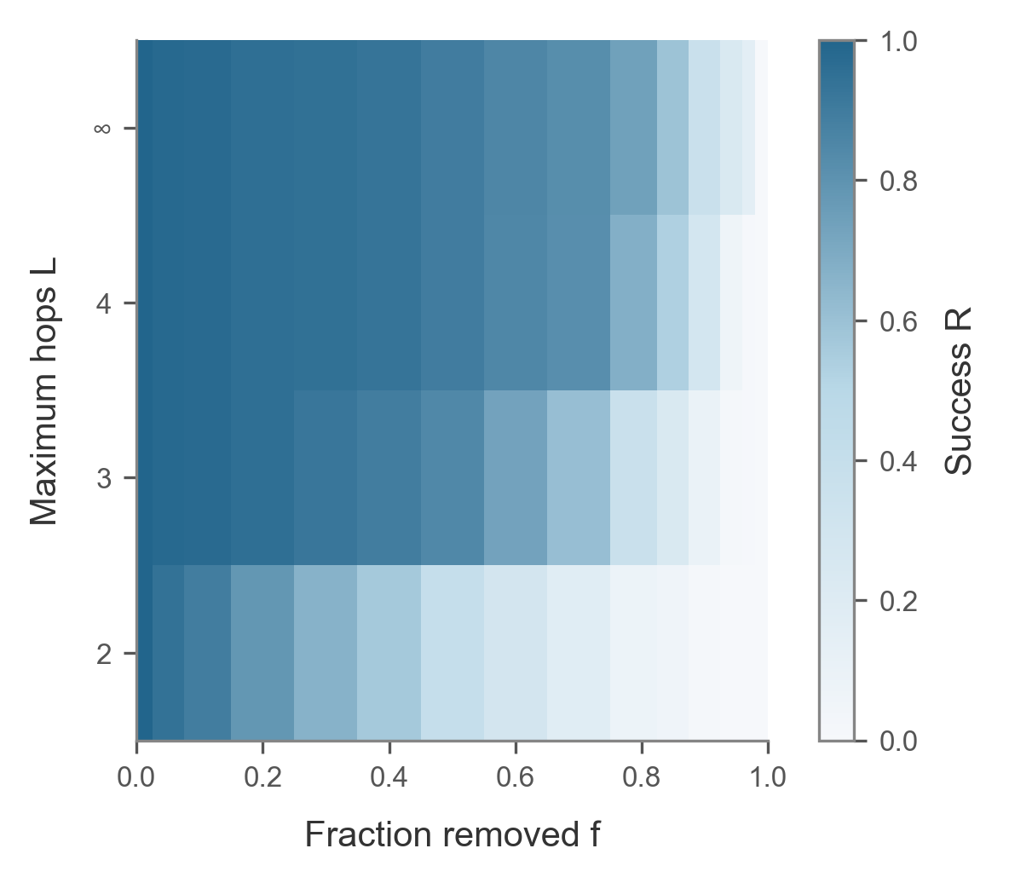
One extra hop recovers many queries
At 50% edge removal, success rises from 40.3% to 84.5% with one extra hop.
Hop scan uses the same three edge-removal seeds for every path limit.
C / 08
Notes:
For this comparison, we use the same three damage seeds for every hop limit. At 50 percent edge removal, allowing one protein–protein step increases mean success from 40.3 to 84.5 percent. Four hops reach 89.5 percent. At more severe damage, the four-hop and unlimited curves separate. The heatmap shows how retrieval changes with both the deletion fraction and the allowed path length. Sources: results/ws1 and results/ws3, primekg_5000_bfs_v1.

