Slide 1
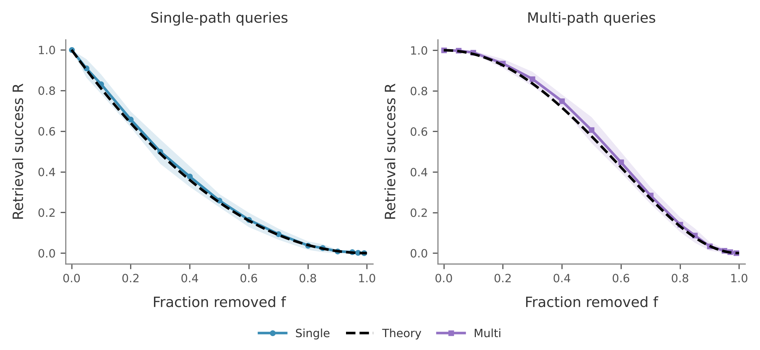
One formula predicts two-hop retrieval
R(p) = 1 − G(1 − p²)
G(z) = Σ P(m) z^{m}, m = paths per query
0
fitted parameters
< 0.001
gap to the mean of 5,000 fresh damage orders
0.72 vs 0.71
per-query AUC at 50% loss: formula vs logistic regression
Ten-seed mean ± SD. The dashed formula is not fitted to these data.
D / 09
Notes:
Why do the curves on the last slides look the way they do? A two-hop query with m shared proteins has m routes. Each route needs two edges, so it survives with probability p squared. Routes through different proteins share no edge, so they fail independently. The query fails only if all m routes fail. Averaging over the query set gives one line: R equals one minus G of one minus p squared, where G is the generating function of path counts. There are no fitted parameters. The dashed lines match both query groups, and over five thousand fresh damage orders the difference is below 0.001. A logistic regression with degree features does no better at predicting which query fails.
Source: results/ws4/primekg_5000_bfs_v1__theory.csv, __monte_carlo_check.csv, __prediction.csv.

Slide 2
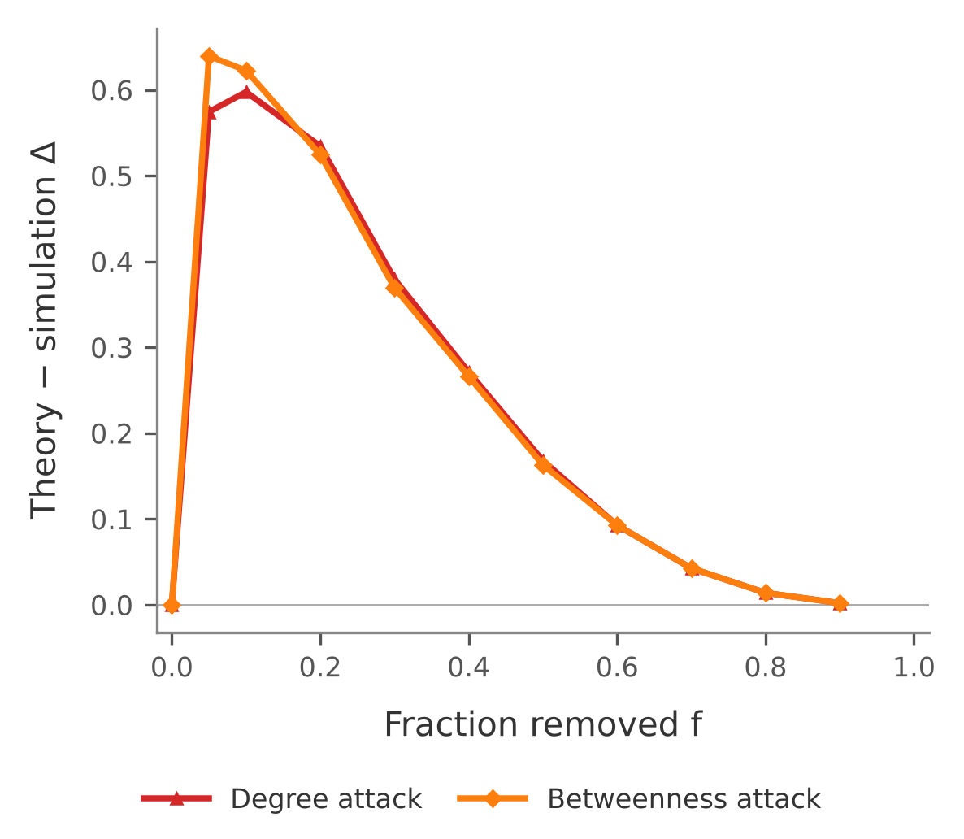
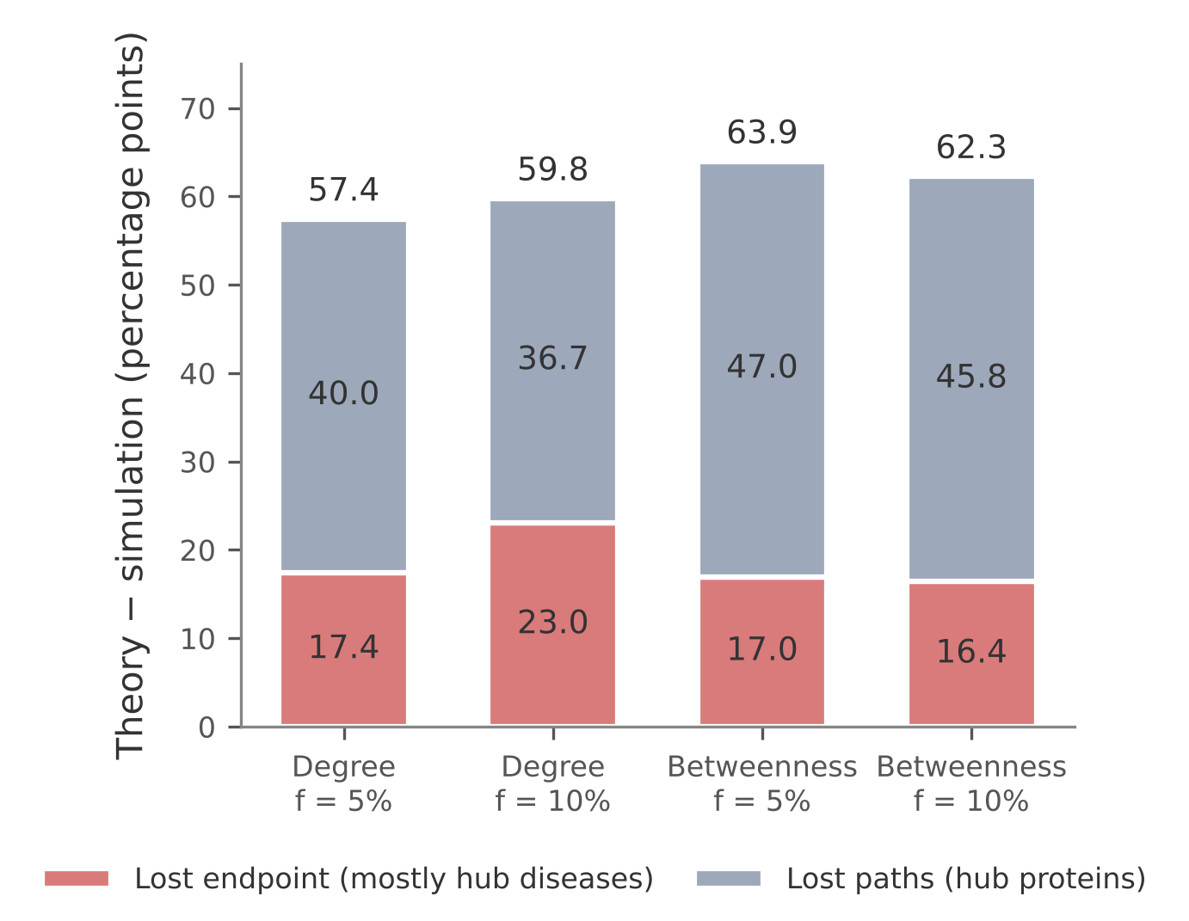
Targeted attacks break independence
57 pp
above the formula after a 5% degree attack
188 vs 25
median degree: per query path vs all proteins
53%
of multi-path queries fail; only 22% lose every shared protein
At 5% node loss, the degree attack costs 7 pp more GCC than random removal, but 56 pp more retrieval.
D / 10
Notes:
That formula assumes damage ignores the graph. A targeted attack does not. This plot shows the gap between the random-removal formula and measured success under attack. Removing the top five percent of nodes by degree leaves 30 percent of queries working, while the formula predicts 88 percent. That is a penalty of 57 points. It has two channels. About 17 points come from lost endpoints, mostly hub diseases. About 40 come from lost paths, because query paths run through hubs: the median path protein has degree 188, against 25 for all proteins. So path count is not effective redundancy: 53 percent of multi-path queries fail. The giant component hides this: compared with random removal it falls 7 points, while retrieval falls 56.
Source: results/ws4/primekg_5000_bfs_v1__corr_penalty.csv, __provenance.json, __equal_damage_summary.csv. The split averages both orders of the two factors. 188 is per query path; the median over the 133 unique proteins is 106.

Slide 3
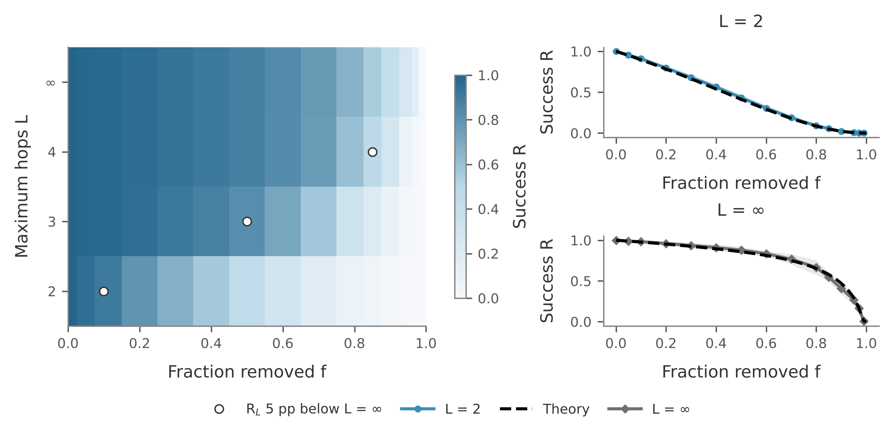
Longer horizons move the bottleneck
10 → 50 → 85%
edge loss where L = 2, 3, 4 first fall 5 pp below L = ∞
> 90%
of L = ∞ failures, up to 90% edge loss, are a drug with no surviving target
PPI giant at 90% edge loss: 75.0% simulated, 75.1% GF. Molloy–Reed p_{c} ≈ 0.006. Markers use 600 fresh orders.
D / 11
Notes:
Finally, the hop limit. We have two analytic limits. At L equals two, retrieval is local, and our formula applies. At L equals infinity, a query only needs both endpoints to reach the protein–protein giant component. Generating functions give that probability with no fit, and it matches the mean over 600 fresh damage orders to within 0.01. In between, each extra hop delays the damage at which the limit matters: about ten, fifty and eighty-five percent edge loss for two, three and four hops. We expected a sharp percolation collapse at L infinity, and we did not see one. The protein giant component still holds 75 percent of proteins at 90 percent edge loss. Up to that point, over 90 percent of L-infinity failures are drugs that have lost every target. So on this benchmark, longer horizons move the bottleneck from shared proteins to the drug's own target links.
Source: results/ws4/primekg_5000_bfs_v1__hop_scan_10seeds.csv, __theory.csv, __hop_boundary.csv, __hop_fresh_orders.csv. The heatmap uses all ten seeds; slide 8 uses seeds 0–2. The 5 pp marker is a display choice, not a phase boundary. p_c is an estimate: the scan stops at p = 0.01.

Slide 4
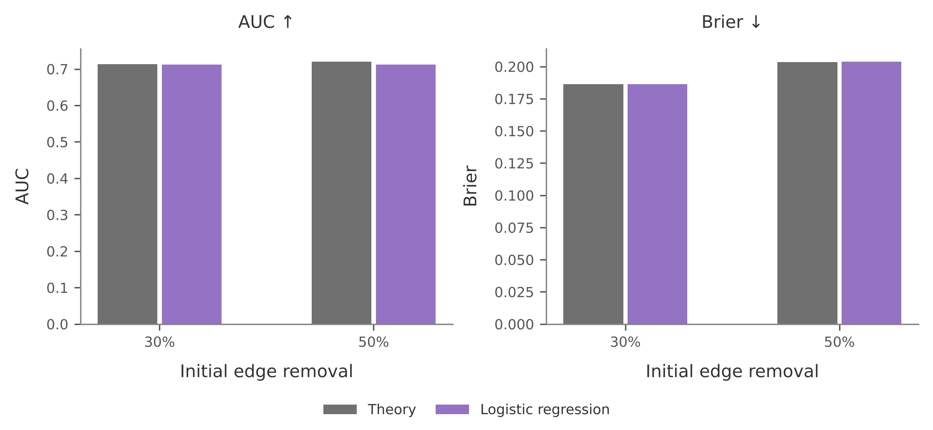
Backup: predicting which query fails
Damage | AUC formula | AUC logistic | Brier formula | Brier logistic
Random edges, 30% | 0.713 | 0.712 | 0.186 | 0.186
Random edges, 50% | 0.720 | 0.712 | 0.204 | 0.204
Degree attack, 5% | 0.658 | 0.884 | 0.535 | 0.138
Betweenness, 5% | 0.686 | 0.874 | 0.585 | 0.129
Random: test seeds 7–9. Attacks: 5-fold CV over queries, exploratory; degree-attack AUC is 0.83 with folds split by drug.
D / B1
Notes:
Under random damage the formula sits at the AUC ceiling of about 0.72, so degree features add nothing. Under attack, degree features help a great deal, but they include the quantity that defines the attack, so this is exploratory. Source: results/ws4/primekg_5000_bfs_v1__prediction_detail.csv.

Slide 5
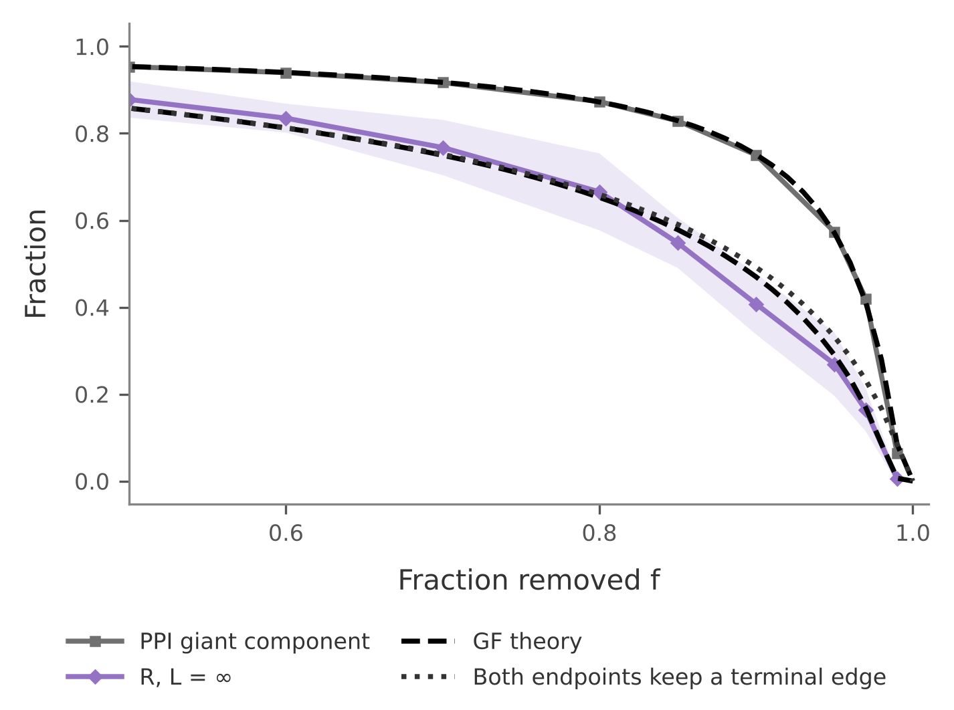
Backup: how the theory was checked
Check | Largest gap
Configuration model, bond and site | 0.0012
Configuration model, degree attack, f ≤ 0.5 | 0.0009
Two-hop formulas vs 5,000 fresh orders | 0.0010
GF vs A’s separate solver | < 10⁻¹²
PPI giant, GF vs ten seeds, f ≤ 0.97 | 0.009
L = ∞ formula vs 600 fresh orders | 0.009
Largest absolute difference in fraction units. Configuration-model graphs share the real degree sequence.
D / B2
Notes:
The configuration-model check tests the code; the other rows test the assumptions. The attack check excludes f = 0.6, where the theory is at its threshold and the finite graph gives 0.025. The PPI gap reaches 0.020 at f = 0.99. Source: results/ws4/primekg_5000_bfs_v1__configuration_model_check.csv and __monte_carlo_check.csv.

Slide 6
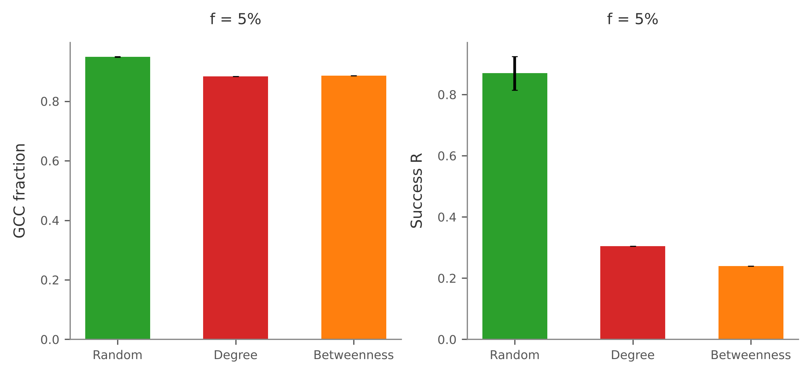
Backup: equal damage, different outcomes
Attacks are worse than random on both metrics at every damage level above zero.
The size differs: 7 pp in GCC against 56 pp in retrieval at 5% damage.
Beyond 10% damage, degree and betweenness differ by at most 2 of 200 queries, so we do not rank them.
Random bars show ten-seed mean ± SD. Attacks are deterministic.
D / B3
Notes:
Source: results/ws4/primekg_5000_bfs_v1__equal_damage.csv and __equal_damage_summary.csv.

