Slide 1
COVID-19 DEATH
Group2

Slide 2
Background
COVID DEATH AND OTHER DIEASE
In Geographic
In time
In gender
In age
…

Slide 3

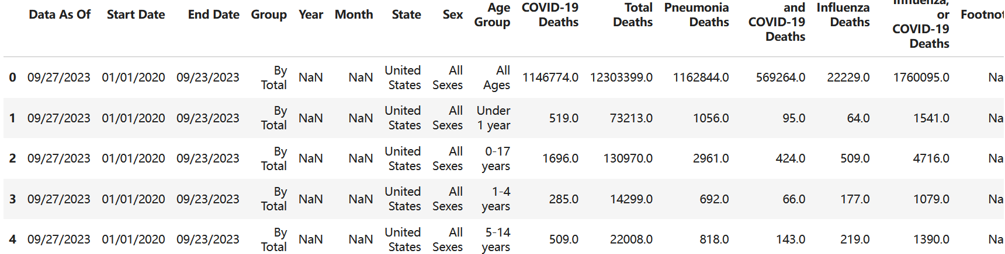
Dataset
Dataset is from CDC
Shape:
Head:
Important Feature: Year, Month; State; Age Group; Sex; Deaths

Slide 4
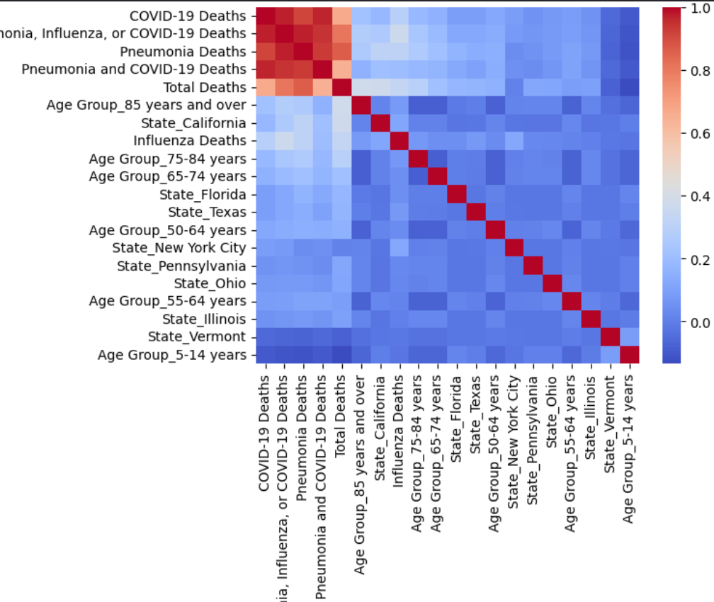
EDA-Heatmap

Slide 5
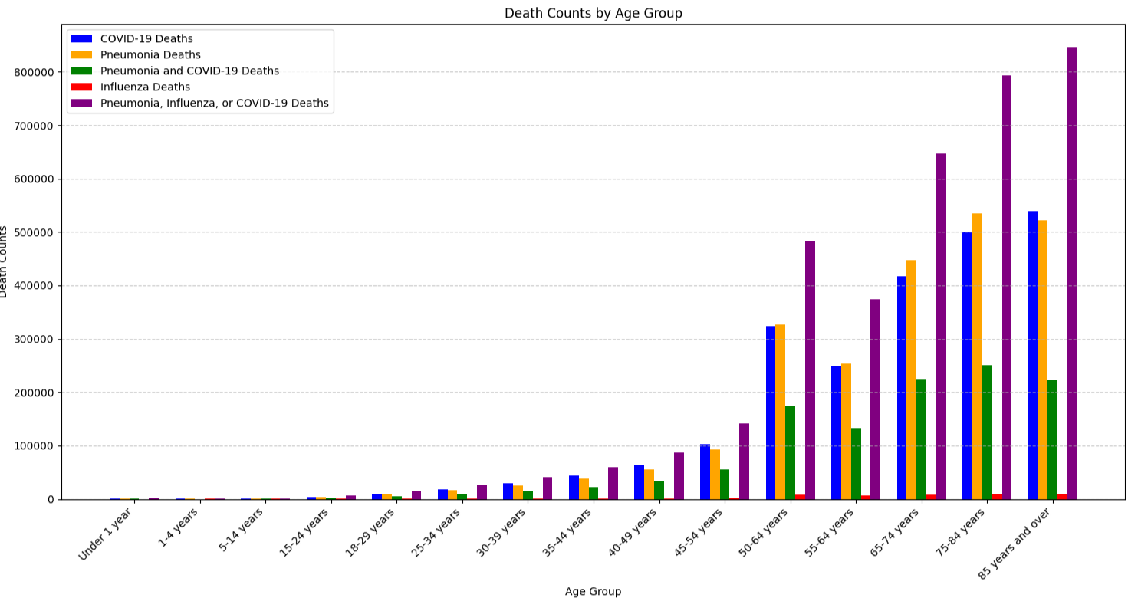
Age

Slide 6
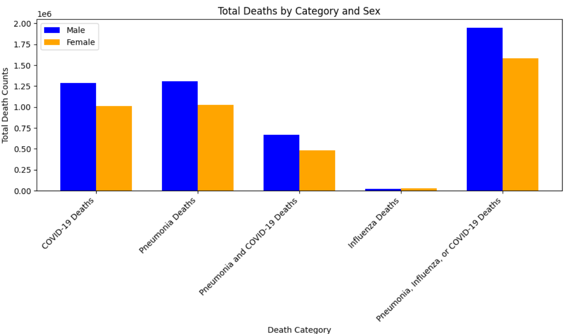
Gender

Slide 7
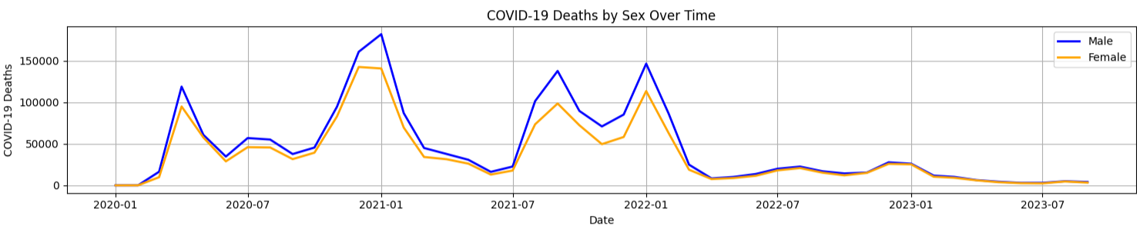
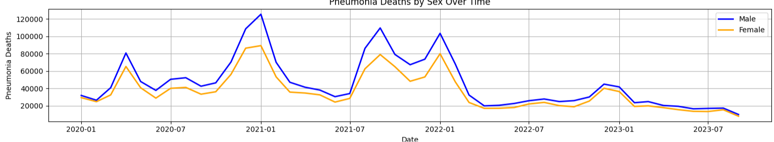
Time

Slide 8
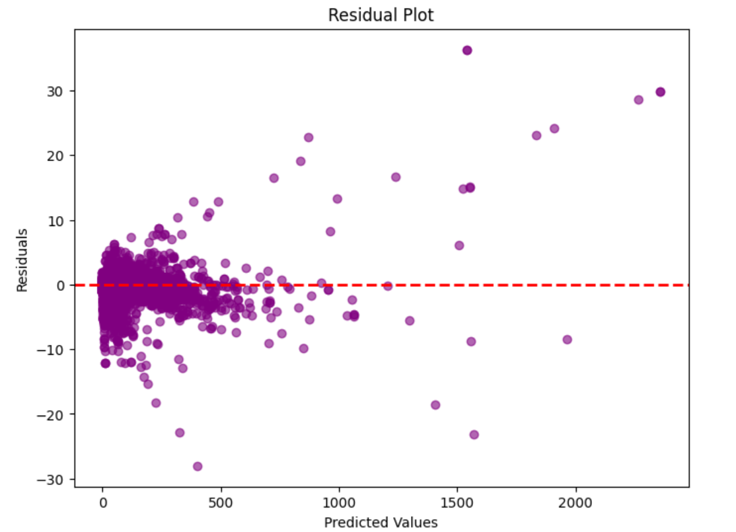
Linear
Mean Squared Error : 1.520949127860919
RMSE: 1.233267662699756
R-squared : 0.9997999672934207
Cross-Validated MSE : 1.51030214941287

Slide 9
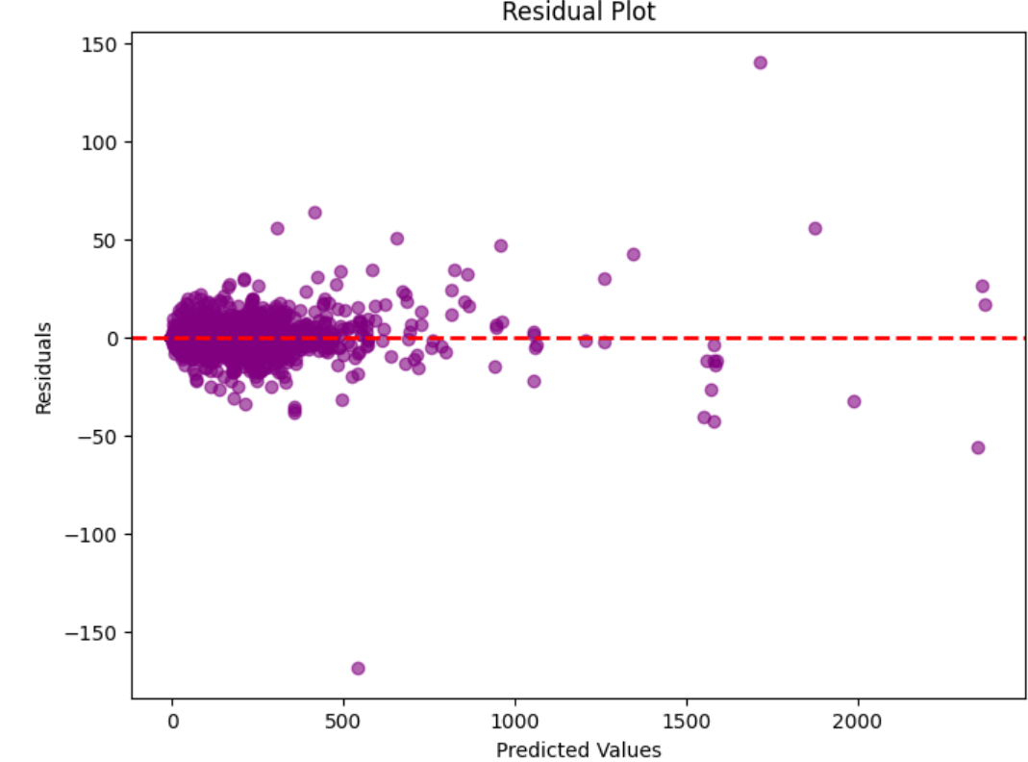
RF
Mean Squared Error: 8.791593286627121
RMSE: 2.965062105020251
R-squared: 0.9988437442330884.
Cross-validated MSE: 13.042910890148272

Slide 10
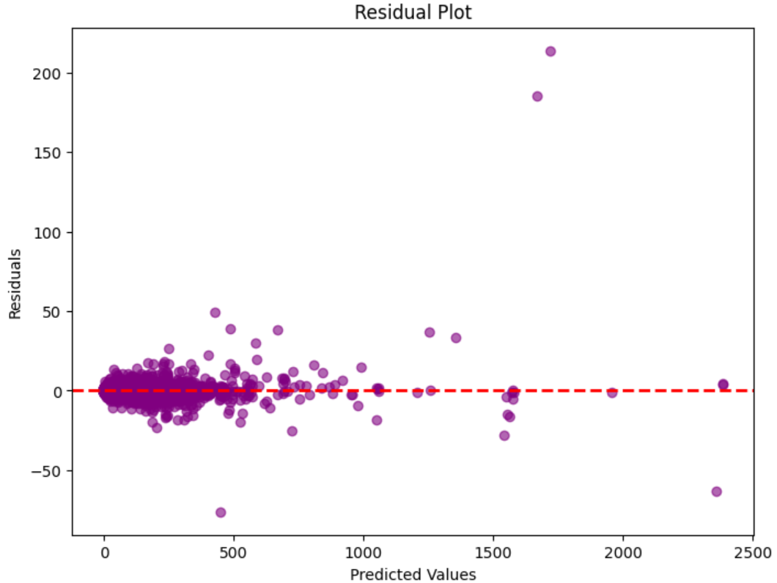
GBM
Cross-Validated MSE: 6.6972207975294555,
Mean Squared Error: 6.964972264887826,
RMSE: 2.587898915632034
R-squared: 0.999083978400149

Slide 11
Compare
 | Linear | RF | GBM
R2 | 0.9997999672934207 | 0.9988437442330884 | 0.999083978400149
MSE | 1.520949127860919 | 8.791593286627121 | 6.964972264887826,
RMSE | 1.233267662699756 | 2.965062105020251 | 2.587898915632034
CV MSE | 1.51030214941287 | 13.042910890148272 | 6.6972207975294555,

Slide 12
Suggestion for Future
Model:
Linear have overfitting problem, even with Ridge Model
RF’s hyperparameter tuning is not good as expect
GBM could do more future update with more future data to keep update
Insights:
Cold weather affect
Avoid Crowed place
More focus on other disease
…

Slide 13
Conclusion
LAST COVID-19 DEATH IN FUTURE
MORE ATTENTION ON OTHER DISEASE
…

Slide 14
References
Cai, J., Xu, K., Zhu, Y., Hu, F., & Li, L. (2020). Prediction and analysis of net ecosystem carbon exchange based on gradient boosting regression and random forest. Applied energy, 262, 114566. https://doi.org/10.1016/j.apenergy.2020.114566
Camacho, J. (2014). Visualizing big data with compressed score plots: approach and research challenges. Chemometrics and Intelligent Laboratory Systems, 135, 110-125. https://doi.org/10.1016/j.chemolab.2014.04.011
Ioannidis, J.P.A. (2021). Over- and under-estimation of COVID-19 deaths. Eur J Epidemiol 36, 581–588. https://doi.org/10.1007/s10654-021-00787-9
Melkumova, L. E., & Shatskikh, S. Y. (2017). Comparing Ridge and LASSO estimators for data analysis. Procedia engineering, 201, 746-755. https://doi.org/10.1016/j.proeng.2017.09.615
Mortensen, E. M., Coley, C. M., Singer, D. E., Marrie, T. J., Obrosky, D. S., Kapoor, W. N., & Fine, M. J. (2002). Causes of death for patients with community-acquired pneumonia: results from the Pneumonia Patient Outcomes Research Team cohort study. Archives of internal medicine, 162(9), 1059-1064. https://doi/10.1001/archinte.162.9.1059
Rodriguez-Galiano, V., Sanchez-Castillo, M., Chica-Olmo, M., & Chica-Rivas, M. J. O. G. R. (2015). Machine learning predictive models for mineral prospectivity: An evaluation of neural networks, random forest, regression trees and support vector machines. Ore Geology Reviews, 71, 804-818. https://doi.org/10.1016/j.oregeorev.2015.01.001
Sherstinsky, A. (2020). Fundamentals of recurrent neural network (RNN) and long short-term memory (LSTM) network. Physica D: Nonlinear Phenomena, 404, 132306. https://doi.org/10.1016/j.physd.2019.132306
U.S. Department of Health & Human Services. (2023, September 29). U.S. Department of Health & Human Services - Provisional Covid-19 deaths by sex and age. Catalog. https://catalog.data.gov/dataset/provisional-covid-19-death-counts-by-sex-age-and-state

Slide 15
Thank you

