Slide 1
Netflix Recommendation System
By Zhengyang Zhang
Zhaonian Zhu
Chenxu Yi

Slide 2
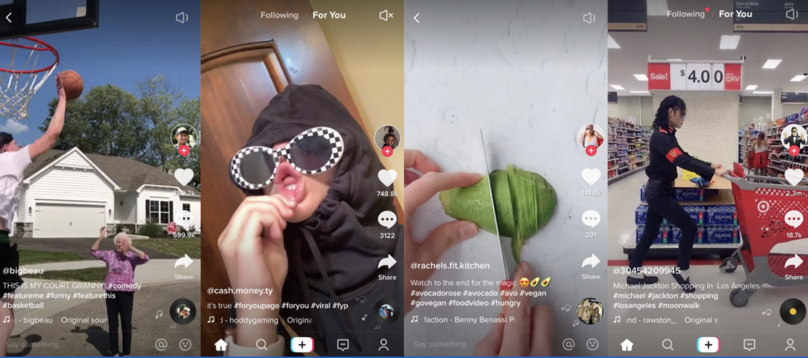
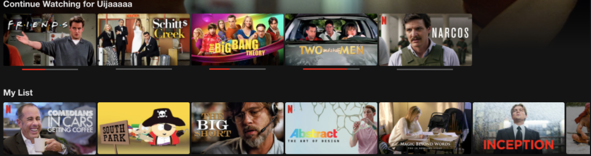
What is Recommendation System
The recommendation system is a technique to recommend things to users based on factors such as using habit, preference, etc. As a result, this technique could improve user experience.

Slide 3
Data Description
26847522 ratings total
17769 different movies
480189 unique users
Average each user rate 209 movies
User rated maximum of 17653 movies
User rated minimum of 1 movie

Slide 4

Rank Based Recommendation
The Simplest recommendation method
Easy to apply
Practical and Useful
Works for both new users and old users

Slide 5
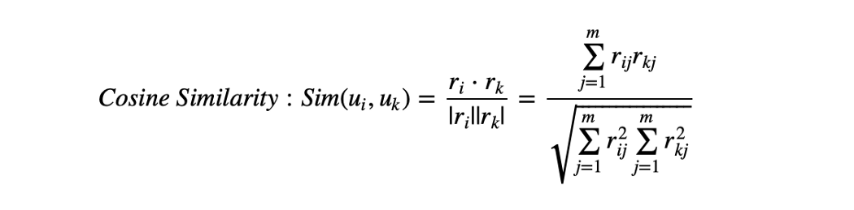
User-User Recommendation
Collaborative Filtering
No domain knowledge necessary
Cannot handle fresh items
Notes:
We build a collaborative filtering as user to user recommendation system. we think two users are similar when they give the similar item and similar ratings. The similarity is measured by cosine similarity. The pros and cons, for example, No domain knowledge necessary, we don't need domain knowledge because the embeddings are automatically learned. But the system cannot handle fresh items. Since the prediction of the model for a given by user and item pair is the dot product of the corresponding embeddings. So, if an item is not seen during training, the system can't create an embedding for it and can't query the model with this item.

Slide 6
Content Based Recommendation
NLP
Movie Title
Common word
Number of Occurrence of the common word

Slide 7
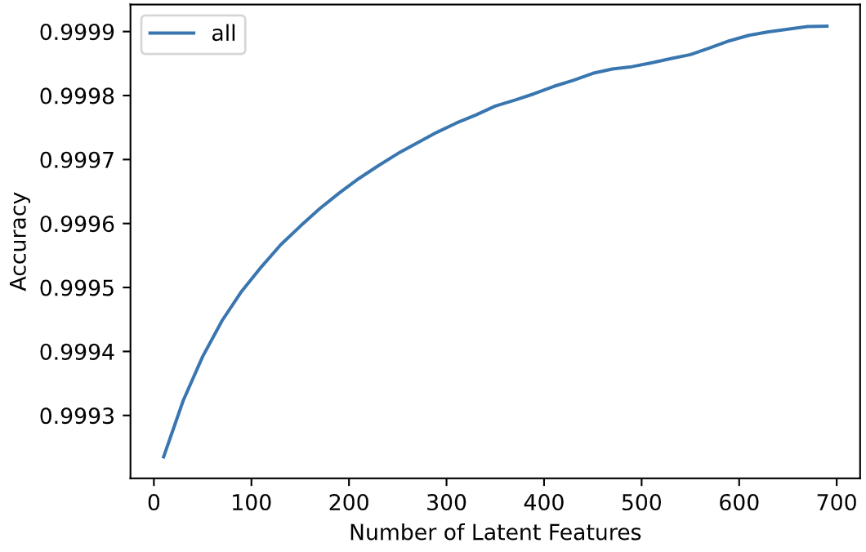
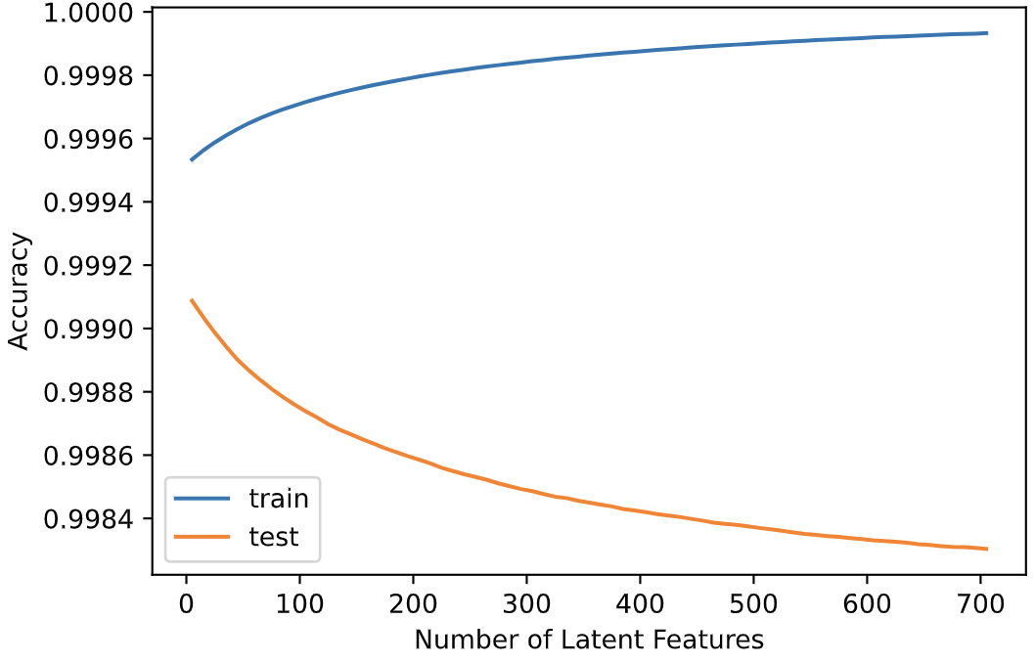
Matrix Factorization

Slide 8
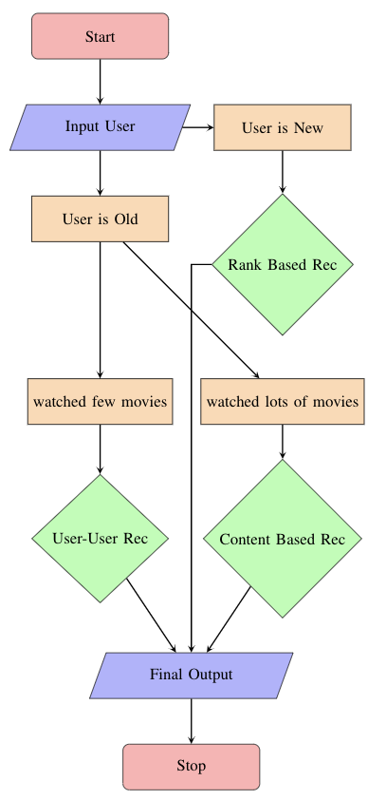
System Design

