Slide 1
Bluebell SaaS Pte Ltd
Investor Update
September 2026 · Prepared for current and prospective investors
Confidential — for discussion purposes only

Slide 2
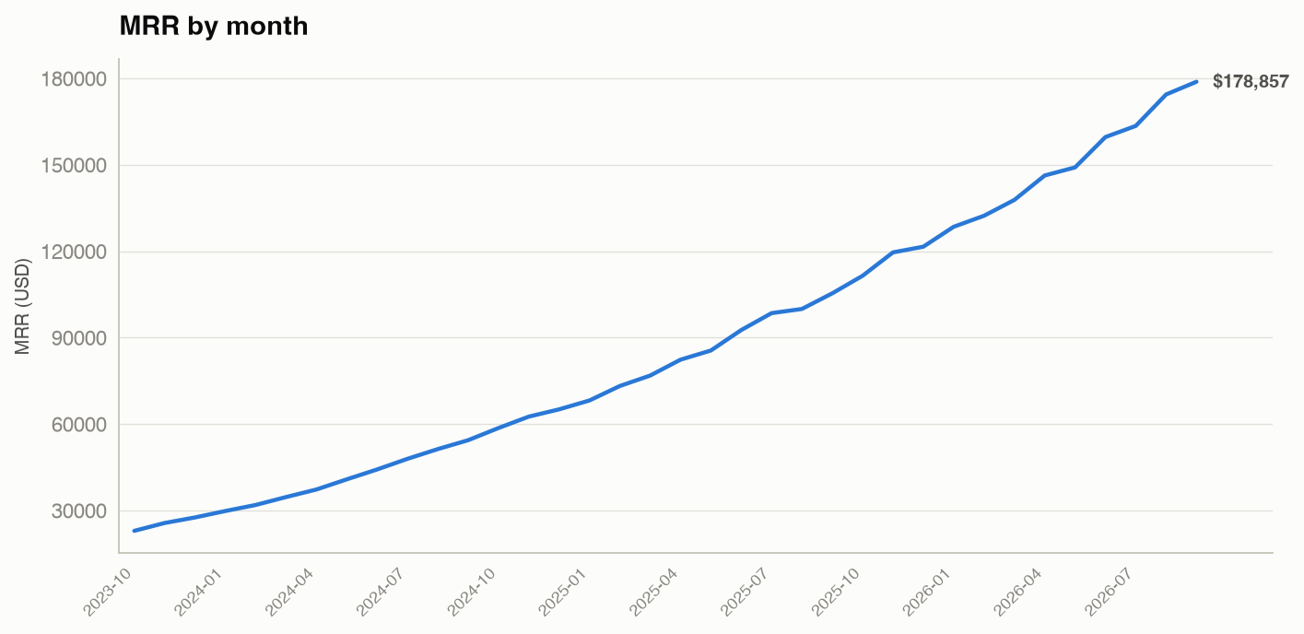
MRR trend
Monthly recurring revenue, Oct 2023 – Sep 2026
Current MRR
$178,857
+60.4% year over year
36-month growth
7.8×
MRR 12 months ago
$111,508
MRR at start (Oct 2023)
$22,955
Bluebell SaaS Pte Ltd · Investor Update · September 2026 · Confidential

Slide 3
Gross margin & cost structure
Trailing 12 months (Oct 2025 – Sep 2026)
Item | LTM value | Share
MRR (revenue) | $1,723,316
COGS | $393,885 | 22.9% of MRR
Gross profit | $1,329,432
Gross margin | 77.1%
Sales & marketing spend | $509,045 | 29.5% of MRR
Margin highlights
Latest-month gross margin
78.0%
Avg gross margin (LTM)
77.1%
Range over 36 months
72.0% – 78.0%
Gross margin has expanded steadily as the business scales, with COGS remaining roughly one-quarter of revenue.
Bluebell SaaS Pte Ltd · Investor Update · September 2026 · Confidential

Slide 4
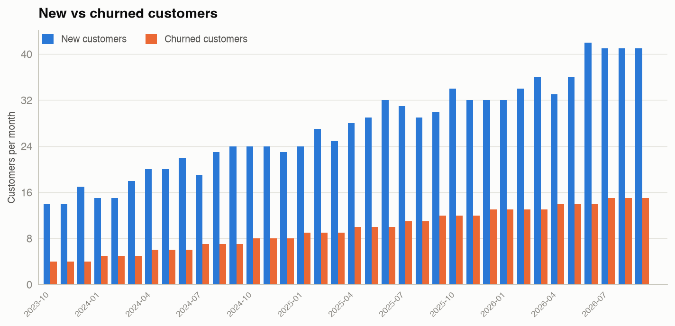
Customer growth
Active accounts and net adds
Active customers
757
up from 120 at period start
Net new customers (LTM)
+271
New customers (LTM)
434
Churned customers (LTM)
163
Bluebell SaaS Pte Ltd · Investor Update · September 2026 · Confidential

Slide 5
Unit economics
Trailing 12 months (Oct 2025 – Sep 2026)
Metric | Value | How it is calculated
CAC | $1,172.91 | LTM sales & marketing ÷ LTM new customers
LTV | $8,019.93 | ARPA × gross margin ÷ monthly churn
LTV / CAC | 6.84 | Lifetime value ÷ acquisition cost
CAC payback (months) | 6.44 | CAC ÷ monthly gross profit per customer
ARPA | $236.27 | Latest MRR ÷ latest active customers
LTV / CAC of 6.84× and a ~6.4-month payback indicate strong unit economics; every dollar of acquisition spend is recovered in roughly half a year of gross profit.
Bluebell SaaS Pte Ltd · Investor Update · September 2026 · Confidential

Slide 6
Five-year financial projection
DCF model (no terminal value)
Year | Revenue | FCF
Year 0 | $1,723,316 | -$5,000,000
Year 1 | $2,154,145 | $323,122
Year 2 | $2,606,516 | $456,140
Year 3 | $3,049,623 | $609,925
Year 4 | $3,446,074 | $775,367
Year 5 | $3,790,682 | $947,670
Valuation summary
NPV (12% discount rate)
-$2,883,241
IRR
-12.29%
Growth assumption
25% / 21% / 17% / 13% / 10%
FCF margin assumption
15% / 17.5% / 20% / 22.5% / 25%
At the assumed growth and margin path, the equity investment of $5.0M yields a negative NPV and IRR; see appendix for assumptions.
Bluebell SaaS Pte Ltd · Investor Update · September 2026 · Confidential

Slide 7
Term loan
Debt facility supporting the growth plan
Term | Value
Principal | $2,000,000
Annual interest rate | 7.00%
Term | 60 months
Monthly payment | $39,602.40
Total interest over term | $376,143.82
60-month amortization
The $2.0M facility amortizes in full over 60 equal monthly payments.
Total interest
$376,143.82
Full amortization table is in model.xlsx (sheet "loan").
Bluebell SaaS Pte Ltd · Investor Update · September 2026 · Confidential

Slide 8
Use of funds
Proposed allocation of the $7.0M capital raise
Sources of capital
$5.0M equity investment + $2.0M term loan = $7.0M total
Use | Share | Amount
Sales & marketing expansion | 40% | $2.80M
Product & engineering | 30% | $2.10M
Working capital & G&A | 20% | $1.40M
Debt service reserve | 10% | $0.70M
Allocation is management’s proposal; see appendix for assumptions.
Bluebell SaaS Pte Ltd · Investor Update · September 2026 · Confidential

Slide 9
Appendix — Assumptions
Every assumption used in this update
• Starting active customers = 120 (provided). Active customers per month = prior active + new − churned.
• “Trailing 12 months / LTM” = the final 12 of the 36 monthly rows (Oct 2025 – Sep 2026).
• Gross margin = (MRR − COGS) ÷ MRR.
• Monthly churn = churned customers ÷ prior-month active customers.
• CAC (LTM) = LTM sales & marketing spend ÷ LTM new customers.
• ARPA = latest-month MRR ÷ latest-month active customers.
• LTV = ARPA × LTM avg gross margin ÷ LTM avg monthly churn.
• CAC payback = CAC ÷ (ARPA × LTM avg gross margin).
• DCF: revenue year 0 = LTM MRR; growth 25%, 21%, 17%, 13%, 10% (years 1–5); FCF margin 15%, 17.5%, 20%, 22.5%, 25%; discount rate 12%; initial investment −$5,000,000 at year 0; no terminal value.
• Loan: principal $2,000,000; 7.00% annual; 60 equal monthly payments (full amortization).
• Use-of-funds allocation (40/30/20/10) is management’s proposal, not derived from the dataset.
• MRR year-over-year growth of +60.4% compares Sep 2026 to Sep 2025.
Bluebell SaaS Pte Ltd · Investor Update · September 2026 · Confidential

Slide 10
Appendix — Board deck reconciliation
Q2 board deck, slide 7 (“Unit Economics”) vs. recomputation
The prior board deck reported CAC of $1,583.00, which does not reconcile with the stated formula. The corrected value is $1,172.91. All other metrics on slide 7 match.
Metric | Board deck (slide 7) | Computed | Status
CAC (trailing 12m) | $1,583.00 | $1,172.91 | CONFLICT — corrected to $1,172.91
LTV | $8,019.93 | $8,019.93 | Match
CAC payback (months) | 6.44 | 6.44 | Match
ARPA | $236.27 | $236.27 | Match
Bluebell SaaS Pte Ltd · Investor Update · September 2026 · Confidential

