Slide 1
INVESTOR UPDATE · SEPTEMBER 2026
Bluebell SaaS
Trailing 36 months: October 2023 – September 2026
Revenue · customers · unit economics · margins
Confidential · Prepared for investor review

Slide 2
OVERVIEW
Executive summary
$178.9k
757
+69.7%
Ending MRR · ARR $2.15M
Active customers (from 120)
YoY MRR growth · 98% CAGR
$1.72M
77.1%
$236
Trailing-12m revenue
Gross margin (TTM)
ARPA · 6.4-mo CAC payback
Over 36 months, Bluebell grew MRR 7.8× (from $23.0k to $178.9k) while expanding its customer base from 120 to 757 accounts on improving unit economics: ARPA up from $176 to $236, gross margin up ~6 pts to 77%, and blended CAC payback holding at ~6.4 months. Headcount scaled from 9 to 34.

Slide 3
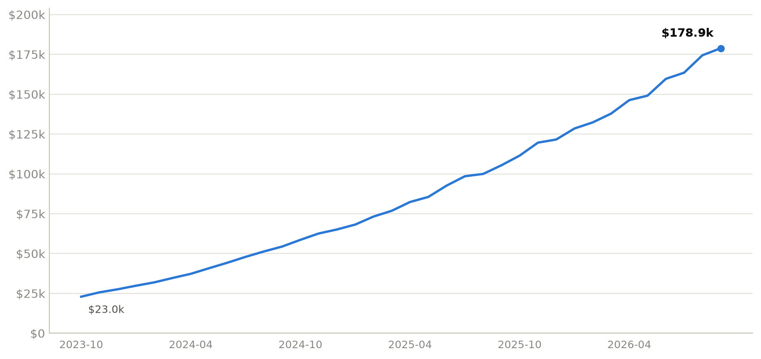
REVENUE
Monthly recurring revenue
$2.15M
ARR (run-rate, Sep 2026)
$1.72M
TTM revenue (last 12m)
7.8×
MRR multiple over 36m

Slide 4
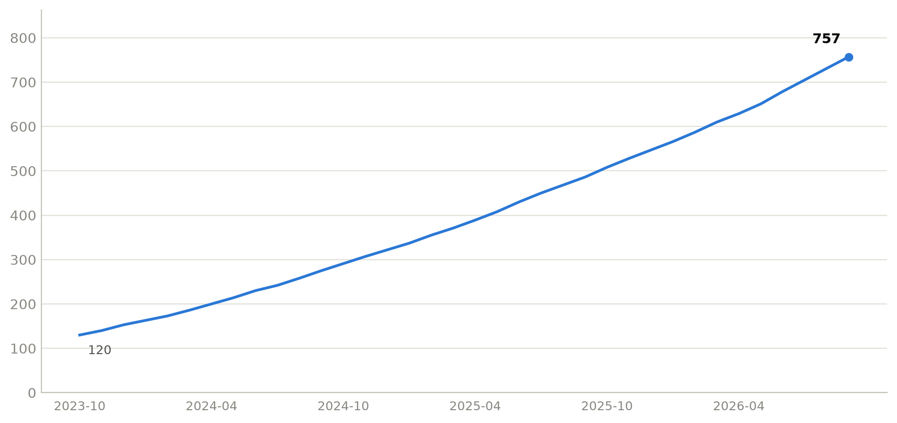
CUSTOMERS
Customer growth
757
Active customers
+637
Net adds over 36m
2.3%
Avg monthly logo churn

Slide 5
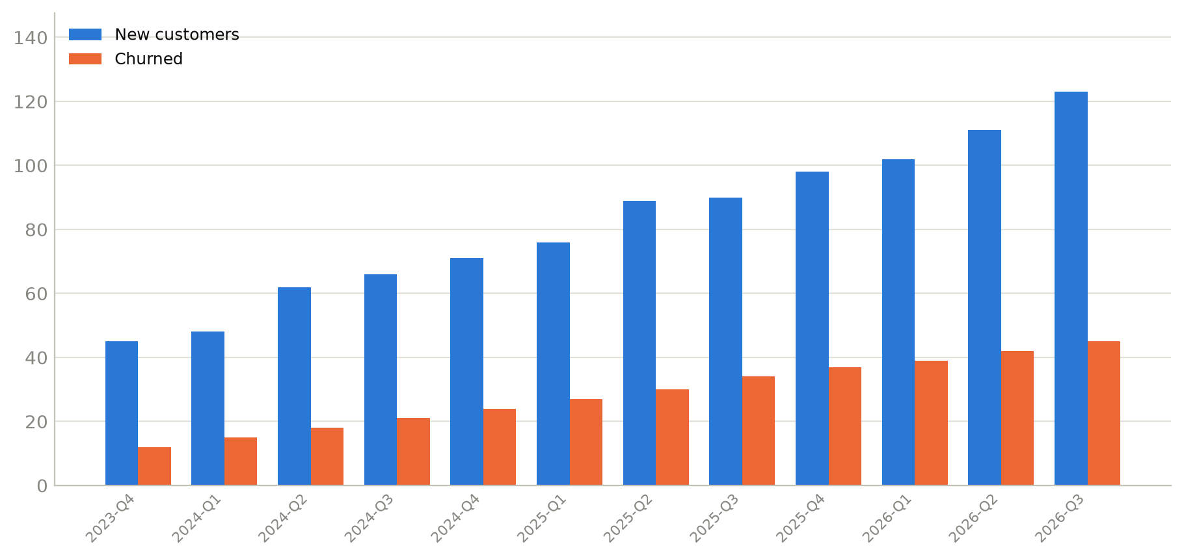
ACQUISITION
New vs churned customers
981
New customers (36m)
344
Churned (36m)
+78
Net adds (Q3-2026)

Slide 6
UNIT ECONOMICS
Unit economics (TTM, Sep 2026)
$236.27
$1,173
$8,029
6.4 mo
ARPA
Blended CAC
LTV
CAC payback
LTV = ARPA × gross margin ÷ avg monthly logo churn (2.27%). CAC = S&M (TTM) ÷ new logos (TTM).
Note — prior board deck (slide 7) differs
Slide 7 (labelled 'end of Q2') reported CAC $1,583 and LTV $8,019.93. Our recomputation gives CAC $1,157 (Q2-end) / $1,173 (latest) and LTV $7,608 (Q2-end) / $8,029 (latest). See the reconciliation slide for details.

Slide 7
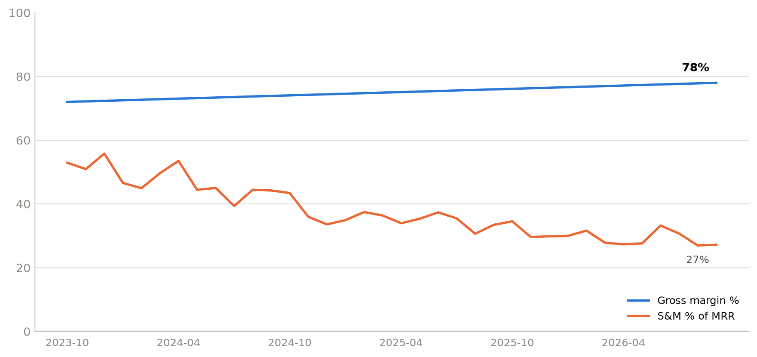
EFFICIENCY
Gross margin & S&M efficiency
77.1%
Gross margin (TTM)
27.2%
S&M as % of MRR (latest)
$90.8k
Contribution after COGS & S&M

Slide 8
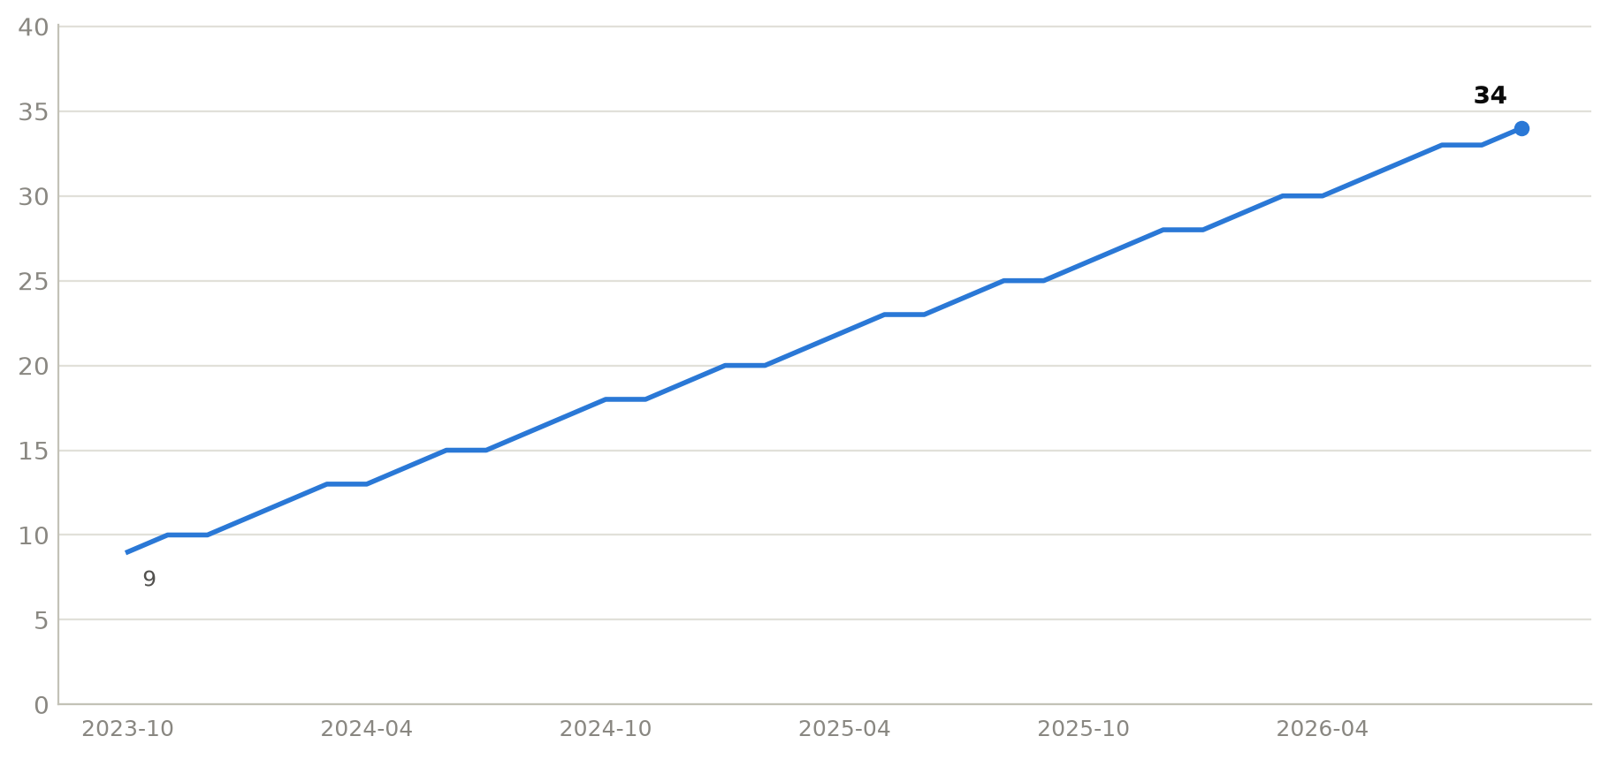
TEAM
Headcount
34
Headcount (Sep 2026)
9 → 34
Headcount over 36m
$5.3k
MRR per employee

Slide 9
DATA NOTE
Reconciliation — prior deck slide 7
Slide 7 ('Q2 Board Update — Unit Economics') was labelled 'end of Q2'. We recomputed the same metrics from data/financials.xlsx.
Metric | Slide 7 | Computed @ Q2-end (Jun 2026) | Computed @ latest (Sep 2026) | Assessment
ARPA | $236.27 | $235.13 | $236.27 | Slide value = Sep, not Jun
CAC (TTM) | $1,583 | $1,157.02 | $1,172.91 | Slide CAC not reproducible
LTV | $8,019.93 | $7,608.25 | $8,028.95 | Slide ≈ Sep, ≠ Jun
CAC payback | 6.44 mo | 6.42 mo | 6.44 mo | Slide value = Sep, not Jun
Key finding: the slide's ARPA and CAC payback match September 2026 (latest data), not the 'end of Q2' label; and the CAC of $1,583 cannot be reproduced from the provided financials under any standard blended-CAC definition.

