Slide 1
BLUEBELL SAAS PTE LTD
Investor Update
Q3 2026 · Operating period: October 2023 – September 2026
MRR $178,857.07 Active customers 757 LTV / CAC 6.84
Prepared 11 September 2026 · Confidential — for prospective investors

Slide 2
Q3 2026 INVESTOR UPDATE
Executive summary
MRR — Sep 2026
Active customers
LTV / CAC
Gross margin — Sep 2026
$178,857.07
757
6.84
78.00%
Oct 2023: $22,955.41 (7.79x growth)
Started at 120; net +637
LTV $8,019.93 · CAC $1,172.91
Trailing-12m average 77.06%
What investors should know
• Recurring revenue scaled 7.79x over 36 months, from $22,955.41 to $178,857.07 MRR; LTM revenue (sum of the last 12 MRR) is $1,723,316.18.
• Customer base grew from 120 to 757 active customers; trailing-12m 434 new logos vs 163 churned (net +271), with average monthly logo churn of 2.27%.
• Efficient growth engine: CAC $1,172.91 (trailing 12m), LTV $8,019.93, payback 6.44 months; S&M consumed 29.54% of LTM revenue.
• Financing: modelled $5,000,000 equity investment (5-year DCF, no terminal value) and a $2,000,000 term loan; headcount ended the period at 34.
Bluebell SaaS Pte Ltd · Investor Update, Q3 2026 · Confidential
2

Slide 3
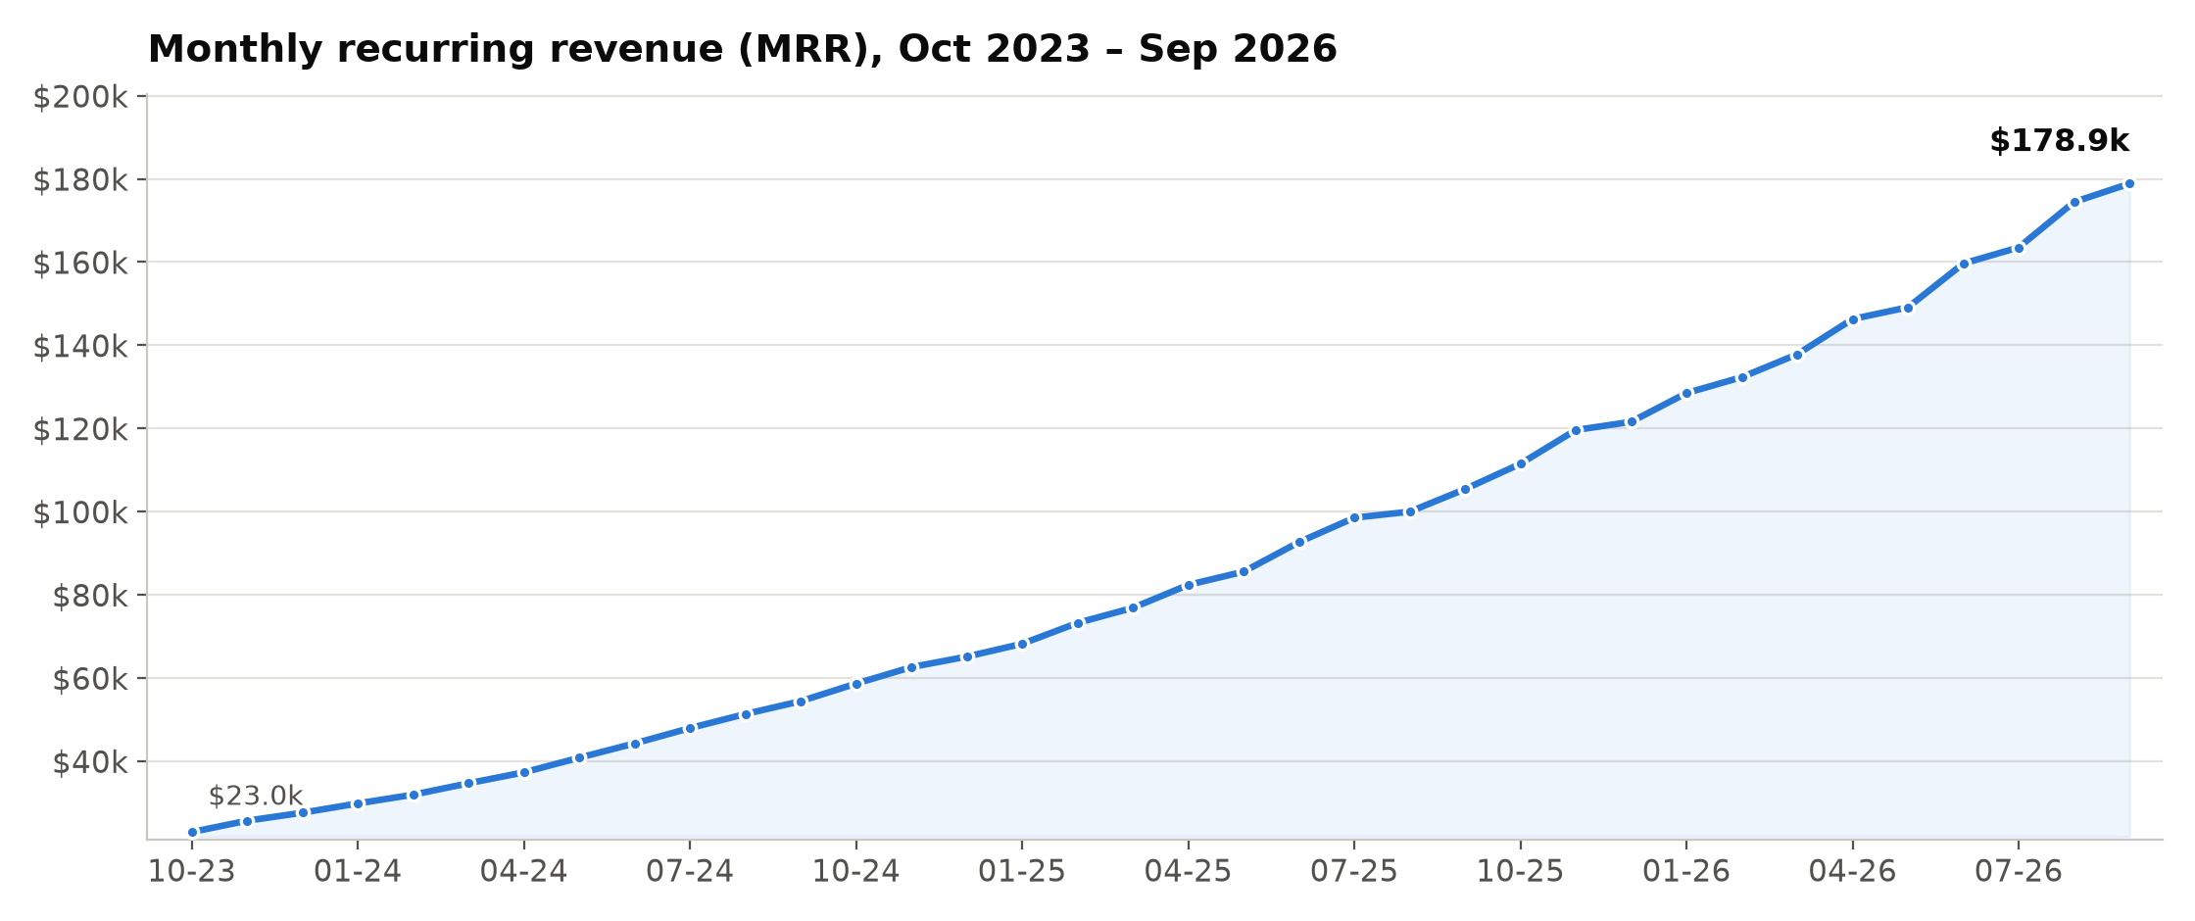
MRR trend
Takeaway: MRR grew from $22,955.41 to $178,857.07 (7.79x over 36 months); LTM revenue $1,723,316.18. Monthly values from model.xlsx sheet 'raw'.
Bluebell SaaS Pte Ltd · Investor Update, Q3 2026 · Confidential
3

Slide 4
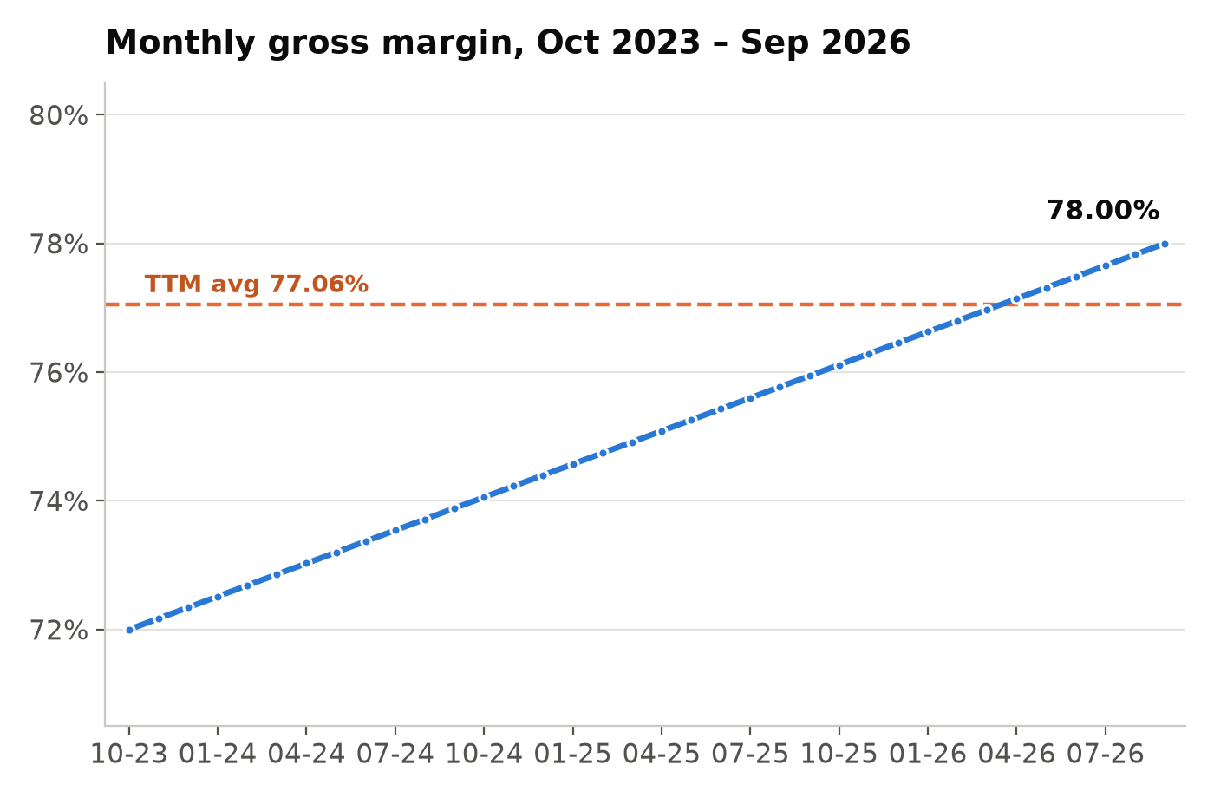
Gross margin & cost structure
Gross margin — Sep 2026
(MRR − COGS) / MRR, monthly
78.00%
Gross margin — Oct 2023
72.00% at period start
72.00%
Average gross margin, L12
Simple average of last 12 monthly GM
77.06%
LTM blended gross margin
LTM gross profit $1,329,431.63 / revenue
77.14%
LTM revenue (Σ last 12 MRR)
COGS over the same period: $393,884.55
$1,723,316.18
LTM sales & marketing spend
29.54% of LTM revenue
$509,044.99
Bluebell SaaS Pte Ltd · Investor Update, Q3 2026 · Confidential
4

Slide 5
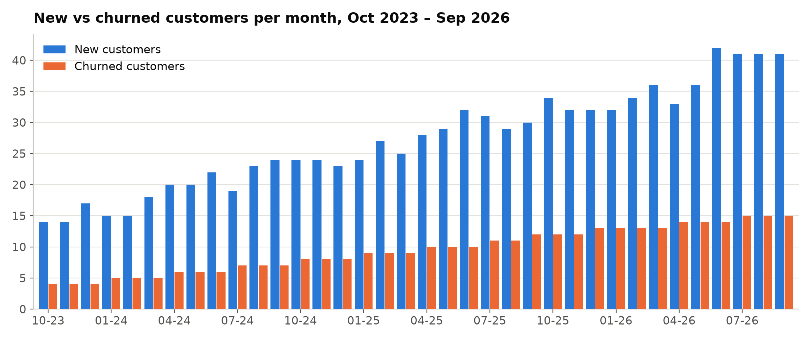
Customer growth
Takeaway: Active customers 120 → 757. Trailing 12 months: 434 new vs 163 churned (net +271); average monthly logo churn 2.27%.
Bluebell SaaS Pte Ltd · Investor Update, Q3 2026 · Confidential
5

Slide 6
Unit economics — trailing 12 months (Oct 2025 – Sep 2026)
Metric | Value | How it is calculated
CAC (trailing 12 months) | $1,172.91 | S&M $509,044.99 ÷ 434 new customers
LTV | $8,019.93 | ARPA × avg GM 77.06% ÷ avg monthly churn 2.27%
LTV / CAC | 6.84 | $8,019.93 ÷ $1,172.91
CAC payback (months) | 6.44 | CAC ÷ (ARPA × avg GM 77.06%)
ARPA | $236.27 | Sep 2026 MRR $178,857.07 ÷ 757 active customers
All five values shown to two decimals and linked as live Excel formulas (model.xlsx → sheet 'unit_economics', cells G7, G13, G14, G15, G12).
Interpretation: LTV/CAC of 6.84 and a 6.44-month payback indicate an efficient accretion engine at current scale.
Bluebell SaaS Pte Ltd · Investor Update, Q3 2026 · Confidential
6

Slide 7
5-year DCF — management assumptions
Assumptions
Valuation result
• Revenue year 0 = Σ last 12 MRR = $1,723,316.18
• Growth, years 1–5: 25.00%, 21.00%, 17.00%, 13.00%, 10.00%
• FCF margin, years 1–5: 15.00%, 17.50%, 20.00%, 22.50%, 25.00%
• Discount rate: 12.00%
• Initial investment: −$5,000,000 at year 0
• No terminal value; NPV = =NPV() + year 0; IRR = =IRR()
NPV
$-2,883,240.59
IRR
-12.29%
Year | 0 | 1 | 2 | 3 | 4 | 5
Revenue | $1,723,316.18 | $2,154,145.23 | $2,606,515.72 | $3,049,623.40 | $3,446,074.44 | $3,790,681.88
Free cash flow | $-5,000,000.00 | $323,121.78 | $456,140.25 | $609,924.68 | $775,366.75 | $947,670.47
Reading: on these assumptions the five years of projected FCF do not by themselves return the $5,000,000 investment (no terminal value, per the agreed convention). NPV and IRR are reported unadjusted as live formulas in model.xlsx → sheet 'dcf' (B16, B17).
Bluebell SaaS Pte Ltd · Investor Update, Q3 2026 · Confidential
7

Slide 8
Term loan — amortization summary
Principal
Annual rate
Term
Equal monthly payment
$2,000,000.00
7.00%
60 months
$39,602.40
Item | Amount / value
Monthly payment (PMT, 60 equal payments) | $39,602.40
Total payments over 60 months | $2,376,143.82
Total interest (sum of interest column) | $376,143.82
Interest portion of payment 1 | $11,666.67
Principal portion of payment 1 | $27,935.73
Ending balance after payment 60 | $0.00
Mechanics
• Monthly rate = 7.00% ÷ 12 = 0.5833%
• Payment via Excel =PMT(): $39,602.40
• Full 60-row amortization table (beginning balance, interest, principal, ending balance) is a live schedule in model.xlsx → sheet 'loan'.
Bluebell SaaS Pte Ltd · Investor Update, Q3 2026 · Confidential
8

Slide 9
Use of funds — $5,000,000 round (illustrative)
Product & engineering
Platform build-out, R&D, technical infrastructure
40%
$2,000,000
Sales & marketing
Demand generation and CAC-funded acquisition
30%
$1,500,000
Team expansion
Hiring across G&A, customer success and delivery
20%
$1,000,000
Working capital & reserve
Operating buffer; complements the $2.0M term loan
10%
$500,000
Total planned deployment: $5,000,000 (100%). Allocation is an illustrative management plan — see appendix assumptions. The $2,000,000 term loan (slide 8) is a separate, fully-amortizing facility.
Bluebell SaaS Pte Ltd · Investor Update, Q3 2026 · Confidential
9

Slide 10
Appendix A — data, definitions and model assumptions
A1 Source: data/financials.xlsx, sheet 'raw'; 36 monthly rows, Oct 2023 – Sep 2026.
B1 DCF revenue year 0 = Σ of last 12 MRR = $1,723,316.18 (MRR treated as recognized monthly revenue).
A2 Starting active customers = 120 at 30 Sep 2023 (given).
B2 Revenue growth years 1–5: 25%, 21%, 17%, 13%, 10%.
A3 Active customers = prior active + new − churned, applied monthly from 120.
B3 FCF margin years 1–5: 15%, 17.5%, 20%, 22.5%, 25%.
A4 Gross margin = (MRR − COGS) / MRR, computed per month.
B4 Discount rate 12%; initial investment −$5,000,000 at year 0; no terminal value.
A5 Monthly churn = churned / prior month active; first month denominator = 120.
B5 Excel: NPV = NPV(rate, FCF1:FCF5) + FCF0; IRR = IRR(FCF0:FCF5).
A6 Trailing-12m window = Oct 2025 – Sep 2026 (the final 12 rows).
B6 Loan: $2,000,000 principal, 7.00% nominal annual rate (monthly 0.5833%), 60 equal monthly payments via =PMT() = $39,602.40; full schedule in model.xlsx.
A7 CAC = Σ S&M over trailing 12m ÷ Σ new customers over trailing 12m = $509,044.99 ÷ 434 = $1,172.91.
B7 Use-of-funds split (40/30/20/10) is an illustrative management assumption.
A8 ARPA = Sep 2026 MRR ÷ active customers = $178,857.07 ÷ 757 = $236.27.
B8 All figures USD; no inflation or FX adjustment; headcount 34 at period end.
A9 LTV = ARPA × avg gross margin (L12) ÷ avg monthly churn (L12) = $8,019.93; simple churn-only formula as specified (constant GM/churn, no discounting).
B9 model.xlsx holds live formulas only — raw data plus formulas on 'unit_economics', 'dcf' and 'loan'; no metric was pasted as a static number.
A10 CAC payback = CAC ÷ (ARPA × avg GM) = 6.44 months.
Bluebell SaaS Pte Ltd · Investor Update, Q3 2026 · Confidential
10

Slide 11
Appendix B — reconciliation vs prior board deck
Comparison with slide 7 of last quarter's board deck ("Q2 Board Update — Unit Economics"):
Metric | Board deck (Q2) | This update (recomputed) | Status
CAC (trailing 12 months) | $1,583 | $1,172.91 | CONFLICT — corrected
LTV | $8,019.93 | $8,019.93 | Matches
CAC payback (months) | 6.44 | 6.44 | Matches
ARPA | $236.27 | $236.27 | Matches
LTV / CAC (derived) | 5.07 | 6.84 | CONFLICT — corrected
Conflict & correction: the Q2 board deck reported CAC of $1,583. Applying the stated definition to the trailing-12m data gives $1,172.91 (S&M $509,044.99 ÷ 434 new customers); no 12-month window in the data produces $1,583, so the earlier figure was erroneous. Derived LTV/CAC corrects from 5.07 to 6.84. LTV ($8,019.93), payback (6.44) and ARPA ($236.27) matched exactly and are reaffirmed.
Bluebell SaaS Pte Ltd · Investor Update, Q3 2026 · Confidential
11

