Slide 1
Investor Update
BLUEBELL SAAS PTE LTD
Q3 2026 · 36-month review, October 2023 – September 2026
Prepared 11 Sep 2026. All figures derive from the company's monthly finance export; unit economics on a trailing-12-month basis. Accompanying CFO model: Bluebell_Investor_Model.xlsx (live formulas).
CONFIDENTIAL

Slide 2
AT A GLANCE
The numbers that matter
$2.15M
ARR
MRR $178.9k at 30 Sep 2026
+69.7%
MRR growth, year over year
+93.7% a year earlier; scaling base
757
Active customers
120 at start; +271 net over last 12 months
$236.27
ARPA
Up 34% from $176.58 in Oct 2023
77.1%
Gross margin (TTM)
73.2% at Sep 2024; 76.6% at end Q2
$1,173
CAC (TTM, gross adds)
S&M $509k ÷ 434 new customers
6.44 mo
CAC payback
Stable all year (Q2: 6.42)
6.8x
LTV / CAC
LTV $8,029; ratio was 5.1x at Sep 2024
TTM revenue $1.72M · S&M intensity 29.5% of revenue · contribution after COGS and S&M 47.6% · Rule-of-40 proxy (YoY growth + contribution margin) ≈ 117
Bluebell SaaS Pte Ltd · Investor Update · data through 30 Sep 2026
2

Slide 3
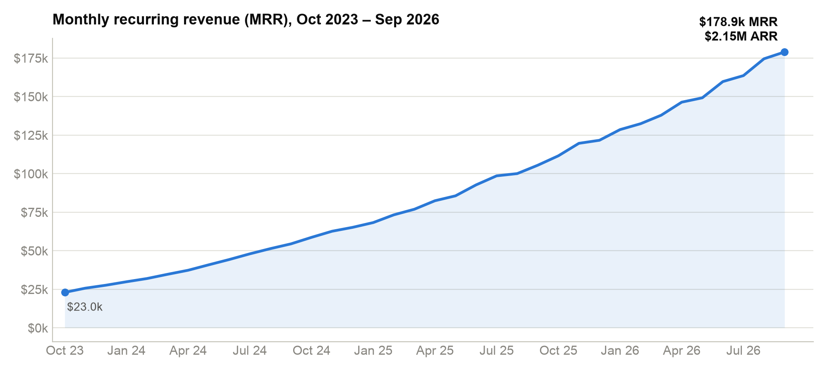
REVENUE
MRR grew 7.8x in 36 months; ARR now $2.15M
• MRR $23.0k → $178.9k
7.79× over the period; 6.04% monthly CAGR
• Crossed $2M ARR in August 2026
$1.96M Jul → $2.09M Aug → $2.15M Sep
• Q3 net MRR add: $19.2k
+12.0% QoQ (Q2: +15.8%)
• TTM revenue $1.72M
Sum of MRR, Oct 2025 – Sep 2026
• No lost-month pattern
MRR rose in every month of the period
Bluebell SaaS Pte Ltd · Investor Update · data through 30 Sep 2026
3

Slide 4
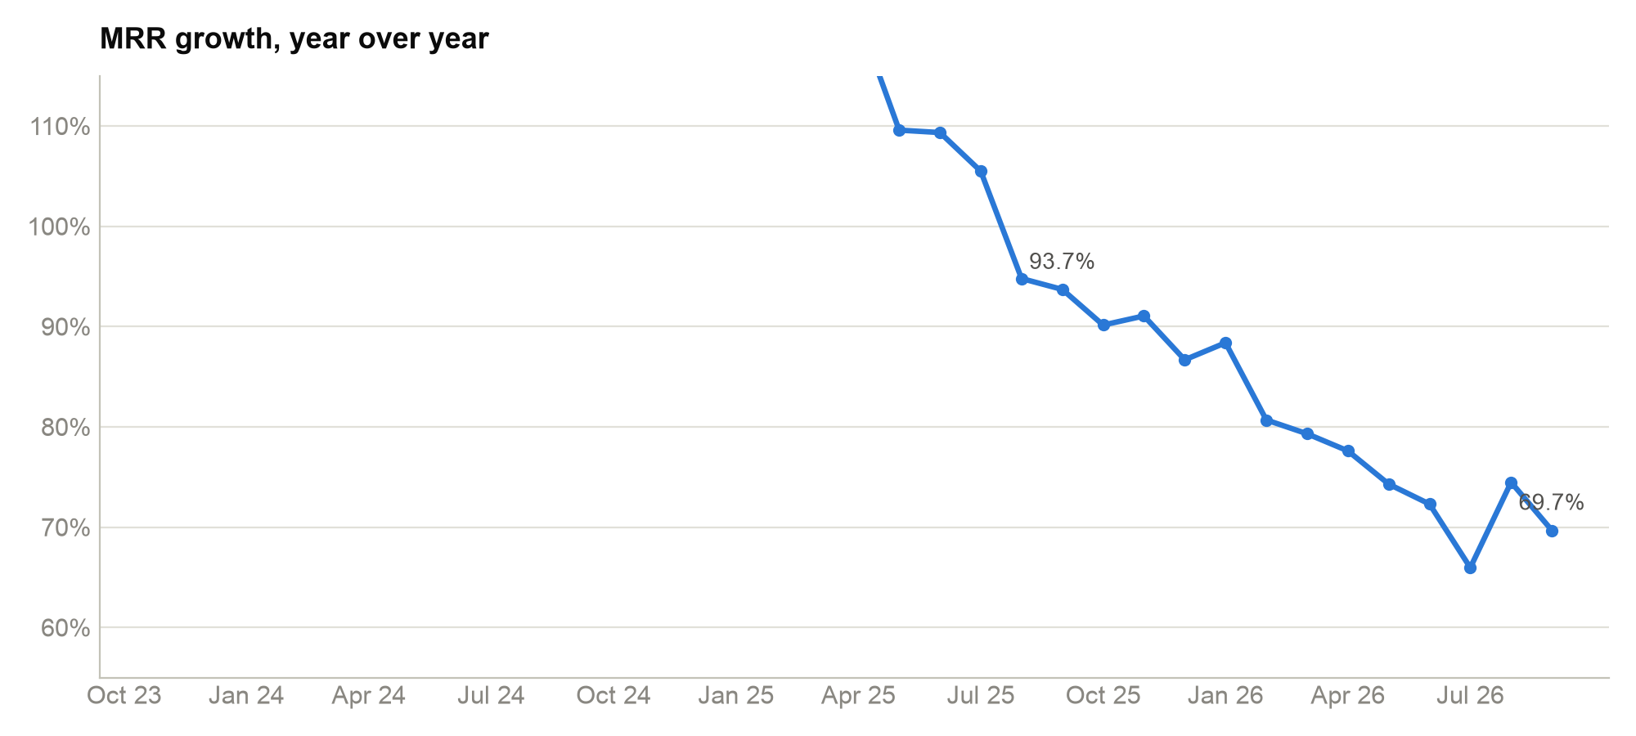
GROWTH
Growth is decelerating off a larger base — still ~70% YoY
• 69.7% YoY at Sep 2026
93.7% at Sep 2025 — expected as the base scales
• Absolute adds keep compounding
Last 12m added $73.4k MRR vs $51.0k the prior year
• Growth stays efficient
S&M = 29.5% of TTM revenue
• Rule-of-40 proxy ≈ 117
69.7% YoY growth + 47.6% contribution margin (after COGS & S&M)
• Watch
Further moderation in 2027 as ARR base compounds
Bluebell SaaS Pte Ltd · Investor Update · data through 30 Sep 2026
4

Slide 5
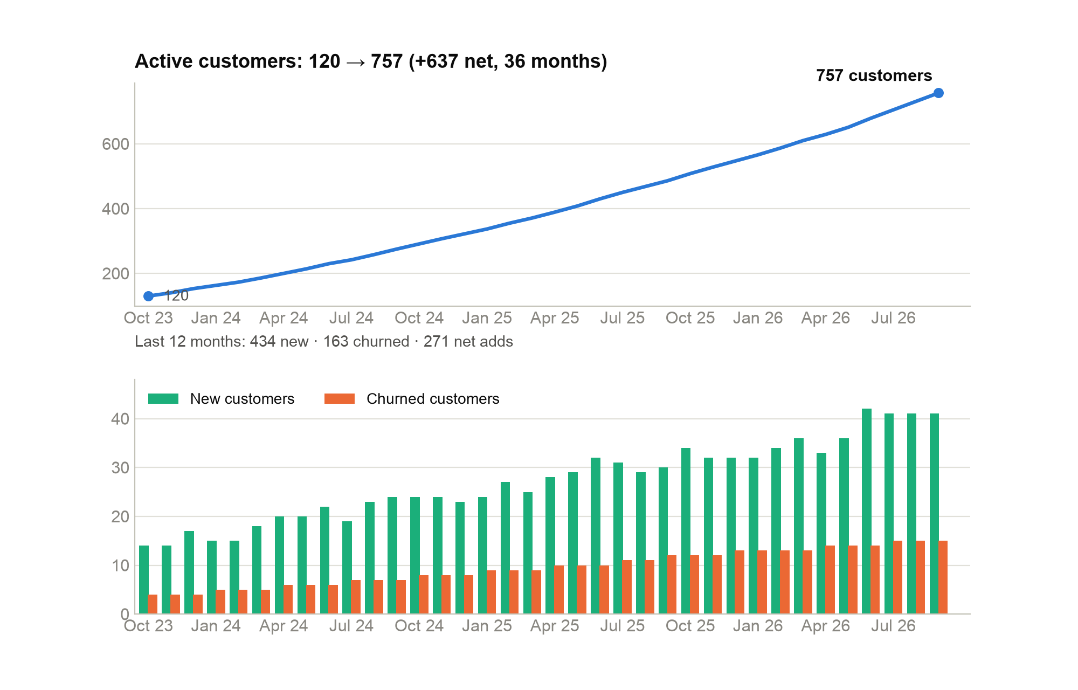
CUSTOMER BASE
120 → 757 customers; churn rate nearly halved
• 981 new customers, 344 churned
36-month gross flows; 637 cumulative net adds (981 − 344)
• Last 12m: 434 new · 163 out
271 net adds TTM; 78 in Q3 alone
• Monthly logo churn 3.33% → 2.05%
Annualised logo retention ≈ 76%
• Acquisition accelerated in Q3
41 new logos in each of Jul/Aug/Sep — record run
• Data note
No expansion/contraction split in source data; MRR-based NRR not calculable
Bluebell SaaS Pte Ltd · Investor Update · data through 30 Sep 2026
5

Slide 6
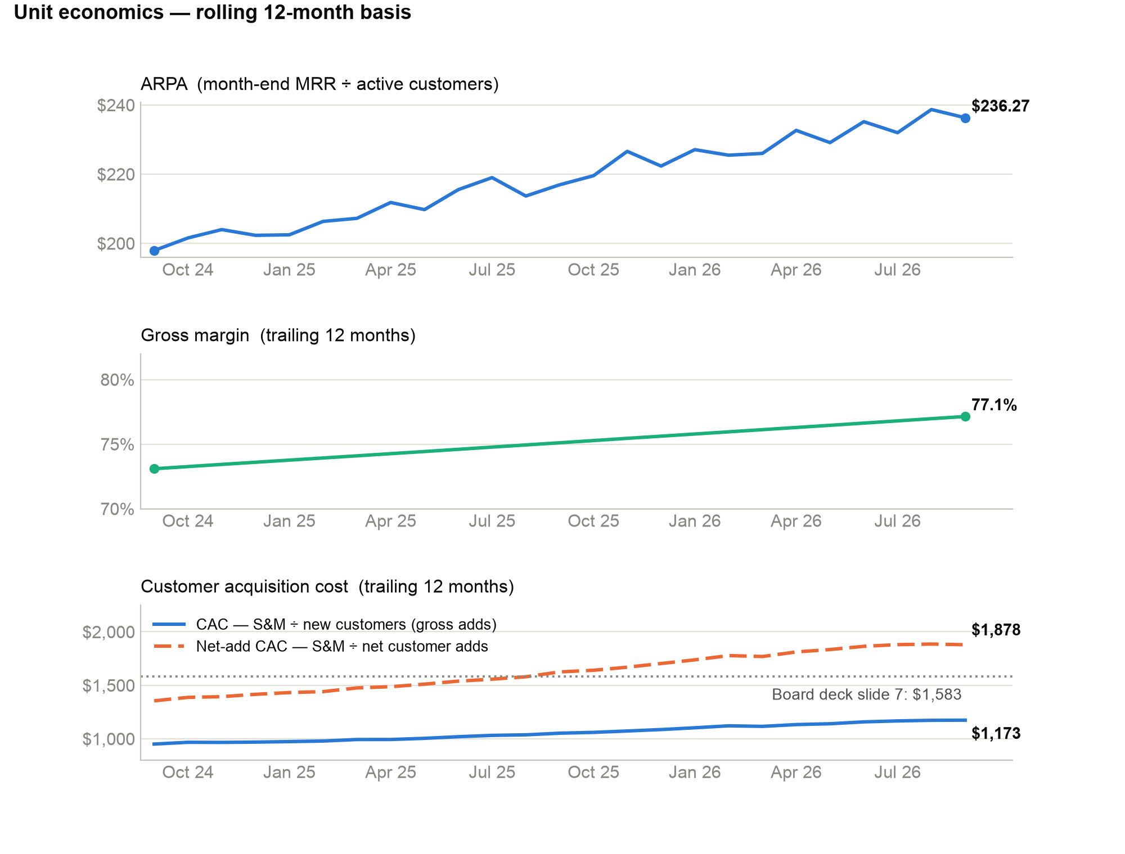
UNIT ECONOMICS
ARPA and gross margin rising; CAC stable near $1.2k
• ARPA $197.9 → $236.27 (TTM window)
Pricing/mix tailwind; +$1.14 QoQ vs Jun ($235.13)
• Gross margin 73.2% → 77.1%
TTM basis; 78.0% in September alone
• Headline CAC: $1,173
S&M ÷ GROSS new customers — standard definition
• Net-add CAC: $1,878 (dashed)
S&M ÷ net adds; NOT comparable — this is the basis behind the board's $1,583
• LTV $8,029
ARPA × GM ÷ avg monthly logo churn (2.27%)
Bluebell SaaS Pte Ltd · Investor Update · data through 30 Sep 2026
6

Slide 7
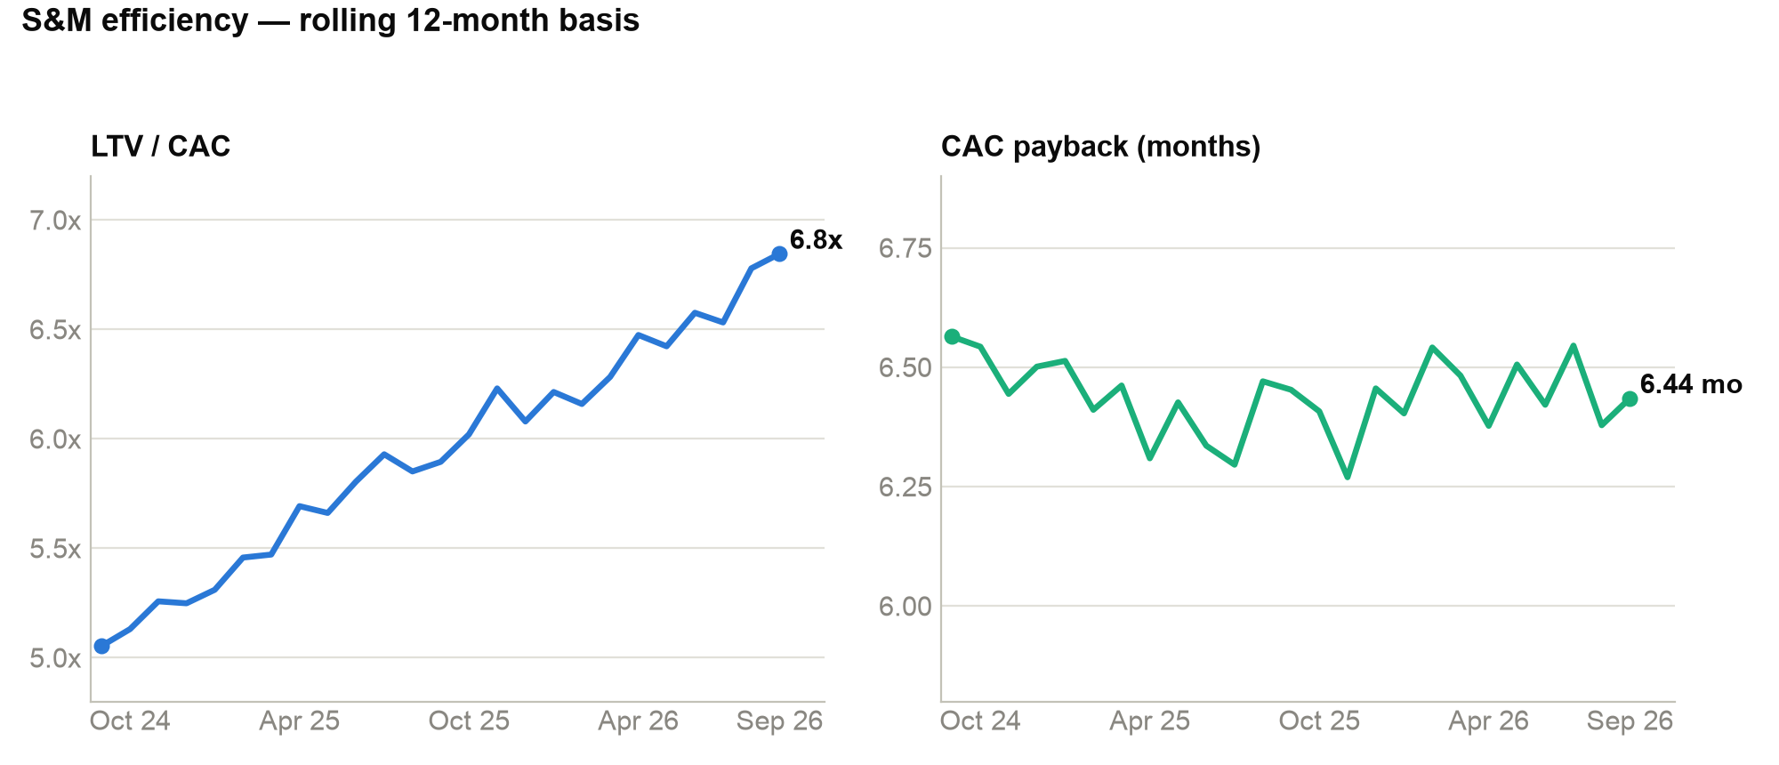
S&M EFFICIENCY
LTV/CAC improved from 5.1x to 6.8x; payback holds ~6.4 months
• LTV/CAC 5.1x → 6.8x
Rising ARPA & margin against broadly stable CAC
• Payback range-bound 6.3–6.55
Despite S&M rising to $509k TTM
• June spike absorbed
$53k S&M / 42 adds; efficiency recovered Jul–Sep
• ARR per employee $63.1k
Headcount 34 at Sep 2026; ratio improving with scale
• Bottom line
Every $1 of S&M is returning ~$6.85 of steady-state gross profit
Bluebell SaaS Pte Ltd · Investor Update · data through 30 Sep 2026
7

Slide 8
DATA INTEGRITY
Conflict check: prior board deck, slide 7 vs. current model
The Q2 board deck (“Source: finance model, end of Q2”) reported four unit-economics figures. Recomputed from the same source data:
Metric | Board deck | Recomputed (Sep 2026 / Jun 2026) | Assessment
ARPA | $236.27 | $236.27 / $235.13 | Matches Sep-2026 EXACTLY — not end-Q2. The slide is mislabeled: it carries a Q3 number.
CAC (TTM) | $1,583 | $1,173 / $1,157 | CONFLICT. Standard CAC (S&M ÷ gross new customers) is $1,173. $1,583 only appears as S&M ÷ NET adds around Aug 2025 ($1,579) — wrong denominator AND stale by a year.
LTV | $8,019.93 | $8,028.95 / $7,608.25 | Within ~$9 (0.1%) of the current-cut LTV; exact figure not reproducible under any window/method tested. End-Q2 was $7,608, so not a Q2 figure either.
Payback | 6.44 mo | 6.44 / 6.42 | Matches Sep-2026 EXACTLY. Internally inconsistent with the slide's own $1,583 CAC: 6.44 × $236.27 × 77.1% implies CAC ≈ $1,174.
Net: the $1,583 CAC should be corrected to $1,173 (gross-add basis) before external reuse. Full line-by-line math in the model, sheet “Slide7_Reconciliation”.
Bluebell SaaS Pte Ltd · Investor Update · data through 30 Sep 2026
8

Slide 9
APPENDIX
Methodology, assumptions and watch items
Definitions (trailing 12 months unless noted)
• ARPA = month-end MRR ÷ active customers
• Gross margin = (MRR − COGS) ÷ MRR
• Logo churn = churned ÷ beginning customers; LTV churn input = average of 12 monthly rates (2.27%)
• CAC = S&M ÷ gross new customers; payback = CAC ÷ (ARPA × gross margin)
• LTV = ARPA × gross margin ÷ monthly churn, undiscounted steady state
Assumptions & data caveats
• 120 customers at 30 Sep 2023 (given); rollforward ends at 757
• MRR treated as recognised monthly revenue; only COGS and S&M cost lines were provided — no payroll/other opex
• No expansion/contraction split: logo retention used; MRR NRR not calculable
• Every figure ties to Bluebell_Investor_Model.xlsx with live formulas (Notes sheet documents all inputs)
What we're watching
• Growth deceleration
69.7% YoY and moderating; the FY27 plan should assume a smaller growth rate off $2.15M ARR.
• Absolute churn volume
163 logos lost TTM even at a falling rate — retention work compounds on a 757 base.
• CAC discipline
Net-add CAC rose $1,624 → $1,878 over the last 12 months; gross-add CAC is roughly flat, but S&M efficiency must hold if adds keep accelerating.
• Reporting hygiene
Adopt one CAC definition (gross adds) across board and investor materials; correct the Q2 deck's $1,583.
Bluebell SaaS Pte Ltd · Investor Update · data through 30 Sep 2026
9

