Slide 1
BLUEBELL SaaS PTE LTD
Investor Update
Financial & Unit-Economics Review | FY24–FY26 (36 months)
Reporting period: October 2023 – September 2026 • Prepared 11 September 2026

Slide 2
Executive Summary
Key metrics as of September 2026
$178,857
757
77.1%
$1,172.91
MRR (latest month)
Active customers
Gross margin (12-mo avg)
CAC (12-mo trailing)
$8,019.93
6.84
6.44 mo
2.27%
LTV
LTV / CAC
CAC payback
Monthly churn (12-mo avg)
Highlights
• MRR grew from $22,955 (Oct-23) to $178,857 (Sep-26) — a 7.8x increase over 36 months.
• Active customer base expanded from 120 to 757, with consistently low monthly churn (~2.3% trailing 12).
• Healthy unit economics: LTV/CAC of 6.84 and CAC payback of 6.44 months.
• Gross margin improved steadily from 72.0% to 78.0% and averages 77.1% over the trailing 12 months.
Bluebell SaaS Pte Ltd | Investor Update
Confidential
2

Slide 3
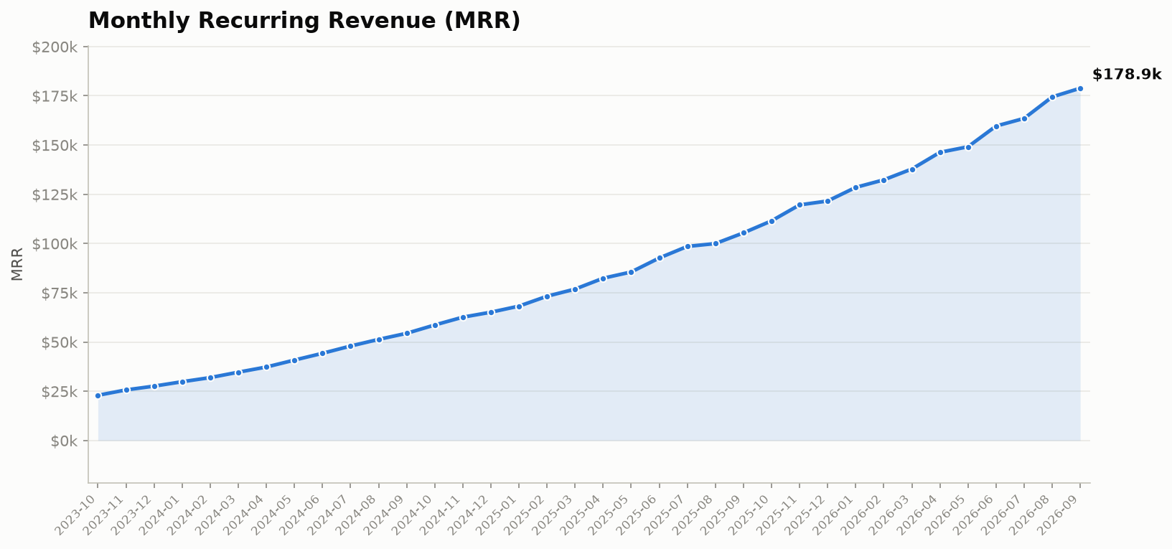
MRR Trend
Monthly recurring revenue, Oct 2023 – Sep 2026
At a glance
• Latest MRR: $178,857.07
• 36-month growth: 7.8x
• Trailing-12 revenue: $1,723,316
• Compound monthly growth
over the period: ~6.0%
MRR expanded every single month
without a sequential decline,
reflecting durable net revenue
retention and consistent new
logo acquisition.
Bluebell SaaS Pte Ltd | Investor Update
Confidential
3

Slide 4
Gross Margin & Cost Structure
Latest month (Sep 2026) and 12-month averages
Latest month cost structure (Sep 2026)
Gross margin trajectory
Line item | Amount | % of MRR
MRR | $178,857.07 | 100.0%
COGS | $39,348.56 | 22.0%
Gross profit | $139,508.51 | 78.0%
Sales & marketing spend | $48,686.47 | 27.2%
Headcount | 34 | —
• Latest-month gross margin: 78.0%
• First-month gross margin (Oct-23): 72.0%
• Trailing-12 average gross margin: 77.06%
• Improvement of ~6.0 pts over the period as
COGS scaled sub-linearly with MRR.
• Monthly churn (trailing-12 avg): 2.27%
• Sales & marketing remains the largest
discretionary cost line at ~27% of MRR.
Cost structure has become progressively more efficient: COGS as a share of MRR fell from 28.0% to 22.0%, widening gross profit available for growth investment.
Bluebell SaaS Pte Ltd | Investor Update
Confidential
4

Slide 5
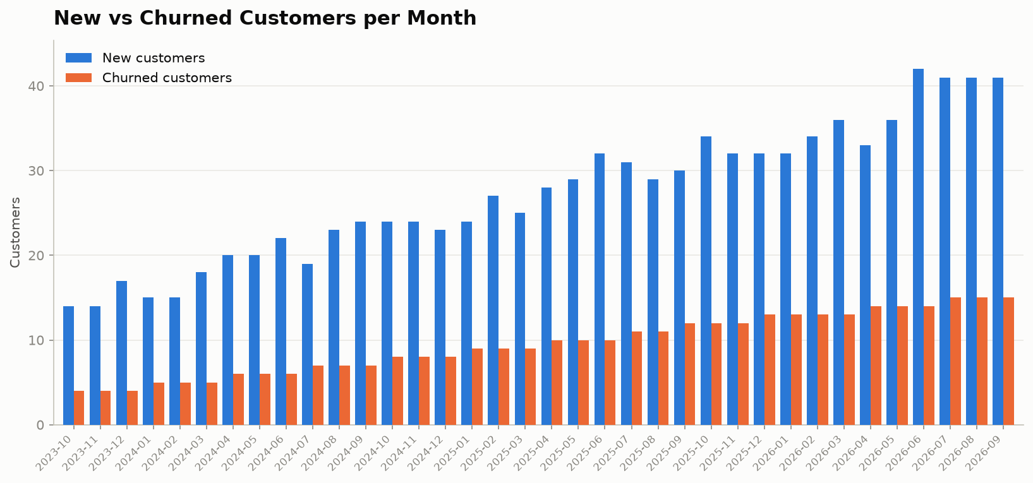
Customer Growth
New vs churned customers per month
At a glance
• Active customers: 120 → 757
• Net adds over period: +637
• Trailing-12 monthly churn
avg: 2.27%
• New-customer acquisition
accelerated in FY26, peaking
at 42 net adds in Jun-26.
Churn stayed within a tight 2–3%
monthly band, keeping net growth
strongly positive throughout.
Bluebell SaaS Pte Ltd | Investor Update
Confidential
5

Slide 6
Unit Economics
As of September 2026 (trailing 12 months)
Metric | Value | Definition
CAC (trailing 12 months) | $1,172.91 | Sum of S&M spend / sum of new customers, last 12 mo
LTV | $8,019.93 | ARPA × avg gross margin / avg monthly churn
LTV / CAC | 6.84 | LTV divided by CAC
CAC payback (months) | 6.44 | CAC / (ARPA × avg gross margin, 12 mo)
ARPA | $236.27 | Latest-month MRR / latest-month active customers
Average gross margin (12 mo) | 77.06% | Mean monthly (MRR−COGS)/MRR, last 12 mo
Average monthly churn (12 mo) | 2.27% | Mean churned / prior active, last 12 mo
LTV/CAC of 6.84 and CAC payback of 6.44 months indicate capital-efficient growth: each dollar of customer acquisition cost is repaid in roughly six and a half months and returns ~6.8x over the customer lifetime.
Bluebell SaaS Pte Ltd | Investor Update
Confidential
6

Slide 7
DCF Valuation Overview
5-year FCF model — assumptions and output
Assumptions
5-year FCF line
Assumption | Value
Revenue, Year 0 (sum last-12 MRR) | $1,723,316
Growth Y1–Y5 | 25% / 21% / 17% / 13% / 10%
FCF margin Y1–Y5 | 15% / 17.5% / 20% / 22.5% / 25%
Discount rate | 12.0%
Initial investment (Year 0) | ($5,000,000)
Year | Revenue | Growth | FCF margin | FCF
Year 1 | $2,154,145 | 25% | 15.0% | $323,122
Year 2 | $2,606,516 | 21% | 17.5% | $456,140
Year 3 | $3,049,623 | 17% | 20.0% | $609,925
Year 4 | $3,446,074 | 13% | 22.5% | $775,367
Year 5 | $3,790,682 | 10% | 25.0% | $947,670
NPV (5-yr FCF incl. Year 0, no terminal value)
IRR
$-2,883,241
-12.29%
Note: the model deliberately excludes a terminal value. Without one, the 5-year FCF stream does not recover the $5M Year-0 investment (negative NPV/IRR); this frames the valuation floor. See the model.xlsx 'dcf' sheet for live formulas.
Bluebell SaaS Pte Ltd | Investor Update
Confidential
7

Slide 8
Use of Funds
Proposed $2.0M growth facility
A 60-month, 7% p.a. term loan (principal $2,000,000) to fund the next phase of growth:
Allocation | Share | Amount | Rationale
Sales & marketing expansion | 40% | $800,000 | Accelerate new-logo acquisition and expand the SDR/AE team.
Product & engineering | 30% | $600,000 | Platform scalability, integrations, and gross-margin-protecting automation.
Customer success & retention | 15% | $300,000 | Onboarding and CS headcount to protect the sub-2.5% monthly churn.
Working capital & buffer | 15% | $300,000 | Operating reserve to absorb ramp and timing variability.
Loan terms
• Principal: $2,000,000 • Annual rate: 7% • Term: 60 equal monthly payments
• Monthly payment: $39,602.40 • Total interest over life: $376,143.82
• Full amortization schedule in model.xlsx 'loan' sheet (60 rows, ending balance → 0).
Bluebell SaaS Pte Ltd | Investor Update
Confidential
8

Slide 9
Appendix — Assumptions & Reconciliation
All assumptions stated; board-deck reconciliation
Assumptions
• Active-customer roll-forward starts at 120 (Oct-23); each month = prior active + new − churned.
• Gross margin = (MRR − COGS) / MRR, per month.
• Monthly churn = churned customers / prior-month active customers.
• CAC (trailing 12) = Σ sales & marketing spend / Σ new customers, over the trailing 12 months.
• ARPA = latest-month MRR / latest-month active customers.
• LTV = ARPA × (avg gross margin, 12 mo) / (avg monthly churn, 12 mo).
• CAC payback = CAC / (ARPA × avg gross margin, 12 mo).
• DCF Revenue Year 0 = Σ MRR over the last 12 months.
• DCF growth Y1–Y5 = 25%, 21%, 17%, 13%, 10%; FCF margin Y1–Y5 = 15%, 17.5%, 20%, 22.5%, 25%.
• DCF discount rate = 12%; Year-0 investment = −$5,000,000; no terminal value included.
• Loan: principal $2,000,000; 7% p.a.; 60 equal monthly payments; standard amortization.
• All Excel figures are live formulas in model.xlsx (sheets: raw, unit_economics, dcf, loan) — no pasted numbers.
Reconciliation vs. last board deck (slide 7, "end of Q2")
Board deck stated: CAC $1,583, LTV $8,019.93, CAC payback 6.44, ARPA $236.27. LTV, CAC payback and ARPA reconcile to this update. CAC conflicts: deck shows $1,583; recomputed (trailing-12 Σ S&M / Σ new customers) = $1,172.91 — corrected value used throughout. (The deck's $1,583 does not match any 12-month CAC window in the underlying data.)
Bluebell SaaS Pte Ltd | Investor Update
Confidential
9

