Slide 1
BLUEBELL SaaS
Investor Update
36-month operating review · Oct 2023 – Sep 2026
Prepared 10 September 2026 · Figures in USD · Confidential

Slide 2
Executive summary
2
The numbers that matter, as of Sep-2026
MRR
Active customers
TTM revenue
Rule of 40
$178,857
757
$1.7M
125%
+679% over 36 months
130 → 757
+78% YoY
Growth 78% + margin 48%
Gross margin
Net revenue retention
LTV : CAC
Monthly contribution
78.0%
~98%
7.7x
$90,822
+5.7pp vs start
Churn 2.1% / month
Payback 6.4 months
Profitable every month
What the board should take away
• Scaling efficiently. MRR grew from $23K to $179K (+679%) over 36 months while gross margin expanded from 72% to 78% — growth and margin improving together.
• Unit economics are strong and durable. LTV:CAC of 7.7x and 6.4-month payback have held above the 3x threshold for 2+ years; CAC is stable around $1.1–1.2K.
• Rule of 40 at 125% (78% growth + 48% contribution margin) puts the business well above the benchmark for SaaS at this stage.
• Self-sustaining at the contribution line. No month in the period had negative contribution profit; S&M is funded out of gross profit.
Bluebell SaaS · Investor Update · Sep 2026 · Confidential

Slide 3
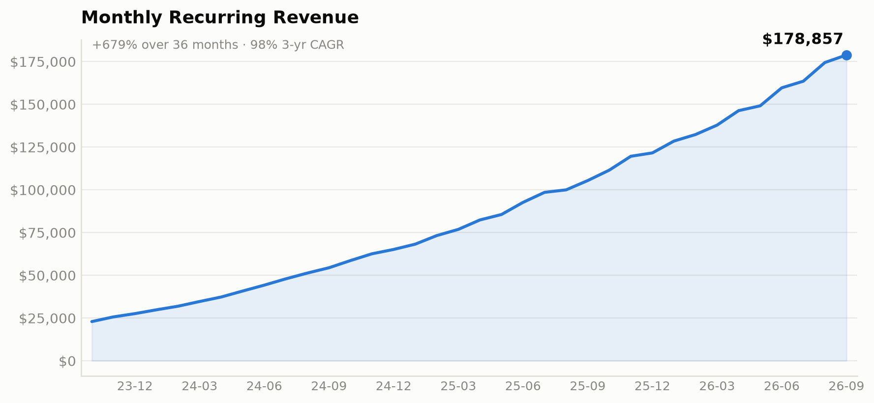
Revenue: durable, accelerating growth
3
TTM revenue $1.7M · 78% YoY · 98% 3-yr CAGR
Revenue at a glance
TTM revenue
$1,723,316
Monthly MRR
$178,857
YoY growth
+78%
3-yr CAGR
98%
ARPA
$236.27
MRR / FTE
$5,261
Headcount
34
MRR slope has steepened through 2026 — the last quarter added $47K MRR, the strongest in the period.
Bluebell SaaS · Investor Update · Sep 2026 · Confidential

Slide 4
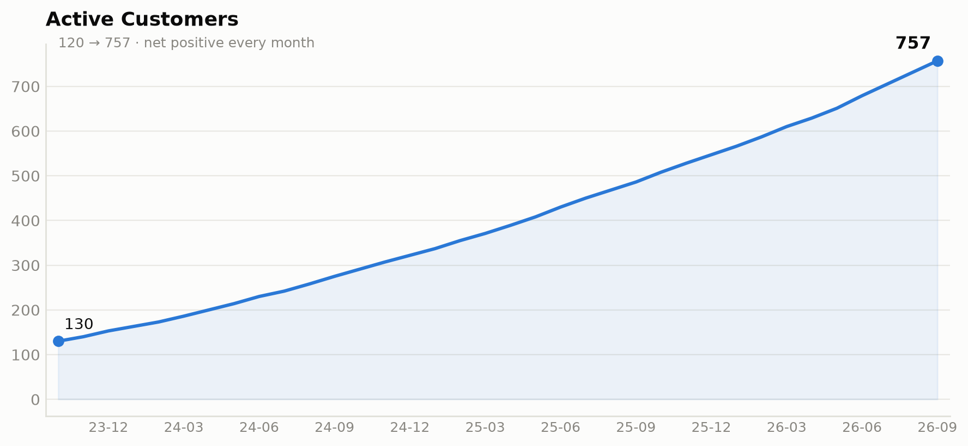
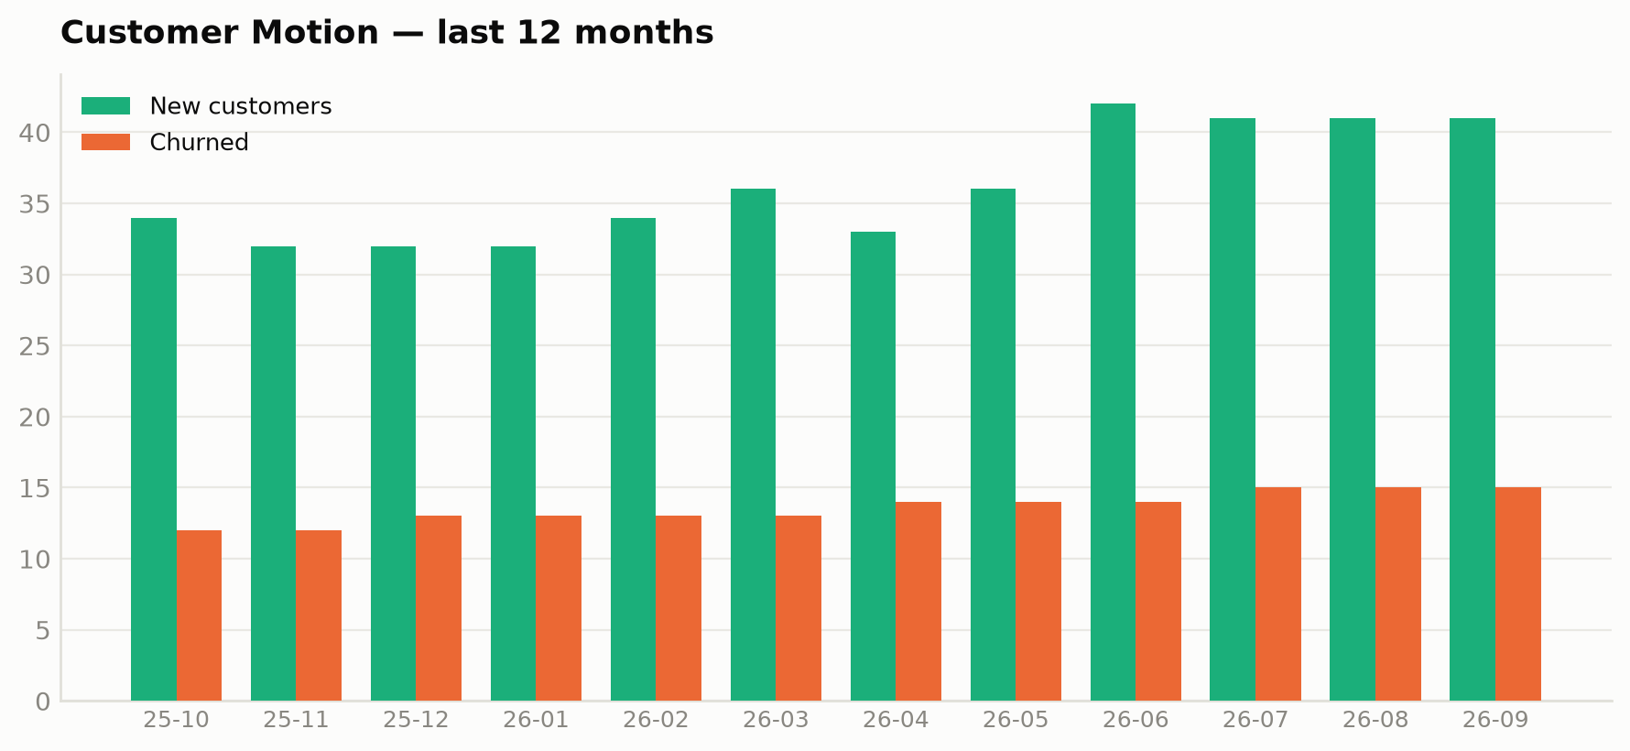
Customer base: compounding with low churn
4
120 → 757 customers · 2.1% monthly churn
Net positive every month. New logos outpaced churn in all 36 months. Monthly churn has trended down from ~2.9% to ~2.1% as the base matured, so net adds have accelerated — the last 12 months added 318 customers net, more than the prior 24 combined.
Bluebell SaaS · Investor Update · Sep 2026 · Confidential

Slide 5
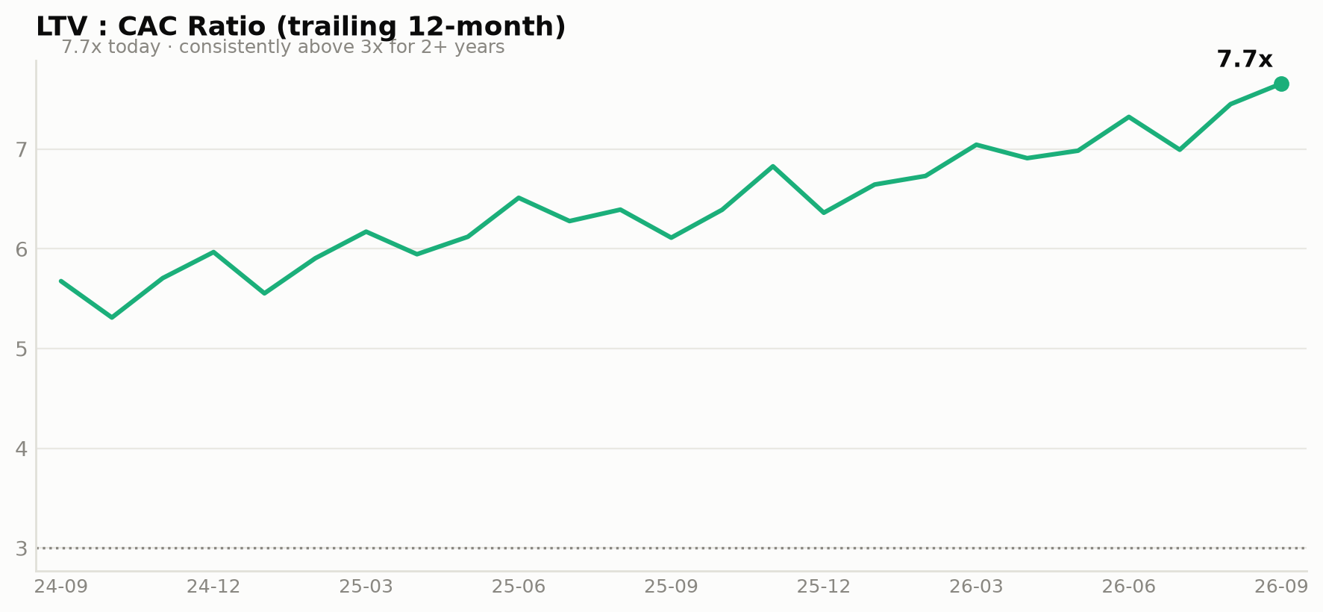
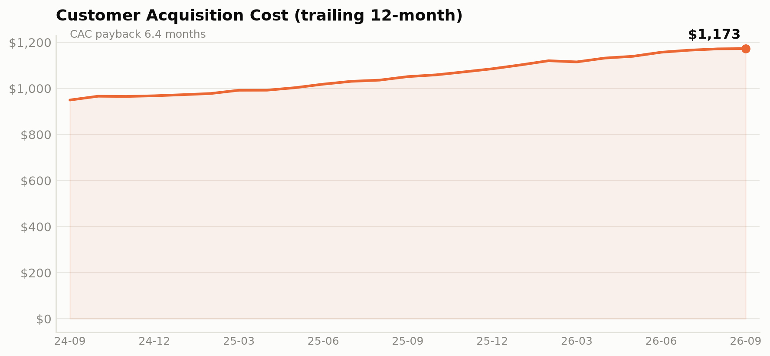
Unit economics: efficient, well above threshold
5
LTV:CAC 7.7x · payback 6.4 months · CAC $1,173
Unit economics
LTV
$8,981
CAC (TTM)
$1,173
LTV : CAC
7.7x
CAC payback
6.4 months
ARPA
$236.27
Gross margin
78.0%
Monthly churn
2.1%
Gross churn / new
Healthy
CAC has been stable around $1.1–1.2K for two years despite rising ad spend, a sign of efficient, scalable acquisition.
Bluebell SaaS · Investor Update · Sep 2026 · Confidential

Slide 6
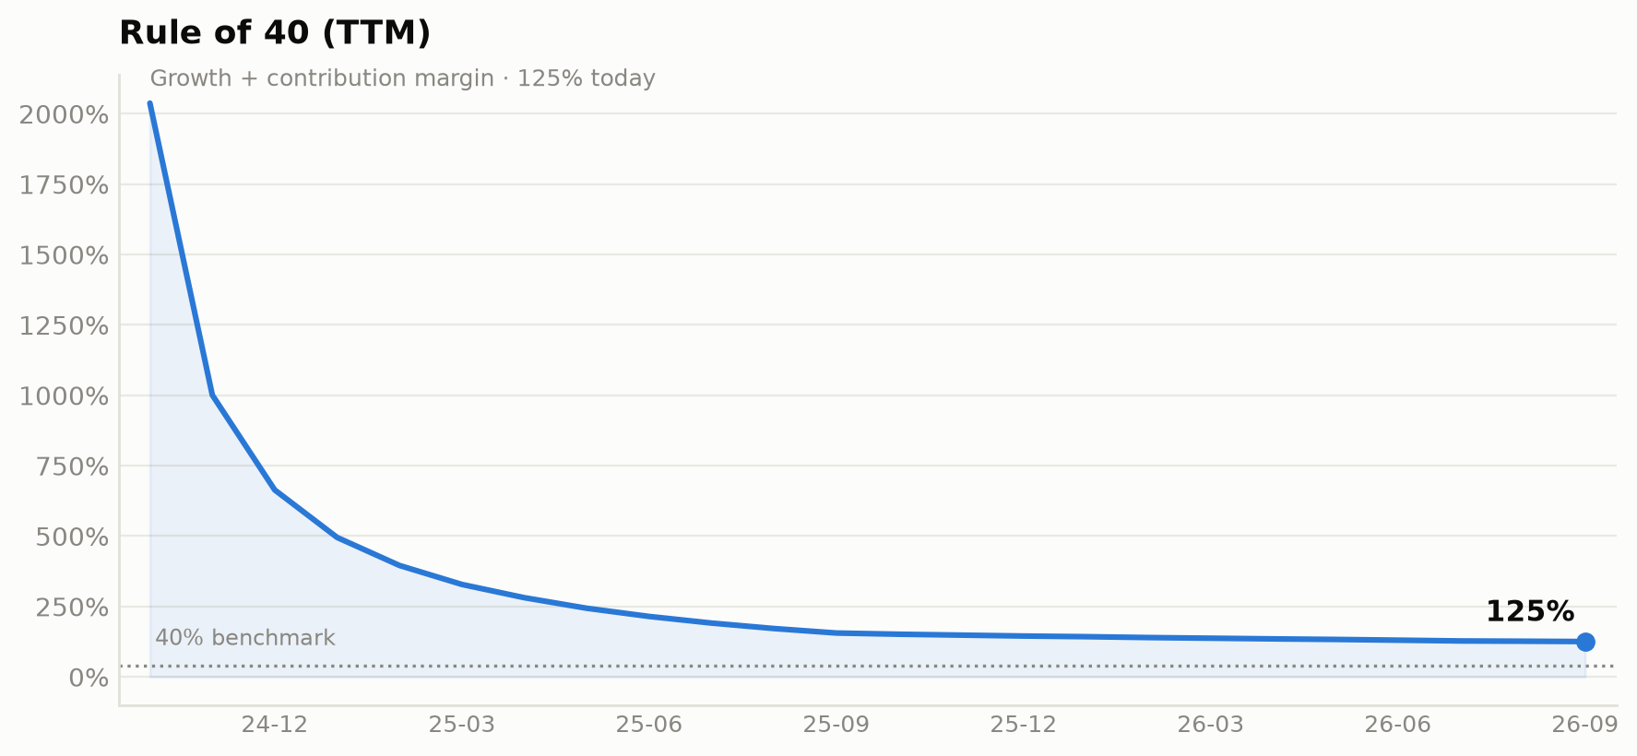
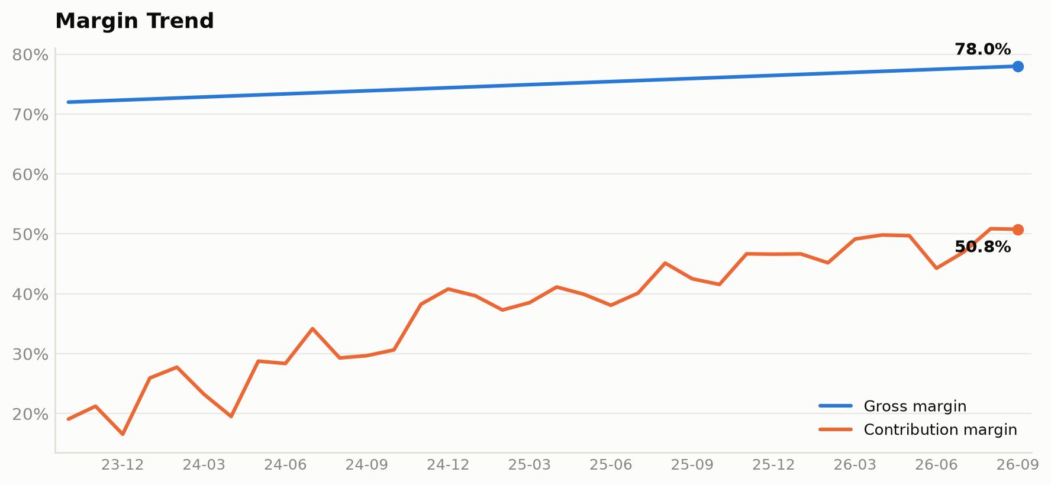
Rule of 40: 125% — growth + margin together
6
78% growth + 48% contribution margin (TTM)
Growth and margin are not trading off. Gross margin expanded ~5.7pp to 78% while revenue nearly 8x'd, and contribution margin held at 48% — the business funds its own growth spend. Every month in the period was contribution-positive.
Bluebell SaaS · Investor Update · Sep 2026 · Confidential

Slide 7
Data callout: last quarter's board deck (slide 7)
7
Three of four figures do not reproduce from source — flag before sending
Metric
Board deck (slide 7)
This model (Jun-2026)
Δ
Status
CAC (TTM)
$1,583
$1,157
−$426
Does not tie to any trailing window in the data
LTV
$8,019.93
$7,743
−$277
Falls between the two standard churn methods
CAC payback
6.44 mo
6.35 mo
−0.09 mo
Minor; consistent with the churn-method difference
ARPA
$236.27
$235.13
+$1.14
$236.27 is the Sep-2026 figure, not Jun-2026
Recommendation
Re-cut slide 7 against this model before the investor update goes out. The ARPA figure ($236.27) matches Sep-2026, not the Jun-2026 the slide labels — the deck appears to mix period labels. The CAC of $1,583 does not reproduce under any standard trailing window on the source data. See the Reconciliation tab in the accompanying model for the full side-by-side.
Bluebell SaaS · Investor Update · Sep 2026 · Confidential

Slide 8
Outlook: next 6 months (directional)
8
Projections — not guidance · assumptions in the model
Projected MRR (Mar-27)
Projected customers
Projected ARR (annualized)
CAC payback
~$225K
~892
~$2.7M
~6.4 mo
+25% vs Sep-26
~+135 in 6 mo
vs $2.15M today
Held flat
Assumptions
• MRR: 3-month linear trend ($8.6K/month increment) extrapolated.
• Churn: 12-month trailing average (~2.3%) held constant on the growing base.
• New customers: prior 3-month average (~38/month) held constant.
• S&M: scales with MRR at the 12-month trailing ratio.
• Gross margin: held at the 12-month trailing average (~77%).
These are mechanical projections of recent trends, not committed guidance. Refresh inputs on the Projections tab of the model before circulating externally.
Bluebell SaaS · Investor Update · Sep 2026 · Confidential

Slide 9
THE ASK
Scale the engine that's already working.
125% Rule-of-40 · 7.7x LTV:CAC · 78% YoY growth — fund the growth, not a turnaround.
Supporting model: Bluebell_Financial_Model.xlsx · Reconciliation tab documents the slide-7 discrepancies.

