Slide 1
Bluebell SaaS Pte Ltd
Investor Update
36 months to 2026-09 · prepared 2026-09
$2,146,285
$178,857
757
78.00%
ARR (last month MRR x 12), 2026-09
MRR, 2026-09
Active customers (from 120)
Gross margin, last month
MRR up 69.68% over the last 12 months; 6.31x active customers since the period opened at 120.
LTV/CAC 6.84x with 6.44-month CAC payback — efficient growth, not bought growth.
All figures tie to out/model.xlsx, where every metric is a live formula over the raw monthly data.
Source: out/model.xlsx (live formulas) · data/financials.xlsx
1

Slide 2
Where the business stands
Trailing 12 months, 2025-10 to 2026-09
$1,723,316
77.14%
6.84x
2.27%
Revenue, last 12 months
Blended gross margin, last 12m
LTV / CAC
Average monthly logo churn
Metric | Last 12 months | Comment
Revenue | $1,723,316.18 | Sum of monthly MRR
Gross profit | $1,329,431.63 | 77.14% blended margin
Sales & marketing | $509,044.99 | 29.54% of revenue
Gross profit after S&M | $820,386.64 | 47.61% of revenue
New customers | 434 | 163 churned, 271 net adds
Headcount (period end) | 34 | $5,260.50 MRR per employee
Source: out/model.xlsx (live formulas) · data/financials.xlsx
2

Slide 3
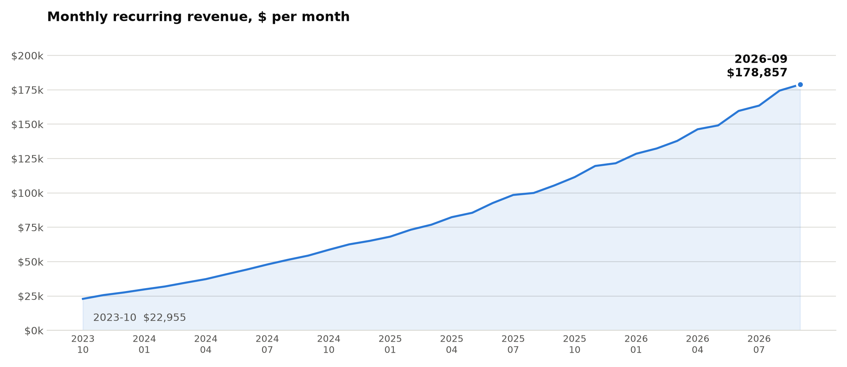
MRR trend
Monthly recurring revenue, 2023-10 to 2026-09
MRR grew from $22,955.41 to $178,857.07 — 69.68% in the last 12 months alone, with no down month in 36.
Source: out/model.xlsx (live formulas) · data/financials.xlsx
3

Slide 4
Gross margin & cost structure
Last 12 months, 2025-10 to 2026-09
78.00%
77.14%
29.54%
$5,260.50
Gross margin, last month
Blended gross margin, 12m
S&M as % of revenue, 12m
MRR per employee
Line item | Last 12 months | % of revenue
Revenue | $1,723,316.18 | 100.00%
Cost of goods sold | $393,884.55 | 22.86%
Gross profit | $1,329,431.63 | 77.14%
Sales & marketing | $509,044.99 | 29.54%
Gross profit after S&M | $820,386.64 | 47.61%
What drives it
Gross margin has widened from 72.00% in 2023-10 to 78.00% — COGS is now 22.00% of MRR.
S&M is the dominant discretionary cost at 29.54% of revenue and is what the round scales.
Headcount 34, carrying $5,260.50 of MRR per employee.
Source: out/model.xlsx (live formulas) · data/financials.xlsx
4

Slide 5
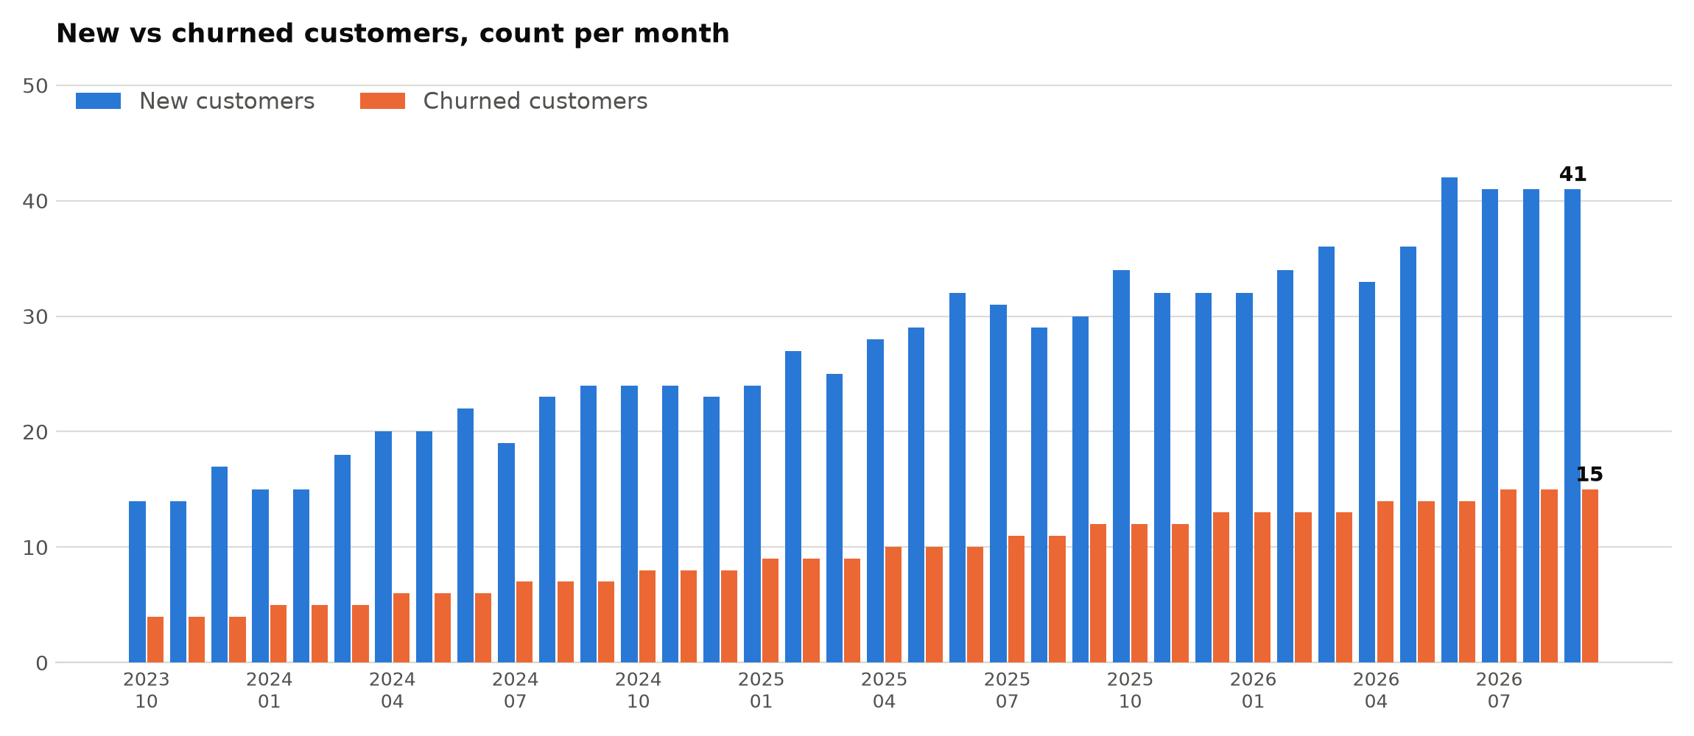
Customer growth
New vs churned customers per month, 2023-10 to 2026-09
434 customers added and 163 lost in the last 12 months — 271 net adds, taking the base to 757.
Source: out/model.xlsx (live formulas) · data/financials.xlsx
5

Slide 6
Retention & churn
Logo churn against the prior month's active base
2.27%
2.05%
75.91%
757
Avg monthly churn, last 12m
Monthly churn, 2026-09
Implied annual logo retention
Active customers
Measure | Value | Basis
Monthly churn, first month | 3.33% | 2023-10, on the opening base of 120
Monthly churn, last month | 2.05% | 2026-09, on the prior month's active base
Average monthly churn, 12m | 2.27% | Simple average of the last 12 monthly rates
Implied annual retention | 75.91% | (1 - average monthly churn) ^ 12
Net customer adds, 12m | 271 | 434 new less 163 churned
Churn is falling as the base grows: the absolute number of churned logos is up, but the monthly rate is down from 3.33% to 2.05% since the period opened.
Source: out/model.xlsx (live formulas) · data/financials.xlsx
6

Slide 7
Unit economics
Trailing 12 months to 2026-09; ARPA measured on the last month
Metric | Value | How it is calculated
CAC (trailing 12 months) | $1,172.91 | $509,044.99 S&M / 434 new customers
LTV | $8,019.93 | ARPA x 77.06% avg gross margin / 2.27% avg churn
LTV / CAC | 6.84x | $8,019.93 / $1,172.91
CAC payback (months) | 6.44 | CAC / $182.06 gross profit per account per month
ARPA | $236.27 | $178,857.07 MRR / 757 active customers
Payback in 6.44 months against a 6.84x LTV/CAC: each dollar of S&M is recovered inside two quarters and returns roughly 6.8x over the life of the account.
LTV is undiscounted and assumes churn stays at 2.27% a month; treat it as the ceiling, and the 6.44-month payback as the number to underwrite.
Source: out/model.xlsx (live formulas) · data/financials.xlsx
7

Slide 8
Use of funds
Allocation of the $5,000,000 round
Category | % of round | Amount
Sales & marketing — scale the engine | 45.0% | $2,250,000.00
Product & engineering | 30.0% | $1,500,000.00
G&A, finance and compliance | 12.0% | $600,000.00
Working capital buffer | 13.0% | $650,000.00
Total | 100.0% | $5,000,000.00
Why this split
S&M is the largest line because payback is 6.44 months — the constraint is capital, not demand.
At today's CAC of $1,172.91, $2,250,000 of S&M funds roughly 1,918 new customers.
Product spend defends the gross margin; the buffer covers 12 months of working capital swings.
Financing alongside the round
Debt facility | Value
Principal at 7.00% annual, 60 months | $2,000,000.00
Equal monthly payment | $39,602.40
Total interest over the term | $376,143.82
Source: out/model.xlsx (live formulas) · data/financials.xlsx
8

Slide 9
Five-year plan & returns
Revenue year 0 = last 12 months of MRR; no terminal value
Year | Growth | Revenue | FCF margin | Free cash flow | Net cash flow
Year 0 | - | $1,723,316 | - | - | -$5,000,000
Year 1 | 25.0% | $2,154,145 | 15.0% | $323,122 | $323,122
Year 2 | 21.0% | $2,606,516 | 17.5% | $456,140 | $456,140
Year 3 | 17.0% | $3,049,623 | 20.0% | $609,925 | $609,925
Year 4 | 13.0% | $3,446,074 | 22.5% | $775,367 | $775,367
Year 5 | 10.0% | $3,790,682 | 25.0% | $947,670 | $947,670
-$2,883,241
-12.29%
$3,112,224
$39,602.40
NPV @ 12%, no terminal value
IRR on the year 0-5 cash flows
Undiscounted FCF, years 1-5
Monthly loan payment
Read this as a floor, not a valuation: with no terminal value the $5,000,000 investment is measured against five years of cash flow only, which is why NPV is -$2,883,241 and IRR -12.29%. The business is worth what happens after year 5.
Source: out/model.xlsx (live formulas) · data/financials.xlsx
9

Slide 10
Appendix — assumptions
Every assumption behind the numbers in this deck
1. Opening base: 120 active customers immediately before 2023-10; active customers = prior month + new - churned, compounded monthly.
8. 12-month averages are simple monthly averages, not revenue-weighted. This is why average monthly gross margin (77.06%) differs slightly from blended 12-month margin (77.14%).
2. Period: 36 monthly rows, 2023-10 to 2026-09. “Last 12 months” means 2025-10 to 2026-09 (rows 26:37 of the raw sheet).
9. CAC payback = CAC / (ARPA x average gross margin 12m): gross-margin-adjusted, undiscounted.
3. Gross margin = (MRR - COGS) / MRR, using COGS as reported; no headcount or overhead is allocated into COGS.
10. DCF: revenue year 0 = sum of the last 12 months of MRR ($1,723,316.18); growth 25/21/17/13/10%; FCF margin 15.0/17.5/20.0/22.5/25.0%; discount rate 12%; investment -$5,000,000.00 at year 0.
4. Monthly churn = churned customers / the prior month's active base (logo churn, not revenue churn). The first month is measured against the 120 opening base.
11. The DCF carries NO terminal value and assumes year-end cash flows. NPV = NPV(12%, years 1-5) + the year-0 investment; IRR is taken on the year 0-5 net cash flow line.
5. CAC = trailing-12-month S&M spend / trailing-12-month new customers ($509,044.99 / 434). All S&M is treated as acquisition cost, with no lag between spend and signup.
12. Loan: $2,000,000 at 7.00% nominal annual, compounded monthly (0.5833%), 60 equal payments in arrears, no fees, no prepayment.
6. ARPA = last month's MRR / last month's active customers (2026-09), so it is a point-in-time figure, not a 12-month average.
13. Use of funds (45/30/12/13) is a planning allocation of the $5,000,000 year-0 investment, not committed spend.
7. LTV = ARPA x average gross margin (12m) / average monthly churn (12m). No discounting, no expansion revenue and no cap on customer life - it is an upper bound.
14. All amounts are USD. The model holds unrounded values; slides round to two decimals, so columns may not re-add exactly on screen.
Source: out/model.xlsx (live formulas) · data/financials.xlsx
10

Slide 11
Appendix — reconciliation with last quarter's board deck
data/last_board_deck_slide7.png, “Q2 Board Update — Unit Economics”
Metric | Board deck, slide 7 | This update | Status
CAC (trailing 12 months) | $1,583.00 | $1,172.91 | CONFLICT — corrected here
LTV | $8,019.93 | $8,019.93 | Matches
CAC payback (months) | 6.44 | 6.44 | Matches
ARPA | $236.27 | $236.27 | Matches
The conflict: CAC
Last quarter's slide 7 shows CAC of $1,583. Recomputed from the same definition — trailing-12-month S&M of $509,044.99 over 434 new customers — CAC is $1,172.91.
The old figure is also inconsistent with its own slide: 6.44 months of payback x $182.06 of monthly gross profit per account implies a CAC of about $1,172, not $1,583.
Consequence: LTV/CAC is 6.84x, not 5.07x. LTV, CAC payback and ARPA on the old slide all reconcile exactly and are unchanged.
Source: out/model.xlsx (live formulas) · data/financials.xlsx
11

