Slide 1
Investor Update
Bluebell SaaS Pte Ltd · 36 months to Sep-2026
ARR
CUSTOMERS
GROSS MARGIN
CAC PAYBACK
$2.15M
757
78%
6.4 mo
+70% year on year
from 120 at period start
up from 72% in Oct-2023
LTV:CAC of 6.9x
Prepared from the 36-month financial extract. One figure on slide 7 of last quarter's board deck does not reconcile to this data — the correction is on slide 9.
Source: data/financials.xlsx · supporting model: bluebell_saas_model.xlsx
1

Slide 2
The numbers that matter
All figures as at Sep-2026; trailing-twelve-month basis where marked
ARR
YOY GROWTH
NET REVENUE / CUSTOMER
LOGO CHURN (TTM)
$2.15M
+70%
$236
2.26%/mo
MRR $179k
7.8x over 36 months
+34% since Oct-2023
~27% annualised
CAC (TTM)
LTV
LTV : CAC
MAGIC NUMBER
$1,173
$8,081
6.9x
1.72
S&M / new logos
44-month implied life
target 3.0x
target 0.75
Growth is holding at scale. ARR compounded from $0.28M to $2.15M with no quarter below +12% QoQ; the last twelve months added $0.88M of net new ARR.
Efficiency is improving, not decaying. Gross margin widened 72% → 78%, logo churn fell 3.3% → 2.1% per month, and payback has sat between 6.3 and 6.6 months for two years while spend more than doubled.
The constraint is data, not performance. The extract carries no R&D, G&A or payroll, so burn, runway and Rule of 40 cannot be computed here (slide 11).
Bluebell SaaS Pte Ltd - investor update
2

Slide 3
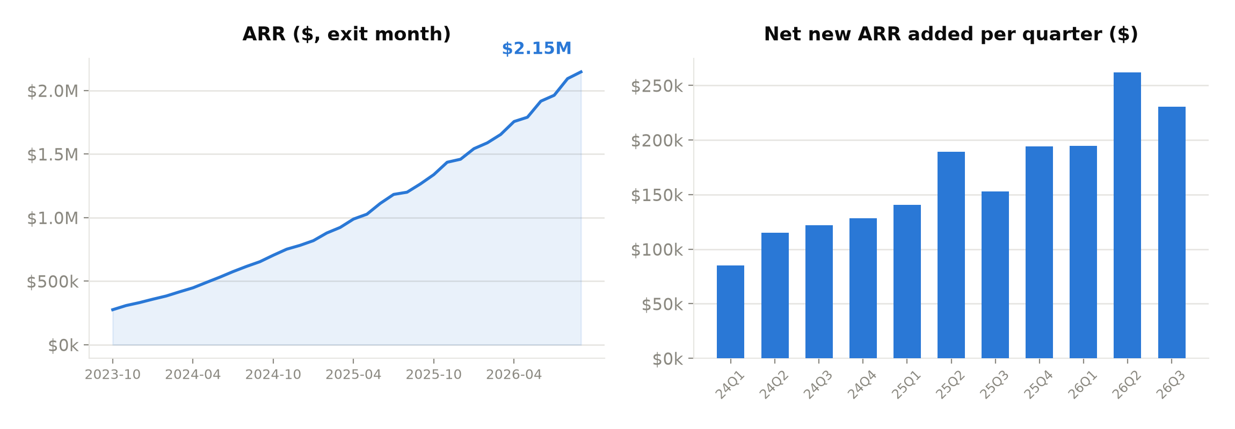
ARR growth
Exit-month ARR and net new ARR added per quarter
ARR grew 7.8x over the period, and only two quarters in three years added less net new ARR than the quarter before. The last four quarters added $0.88M — more than the entire ARR base 24 months ago. Growth is decelerating in percentage terms (+26% QoQ to +12%) while accelerating in absolute dollars, which is what compounding looks like.
Bluebell SaaS Pte Ltd - investor update
3

Slide 4
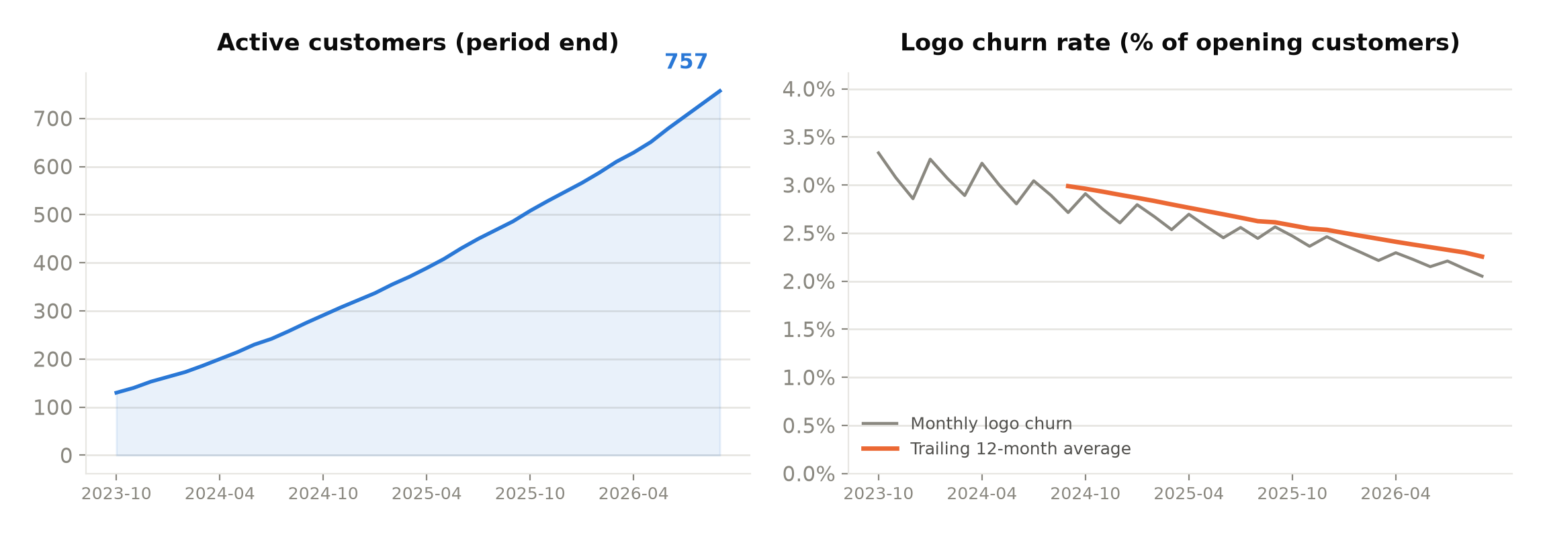
Customers and retention
Active customers seeded at 120 in Oct-2023
757 active customers, up 6.3x. Monthly logo churn improved from 3.3% to 2.1%, lifting implied customer life to 44 months from 33 two years ago. Retention is improving as the base grows — the opposite of the usual pattern.
Bluebell SaaS Pte Ltd - investor update
4

Slide 5
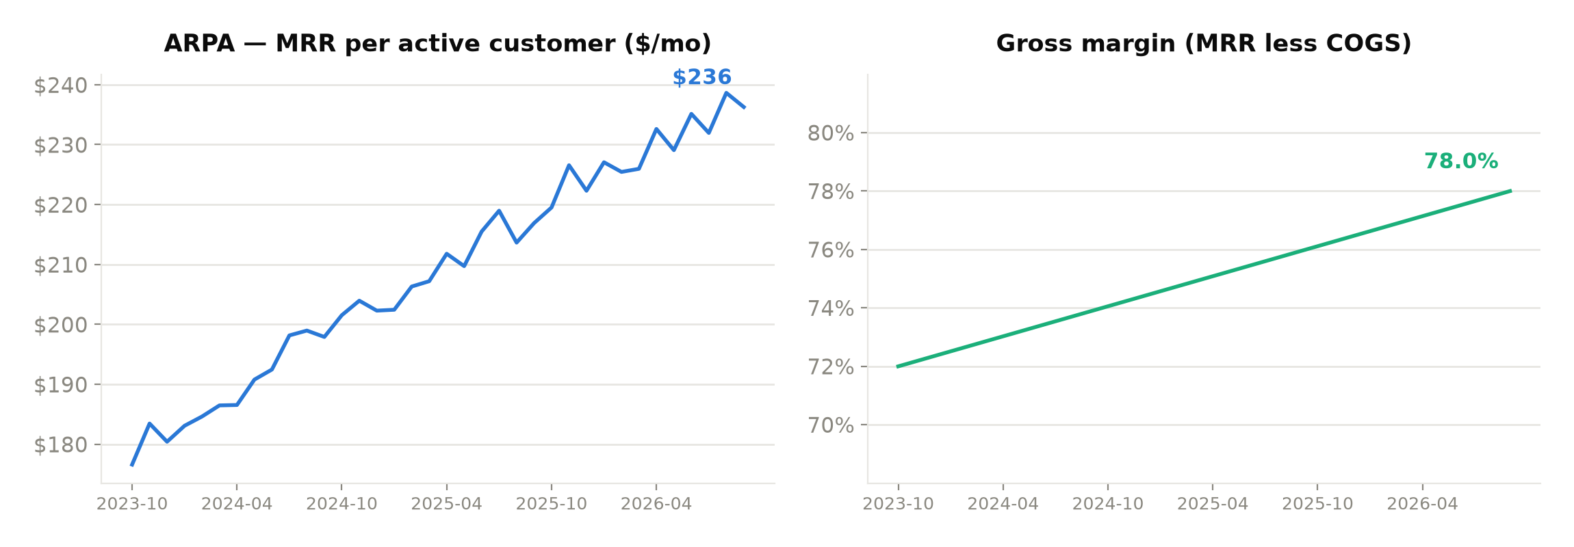
Pricing and gross margin
ARPA and gross margin, monthly
ARPA rose from $177 to $236 (+34%) and gross margin widened 72% → 78%, adding roughly 6 points of gross profit on every dollar of revenue. ARPA oscillates month to month as new cohorts land below the blended average.
Bluebell SaaS Pte Ltd - investor update
5

Slide 6
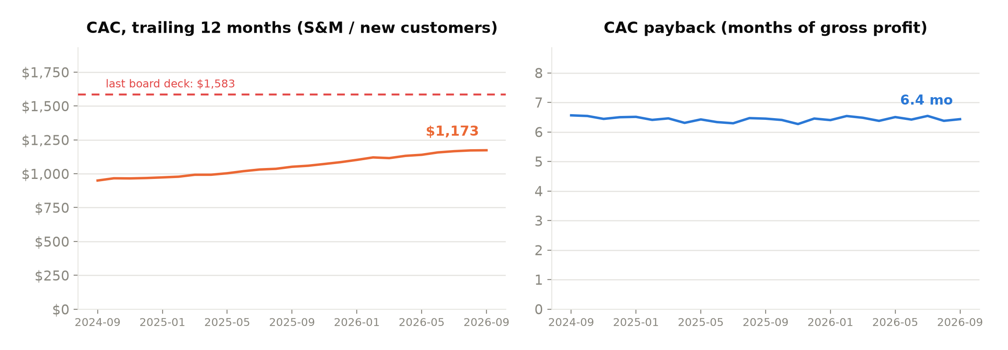
Unit economics
Trailing-twelve-month basis. The red line is the CAC printed on last quarter's board deck.
CAC $1,173 · LTV $8,081 · LTV:CAC 6.9x · payback 6.4 months.
CAC has risen 24% over two years, but ARPA rose 19% alongside it and gross margin widened, so payback is unchanged at ~6.4 months. We pay more per logo and recover it just as fast. Worth watching; not yet a problem.
Bluebell SaaS Pte Ltd - investor update
6

Slide 7
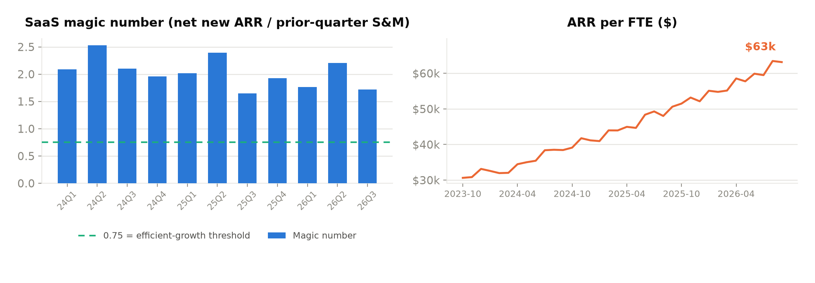
Go-to-market efficiency
Magic number by quarter and ARR per FTE
The magic number has never dropped below 1.65 — well above the 0.75 threshold at which incremental S&M is usually considered worth funding. ARR per FTE doubled to $63k while headcount went 9 → 34.
Bluebell SaaS Pte Ltd - investor update
7

Slide 8
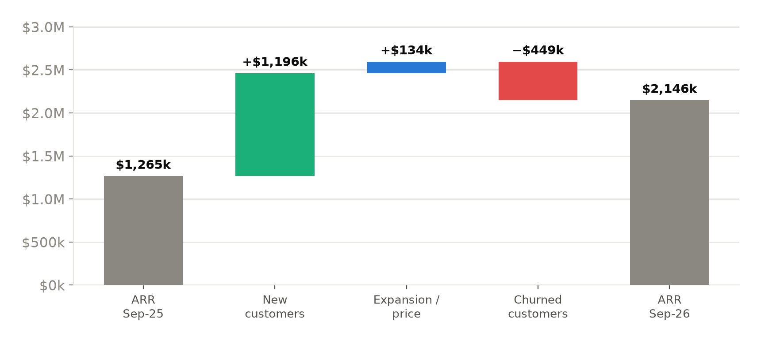
ARR bridge, last twelve months
How $1.26M of ARR became $2.15M
New logos drove $1.20M of gross new ARR against $0.45M lost to churn. Expansion is the $134k residual — the extract has no per-customer detail, so this is an estimate, not a measured figure.
Bluebell SaaS Pte Ltd - investor update
8

Slide 9
Correction to last quarter's board deck (slide 7)
Same source data, recomputed. One of the four figures does not hold.
Metric | Board deck | Computed now | Delta | Verdict
CAC (trailing 12 months) | $1,583.00 | $1,172.91 | −$410.09 | CONFLICT
LTV | $8,019.93 | $8,081.31 | +$61.38 | Definition gap
CAC payback (months) | 6.44 | 6.44 | 0.00 | Ties out
ARPA | $236.27 | $236.27 | $0.00 | Ties out
CAC of $1,583 is overstated by roughly 35%.
On S&M divided by NEW customers, no twelve-month window in the 36-month record produces $1,583 — every window falls between $950 and $1,173. The figure is reproduced almost exactly ($1,584) by dividing S&M by NET adds over Feb-2024 to Dec-2025: churned logos were subtracted from the denominator, and the window was already stale when the deck was printed.
The slide contradicts itself. Payback of 6.44 months only reconciles at a CAC of ~$1,173 — the correct number. LTV and ARPA on that slide are sound (LTV differs by 0.8%, a churn-averaging convention, not an error).
Consequence: LTV:CAC was understated at ~5.1x when it was ~6.9x. Restate CAC and anything derived from it; adopt one CAC definition (see Unit_Economics in the model) and hold it constant.
Bluebell SaaS Pte Ltd - investor update
9

Slide 10
Quarterly scorecard
Last eight quarters, exit-month basis
Quarter | 24Q4 | 25Q1 | 25Q2 | 25Q3 | 25Q4 | 26Q1 | 26Q2 | 26Q3
Exit ARR | $782k | $922k | $1.11M | $1.26M | $1.46M | $1.65M | $1.92M | $2.15M
QoQ growth | 19.7% | 18.0% | 20.5% | 13.8% | 15.4% | 13.4% | 15.8% | 12.0%
Net new ARR | $129k | $141k | $189k | $153k | $194k | $195k | $262k | $230k
New logos | 71 | 76 | 89 | 90 | 98 | 102 | 111 | 123
Churned logos | 24 | 27 | 30 | 34 | 37 | 39 | 42 | 45
Ending customers | 322 | 371 | 430 | 486 | 547 | 610 | 679 | 757
Gross margin | 74.2% | 74.7% | 75.3% | 75.8% | 76.3% | 76.8% | 77.3% | 77.8%
S&M spend | $70k | $79k | $93k | $101k | $110k | $119k | $134k | $146k
Magic number | 1.96 | 2.02 | 2.39 | 1.65 | 1.93 | 1.77 | 2.21 | 1.72
Quarterly revenue, COGS and contribution for all twelve quarters are on the Quarterly tab of the model.
Bluebell SaaS Pte Ltd - investor update
10

Slide 11
Definitions, assumptions and what is missing
Read this before quoting any number on the preceding slides
Definitions
What this data cannot tell us
Active customers — opening 120 plus cumulative new less churned. The 120 is management-supplied and unaudited; every customer-based metric moves with it.
ARPA — MRR divided by period-end active customers.
CAC — trailing-12-month S&M divided by trailing-12-month NEW customers. Churned logos are not netted out.
LTV — ARPA × TTM gross margin ÷ TTM logo churn rate.
CAC payback — CAC ÷ (ARPA × TTM gross margin), in months.
Magic number — quarterly net new ARR ÷ prior-quarter S&M.
Churn is measured on logos, not dollars; dollar churn is not derivable here.
No opex. The extract holds revenue, COGS, S&M and headcount only — no R&D, G&A or payroll. Operating expense, EBITDA, net burn, runway and Rule of 40 are therefore not computed anywhere in this pack. "Contribution" means MRR less COGS less S&M: an upper bound on profitability, not a burn figure.
No expansion detail. Without per-customer or cohort revenue we cannot compute net revenue retention. The ARR bridge on slide 8 values new and churned logos at blended ARPA and treats expansion as the residual — directionally right, not audit-grade.
Sep-2026 is treated as a complete month, as supplied.
Cash, deferred revenue, contract length and billing terms are all absent, so ARR here is MRR × 12, not a contracted-backlog figure.
The extract reads as normalised, not raw. Gross margin rises by exactly 17.1 basis points every month for 36 straight months, and churned-logo counts step up on a fixed cadence. Real ledgers are noisier than this. Reconcile the extract to the accounting system before these figures go to investors.
Bluebell SaaS Pte Ltd - investor update
11

