Slide 1
Bluebell SaaS - Investor Update
reference deck

Slide 2
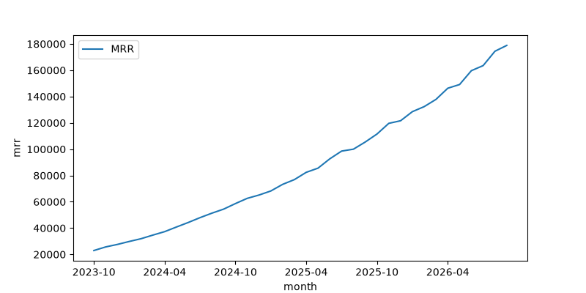
MRR trend

Slide 3
Gross margin & cost structure
Average gross margin (36 months): 75.0%
Revenue year 0: $1,723,316.18

Slide 4
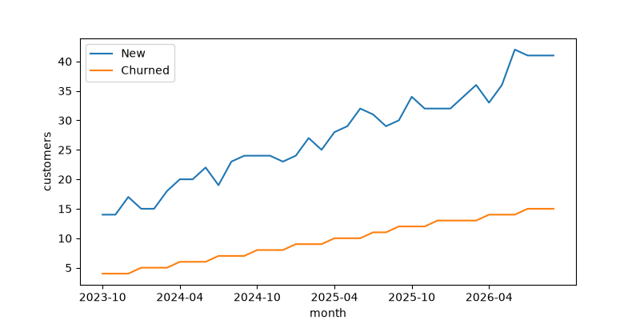
Customer growth

Slide 5
Unit economics
Metric | Value
CAC | $1,172.91
LTV | $8,019.93
LTV/CAC | 6.84x
CAC payback months | 6.44
ARPA | $236.27

Slide 6
DCF
NPV: $-2,883,240.59
IRR: -12.29%

Slide 7
Loan
Monthly payment: $39,602.40
Total interest: $376,143.82

Slide 8
Use of funds
60% product
30% go-to-market
10% ops

Slide 9
Appendix: assumptions
Starting active customers: 120
Discount rate 12%, no terminal value
Loan 2,000,000 at 7% over 60 months
Conflict with last quarter's board deck (slide 7): it shows CAC $1,583; corrected value from this model is $1,172.91.

