Slide 1


Arya: Arbitrary Graph Pattern Mining with Decomposition-based Sampling
Zeying Zhu*, Kan Wu*, Alan Zaoxing Liu
Notes:
Thanks for the introduction. I am Zeying. Today I will talk about Arya, a scalable approximate graph pattern mining system. This work is done in collaboration with Kan Wu at University of Wisconsin-Madison and my advisor Professor Alan Liu at Boston University.

Slide 2
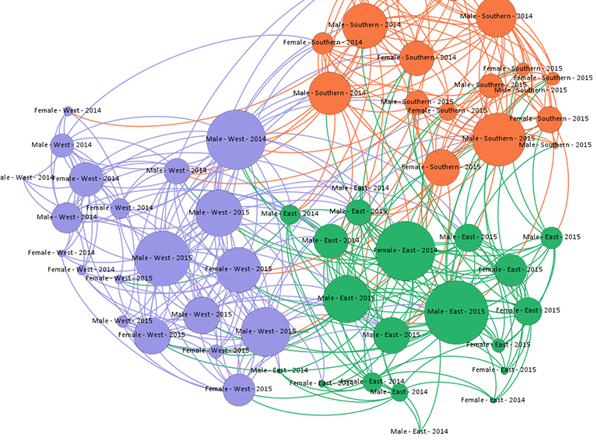
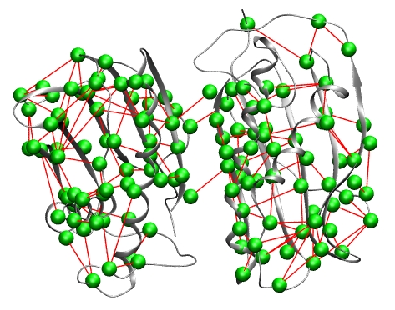
Graph-structured Data are Ubiquitous
Social networks
Protein-protein graph
Twitter graph: ten billion edges*
~80 billion nodes and 250 million edges
*GraphJet: Real-Time Content Recommendations at Twitter
Notes:
Graph-structured Data are Ubiquitous. This kind of data represents real-world connections.
Such big graph data sets can be found in social networks, biology and so on.
For example, Twitter graph already reached ten billion edges in 2016 and a protein-protein graph can have 250 million edges.

Slide 3




Pattern Mining is An Important Analytics Task
Social networks
Spot communities and advertise to users
Biology
Characterize protein-protein structures or interactions
Finance
Money laundering detection
A simple pattern example
W
Small deposits followed by a large withdrawal
D
D
D
W
D
D
D
Notes:
An important analytics task is graph pattern mining. It has many useful real-world applications.
For example, in social networks, pattern mining is used to spot connections between users and content and do advertisements based on these connections.
In biology, graph pattern mining can characterize protein-protein structures or interactions.
In finance, pattern mining can detect money laundering in financial transactions.
This a simple example of a transaction graph. The end nodes are users and banks. On the edges, D stands for the deposits of money to the bank, and W stands for the withdrawal of money from the bank.
A user who performs small deposits followed by a large withdrawal can be considered a money laundering user. Such pattern can be described as combining two triangles, and one node is a user, the other three nodes are the banks.
Finding such pattern in the transaction is the kind of task called pattern mining.
======================
Q: predicate matching in transaction graph; pre-store the subgraph with only predicates appearing in the pattern. => reduce the searching space
Q: real-world example of only counting: trigger alert to see whether a pattern appears more frequently recently; data access frequency for cache prefetching
Q: Social networks: may need first spot communities and then count pattern frequencies.
Q: Biology protein-protein graph: to mine patterns with multiple dimension weights, our system doesn’t support; maybe machine learning should be combined.
Q: 5-house pattern is specifically used in Facebook? 5-house is a representative pattern. 5 or more, like ten-node patterns are used in real cases but these data is not revealed from the company.
Q:
Motivation: For finatial institution: detect the weird patterns for alerts
How you define the patterns? How to run ELP? Input: edges of pattern you want to mine, set the error target e.g., 5%, error latency profile build as the system, estimate the number of samplers; we use bootstrapping from simpler graphs (we can tell more offline).
Q: identify previous bottlenecks; we leverage theory to build the system; we have a lot of system techniques to accelerate

Slide 4
Graph Pattern Mining
Find all subgraph instances matching a given pattern of interest.
Graph
Pattern
Subgraphs
Triangle
Counting the number of any subgraphs
Notes:
Formally, Graph pattern mining tasks focus on finding subgraph instances matching a given pattern of interest.
For example, if we consider finding a triangle pattern in this 5-node graph, the pattern mining algorithm will output a set of subgraphs matching a triangle, for example, the 4 triangles are highlighted in colors here.
In this work, we focus on counting the number of subgraphs matching a given pattern in the graph.

Slide 5
Exact Mining Solutions
Iterate every isomorphic subgraph
Graph
3
1
1
2
1
3
1
4
2
1
2
2
3
2
5
2
1
4
5
3
3
4
3
1
3
5
4
4
1
4
3
4
5
Pattern
5
5
2
5
3
5
4
Notes:
[cut] List nodes and edges, not a detailed example.
Existing works fall into exact mining solutions and approximate mining solutions.
Existing exact mining solutions are to iterate every isomorphic subgraph with expansion methods. It starts from the simplest part of the graph, for example, one node. And then iterate every possible combinations of three nodes to see whether it can form a triangle.
=================================================
That is, given a graph and a pattern, we start with a simplest part of the pattern, for example a single node in the subgraph, and then expand it with the neighboring nodes iteratively.
For example, we start with node 1, and then expand to it’s neighbor 2. Next, we can expand to node 3 from node 2’s neighbor. The pattern has three nodes so we stop here.
We can verify node 1-2-3 forms a triangle.
Node 2 can also expand to node 5, however, not all expansion can form a triangle.
We can repeat the process by enumerating every possible combination in the original graph.

Slide 6
Exact Mining Solutions
Iterate every isomorphic subgraph
Graph
Exponentially growing intermediate candidate sets
3
1
1
2
1
3
1
4
2
1
2
2
3
2
5
2
1
4
5
3
3
4
3
1
3
5
Optimizations: reduce redundant enumeration,
system optimizations, hardware accelerators,
but still NP-Complete
4
4
1
4
3
4
5
Pattern
5
5
2
5
3
5
4
Notes:
The pain point of exact mining solutions is it requires computing and storing over large intermediate candidate sets, which grows exponentially with graph and pattern size.
Recent work improved exact mining by reducing redundant computation and storage, and using hardware accelerators like GPUs, but the problem is still NP-Complete.

Slide 7
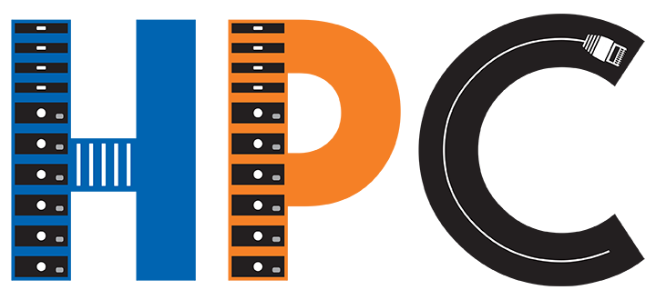
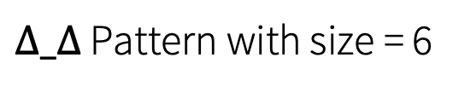
Scalability Challenge in Exact Mining
Arabesque (SOSP ‘15)
GraphPi (SC ’21)
Log scale
~1 billion
~1.2 billion
11 hours
>24 hours
Motifs with size = 3
$∆_∆$ Pattern with size = 6
Notes:
Even with a bunch of optimizations, it’s still challenging to scale for exact mining solutions. Here are some concrete numbers.
Arabesque is the first general pattern mining system with several techniques to reduce the intermediate data. It takes several hours to find simple patterns in a graph with about a billion edges.
More recent work GraphPi in HPC community further reduces redundancy in both the algorithm and system aspects. It still fails to complete a complex triangle-triangle pattern within a day.
Emph: triangle-triangle pattern
=======================
11 hours – server setting: Arabesque paper – 20-server cluster, each with 32 execution threads, 10GbE network.
24 hours – 16-server cluster, each with 20 threads, 10GbE network. 2.2 GHz.

Slide 8
Approximate Pattern Mining
Many mining tasks do not need exact answers.
Output density of certain patterns
List some but not all subgraphs for large graphs.
Output representative ones
General approximate approach:
Sample a subset of the input data and estimate the count based on the probability.
Notes:
We can see through years of optimization on the exact mining solutions, it’s still hard to scale.
However, we do not always require 100% accuracy in pattern counting. An observation is that many mining tasks do not need the exact number of instances or listing all the subgraphs
In fact, it’s very expensive to list all subgraphs for large graph pattern mining.
There are many approximate pattern mining research proposed in recent years. The general approach of applying approximation is to sample a subset of the input data and estimate the count based on the probability.
==================
(=> examples? Counting as an alert; data provenance graph, a pattern represents for data access pattern, only need the frequency of the access pattern for future cache prefetching statistics.)

Slide 9
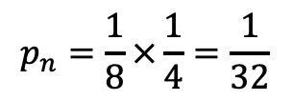
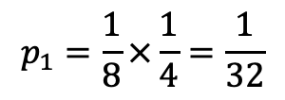



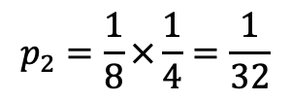
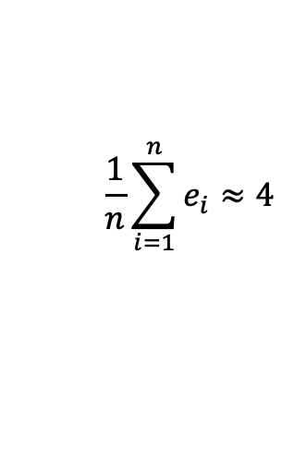
Using Neighborhood Sampling [ASAP, OSDI’18]
Sample a subset of the input data and estimate count based on probability
Graph
3
3
$$p_{1}=\frac{1}{8}×\frac{1}{4}=\frac{1}{32}$$
1
2
$$e_{1}=32$$
2
1
4
5
$$p_{2}=\frac{1}{8}×\frac{1}{4}=\frac{1}{32}$$
$$e_{2}=0$$
$$\frac{1}{n}\sum_{i=1}^{n}{e_{i}}≈4$$
4
5
2
Pattern
…
…
…
$$p_{n}=\frac{1}{8}×\frac{1}{4}=\frac{1}{32}$$
$$e_{n}=0$$
5
3
1
Neighborhood sampling
Probability
△ Counting
Result
Up to 258x speed up in ASAP
Notes:
Given this sampling approach, ASAP is the first approximate graph pattern mining system. It uses neighborhood sampling.
Consider the same graph and the triangle pattern, In neighborhood sampling, we first sample an edge
Sample an edge, and sample a neighbor of the edge, and see whether it forms a triangle.
For each sampling trial, we can calculate the probability to sample such subgraphs. say how to calculate probability 1/8 and 1/4 (8 edges in the graph, one edge has 4 neighbor nodes)
Each sampling trial may form a pattern or not, and it gives an estimated number of triangle counting from the inverse probability, for example, to be 32 triangles or 0.
By combining the sampling results together, we get an estimation of triangle counting.

Slide 10
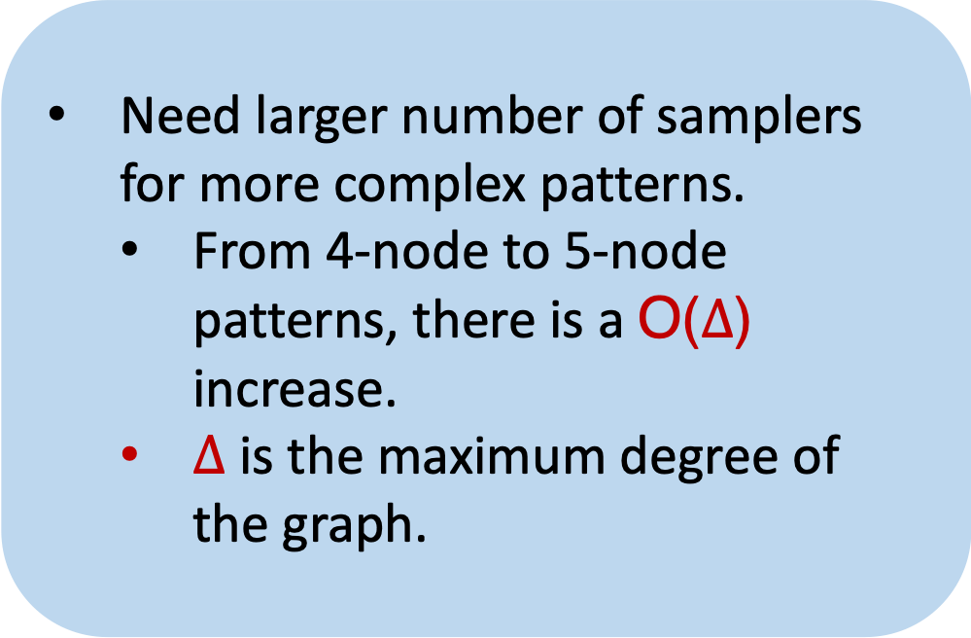
ASAP Cannot Scale to Complex Patterns
5-House
Need larger number of samplers for more complex patterns.
From 4-node to 5-node patterns, there is a O($∆$) increase.
$∆$ is the maximum degree of the graph.
(1.5B)
(3.7B)
16-machine cluster
Notes:
However, ASAP cannot scale to complex patterns. On a 16-machine AWS EC2 cluster, Here it shows the running time of 5% error target and 10% error target.
ASAP takes more 20 minutes to mine a 5-node pattern 5-house in the large graph.
This is because ASAP needs larger number of samplers for more complex patterns.
For example, from 4-node to 5-node patterns, there is a Big O delta increase in the number of samplers. delta here is the maximum degree of the graph, which can be large, for example, 1000 (change to an example).

Slide 11
Our key idea is to leverage graph decomposition theory and sample different sub-patterns individually.
If the patterns are more complex, it needs significantly more samplers and is less scalable.
Can we reduce the complexity of the sampled pattern?
Notes:
With the pattern complexity increasing, if continuing sampling the pattern as a whole unit, there is a large increase in the number of samplers required, which makes approximate mining unscalable.
So instead, we asked the question, can we reduce the complexity of the sampled pattern, and thus possibly reduce the number of samplers required, to scale the system?

Slide 12
Graph Decomposition Theory
A powerful theorem (informal) [S. Assadi et al., 2019] : Solving an optimal fractional edge cover can decompose any patterns into a unique collection of odd cycles and stars, which meets optimal bounds for sampling arbitrary patterns.
0.5
0.5
1.0
1.0
Optimal fractional edge cover LP
0.5
0.5
1.0
Decomposed sub-patterns
0.5
Odd cycle
Star
5Cycle-5Star
Odd cycles with weight 0.5 on edge;
Stars with weight 1 on each edge
Notes:
The powerful graph decomposition theorem says that Solving an optimal fractional edge cover can decompose any patterns into a unique collection of odd cycles and stars, which meets optimal bounds for sampling arbitrary patterns.
Here is an example of decomposing 5Cycle-5Star pattern. Through optimal fractional edge cover, the pattern is decomposed into odd cycles and stars.
I will skip the details of decomposition. The optimal fractional edge cover assigns weights to odd cycles and stars which forms an edge cover.
0.5 and 1 are from the edge cover of the 5-cycle-5-star pattern example.
// The optimal fractional edge cover assigns 0.5 weight to every edge of the odd cycle and 1 weight to every petal of the star.
The pattern sampling includes odd cycle sampling, star sampling and finally testing remaining edges to see whether these odd cycles and stars can form a pattern.
===============
(use a more complex pattern next time)
Q: can we decompose into other sub-patterns? Yes, but manually. The theorem gives that, we can automatically get the decomposed cycles and stars using linear programming solver.

Slide 13
Sample Individual Sub-patterns
Odd cycle sampler: edge sampling
5-Cycle
Star sampler
5-Star
Notes:
Our sampling steps include sampling individual sub-patterns. We use edge sampling to sample odd cycles and sample a star by getting the petal neighbors from a center node.

Slide 14
Form a Pattern
Test remaining edges in 5Cycle-5Star.
Notes:
The last step in decomposition-based pattern sampling is to test the remaining edges between sub-patterns and see whether it forms a complete pattern.
Once we sampled 5-cycle and 5-star separately with odd-cycle sampler and star sampler,
We can test whether the remaining edges exist in the graph.
This is the basic version of sampling.
=================
Decomposed into odd cycles and stars
Test remaining edges

Slide 15
Accelerate the computation
Test remaining edges in 5Cycle-5Star.
System optimizations:
Failure-probability-aware sampler scheduling
Cache and reuse sampled sub-patterns
(check more details in our paper)
Notes:
These are the basic sampling process.
To accelerate the computation,
We propose two optimizations.
Failure-probability-aware sampling scheduling and
cache and reuse sampled sub-patterns.
We focus on the first optimization in this talk and please check more details in our paper.

Slide 16
The “Failure Probability” of Cycle/Star Samplers
Different subpatterns have different sampling failure probabilities.
“Failure”: A sampler does not find the pattern
More likely to fail
e.g., 92%
Do not fail
The subpattern sampling order matters for mining time!
If any subpattern sampling fails, the entire pattern sampling fails.
We can early terminate the sampling if there are any failures.
Notes:
[TODO] Change to 5-house: triangle and 1-star
Define “fail”
Through our offline or online profiling, we found that different sub-patterns have different sampling fail probabilities.
For example, 5-cycle is more likely to fail with probability of 95% percent; while an 5-star sampling only fails with 85% probability because it just needs 5 neighbors from a center node to form a star.
Then sub-pattern sampling order matters for the mining time. If a sub-pattern is going to fail, let it fail early and early prune the sampling trial to save computation. [explain more here]
===================
Q: how does profiling work? Given the graph and popular patterns, we can do offline profiling of failure probability. If the pattern and graph are new to the system, we use the first 10% of samplers to execute in normal order and collect failure probability data. Then we switch to the best order of execution.

Slide 17
Scheduling More-likely-to-fail Subpatterns First
0% fail
92% fail
100% sample triangle
8% sample 1-star
Improve the performance by 2x without affecting accuracy.
Notes:
For example,
If we sample 5-star first, 85% 5-star samplers fail. Then we have 15% probability to sample next sub-pattern 5-cycle.
However, if we sample 5-cycle first, with 95% of the samplers fail to form a 5-cycle. We only have 5% probability to sample next sub-pattern 5-star.
In our evaluation, we see the probability-aware sampler scheduling technique can improve the performance by 2 times for free.
================
Q: will change the accuracy? We don’t the change the correctness of the algorithm. Example 5house : the execution order doesn’t affect final estimation.
Q: most to address online; depend on pattern and graph workload, unseen workload. We don’t know the failure probability beforehand. Graph can be diverse.

Slide 18
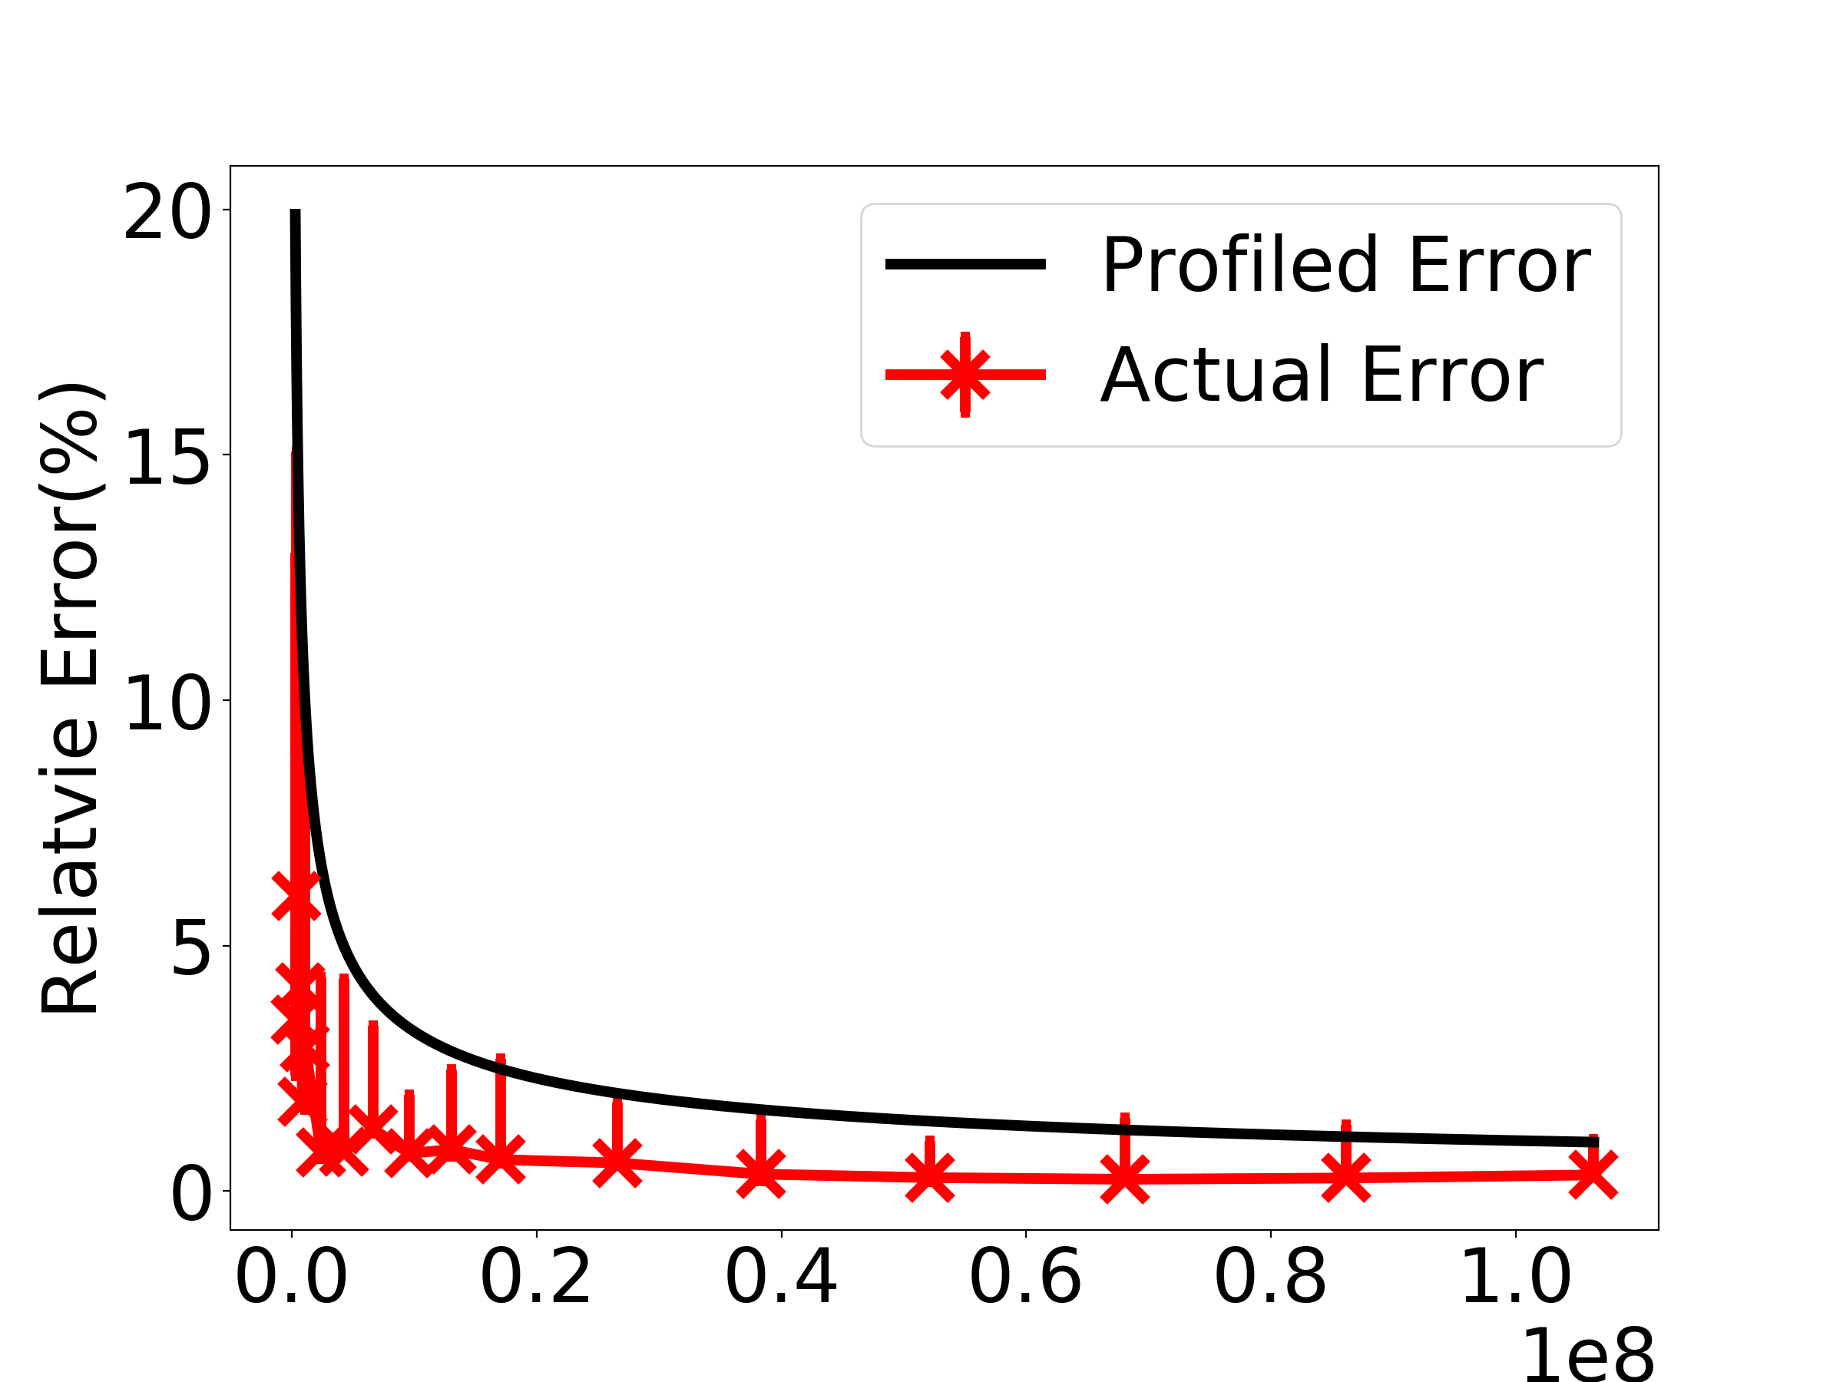
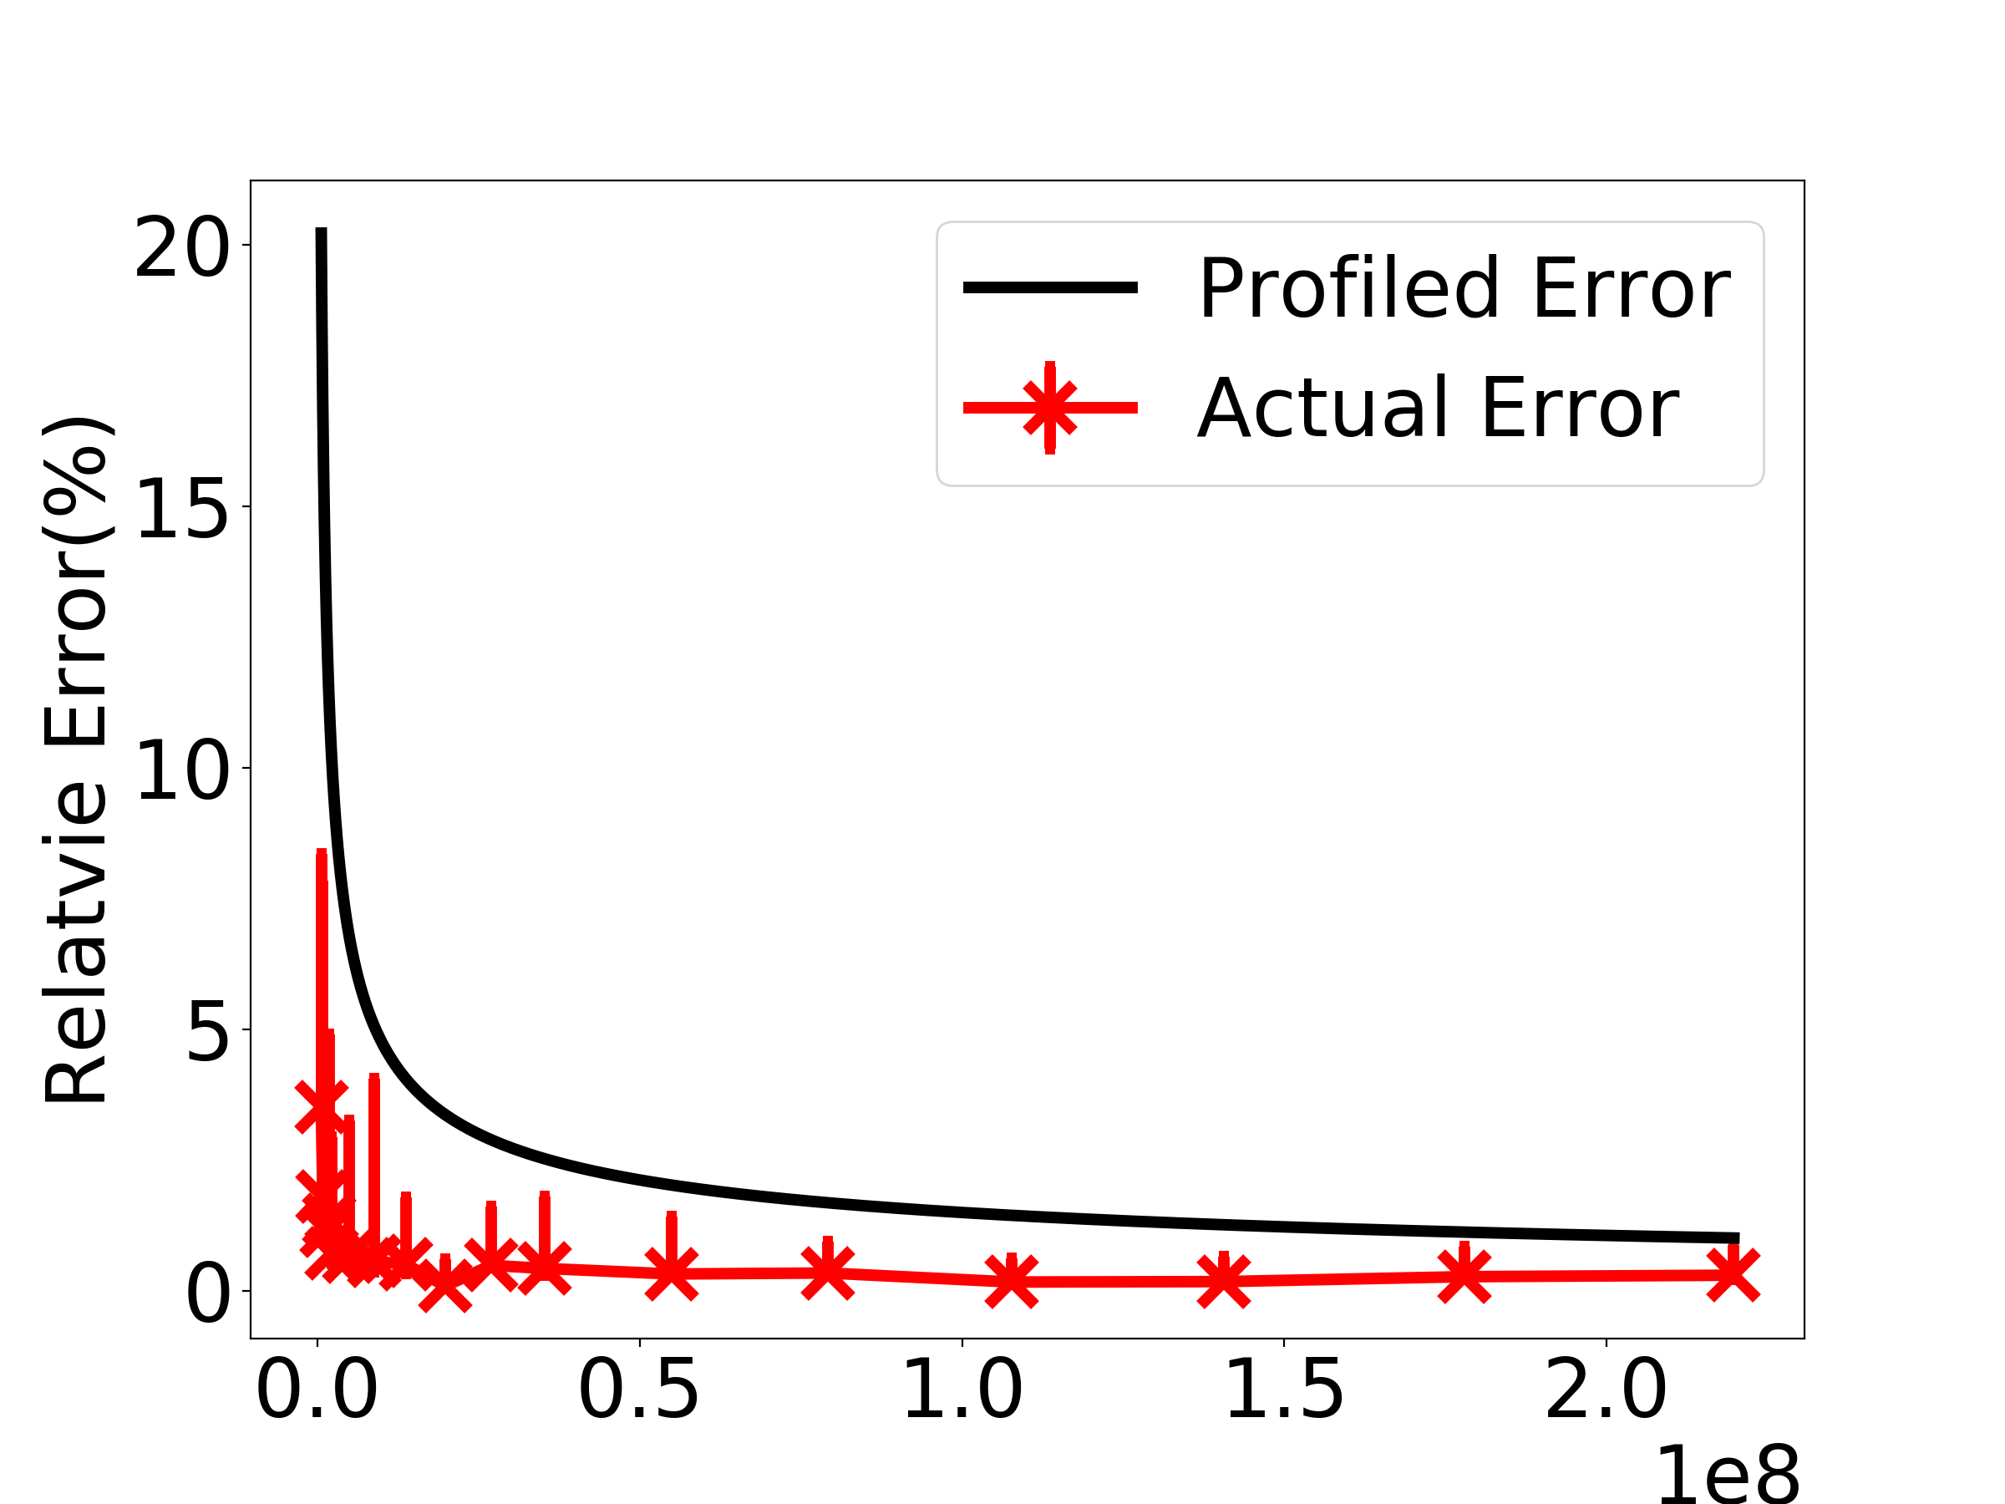
Putting It Together -- Arya
Graph.size (1B)
Pattern(5house, 5%, 0.95)
Fractional Edge Cover
LP Solver
Pattern Decomposer
Error-Latency Profile
/ User Configuration
1
2
Graph
Pattern
3
…
Count: 12345 +/- 617
Time: 12s
…
5
4
Parallel Sampling Engine
Sampled subgraphs
Notes:
Overall, Based on the sampling process, we have implemented Arya with multiple components.
Here is the Arya workflow.
[fix scripts here to be more detailed]
The input to a pattern mining system is the graph and pattern.
Our pattern decomposer decomposes the pattern based on optimal fractional edge cover.
We give user two choices. Then the error-latency profile engine will give an estimation of the required number of samplers on a given error budget; or the user directly specifies the number of samplers to run.
Arya samples decomposed sub-patterns in parallel with a number of samplers
and then estimates the pattern count and outputs sampled subgraphs.

Slide 19
Evaluation
Distributed system implementation (11K LOC)
<5% error
OpenMP/MPI
Memcached key-value store
Evaluated on medium, large, and giant Graphs
Mico, 1M edges
YouTube, 2.9M edges
Twitter, 1.2B edges
Friendster, 1.8B edges
RMAT-5B, 5B edges
RMAT-10B, 10B edges
Patterns
3-Motifs (2 patterns), 4-Motifs (6 patterns), complex patterns (>= 5 nodes)
Notes:
We have single machine implementation as well as distributed system implementation.
We implemented distributed Arya with OpenMP and MPI hybrid programming model, and Memcached key-value store as distributed storage.
We evaluated Arya on median, large and giant graph data sets and
Patterns from simple patterns, like 3-motifs, which includes a 2-star and a triangle, to complex patterns with more than 5 nodes, for example, 5-house and triangle-triangle.
All our evaluation results are within 5% error budget.
X details of patterns
3 animations
==================
Copy pattern figures
Results are < 5% error

Slide 20
Evaluation: Exact Mining Systems
Distributed replicated graph setting
5-House
330x
140x
2,000x
Notes:
Next, we scaled Arya to distributed systems. This is distributed replicated graph setting.
Mining 5-house pattern on mico, YoTube and Twitter graph gives several hundreds of speed up compared with Fractal. Also in large graph Twitter, Arya also outperforms 300 times of speed up.
[emphersize here:]
Our comprehensive evaluation shows that Arya is up to 20,000 times faster than Fractal and up to 1000 times faster than GraphPi in the distributed replicated graph setting within 5% error rate target.
==================

Slide 21
Evaluation: Exact Mining Systems
Distributed replicated graph setting
5-House
330x
140x
2,000x
Up to 20,000x faster than Fractal
Up to 1,000x faster than GraphPi
Notes:
Next, we scaled Arya to distributed systems. This is distributed replicated graph setting.
Mining 5-house pattern on mico, YoTube and Twitter graph gives several hundreds of speed up compared with Fractal. Also in large graph Twitter, Arya also outperforms 300 times of speed up.
[emphersize here:]
Our comprehensive evaluation shows that Arya is up to 20,000 times faster than Fractal and up to 1000 times faster than GraphPi in the distributed replicated graph setting within 5% error rate target.
==================

Slide 22
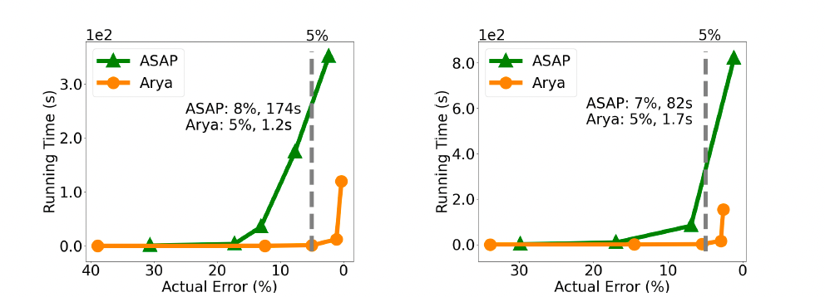
Evaluation: Approximate Mining Systems
150x
YouTube, 5-House
YouTube, Triangle-Triangle
Arya’s number of samplers is smaller than or similar as ASAP.
Each Arya’s sampler runs faster because of edge sampling.
Notes:
We also evaluated Arya compared with ASAP in the single machine setting.
On median graph YouTube and complex pattern 5-house, and triangle-triangle, Arya is up to 150 times faster than ASAP when they both reach the 5% error target.
Arya outperforms ASAP for two reasons.
Arya requires a smaller number of samplers or similar ones as ASAP.
Each Arya’s sampler runs faster than ASAP because of edge sampling.

Slide 23
Discussion and Future Work
4-Motifs
Sampling-based approaches are hard to find a pattern when the graph is sparse.
1/6x
Extending Arya to trillion-edge graph scenarios.
Selecting the best graph pattern mining algorithm for different graph-pattern inputs.
Notes:
However, Arya doesn’t always have the best performance.
for 4-motif mining tasks, Arya is slower than deterministic mining solutions in Friendster graph,
which is because Friendster is a sparse graph, but sampling-based approaches are hard to find a pattern when the graph is sparse.
For future work, we plan to extend Arya to trillion-edge graph scenarios
and select the best graph pattern mining algorithm (either exact or approximate) for different graph-pattern inputs.
Because no system is always the winner for all graph-pattern inputs.

Slide 24
Conclusions
Graph pattern mining is important and challenging.
Larger and denser graphs and complex and arbitrary patterns.
Poor scalability of existing systems.
Arya leverages graph decomposition theory and sampling techniques for fast and scalable pattern mining.
Outperforming existing exact and approximate pattern mining solutions by up to five orders of magnitude.
Open-sourced at https://github.com/Froot-NetSys/Arya.
Notes:
In conclusion,
Graph mining is an important and challenging task. With larger and denser graphs and more complex and arbitrary patterns, existing systems suffer from poor scalability issues.
Arya leverages graph decomposition theory and sampling techniques for fast and scalable pattern mining.
It outperforms existing exact and approximate pattern mining solutions by up to five orders of magnitude.
We open-sourced Arya at this github repo.
This brings the end of the talk. Thank you for listening. I am happy to take any questions.
==========================
Q: what’s the overhead of the decomposition solver? Several seconds to decompose a pattern into three sub-patterns.

