Slide 1

In-Memory Key-Value Store Live Migration with NetMigrate
Zeying Zhu, Yibo Zhao, Alan Zaoxing Liu

Slide 2




In-Memory Key-Value Stores
Key-value stores are widely used
Feature store of machine learning inference
In-memory caching
Real-time analytics
Data amount is large
Store billions of records
Retrieve millions of records under low latency constraints

Slide 3

Live Migration is A Key Technique
No service downtime during key-value shard migration between nodes.
Why migrate data?
Load balancing
Client 1
Client 2
Query
Load
A
B
C
KV server 1
KV server 2

Slide 4
Live Migration is A Key Technique
No service downtime during key-value shard migration between nodes.
Why migrate data?
Load balancing
Spatial locality
Horizontal scaling
Client 1
Client 2
Query
B
Load
A
C
KV server 1
KV server 2

Slide 5
Live Migration is A Key Technique
No service downtime during key-value shard migration between nodes.
Why migrate data?
Load balancing
Spatial locality
Horizontal scaling
Existing solutions
Source-based
Destination-based
Hybrid
Client 1
Client 2
Query
A
B
C
D
KV server 1
KV server 2

Slide 6
Source-based Migration
READ: served by source
WRITE: served by source
Client 1
Client 2
…
Client n
READ
WRITE
WRITE
Migrate all data
Updated
Updated
Dirty data logs
Source KV
Destination KV
RAMCloud [TOCS ‘15], Remus [SIGMOD’22]

Slide 7

Source-based Migration
READ: served by source
WRITE: served by source
Low query latency during migration because source node already has the queried data
Extra dirty data transfer from source to destination
Downtime when terminating migration
RAMCloud [TOCS ‘15], Remus [SIGMOD’22]

Slide 8
Destination-based Migration
READ: served by destination
WRITE: served by destination
Client 1
Client 2
…
Client n
READ
READ
WRITE
Migrate all data
PriorityPull not-migrated data
Not Migrated
Source KV
Destination KV
Rocksteady [SOSP’17]

Slide 9
Destination-based Migration
READ: served by destination
WRITE: served by destination
Quickly shift source node’s pressure, short migration time
High query latency due to missed data access in the destination (increase 100%~400%)
Low throughput (drop 66%)
Rocksteady [SOSP’17]

Slide 10
Hybrid Migration
READ: served by both source and destination
WRITE: served by destination
Bookkeeping migration states: migrated keys
Client 1
Client 2
…
Client n
READ
WRITE
Double-READ
Double-READ
Migrate all data
Not Migrated
Source KV
Destination KV
Fulva [SRDS ‘19]

Slide 11
Hybrid Migration
READ: served by both source and destination
WRITE: served by destination
Leverage both so performance is better when most of data is in the source.
Double-read incurs large bandwidth overhead between clients and servers (~50%) because of no fine-grained state tracking.
Fulva [SRDS ‘19]

Slide 12
Existing Live Migration Systems
Query performance
NetMigrate
Source-based
Design Goals of NetMigrate:
Minimal query performance impact
Low extra overhead from migration
Acceptable and tunable migration time
Fulva (Hybrid)
Rocksteady (Destination)
migration time
Tradeoff between query performance and migration time

Slide 13
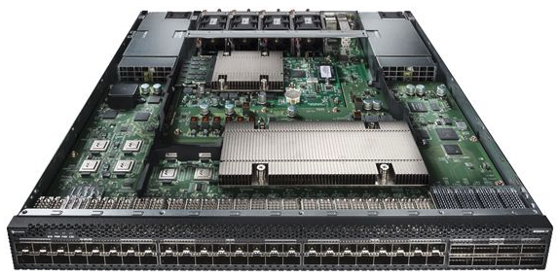
Existing solutions don’t know where the data is and pay cost of going to wrong places.
Clients
Key Idea: Programmable Top-of-Rack switches to track the migration states.
Centralized view of all data movement
Real-time information of who owns the data
ToR Switch Controller
Key-Value Storage Rack
Source
KV
Destination KV
Source
KV
Destination KV
…
Migration Instance 1
Migration Instance 2
Storage Servers

Slide 14
Clients
Query
ToR Switch Controller
ToR Switch Data Plane
Key-Value Storage Rack
Look up migration state
…
Source
KV
Destination KV
Storage Servers
Migration Instance

Slide 15
A Typical Programmable Switch Architecture
Flexible programmability
Parse, read and update custom fields at line rate
Registers
Store data
High line-rate packet processing 12.4 Tbps
Match + Action
Memory
ALU
…
…
…
…
Programmable Parser
Programmable Match-Action Pipeline

Slide 16
Design Challenges of NetMigrate
Challenge #1: How to track fine-grained migration states?
On-switch resources are limited (e.g., 64MB SRAM vs. Millions of KV pairs)
Challenge #2: How to query during migration?
Maintain data consistency during migration.
Read-After-Write, Write-After-Read, Write-After-Write.
Challenge #3: How to support dynamic migration policies?

Slide 17
Design Challenges of NetMigrate
Challenge #1: How to track fine-grained migration states?
On-switch resources are limited (e.g., 64MB SRAM vs. Millions of KV pairs)
Challenge #2: How to query during migration?
Maintain data consistency during migration.
Read-After-Write, Write-After-Read, Write-After-Write.
Challenge #3: How to support dynamic migration policies?

Slide 18
Shrink Record Granularity for Limited Switch Resources
On-switch resources are limited (e.g., 64MB SRAM vs. Millions of KV pairs)
KVS data structure: hash table
Group 1
Group 2
…
Track migration in a coarser record granularity

Slide 19
Three States to Understand Data Location
Group migration states: migrated, ongoing-migration, not-migrated
A
B
C
D
Group 1
Group 2
…
A
B
not-migrated
migrated
C
D
ongoing-migration
Source KV
Destination KV

Slide 20
Probabilistic Ownership Tracking
Track migrated groups
Bloom Filter
BF
Counting Bloom Filter
CBF
Track ongoing-migration groups
ToR Switch
Group
A
B
Source KV
Destination KV

Slide 21
Not Started Migration
Track migrated groups
Bloom Filter
BF
 | 0 |  | 0
Counting Bloom Filter
CBF
0 |  | 0
Track ongoing-migration groups
ToR Switch
Group
A
B
Source KV
Destination KV

Slide 22
Ongoing Migration
Track migrated groups
Bloom Filter
BF
 | 0 |  | 0
Counting Bloom Filter
CBF
1 |  | 1
Track ongoing-migration groups
ToR Switch
A
Group
B
Source KV
Destination KV

Slide 23
Finished Migration
Track migrated groups
Bloom Filter
BF
 | 1 |  | 1
Counting Bloom Filter
CBF
0 |  | 0
Track ongoing-migration groups
ToR Switch
B
A
Group
Source KV
Destination KV

Slide 24
Design Challenges of NetMigrate
Challenge #1: How to track fine-grained migration states?
On-switch resources are limited (e.g., 64MB SRAM vs. Millions of KV pairs)
Challenge #2: How to query during migration?
Maintain data consistency during migration.
Read-After-Write, Write-After-Read, Write-After-Write.
Challenge #3: How to support dynamic migration policies?

Slide 25
Data is Consistent When Not Started Migration
Client 1
Clients
BF
 | 0 |  | 0
READ
WRITE
CBF
0 |  | 0
Migrate all data
Source KV
Destination KV

Slide 26
Data is Consistent When Finished Migration
Client 1
Clients
BF
 | 1 |  | 1
CBF
0 |  | 0
READ
WRITE
Migrate all data
Source KV
Destination KV

Slide 27
An Inconsistent Example When Ongoing Migration
Client 1
Clients
Read-After-Write
BF
 | 0 |  | 0
READ
CBF
1 |  | 1
WRITE
Migrate all data
Updated
Source KV
Destination KV

Slide 28
An Inconsistent Example When Ongoing Migration
Client 1
Clients
Read-After-Write
BF
 | 0 |  | 0
READ
CBF
1 |  | 1
WRITE
Not sure where the key is located because of tracking at group level.
Not sure whether there was a WRITE due to no tracking on every WRITE.
Migrate all data
Updated
Source KV
Destination KV

Slide 29
Data is Consistent When Ongoing Migration
Client 1
Clients
BF
 | 0 |  | 0
WRITE
Double-READ
CBF
1 |  | 1
Double-READ
Migrate all data
Source KV
Destination KV

Slide 30
Data is Consistent When Ongoing Migration
Client 1
Clients
BF
 | 0 |  | 0
WRITE
Double-READ
CBF
1 |  | 1
Double-READ
Data consistency is maintained by Double-READ.
Overhead caused by Double-READ is negligible.
Migrate all data
Source KV
Destination KV

Slide 31
Data is Consistent even with False Positives
Client 1
Updated due to hash collision
Clients
BF
 | 1 |  | 1
READ
WRITE
READ
CBF
0 |  | 0
Migrate all data
Not Migrated
PriorityPull
Source KV
Destination KV
(check more details in our paper)

Slide 32
Data is Consistent even with False Positives
Client 1
Updated due to hash collision
Clients
BF
 | 1 |  | 1
READ
WRITE
READ
CBF
0 |  | 0
Migrate all data
Not Migrated
PriorityPull
Overhead from false positives is negligible
Source KV
Destination KV
(check more details in our paper)

Slide 33

Putting It Together: NetMigrate
ToR Switch Controller
Key-Value Storage Rack
ToR Switch Data Plane
Routing
Migration State
(Probabilistic Data Structures)
Migration Instance Table
Servers
Clients
Leveraging probabilistic data structures on the switch to track three migration states.
Query protocol guaranteeing consistency.
The overhead caused by false positives and unsure states is small.

Slide 34
Evaluation
Testbed
6.5 Tbps Intel Tofino switch
3 servers each with an 8-core CPU, a 40G NIC, and 64GB memory
Baselines
Source-based migration protocol, Rocksteady, Fulva
Workloads
Migrating 256 million KV pairs (~16GB), with 4B key, 64B value
YCSB with 0%, 5%, 10%, 20%, 30% write ratio
Source CPU budgets: 100%, 70%, 40%

Slide 35
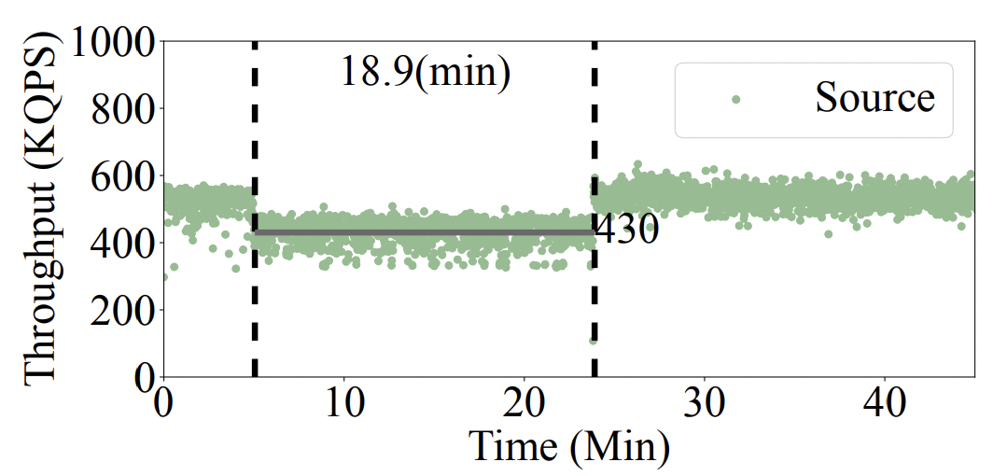
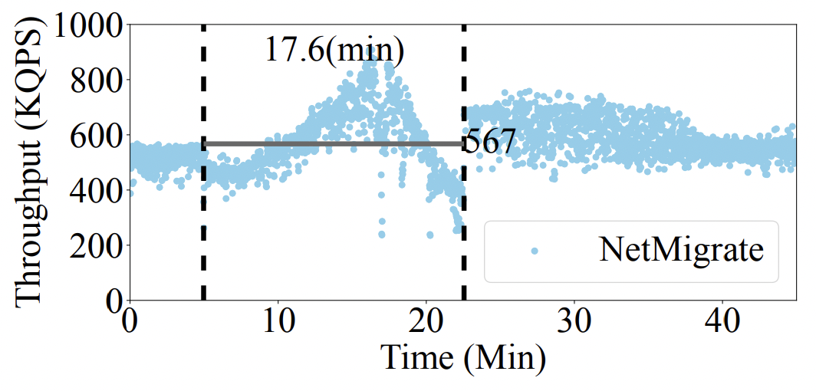
Overall performance -- Throughput
Setting: YCSB-B (5%) write ratio, source node is not overloaded (100%)
32% to 78% average throughput improvement compared to Source-based, Rocksteady, Fulva with similar migration time.

Slide 36
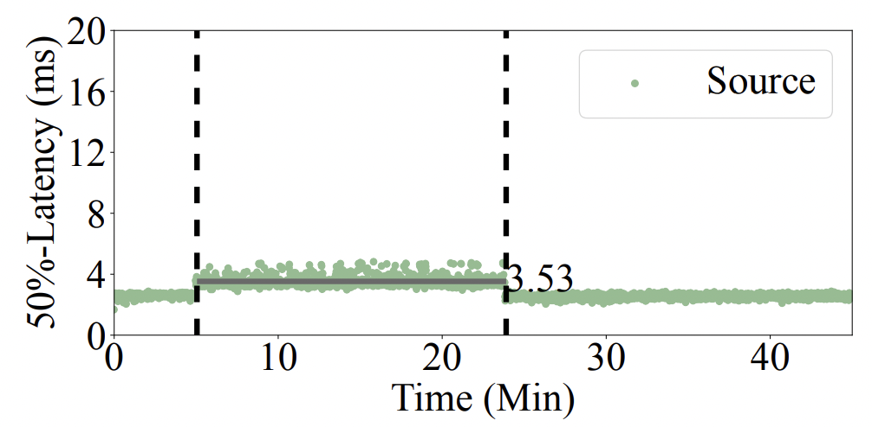
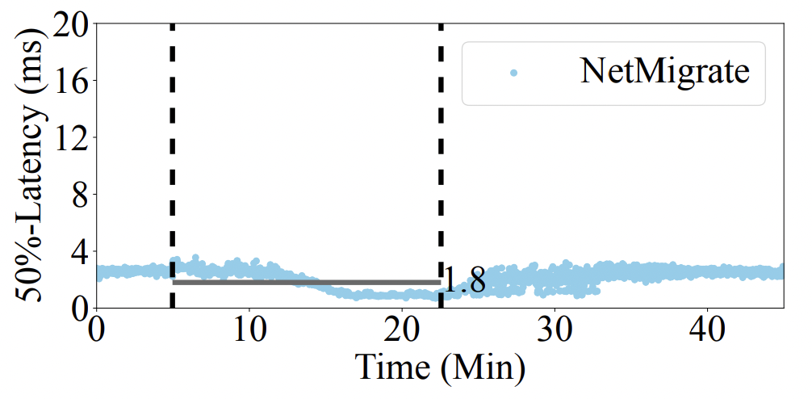
Overall performance – Median Latency
Setting: YCSB-B (5%) write ratio, source node is not overloaded (100%)
49% to 65% average median latency reduction.
Up to 39% average 99% tail-latency reduction.

Slide 37
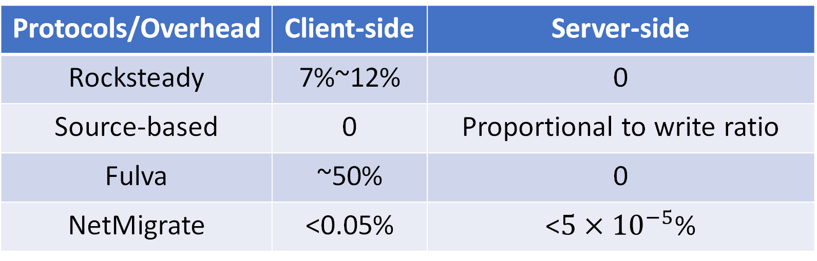
Network Overhead
Protocols/Overhead | Client-side | Server-side
Rocksteady | 7%~12% | 0
Source-based | 0 | Proportional to write ratio
Fulva | ~50% | 0
NetMigrate | <0.05% | <$5{×10}^{−5}$%
Extra network bandwidth overhead
between clients and servers (client-side)
or between servers (server-side)

Slide 38

Conclusions
Existing KV store live migration techniques still suffer from low query-serving performance and high overhead.
We propose NetMigrate, a network-based hybrid live migration approach.
Track fine-grained migration states in programmable data plane.
Provide enhanced throughput and low migration overheads.
Open-sourced at https://github.com/Froot-NetSys/NetMigrate.
Thank you! Q&A
Notes:
In conclusion,
We open-sourced NetMigrate at this github repo.
This brings the end of the talk. Thank you and I am happy to take any questions.

