Slide 1
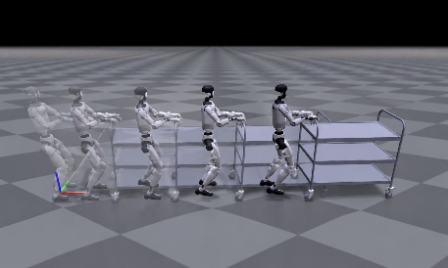
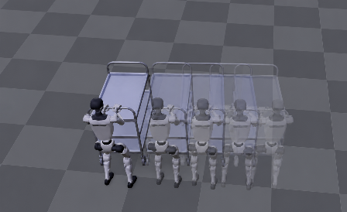
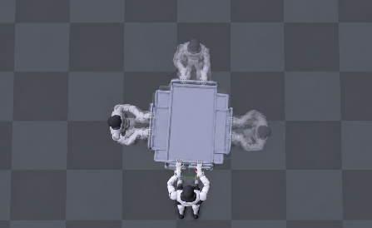



Straight-line motion
Lateral motion
Turning motion
v_{x} (m/s)
v_{y} (m/s)
ω_{z} (rad/s)
Isaac Sim
v_{x} (m/s)
v_{y} (m/s)
ω_{z} (rad/s)
MuJoCo
Time (s)

