Slide 1


Bluestock Mutual Fund Analytics Platform
End-to-End Data Engineering, ETL Pipeline & Interactive Dashboard
Bluestock Fintech — Data Analytics Internship Capstone Project
Technologies: Python | SQL | SQLite | Power BI
Coverage: 40 Mutual Fund Schemes · 10 Fund Houses

Slide 2
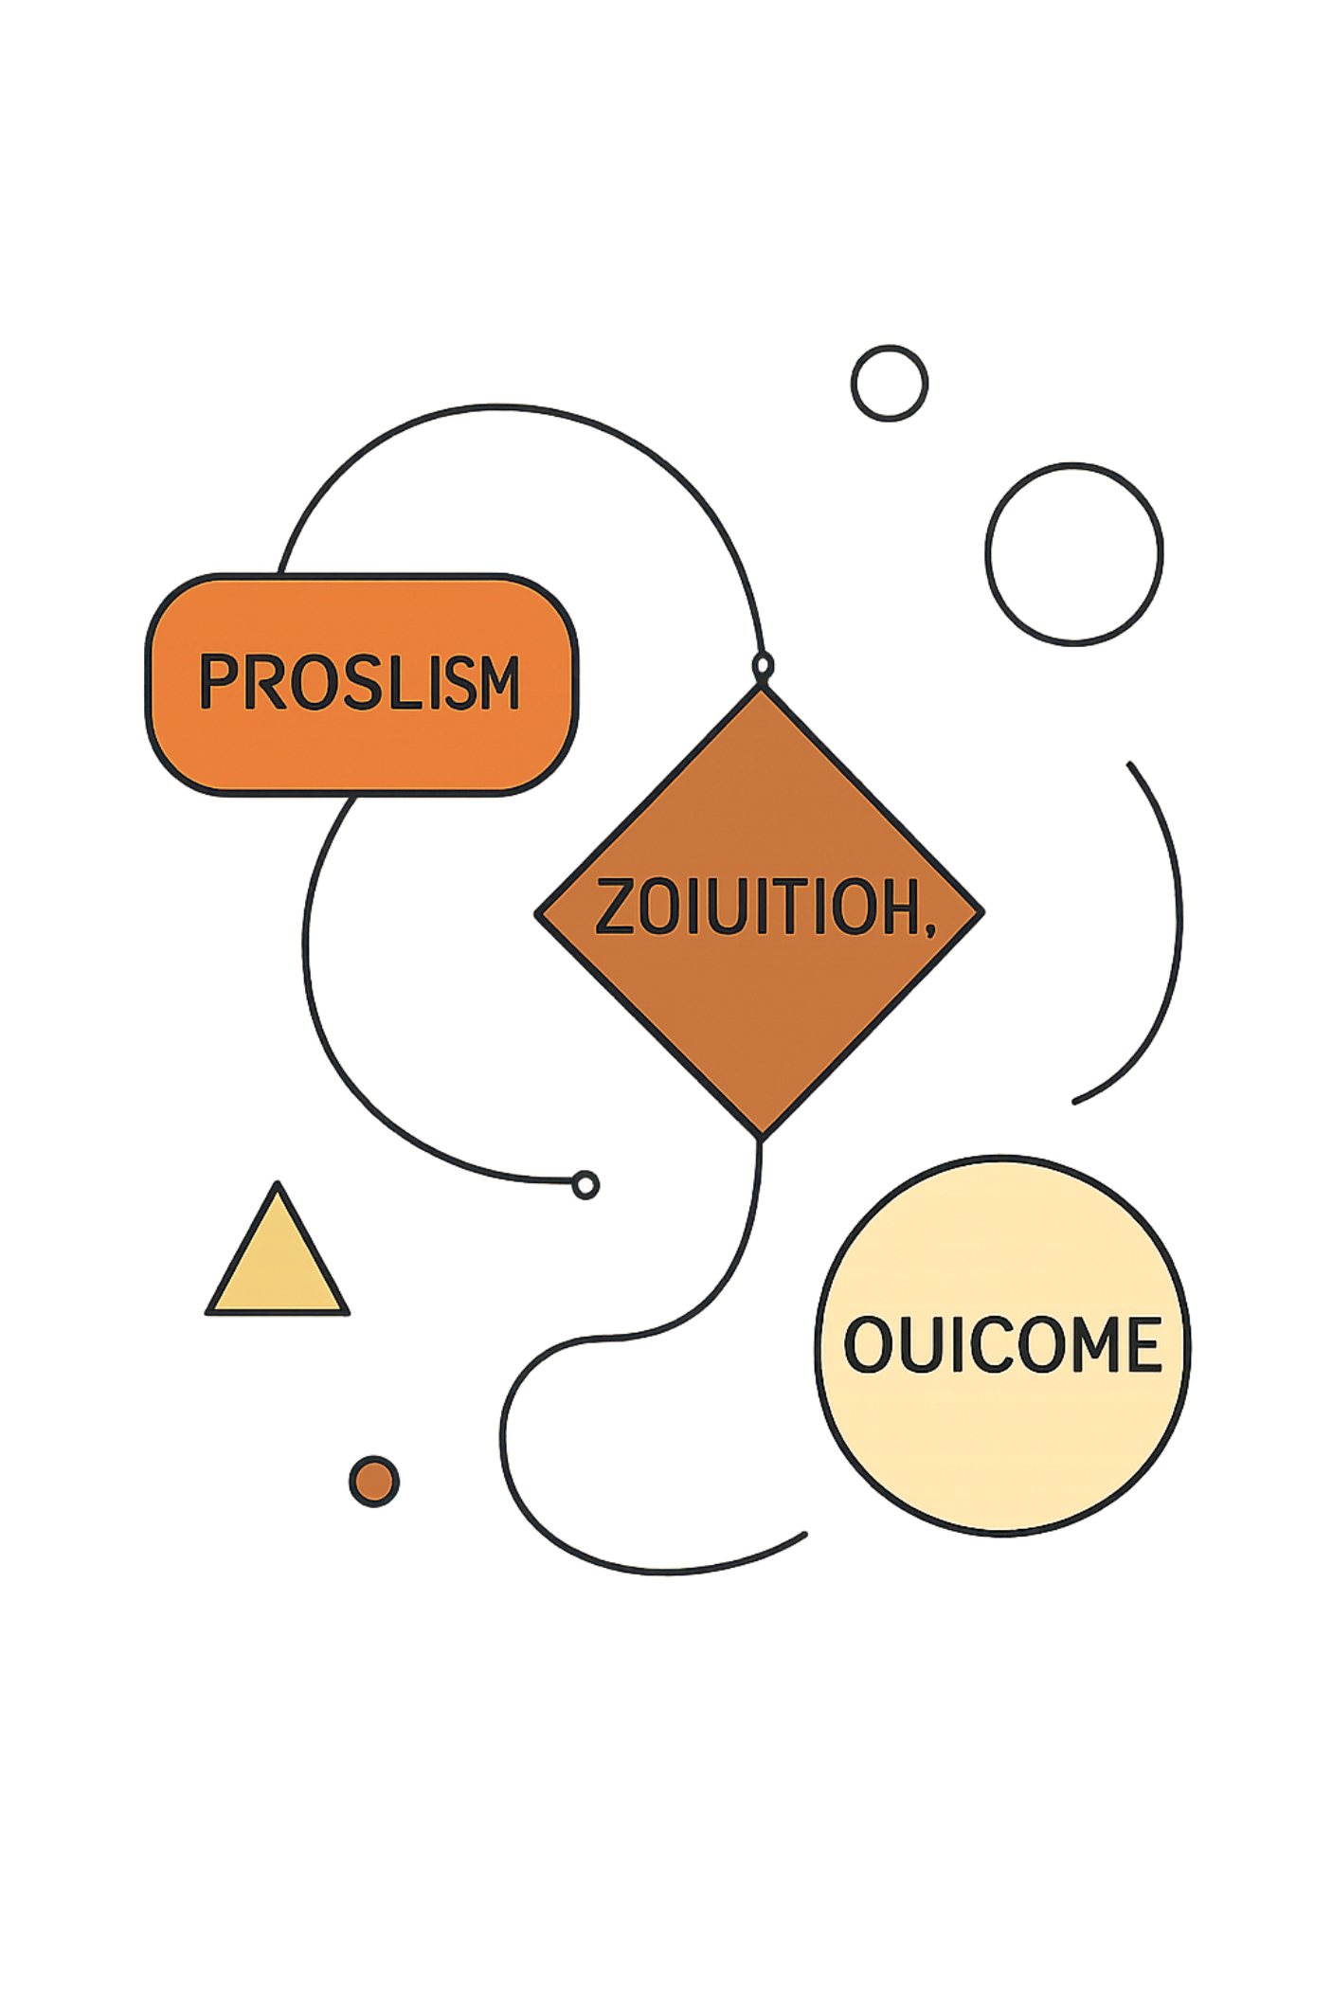
Project Overview & Objectives
01
02
Problem
Solution
Mutual fund information scattered across scheme metadata, NAV history, AUM, investor transactions and benchmarks; needs consolidation for analytics.
Automated Python ETL → relational SQLite star schema → EDA & advanced analytics → Power BI interactive dashboard.
03
Outcomes
Reusable data model, validated datasets, performance & risk analytics, investor insights, and an interactive BI layer for exploration.
Key objectives: Build ETL; Clean & validate; Design star schema; EDA; Performance & risk metrics; Investor behavior; Advanced analytics; Power BI.

Slide 3
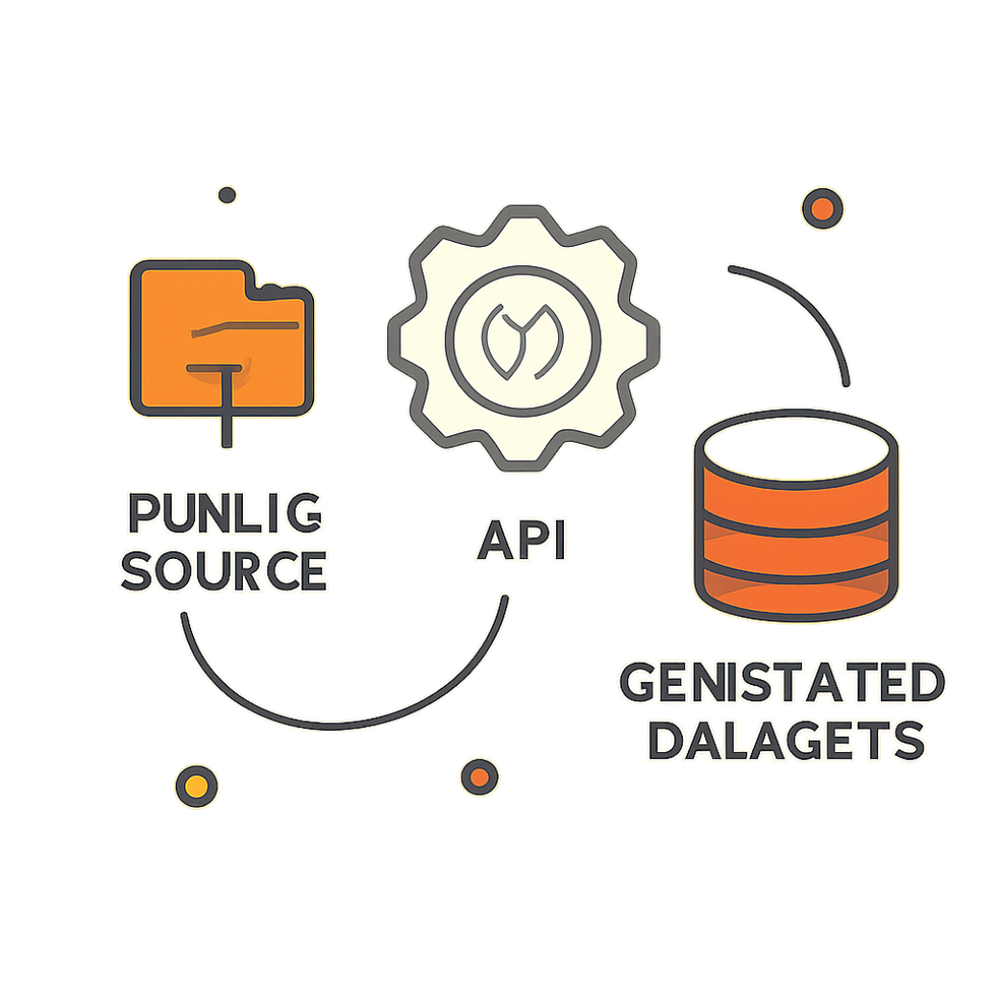

Data Sources & Dataset Inventory
Primary sources
AMFI India
mfapi.in
Public benchmark/index data
Project-generated analytical datasets
Dataset inventory (counts)
Fund Master | 40 records
NAV History | 46,000 records
Investor Transactions | 32,778 records
Scheme Performance | 40 records
AUM by Fund House | 90 records
Portfolio Holdings | 322 records
Benchmark Data | 8,050 records
Monthly SIP Inflows | 48 records
Category Inflows | 144 records
Industry Folio Count | 21 records
Data authenticity: metadata, AMFI codes, historical NAV and benchmarks = public/real-source. Investor transactions, constructed holdings, sector weights and some category inflows = project-generated/constructed.

Slide 4
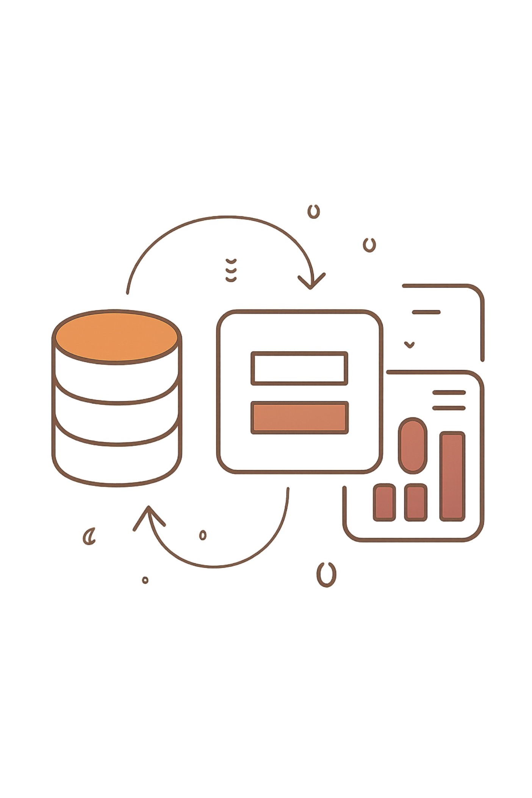
End-to-End ETL Pipeline
Pipeline stages
Raw Data → Ingestion (Python scripts, API pulls)
Validation → Cleaning & Transformation
Processed CSV → Load into SQLite
EDA & Performance Analytics → Advanced Analytics → Power BI
Validation Results
Cleaning Steps
40 fund-master AMFI codes
40 NAV AMFI codes
Missing AMFI codes: 0
Duplicate NAV fund-date records: 0
Non-positive NAV observations: 0
Date standardization
Duplicate checks & NAV validation
Transaction type standardization
Numeric conversion & missing-value checks

Slide 5
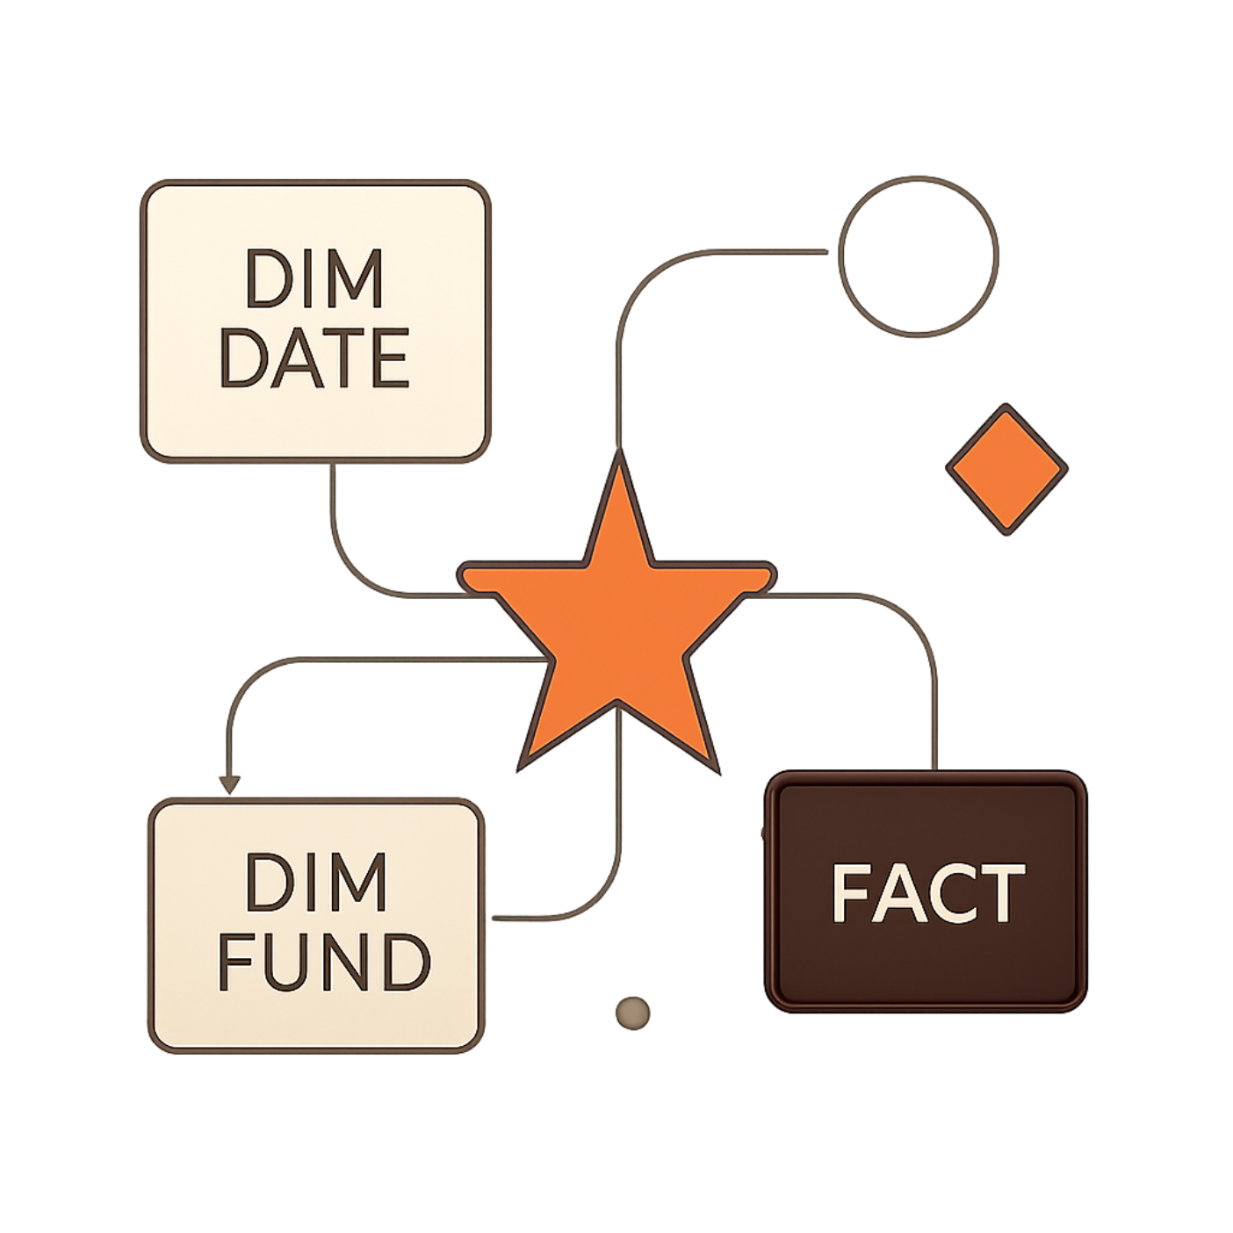
Database Design — SQLite Star Schema
Schema highlights
Core dimensions: dim_fund (AMFI code), dim_date (1,297 dates)
Fact tables: fact_nav (46,000), fact_transactions (32,778), fact_performance (40), fact_aum (90)
AMFI code used as primary fund identifier across facts
Date dimension supports time-series and rolling-window analytics
Implemented analytical SQL queries: rolling returns, windowed Sharpe, cohort aggregations
dim_fund | 40 rows
dim_date | 1,297 rows
fact_nav | 46,000 rows
fact_transactions | 32,778 rows
fact_performance | 40 rows
fact_aum | 90 rows

Slide 6
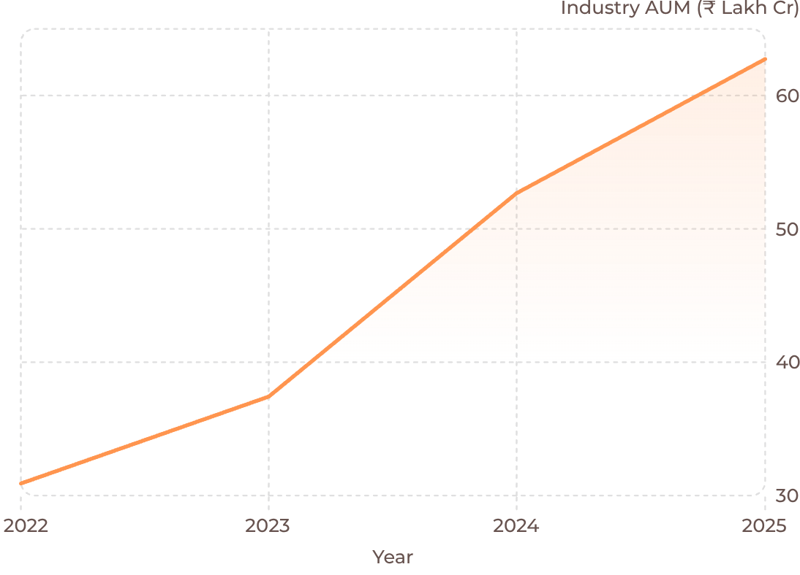
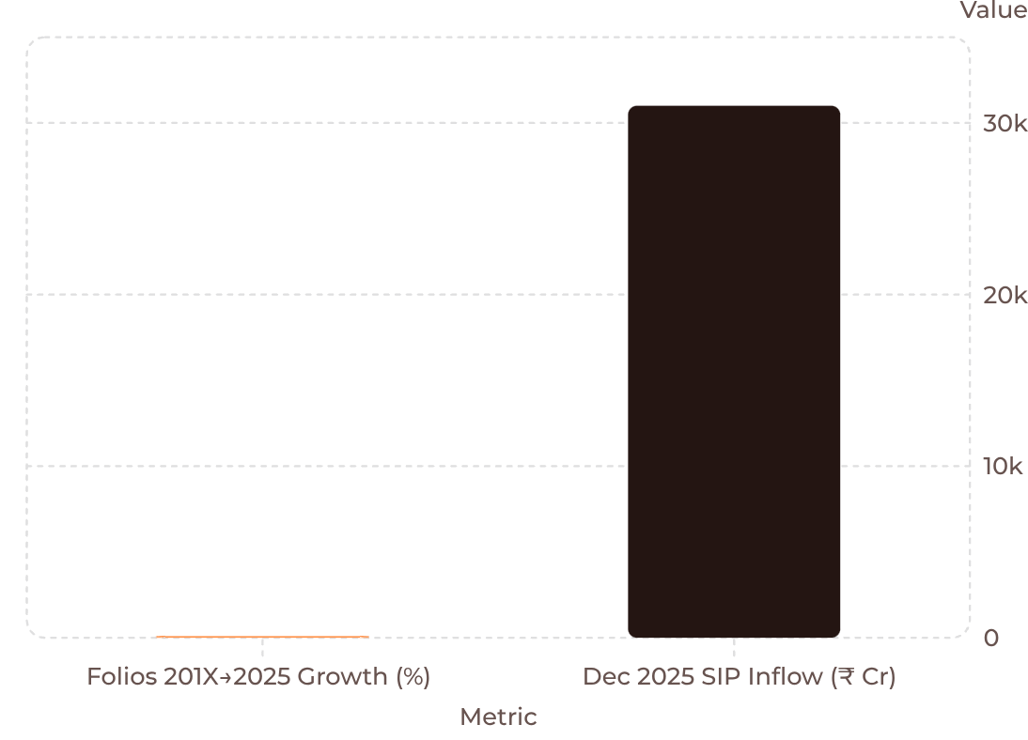
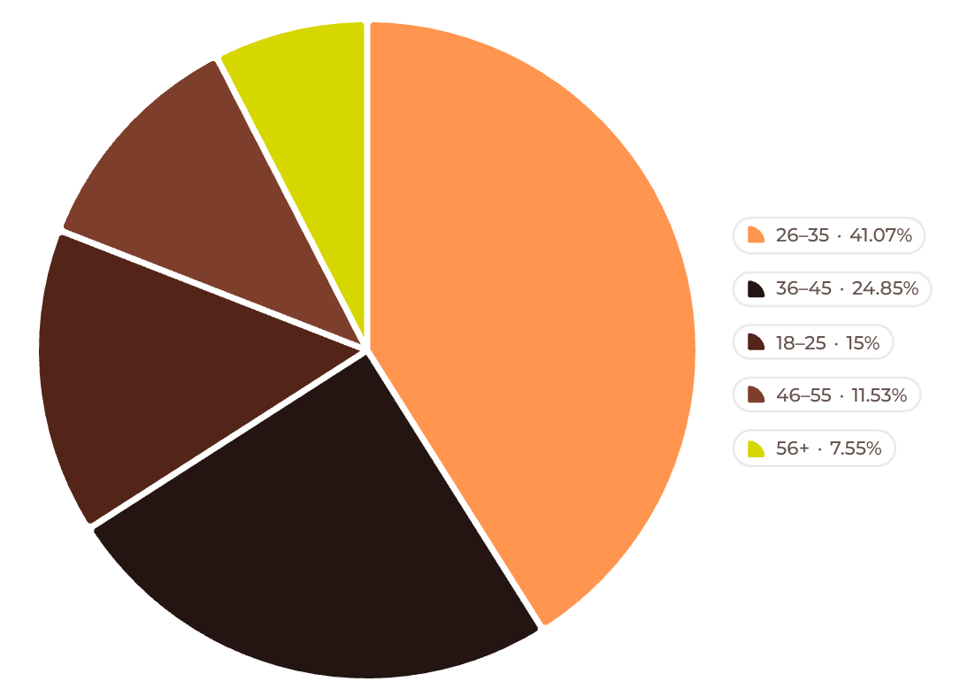
Exploratory Data Analysis — Industry & Investor Trends
Industry AUM trend (2022–2025)
Folio growth and Dec‑2025 SIP inflow
Investor age distribution (project dataset)
Charts use the exact values provided. Age distribution and folio growth derived from project datasets.

Slide 7
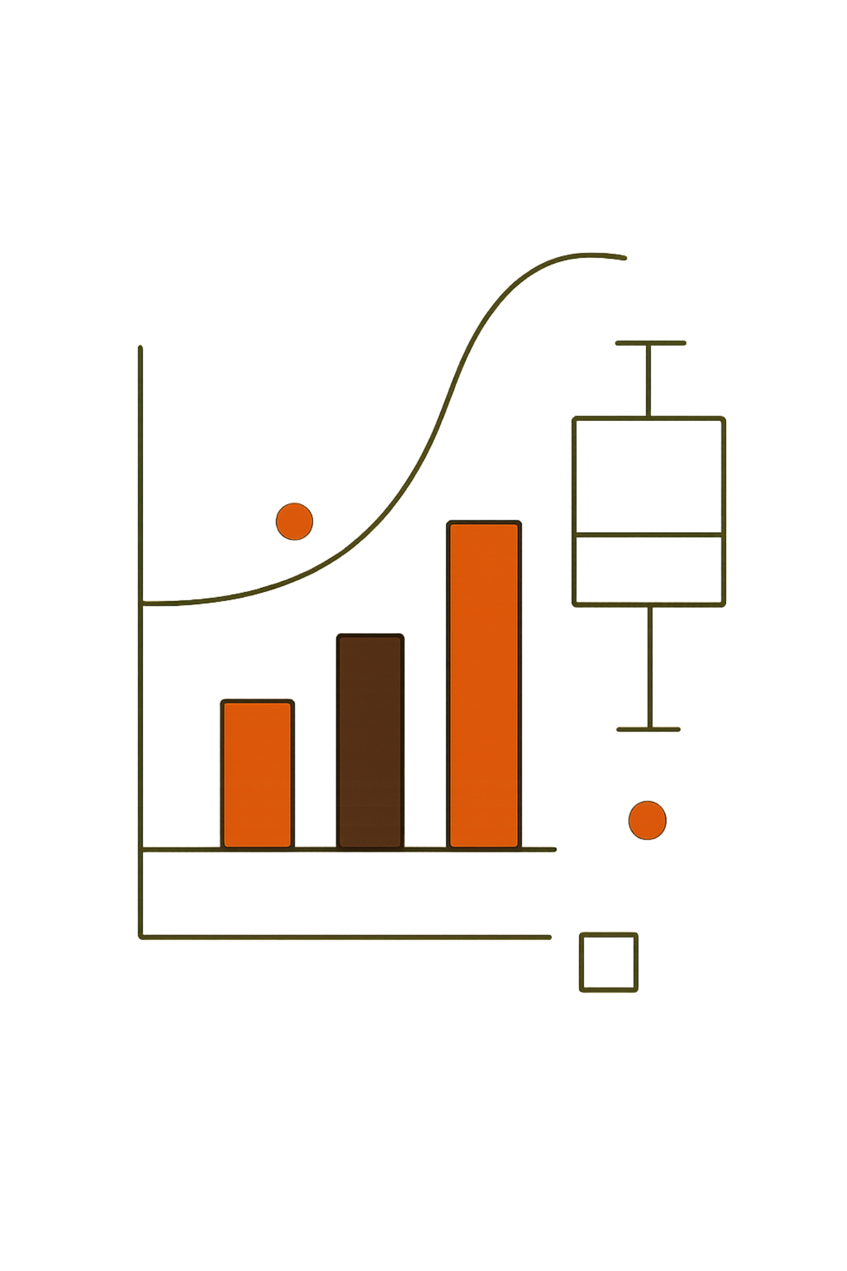

Fund Performance & Risk Analysis
Analysis scope & constraints
Alpha / Beta (37 funds)
Maximum Drawdown
NAV history available Jan 2022 → May 2026; a genuine 5‑year CAGR was not computed. Risk-free rate assumption: 6% annual.
Mean Alpha: 10.94% · Positive Alpha: 31 of 37 funds · 3 funds lacked benchmark data
Mean: -17.87% · Median: -16.31% · Worst: SBI Small Cap Direct -52.57% · Second: Axis Small Cap Regular -51.68%
Performance metrics (Sharpe, Sortino, CAGR‑to‑date) computed from available NAVs; reported exactly as provided.

Slide 8
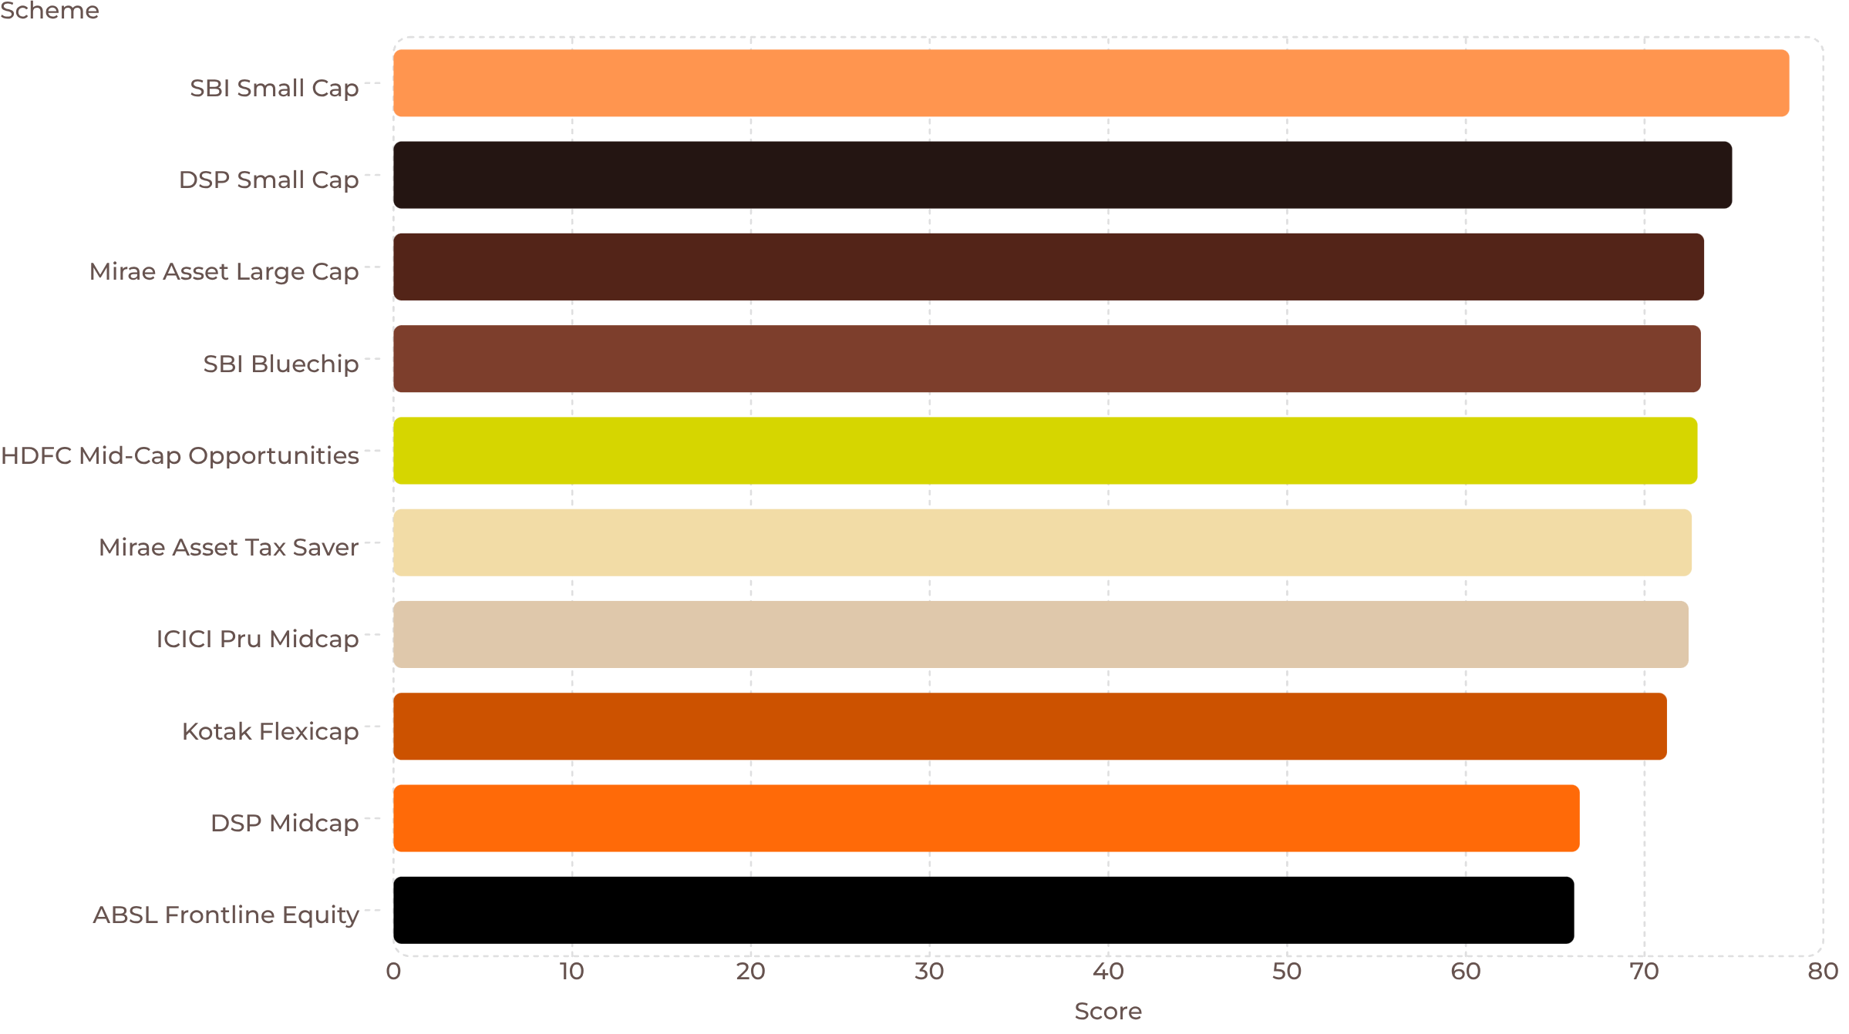
Multi‑Metric Fund Scorecard
Project‑specific analytical scorecard (not investment advice). Weighted metrics:
CAGR 1Y 20% · CAGR 3Y 20% · Sharpe 20% · Sortino 15% · Alpha 15% · Drawdown 10%
Horizontal bar chart displays top 10 schemes by score.

Slide 9
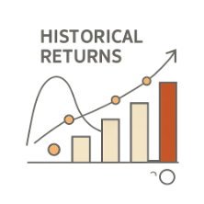




Advanced Analytics — Five Modules
VaR & CVaR
Rolling Sharpe
Investor Cohorts
SIP Continuity
Historical daily returns used; VaR at 95% and CVaR computed as mean of tail returns (project dataset).
90‑day rolling window; annualized using √252; applied to five selected funds for comparative analysis.
Consecutive SIP gaps computed; rule: gap >35 days = "At Risk" (project-defined).
Cohorts by first transaction year; metrics: investment, redemptions, SIP vs lumpsum activity.
Sector HHI
Portfolio concentration measured as sum of squared sector proportions using constructed holdings.

Slide 10
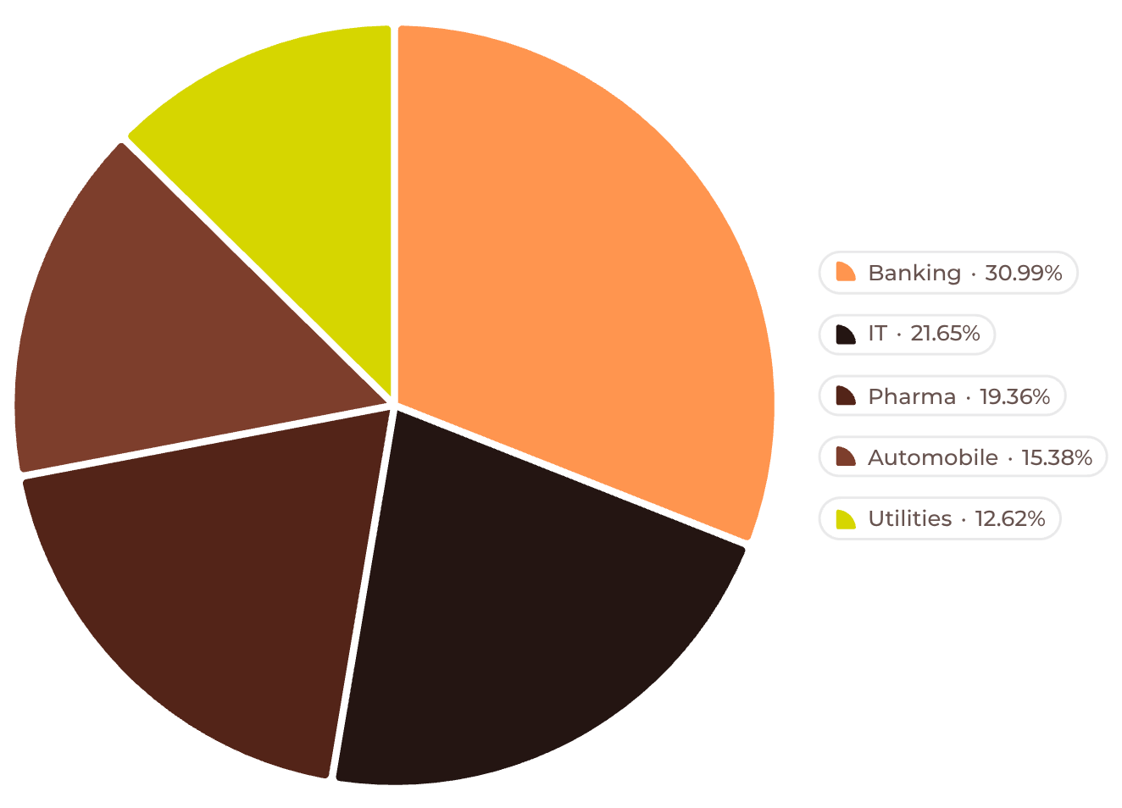

Investor & Sector Insights
Transaction counts (project dataset)
SIP | 19,716
Lumpsum | 8,095
Redemption | 4,967
Total Transactions | 32,778
Geography: T30 — 66.72% · B30 — 33.28%
Top SIP amount states: Madhya Pradesh · Punjab · Telangana · Tamil Nadu · Gujarat
Investor figures are based on the project-generated transaction dataset and should be treated as constructed for analysis.
Top 5 sector concentration: 61.89% (constructed from portfolio holdings)
Sector weights and concentration derived from constructed portfolio holdings; labeled as project-generated data.

Slide 11
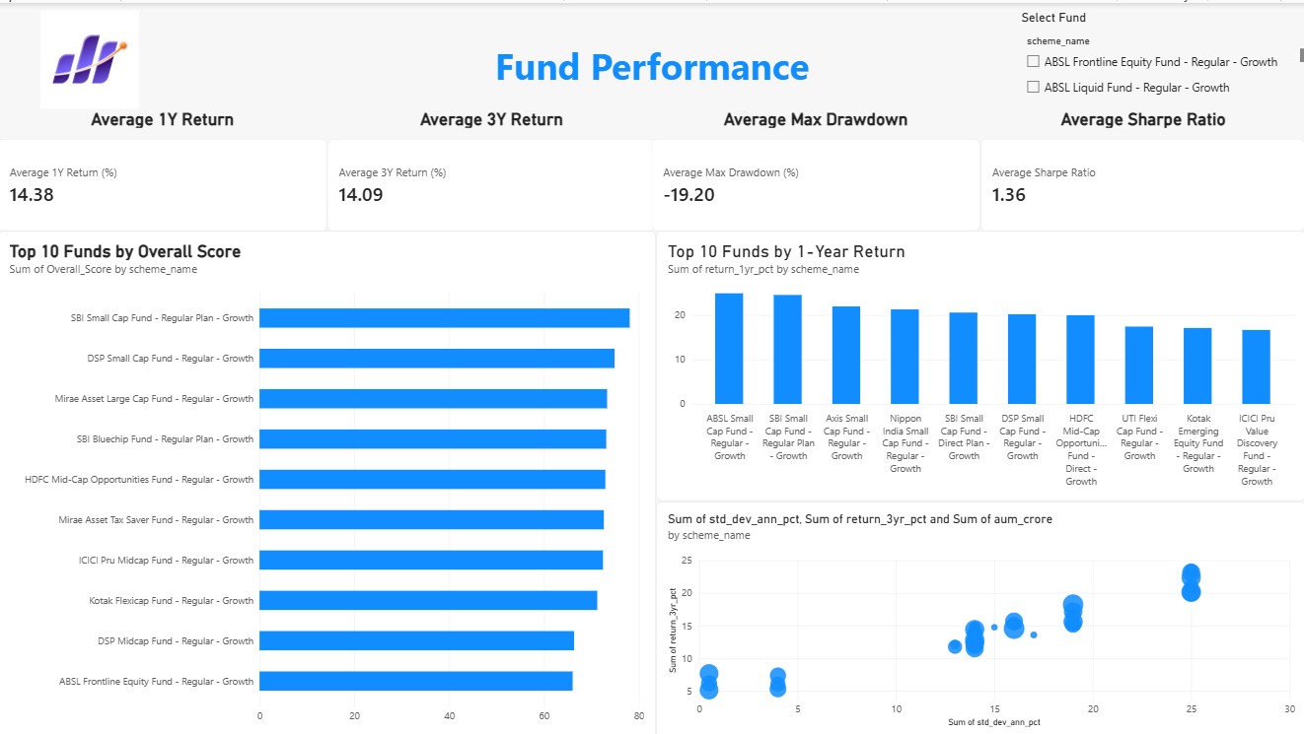
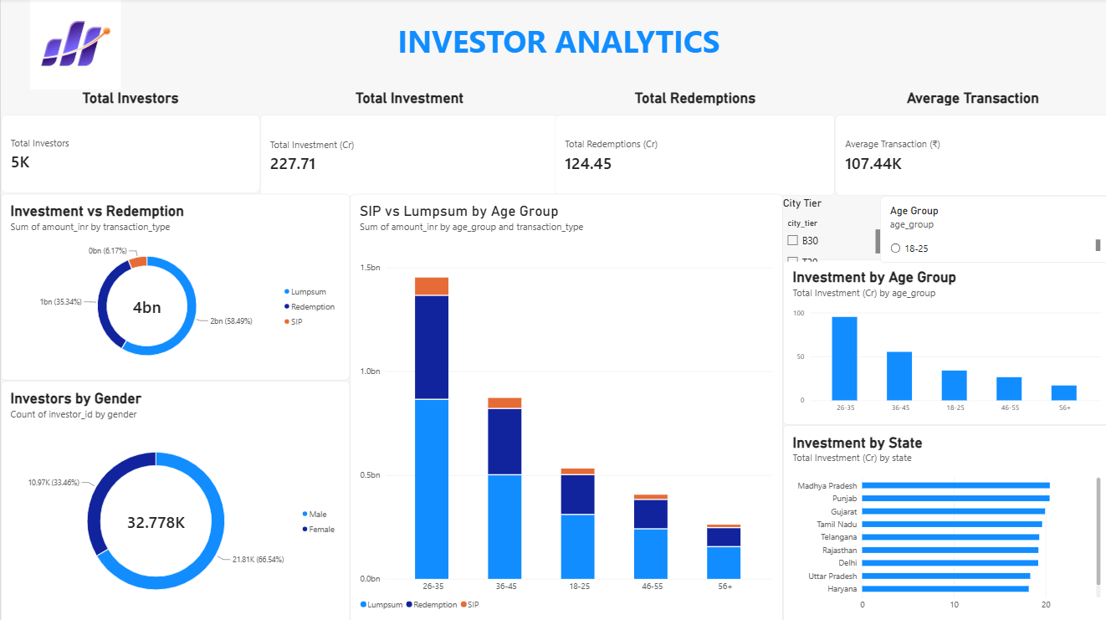
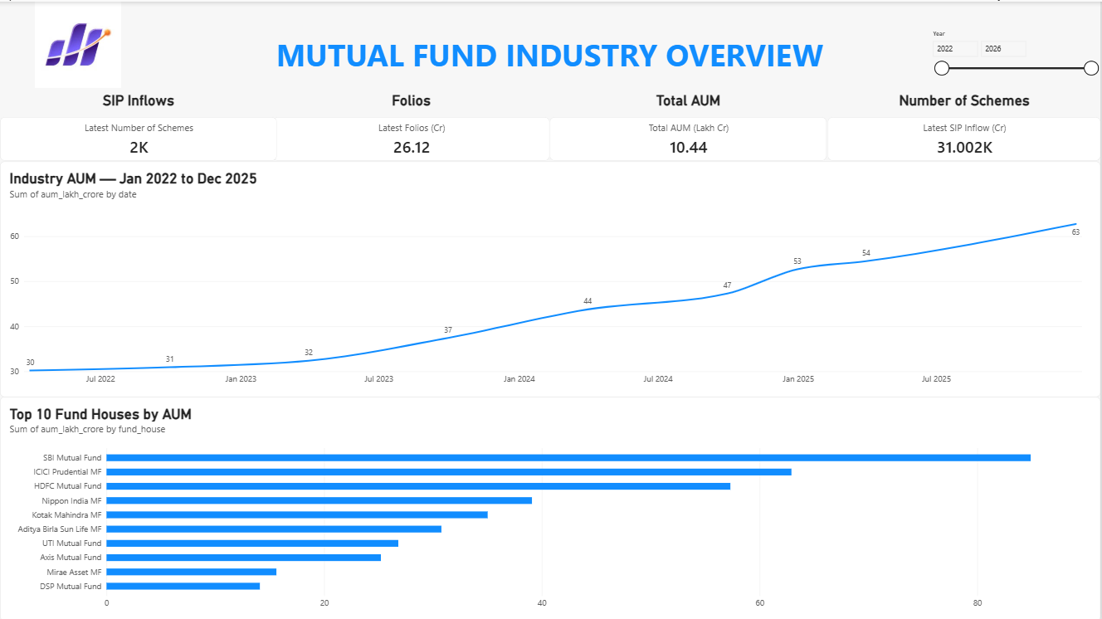
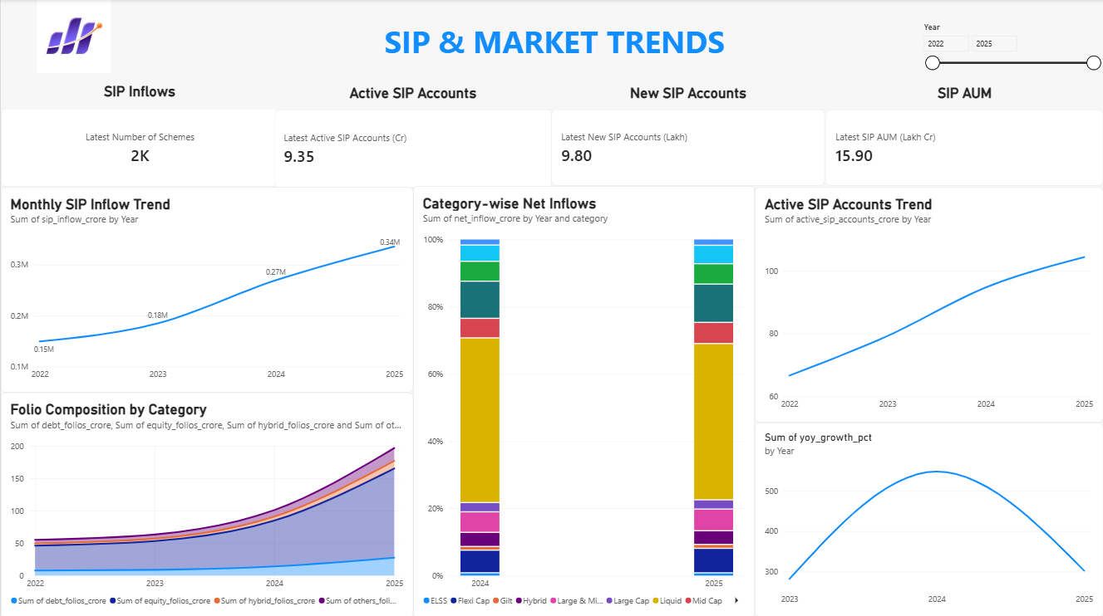
Dashboard Slides

Slide 12
THANK YOU

