Slide 1
Библиотечные

Slide 2
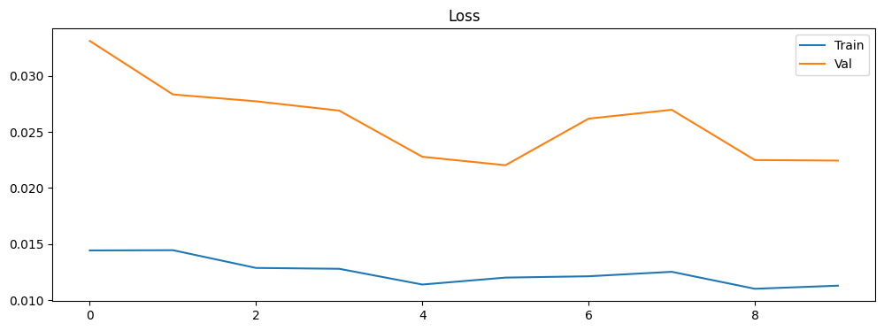
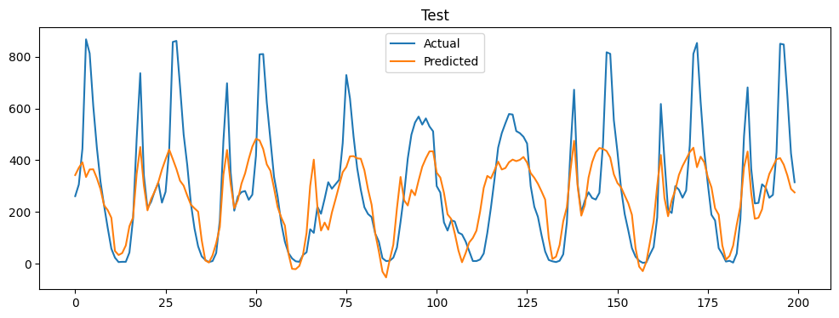
RNN
Test MAE: 106.71, MSE: 21379.11, RMSE: 146.22

Slide 3
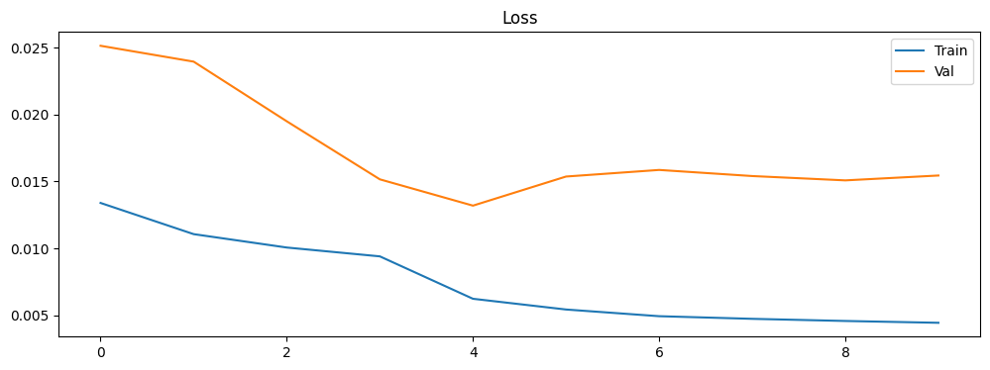
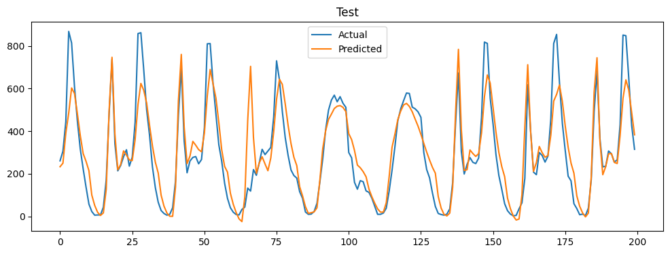
LSTM
Test MAE: 88.04, MSE: 15121.54, RMSE: 122.97

Slide 4
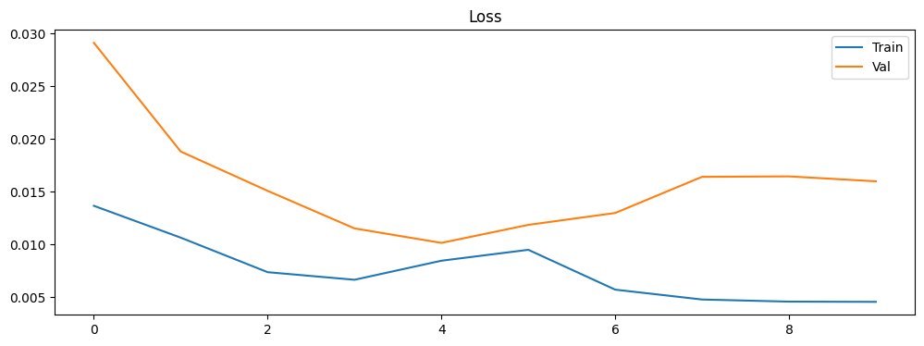
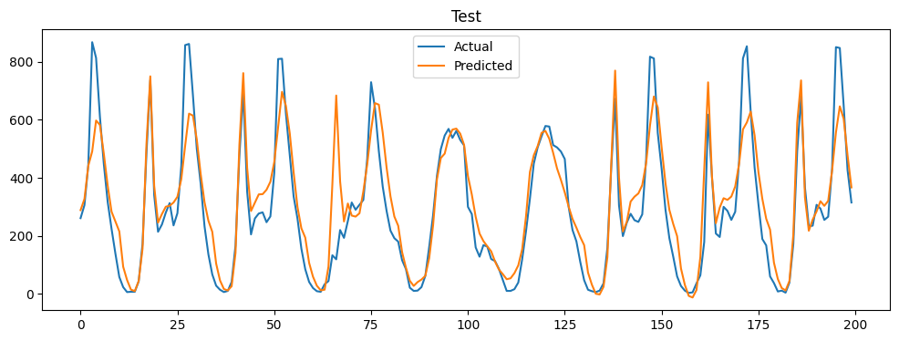
GRU
Test MAE: 77.29, MSE: 12417.29, RMSE: 111.43

Slide 5
Ручные

Slide 6
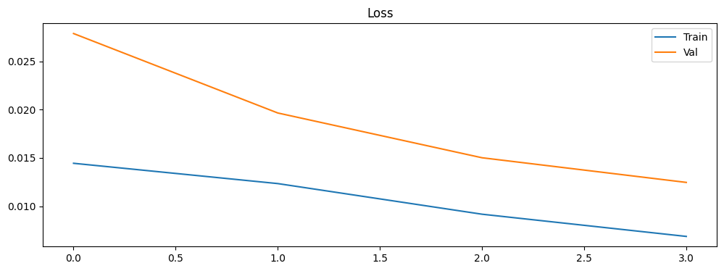
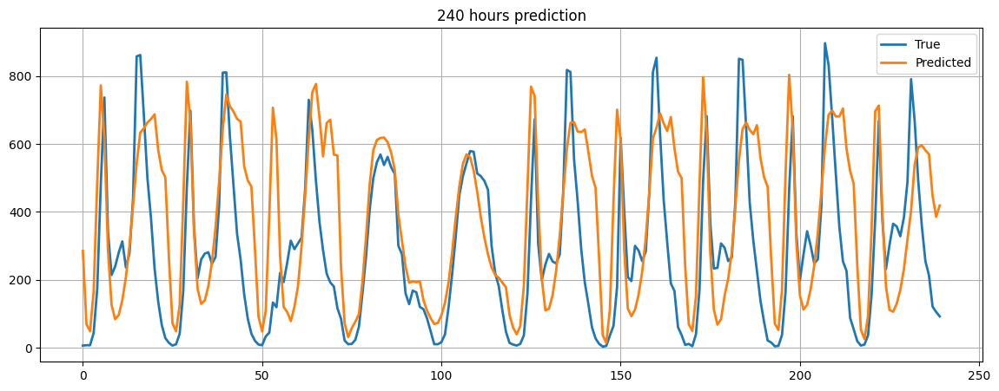
GRU
Test MAE: 169.18, MSE: 49464.68, RMSE: 222.41

Slide 7
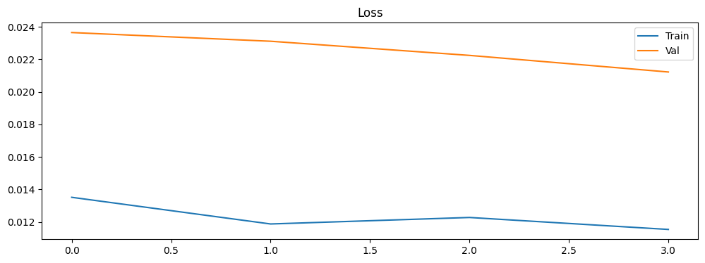
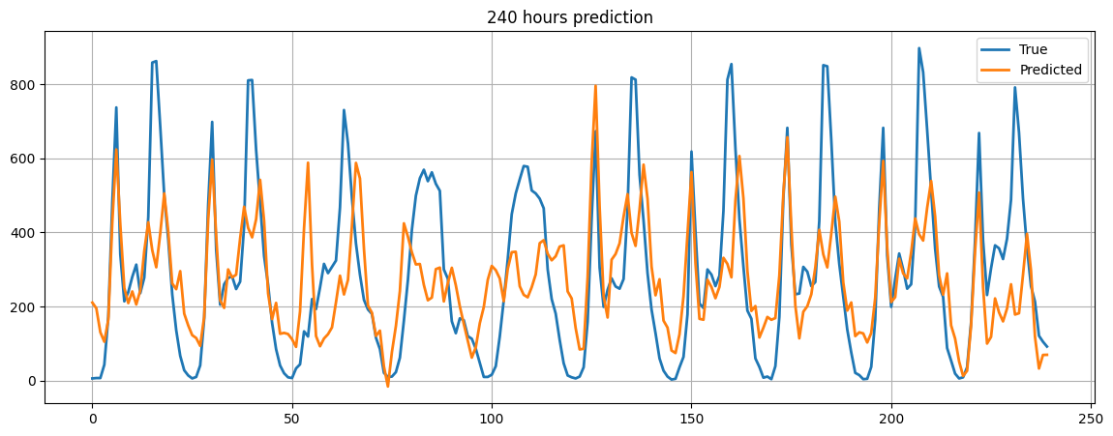
RNN
Test MAE: 134.71, MSE: 33947.45, RMSE: 184.25

Slide 8
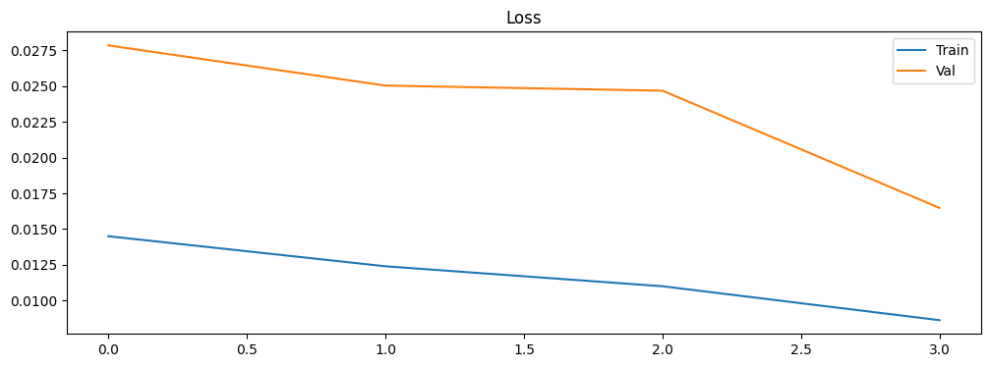
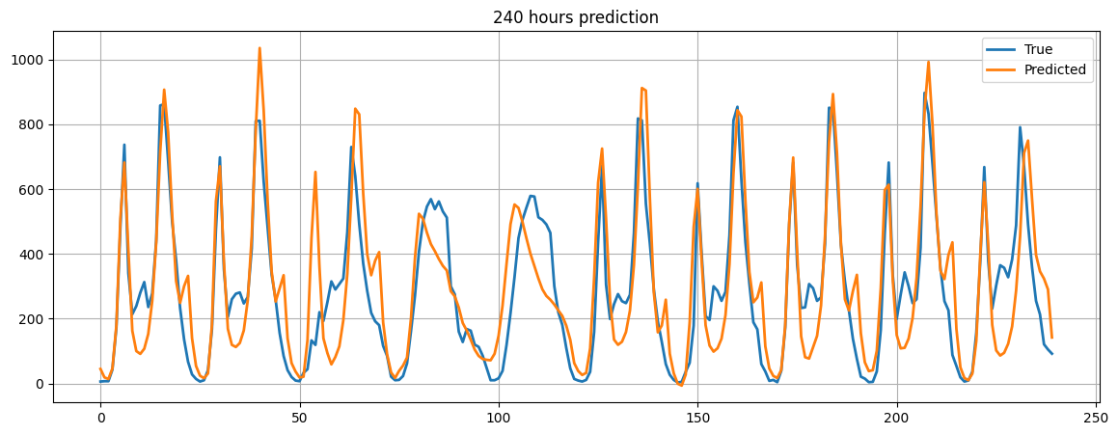
LSTM
Test MAE: 101.56, MSE: 18192.71, RMSE: 134.88

