Slide 1

Unlocking Success:
Identifying Key Factors Driving Job Seekers’ Outcomes
SKILLUP X TEAM TGW
Huai Hsuan Huang, Po An Tao
People Analytics case competition
Notes:
Team TGW

Slide 2
Contents
01
Introduction
02
Methodologies & Analysis
03
Key findings & insights
04
Recommendations
05
Appendix

Slide 3

Introduction
-Company & case
About Case
Using SkillUp website data and survey to:
Track user behaviors – Analyze user interactions, including resource access, coaching, and job applications.
Identify key success factors – Identify key drivers of job placement and training participation.
Understand demographic variations – Examine how success factors differ across user backgrounds and career goals.
Nonprofit organization founded in 2020, helps workers without a degree secure quality jobs through career navigation, training, and resources, empowering them to develop skills and enter high-demand industries.

Slide 4
Methodologies & Analysis
-Overview
1. Data Cleaning Process
Confirm Data Sources: WAP_pulse_survey, WAP_all_time_connect, WAP_individual
Define Analysis Period: Q1:2023-Q3:2024
Define X and Y Variables: Y: skillup_find_new_job, skillup_training/X: user interactions, demographics, and engagement metrics
Handle Missing Data: Apply appropriate imputation strategies (category "Unknown" for categorical variables)
2. Data Analysis
Descriptive Analysis: Correlation analysis, Chi-Square Test
Prediction Model: Logistic Regression、Random Forest
Notes:
Descriptive Analysis: Correlation analysis, Chi-Square Test

Slide 5
Methodologies & Analysis
-Data Cleaning Process
WAP_pulse_survey
WAP_individual
18,696 rows (delete duplicate)
X='desired_industry’
Y='skillup_training', 'skillup_find_new_job’
WAP_id
18,696 rows
X='rural_type','myPathCompleted','preferredRegion','preferredRegionGroup','educationAndWorkExperience','workExperienceGroup','race','highestEducationLevel','latestSalary','targetSalary','completed_career_milestone','completed_jobs_milestone','completed_training_milestone','gender_3','age'
WAP_id, survey_date>=createdAt+180
WAP_all_time_connect
X=
How many times did the seeker connect to the website in the 180 days before the survey? (e.g. ‘Website Visits (Last 180 Days)’)
Did seekers engage in specific actions on the platform within the 180 days? (e.g. ‘Training Clicked Apply’)
(Combine ‘collectionType’ and ‘eventName’ to identify seekers’ behaviors )

Slide 6
Methodologies & Analysis
-Data Analysis
Descriptive Analysis: Chi-Square Test
Outcome: SkillUp Training
Outcome: SkillUp Find New Job
Did you find the training program through SkillUp?
Did you find your new job through SkillUp?

Slide 7
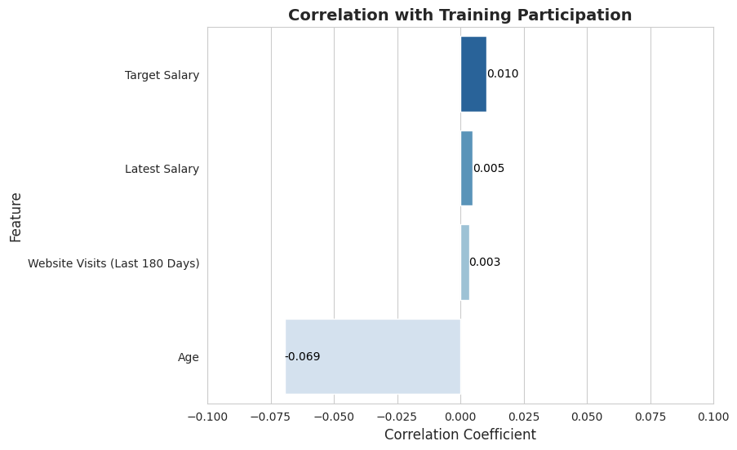
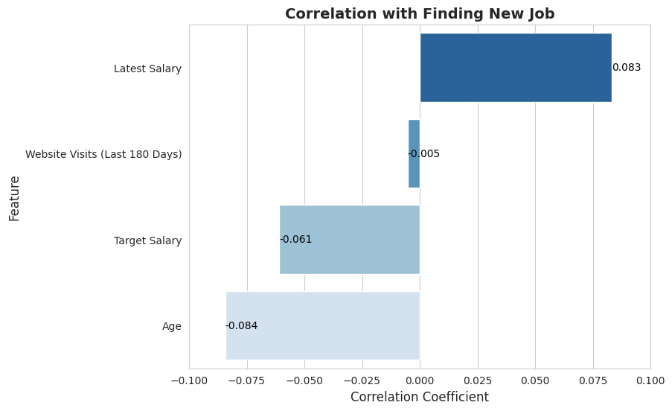
Methodologies & Analysis
-Data Analysis
Descriptive Analysis: Correlation analysis
Outcome: SkillUp Training
Outcome: SkillUp Find New Job
Did you find the training program through SkillUp?
Did you find your new job through SkillUp?

Slide 8
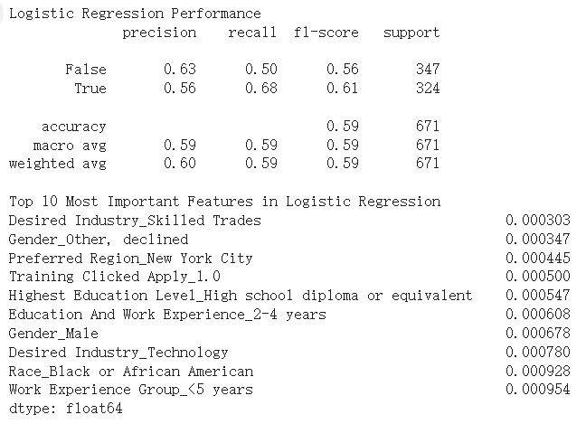
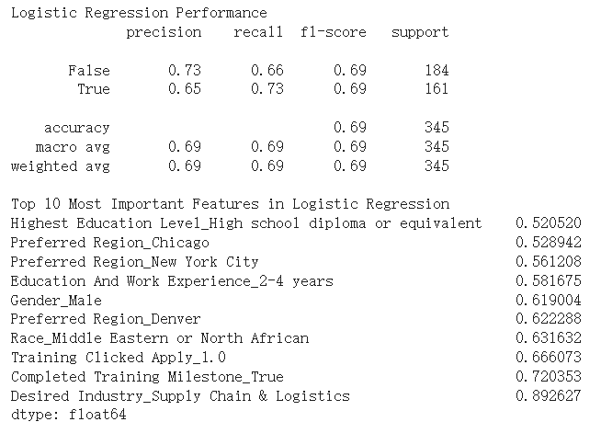
Methodologies & Analysis
-Data Analysis
Prediction Model: Logistic Regression
Outcome: SkillUp Training
Outcome: SkillUp Find New Job

Slide 9
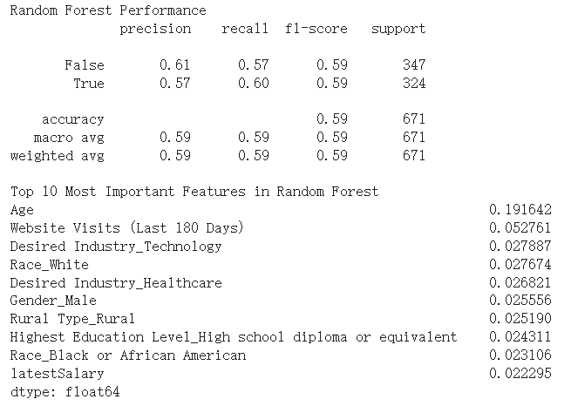
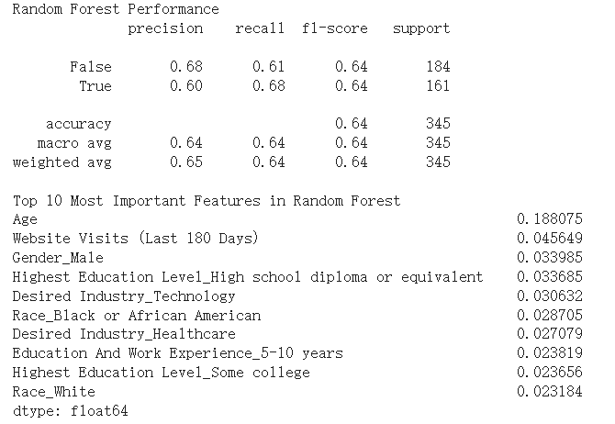
Methodologies & Analysis
-Data Analysis
Prediction Model: Random Forest
Outcome: SkillUp Training
Outcome: SkillUp Find New Job

Slide 10

Key findings & insights
Identify key success factors
✅ Demographics & Career Milestones Matter – Age, race, gender, and completing key milestones (e.g., training, job applications) impact both training and job success.
✅ Regional & Industry Preferences Influence Outcomes – Users in specific regions and industries (e.g., Technology, Healthcare) show higher training and job placement rates.
✅ Platform Engagement is Key – Actions like applying for training, saving jobs, and interacting with career content boost both participation and job success.
SkillUp Training Participation
Demographics: Age, Race, Gender
Education & Work Background: Highest Education Level, Work Experience
Geographical Influence: Preferred Region
Career & Industry Factors: Desired Industry,
Engagement : Completed Training Milestone, Completed Jobs Milestone, Training Clicked Apply
Finding a New Job through SkillUp
Demographics: Age, Race, Gender
Education & Work Background: Highest Education Level, Work Experience, Latest Salary
Geographical Influence: Preferred Region, Rural Type
Career & Industry Factors: Desired Industry
Engagement : Completed Training Milestone, Jobs Clicked Apply, Careers Viewed Catalog Item, Training Saved Catalog Item

Slide 11
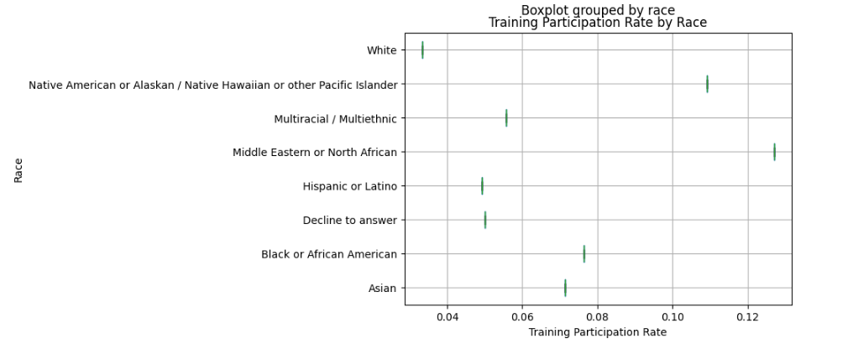
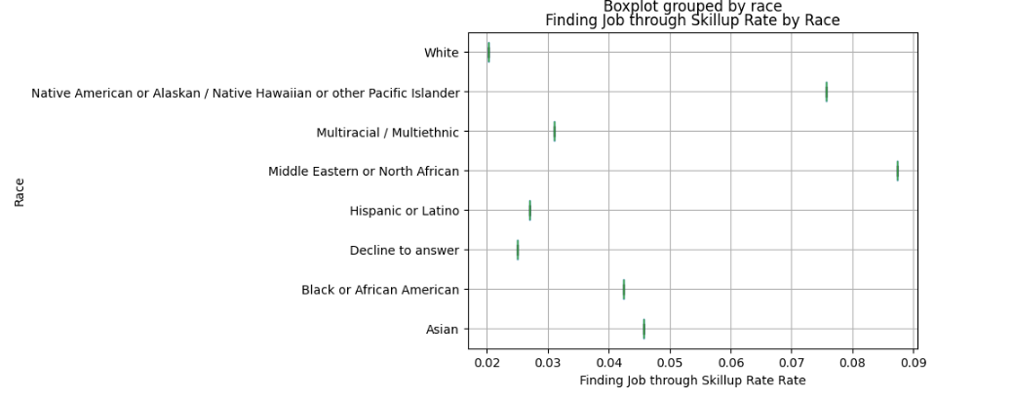
Key findings & insights
Does Race Impact Career Milestones?
Training Participation Rate:
Middle Eastern or North African (12.7%) and Native American or Alaskan / Native Hawaiian (10.9%) have the highest training participation rates.White individuals (3.3%) have the lowest participation rate.
Finding a Job Through Skillup:
Middle Eastern or North African (8.7%) and Native American or Alaskan / Native Hawaiian (7.6%) have the highest job finding rates. White individuals (2.0%) have the lowest job finding rate.

Slide 12
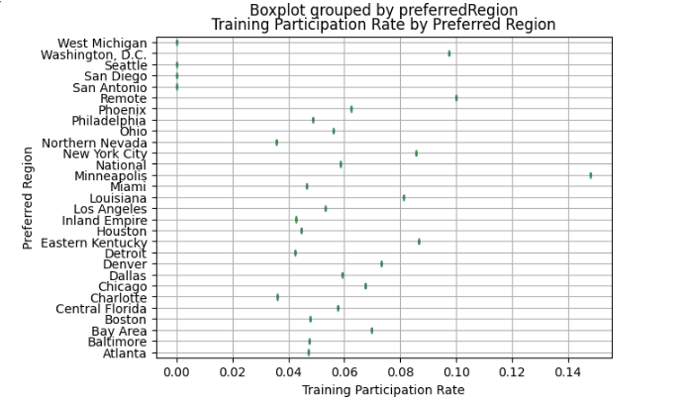
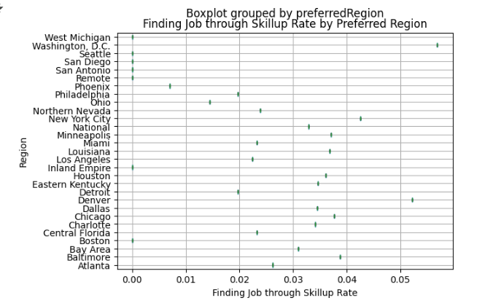
Key findings & insights
Does Race Impact Career Milestones?
Training Participation Rate:
Training participation varies significantly based on the seeker’s desired job location. Washington, D.C. has a higher training participation rate, whereas locations like Seattle show a 0% participation rate, indicating no recorded engagement from seekers targeting those regions.
Finding a Job Through Skillup:
Job attainment through SkillUp also differs by the seeker’s preferred job location. Some locations, such as Denver and Washington, D.C., have higher job placement rates, while others, like Seattle, show a 0% job placement rate, indicating no recorded job outcomes for seekers aiming to work there.

Slide 13
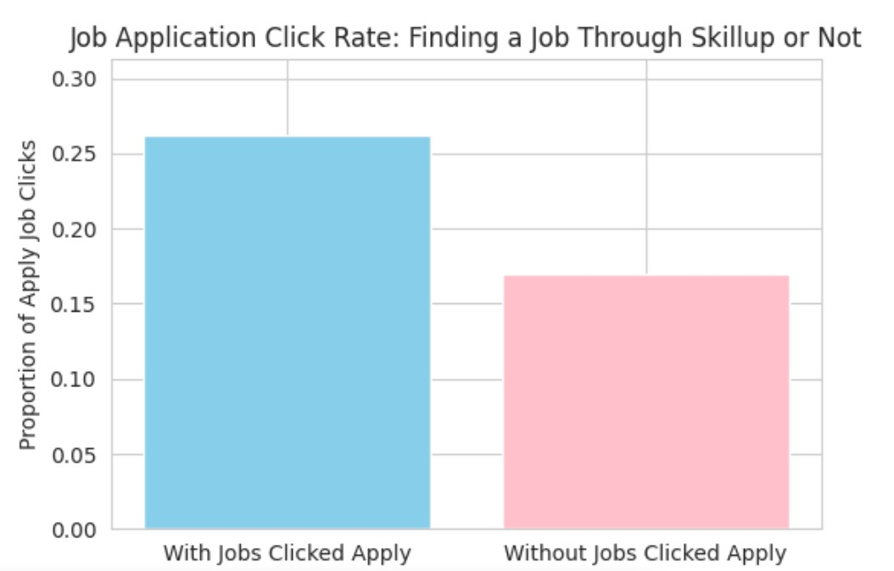
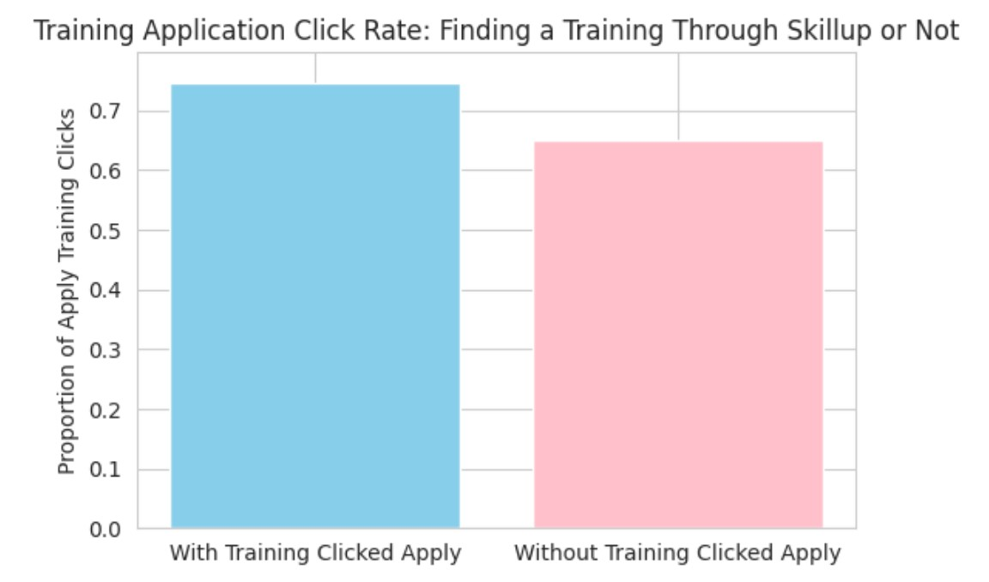
Key findings & insights
Typical User Journey to Success
Job and Training Application Activity Correlates with Success
Individuals who successfully found a job through SkillUp had a higher likelihood of engaging in job applications on the platform. Similarly, those who enrolled in training programs had a higher rate of training application clicks. This highlights the importance of active engagement in the application process for achieving career advancement.

Slide 14



Recommendations
Optimize User Engagement on the Platform：
Since both the frequency of website visits and specific interactions are key predictors of training participation and job success, SkillUp should implement features that encourage consistent and meaningful engagement..
Implement reminder notifications for users who frequently visit the site but have not yet applied for training or jobs.
Provide a clear career progression roadmap for users, showing how different training and job applications contribute to their long-term goals.
Consider Regional and Industry-Specific Strategies：
Tailor SkillUp programs to align with the unique demands of different regions and industries to maximize effectiveness.
Targeted Training and Employment Support for High-Success Industries：
Given the higher job success rates in Technology and Healthcare, prioritizing skill development and career advancement initiatives in these sectors will yield better outcomes.

Slide 15
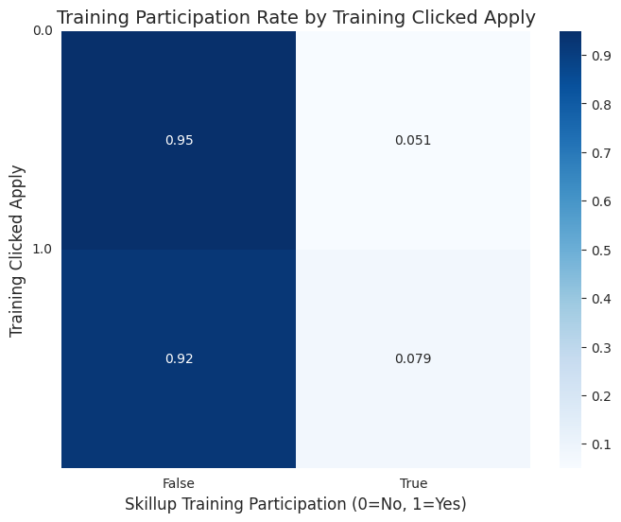
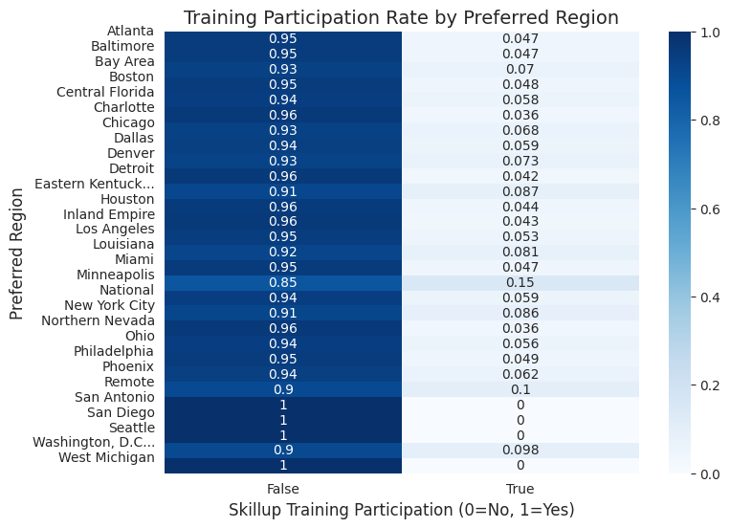
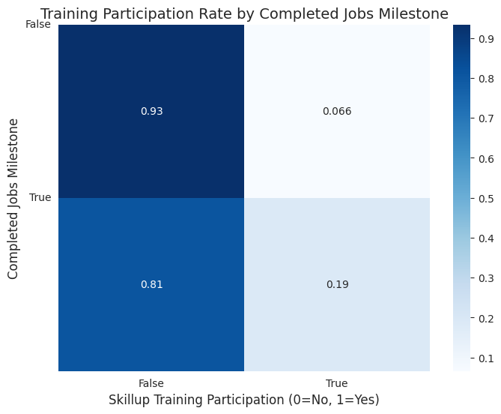
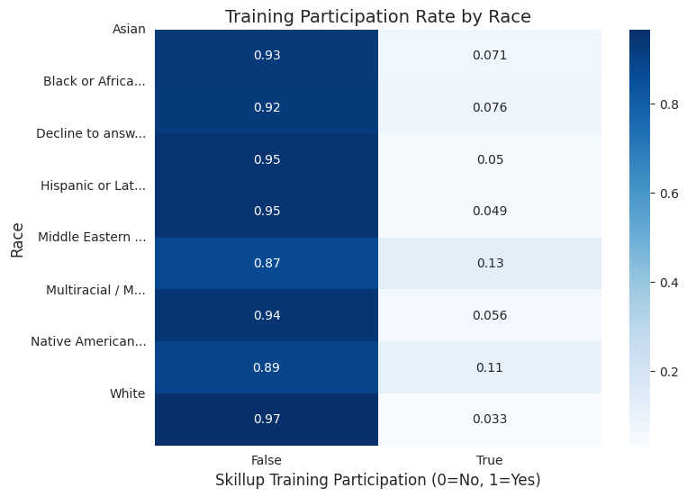
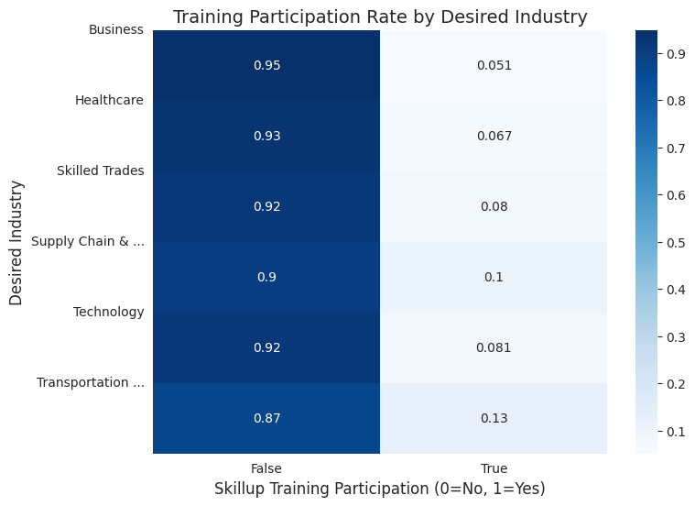
Appendix
-Data Analysis
Descriptive Analysis: Heatmap-Analyzing Significant Factors Affecting Training Participation

Slide 16
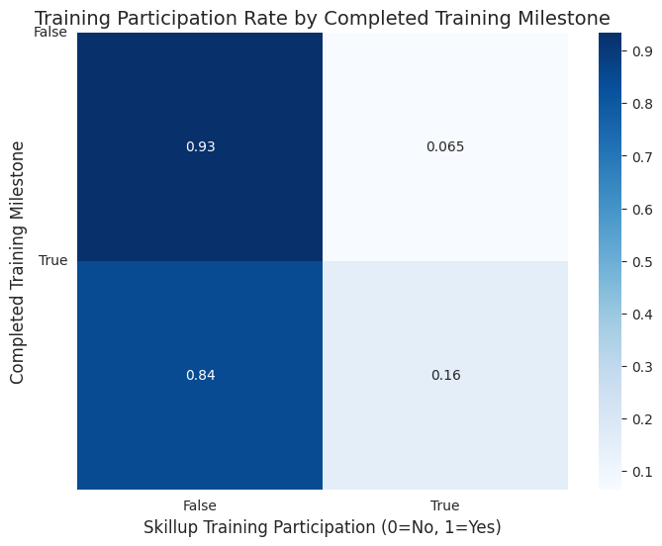
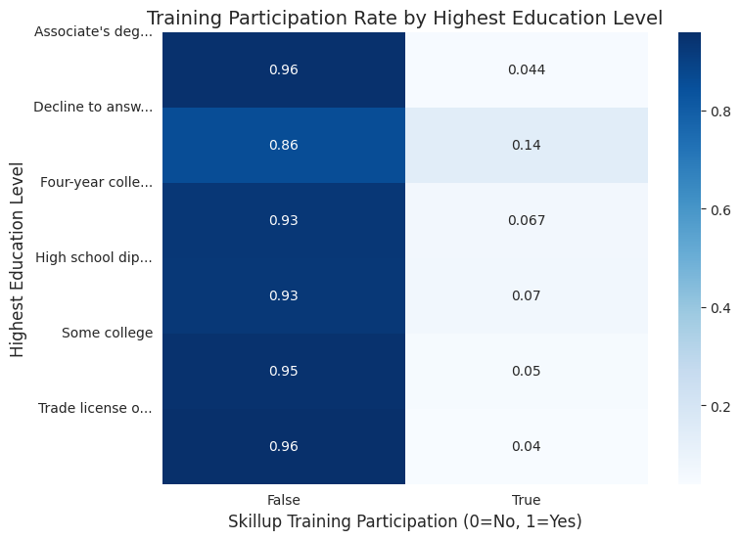
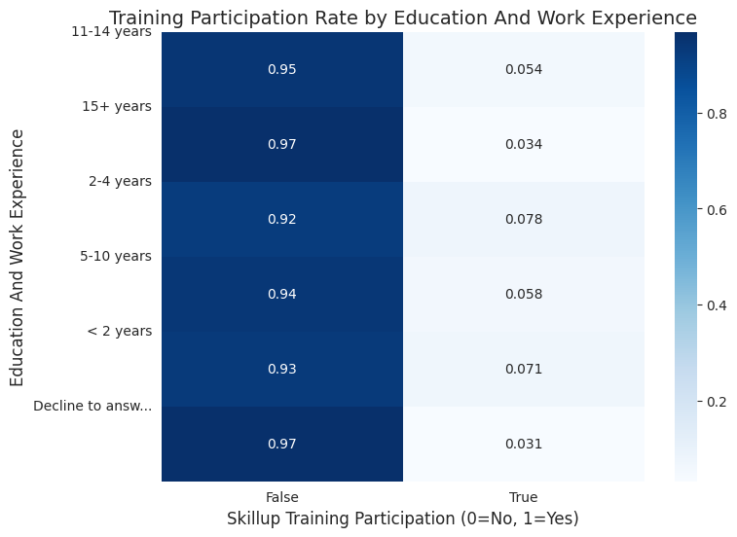
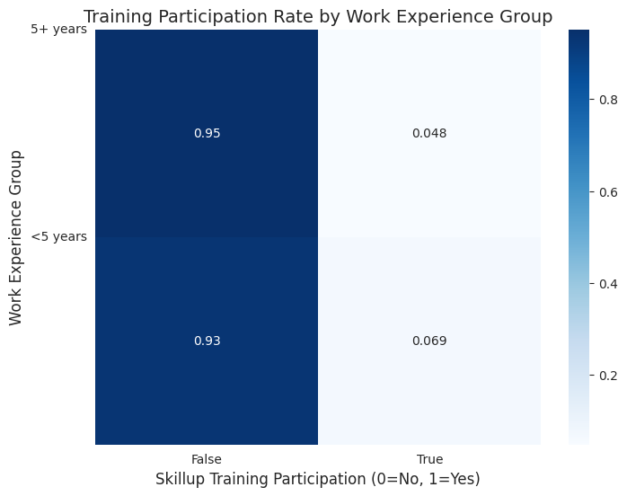
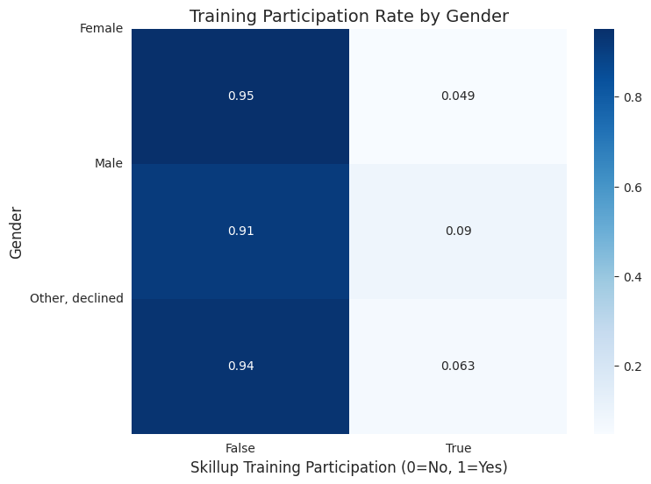
Appendix
-Data Analysis
Descriptive Analysis: Heatmap-Analyzing Significant Factors Affecting Training Participation
Notes:
Did you find your new job through SkillUp?
Did you find the training program through SkillUp?

Slide 17
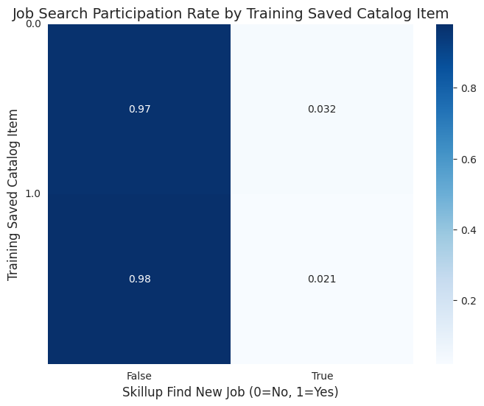


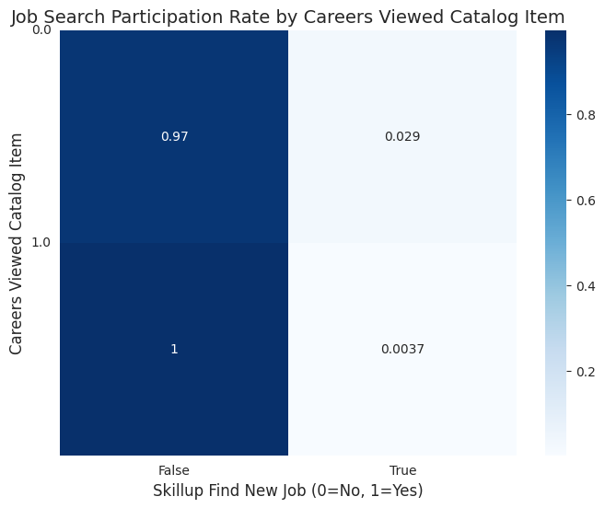
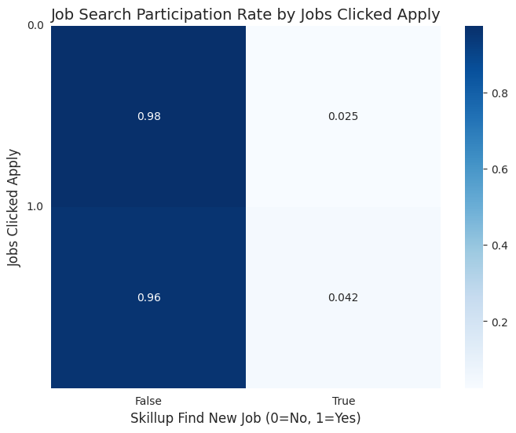
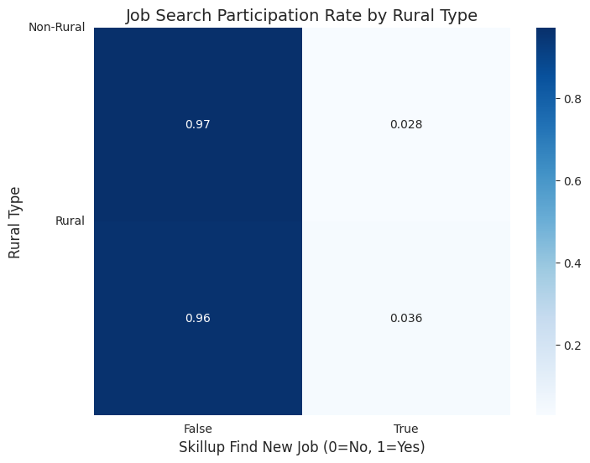
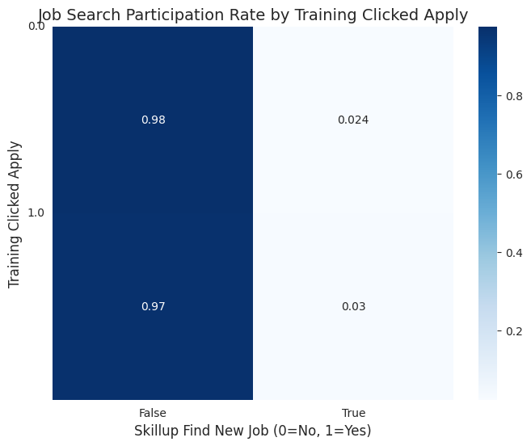

Appendix
-Data Analysis
Descriptive Analysis: Heatmap-Analyzing Significant Factors Affecting Finding New Job Rate
Notes:
Did you find your new job through SkillUp?
Did you find the training program through SkillUp?

Slide 18

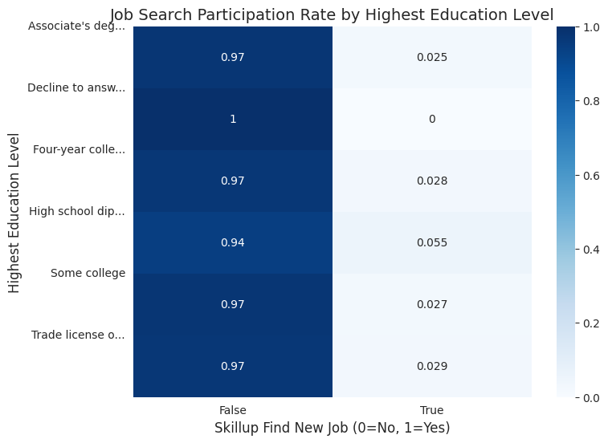
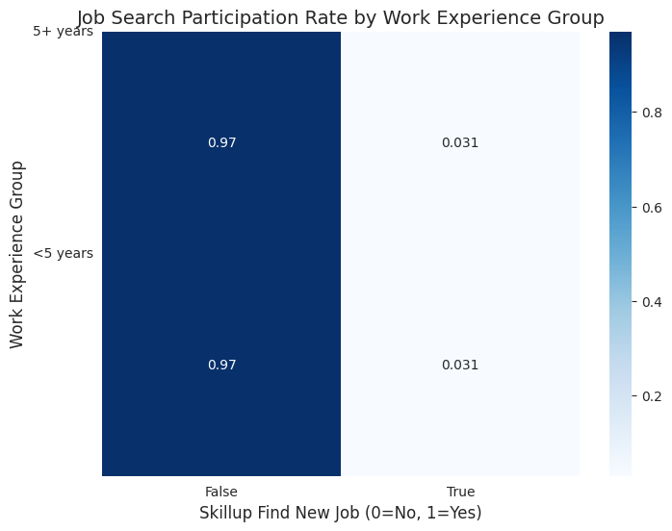
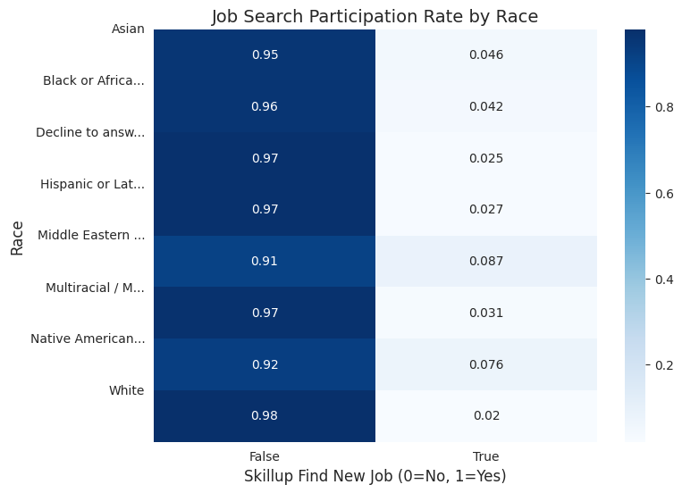
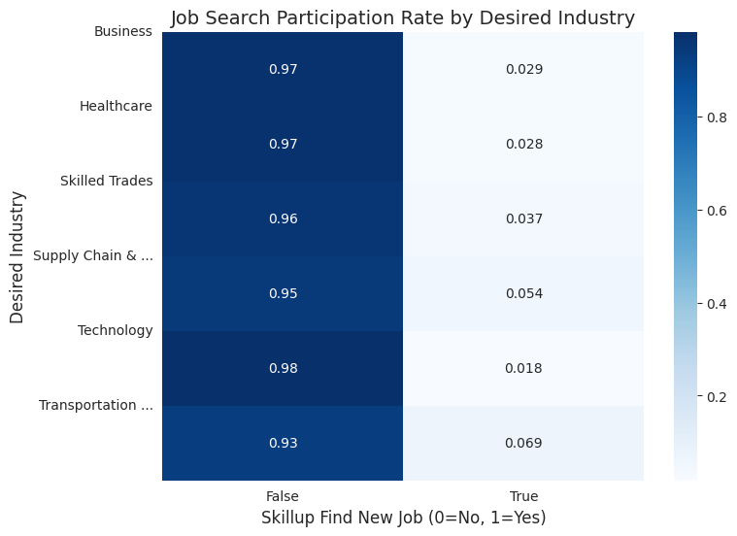
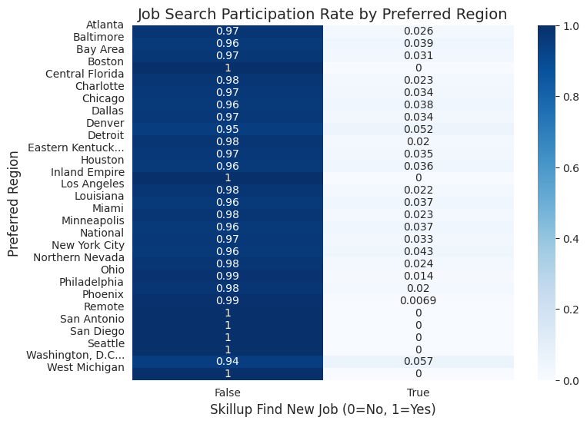

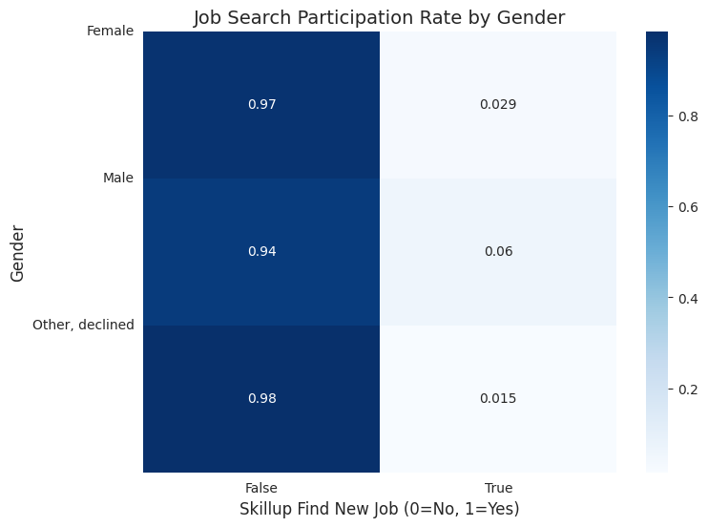
Appendix
-Data Analysis
Descriptive Analysis: Heatmap-Analyzing Significant Factors Affecting Finding New Job Rate

