Slide 1
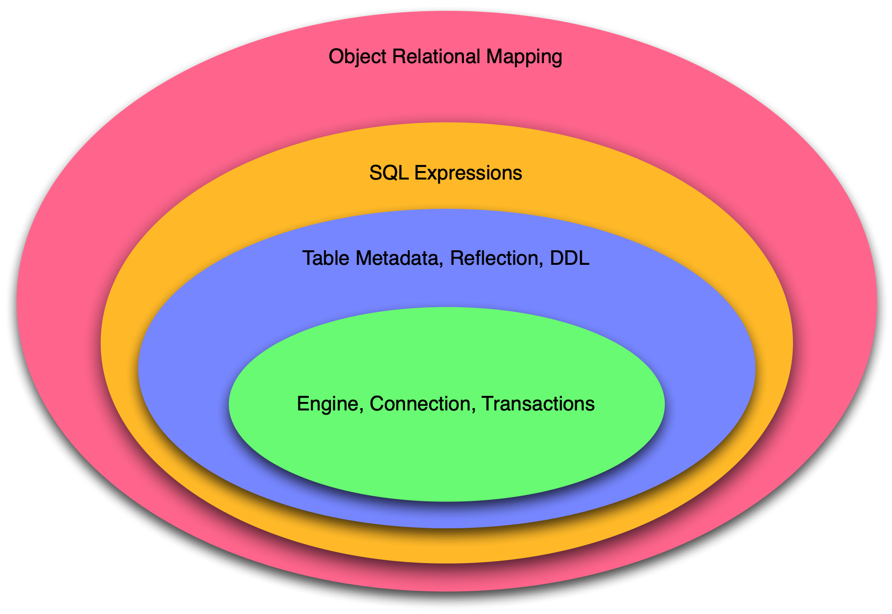

Introduction to SQLAlchemy and ORMs
Mike Bayer
@zzzeek
Companion Package Download:
http://techspot.zzzeek.org/files/2014/sqlalchemy_tutorial.zip

Slide 2
Prerequisite Knowledge
This tutorial assumes some basic knowledge about SQL (in order of importance):
  structure: tables, columns, CREATE TABLE, etc.
  querying: selecting rows with SELECT
  modifying data with INSERT, UPDATE, DELETE
  joins, grouping
  transactions

Slide 3
SQLAlchemy - Overview
the Database Toolkit for Python
introduced 2005
end-to-end system for working with the Python DBAPI, relational databases, and the SQL language
Current release 0.9.7
1.0 is the next major version!

Slide 4
SQLAlchemy Goals
Provide helpers, tools and components to assist and automate database development at every level
Provide a consistent and fully featured facade over the Python DBAPI
Provide an industrial strength, but optional, object relational mapper (ORM)
Act as the foundation for any number of third party or in-house tools

Slide 5
SQLAlchemy Philosophies
Bring the usage of different databases and adapters to an interface as consistent as possible...
...but still expose distinct behaviors and features of each backend.
Never "hide" the database or its concepts - developers must know / continue to think in SQL...
Instead....provide automation and DRY
Allow expression of DB/SQL tasks using declarative patterns

Slide 6
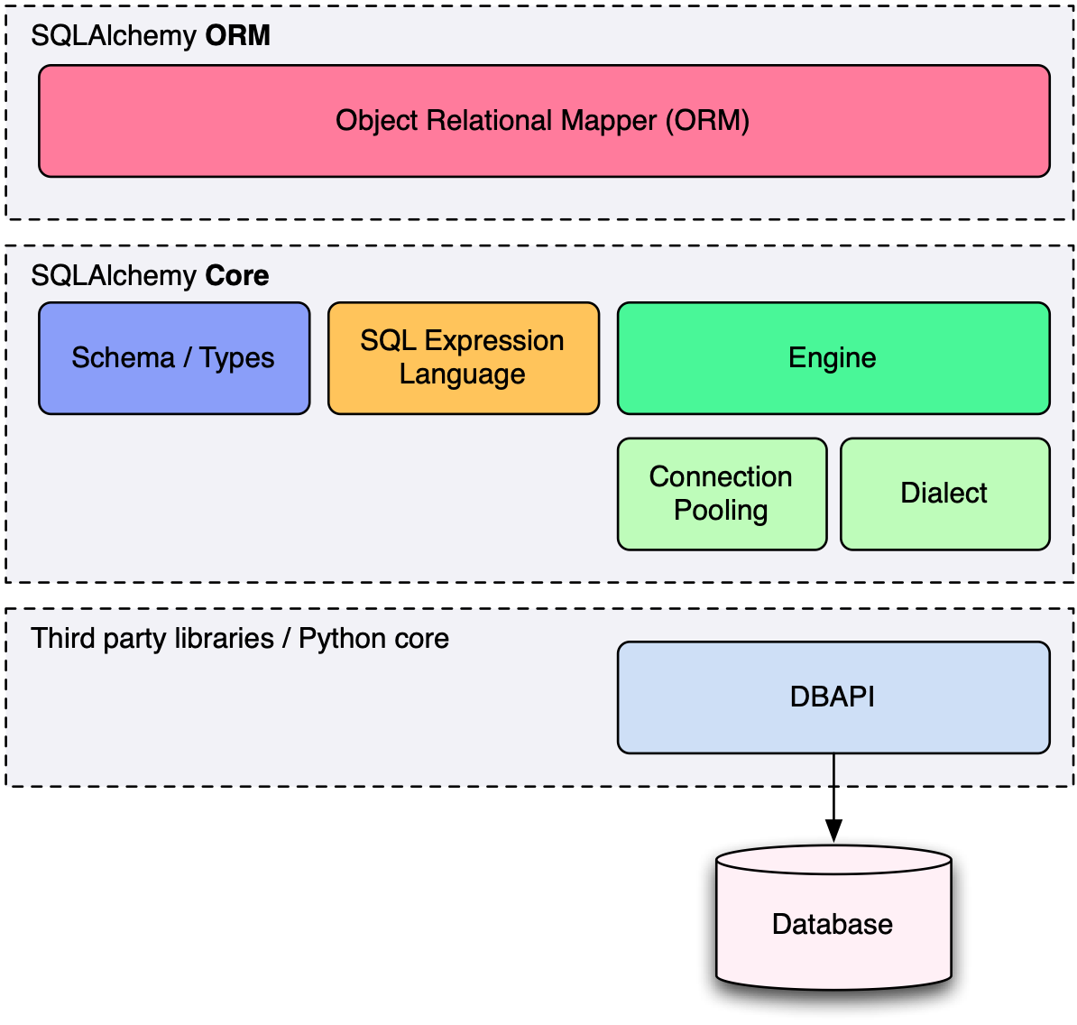
SQLAlchemy Overview
SQLAlchemy consists of the Core and the ORM

Slide 7
SQLAlchemy - Core
Engine - a registry which provides connectivity to a particular database server.
Dialect - interprets generic SQL and database commands in terms of a specific DBAPI and database backend.
Connection Pool - holds a collection of database connections in memory for fast re-use.
SQL Expression Language - Allows SQL statements to be written using Python expressions
Schema / Types - Uses Python objects to represent tables, columns, and datatypes.

Slide 8
SQLAlchemy - ORM
Allows construction of Python objects which can be mapped to relational database tables.
Transparently persists objects into their corresponding database tables using the unit of work pattern.
Provides a query system which loads objects and attributes using SQL generated from mappings.
Builds on top of the Core - uses the Core to generate SQL and talk to the database.
Presents a slightly more object centric perspective, as opposed to a schema centric perspective.

Slide 9
SQLAlchemy is like an Onion
Can be learned from the inside out, or outside in

Slide 10
Level 1, Engine, Connection, Transactions

Slide 11
The Python DBAPI
DBAPI - PEP-0249, Python Database API
The de-facto system for providing Python database interfaces
There are many DBAPI implementations available, most databases have more than one
Features/performance/stability/API quirks/maintenance vary wildly

Slide 12
DBAPI - Nutshell
import psycopg2
connection = psycopg2.connect("scott", "tiger", "test")
cursor = connection.cursor()
cursor.execute(
"select emp_id, emp_name from employee "
"where emp_id=%(emp_id)s",
{'emp_id':5})
emp_name = cursor.fetchone()[1]
cursor.close()
cursor = connection.cursor()
cursor.execute(
"insert into employee_of_month "
"(emp_name) values (%(emp_name)s)",
{"emp_name":emp_name})
cursor.close()
connection.commit()

Slide 13
Important DBAPI Facts
DBAPI assumes that a transaction is always in progress. There is no begin() method, only commit() and rollback().
DBAPI encourages bound parameters, via the execute() and executemany() methods. But has six different formats.
All DBAPIs have inconsistencies regarding datatypes, primary key generation, custom database features, result/cursor behavior
DBAPI has it's own exception hierarchy, which SQLAlchemy exposes directly in a generic namespace.

Slide 14
SQLAlchemy and the DBAPI
The first layer in SQLAlchemy is known as the Engine, which is the object that maintains the classical DBAPI interaction.

Slide 15
Engine - Usage
.venv/bin/sliderepl 01_engine.py

Slide 16
Engine Facts
Executing via the Engine directly is called connectionless execution - the Engine connects and disconnects for us.
Using a Connection is called explicit execution. We control the span of a connection in use.
Engine usually uses a connection pool, which means "disconnecting" often means the connection is just returned to the pool.
The SQL we send to engine.execute() as a string is not modified, is consumed by the DBAPI verbatim.

Slide 17
Level 2, Table Metadata, Reflection, DDL

Slide 18
What is "Metadata"?
Popularized by Martin Fowler, Patterns of Enterprise Architecture
Describes the structure of the database, i.e. tables, columns, constraints, in terms of data structures in Python
Serves as the basis for SQL generation and object relational mapping
Can generate to a schema
Can be generated from a schema

Slide 19
MetaData and Table
.venv/bin/sliderepl 02_metadata.py

Slide 20
Some Basic Types
Integer() - basic integer type, generates INT
String() - ASCII strings, generates VARCHAR
Unicode() - Unicode strings - generates VARCHAR, NVARCHAR depending on database
Boolean() - generates BOOLEAN, INT, TINYINT
DateTime() - generates DATETIME or TIMESTAMP, returns Python datetime() objects
Float() - floating point values
Numeric() - precision numerics using Python Decimal()

Slide 21
CREATE and DROP
metadata.create_all(engine, checkfirst=<True|False>) emits CREATE statements for all tables.
table.create(engine, checkfirst=<True|False>) emits CREATE for a single table.
metadata.drop_all(engine, checkfirst=<True|False>) emits DROP statements for all tables.
table.drop(engine, checkfirst=<True|False>) emits DROP for a single table.

Slide 22
Level 3, SQL Expressions

Slide 23
SQL Expressions
The SQL Expression system builds upon Table Metadata in order to compose SQL statements in Python.
We will build Python objects that represent individual SQL strings (statements) we'd send to the database.
These objects are composed of other objects that each represent some unit of SQL, like a comparison, a SELECT statement, a conjunction such as AND or OR.
We work with these objects in Python, which are then converted to strings when we "execute" them (as well as if we print them).

Slide 24
SQL Expressions
.venv/bin/sliderepl 03_sql_expressions.py

Slide 25
Level 4, Object Relational Mapping

Slide 26
Object Relational Mapping
Object Relational Mapping, or ORM, is the process of associating object oriented classes with database tables.
We refer to the set of object oriented classes as a domain model.

Slide 27
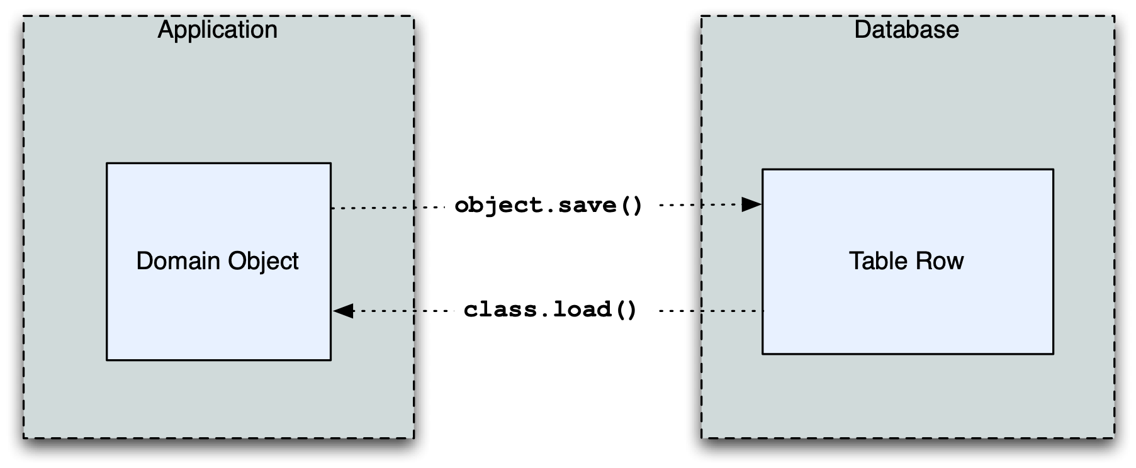
What does an ORM Do?
The most basic task is to translate between a domain object and a table row.

Slide 28
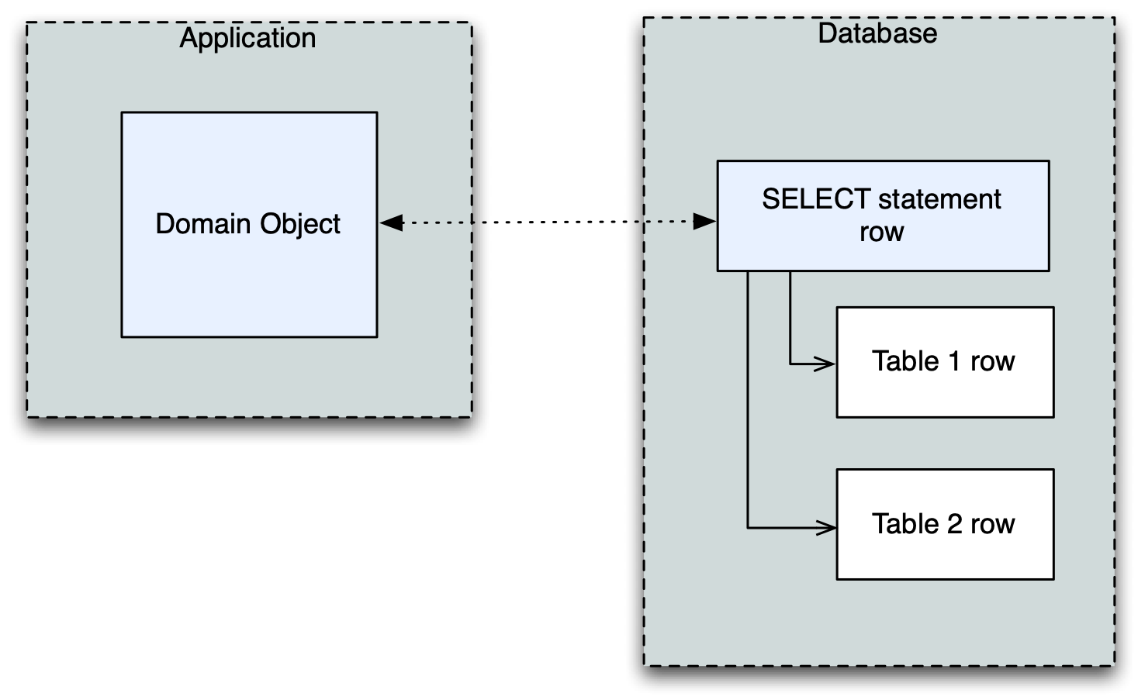
What does an ORM Do?
Some ORMs can also represent arbitrary rows as domain objects within the application, that is, rows derived from SELECT statements or views.

Slide 29
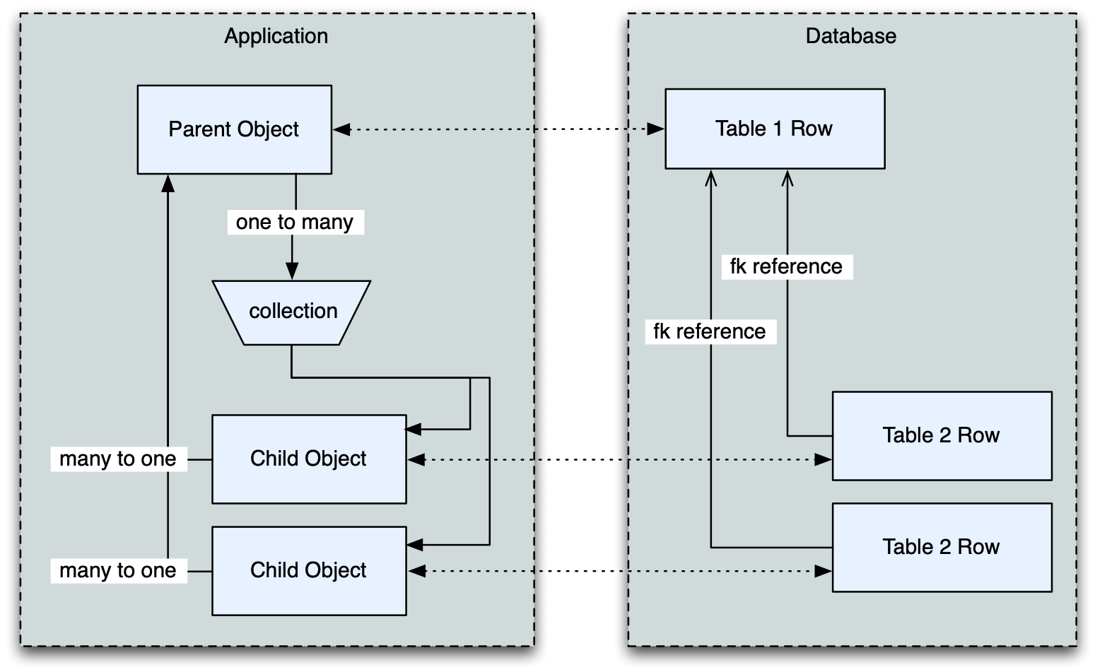
What does an ORM Do?
Most ORMs also represent basic compositions, primarily one-to-many and many-to-one, using foreign key associations.

Slide 30
What does an ORM Do?
Other things ORMs do:
  provide a means of querying the database in terms of the domain model structure
  Some can represent class inheritance hierarchies using a variety of schemes
  Some can handle "sharding" of data, i.e. storing a domain model across multiple schemas or databases
  Provide various patterns for concurrency, including row versioning
  Provide patterns for data validation and coercion

Slide 31
Flavors of ORM
The two general styles of ORM are Active Record and Data Mapper. Active Record has domain objects handle their own persistence:
user_record = User(name="ed", fullname="Ed Jones")
user_record.save()
user_record = User.query(name='ed').fetch()
user_record.fullname = "Edward Jones"
user_record.save()

Slide 32
Flavors of ORM
The Data Mapper approach tries to keep the details of persistence separate from the object being persisted.
dbsession = Session()
user_record = User(name="ed", fullname="Ed Jones")
dbsession.add(user_record)
user_record = dbsession.query(User).filter(name='ed').first()
user_record.fullname = "Edward Jones"
dbsession.commit()

Slide 33
Flavors of ORM
ORMs may also provide different configurational patterns. Most use an "all-at-once", or declarative style where class and table information is together.
class User(Base):
__tablename__ = 'user'
id = Column(Integer, primary_key=True)
name = Column(String(length=50))
fullname = Column(String(length=100))
class Address(Base):
__tablename__ = 'address'
id = Column(Integer, primary_key=True)
user_id = Column(ForeignKey("user.id"))
email_address = Column(String(length=100))
user = relationship("User")

Slide 34
Flavors of ORM
A less common style keeps the declaration of domain model and table metadata separate.
# class is declared without any awareness of database
class User(object):
def __init__(self, name, username):
self.name = name
self.username = username
# elsewhere, it's associated with a database table
mapper(
User,
Table("user", metadata,
Column("id", Integer, primary_key=True),
Column("name", String(50)),
Column("fullname", String(100))
)
)

Slide 35
SQLAlchemy ORM
The SQLAlchemy ORM is essentially a data mapper style ORM.
Modern versions use declarative configuration; the "domain and schema separate" configuration model is present underneath this layer.
The ORM builds upon SQLAlchemy Core, and many of the SQL Expression concepts are present when working with the ORM as well.
In contrast to the SQL Expression language, which presents a schema-centric view of data, it presents a domain-model centric view of data.

Slide 36
Key ORM Patterns
Unit of Work - objects are maintained by a system that tracks changes over the course of a transaction, and flushes pending changes periodically, in a transparent or semi-transparent manner
Identity Map - objects are tracked by their primary key within the unit of work, and are kept unique on that primary key identity.
Lazy Loading - Some attributes of an object may emit additional SQL queries when they are accessed.
Eager Loading - Multiple tables are queried at once in order to load related objects and collections.
Method Chaining - queries are composed using a string of method calls which each return a new query object.

Slide 37
ORM Walkthrough
.venv/bin/sliderepl 04_orm.py

Slide 38
Thanks !
http://www.sqlalchemy.org
@zzzeek

