Slide 1
Parallel Computing Academic year – 2020/21, spring semester Computer science Lecture 1
Lecturer, instructor:
Balakshin Pavel Valerievich
(pvbalakshin@itmo.ru; pvbalakshin@hdu.edu.cn)
Assistant:
TBD
(TBD@hdu.edu.cn)

Slide 2

About myself
PhD in Computer Science
9 years of teaching experience
15 years of IT industry
Associate professor at ITMO University
Lead RPA Developer at Masterdata
Scientific interests: RPA, speech recognition, new IT inventions
Notes:
Slide 2

Slide 3
Course structure
7-8 lectures
4 lab works about the following topics:
Automatic parallelization of programs
Research the effectiveness of multi-threading libraries for C programs
OpenMP technology
7-8 intermediate test after each lesson
1 final test (=exam)
Notes:
If you down know anything about parallel computing and parallel programming, you can ask compiler to use its embedded keys to parallelize execution of the program. And after that you will check the efficiency.
Experienced programmers already created many libraries where a lot of thing are already properly parallelized. As soon as you start it is executed on all available cores. Still execution of parallel computing is not required.
Both labs still allow you not to learn parallel technologies.
Later you will learn enough material to understand and work with OpenMP technology.
In general, this technology requires to add 2-3 rows in original code, but your program will work using parallel schemes.
Also we will discuss PThreads technology, that is quite complex and requires deep understanding of hardware implementation. If we compare OpenMP and PThreads it is similar to C and Assembler languages.
But this is quite reasonable: from simple approaches (automatic), to middle (OpenMP) and to complex ones (PThreads and OpenCL). OpenCL allows to make calculations not on CPU only, but on GPU too. And if CPU can have 2/4/8/16 etc. cores, GPU can have thousand of cores. OpenMP and PThreads couldn’t use GPU.

Slide 4
Breakdown of grades
Result score | Result grade | Result mark | Explanation
[0; 59] | 2F | Fail | Unsatisfactory
[60;67] | 3E | Pass | Satisfactory
[68;74] | 3D | Pass | Satisfactory
[75;83] | 4C | Pass | Good
[84;90] | 4B | Pass | Very good
[91;100] | 5A | Pass | Excellent
4

Slide 5

Penalty
Participants who successfully complete 70% of the attendance and 70% of class work will be allowed to the exam.
Notes:
Slide 5

Slide 6
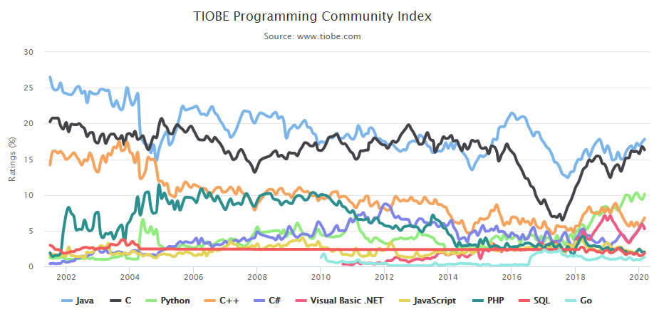
Why С/С++
Notes:
Students usually ask why C instead of other modern languages, like Python. Here is the presentation from TIOBE website, where you can see that C and C++ languages are on 2nd and 4th positions of the most utilized languages.
March 2020:
C = 16,33%
C++ = 6,79%
May 2020:
C = 17,06%
C++ = 6,12%
May 2021:
C = 13,38%
C++ = 7,81%

Slide 7
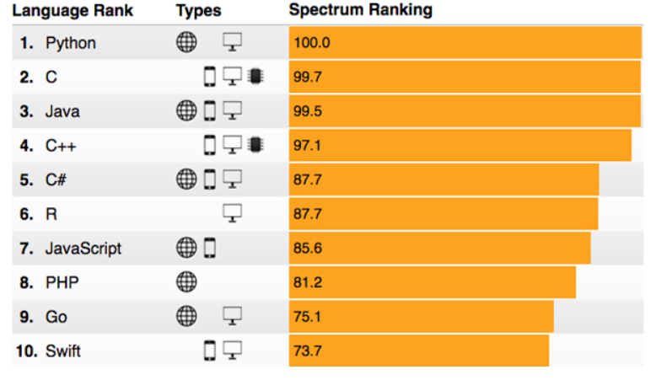
Why С/С++ (2)
https://spectrum.ieee.org/computing/software/the-2017-top-programming-languages
Notes:
Here is information about more reputable source IEEE.
So if you haven’t dealt with C/C++ you can add quite important skill to you profile.

Slide 8
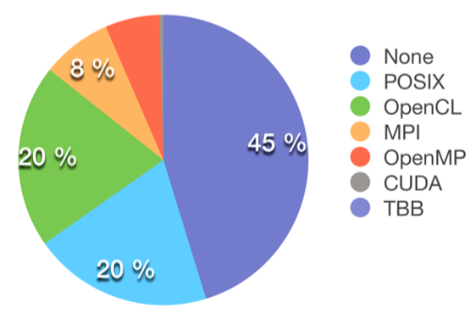
Choosing a language for parallel programming technology
According to the research of Bernhardt G.V. (2016)
Notes:
There was a student whose master work was the following:
1. Take all Github code with C/C++ language projects.
2. Create a script to analyze it.
45% of projects didn’t use any parallelism.
Of course it is better to learn all technologies, but it requires a lot of time and as it was announced earlier you have to start with the basic ideas and then move forward.
MPI – Message Passing Interface
TBB – Thread Building Block.

Slide 9
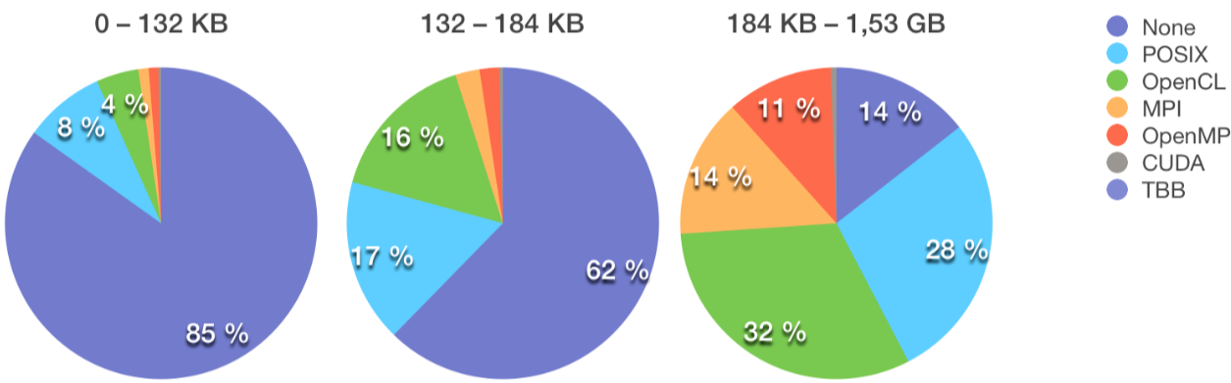
Choosing a language for parallel programming technology(2)
Distribution based on repository size
According to the research of Bernhardt G.V. (2016)
Notes:
Deep analysis
Due to project increase parallel technologies became more important and only 14% of projects are without any kind on parallel improvement.

Slide 10
Definitions
Concurrent computing is a way of organizing calculations on one or more computers, where life periods of several tasks intersect.
Sequential computing – there are no overlapping periods of tasks.
Parallel computing – tasks are executed physically simultaneously on different processors and/or cores of the same computer.
Multicore computing – computations when each processor has more then one core.
Shared memory processing (SMP) – refers to the work of parallel programs on systems with shared memory. In such systems all the processors/cores share common memory of one computer.
Distributed computing – sort of parallel computing, at which to calculations take place on processors located on different computers connected by a network, means one has to transfer programs and/or data through a network to perform calculations.
Notes:
Start1 < Start2
If end1 < start2 – sequential computing
If end1 >= start2 – concurrent computing
In parallel computing, tasks are executed physically simultaneously on different processors and/or cores of the same computer. This means that concurrent includes parallel, i.e. any parallel-like calculations are concurrent, but not any concurrent calculations are parallel.
Time division conception
Assume that we have a computer with one core.
QUESTION: When OS is running – is it concurrent, sequential, parallel?
A classic example of concurrent computing that is not parallel is the implementation of multitasking in an operating system (OS) with only one single-core processor. In this case, the operating system cannot physically perform different tasks in parallel and is forced to run them in time sharing mode, i.e. alternately allowing different tasks to be used by the processor, switching from one task to another several times before the end of each task.
Nowadays there are practically no processors with one core.

Slide 11
Definitions (2)
Parallel calculations are always concurrent ones.
Not all concurrent calculations are parallel.
Parallel computing = multicore computing = SMP.
Not in scope of the course:
Bit-level parallelism
Parallelism at the operand level – concurrency at the data level
Parallelism at the instruction level – superscalarity
Preemptive multitasking
Notes:
Bit-level parallelism – the processor performs the operation for all the bits of the machine word simultaneously. For example, a 64-bit processor can simultaneously invert the value of each of 64 bits of a given operand.
Parallelism at the operand level – one instruction of the processor allows you to execute some operation for an entire array of operands in parallel. For example, you can multiply items of two arrays in pairs during one operation with the help of SSE/MMX technology. (all the multiplications will be performed in parallel in time).
Parallelism at the instruction level – execution of each instruction is divided into phases, each of which can be executed by the processor physically in parallel. This change in the architecture of the processor does not affect the total time of execution of one isolated instruction in any way, but when processing several consecutive instructions (instructions followed one by another in a row) it is possible to organize a conveyor out of them. As a result, successive instructions are executed physically in parallel, which allows increasing the overall performance of the processor expressed in the instructions.
Preemptive multitasking – several processes are in the execution queue and the OS decides how to manage the processor time between them. If the first thread is given a higher priority than the second, then the OS will allocate more time to execute the first thread, only one thread will be executed at a time.

Slide 12
Definitions (3)
During the existence of computer technology, the speed of triggering of elements has increased 10⁶ times, and the speed of calculations has increased 10⁹ times.
The performance of single-processor systems increased by 1.5 times annually from 1986 to 2002.
Since 2002 this increase is only 1.2 times.
Conclusion: Computer science development is history of architectural excellence and practical use of parallelism.
Notes:
Why?
It is difficult to invent new principles to allow transistors work faster.
So more attention should be drawn to software part, means to parallel programming.
Finally it will help you to increase the speed of your program.

Slide 13
Why do we need parallel computing?
Problems of Grand Challenge solution (performance of existing computing systems is not enough > 1 Tflops):
climate modeling;
genetic engineering;
integrated circuit design;
environmental pollution analysis;
drug development.
2. Software development for modern smartphones.
3. Gaming industry.
Notes:
1. 10-15 years ago there were no way to handle these calculations properly without parallel computing.
It was area of big factories, big labs, big universities.
2. Every smartphone has multiple cores.
3. Gaming industry.

Slide 14
Classification of parallel systems (architectures)
SMP (Shared Memory Parallelism, Symmetric MultiProcessor system) – multiprocessor, multicore, GPGPU.
MPP (Massively Parallel Processing) – cluster systems, GRID (distributed computing).
Notes:
GPGPU – General-purpose computing on graphics processing units.
MPP – physically distributed computers.
Cluster – all joints are the same, GRID – joins are different.

Slide 15
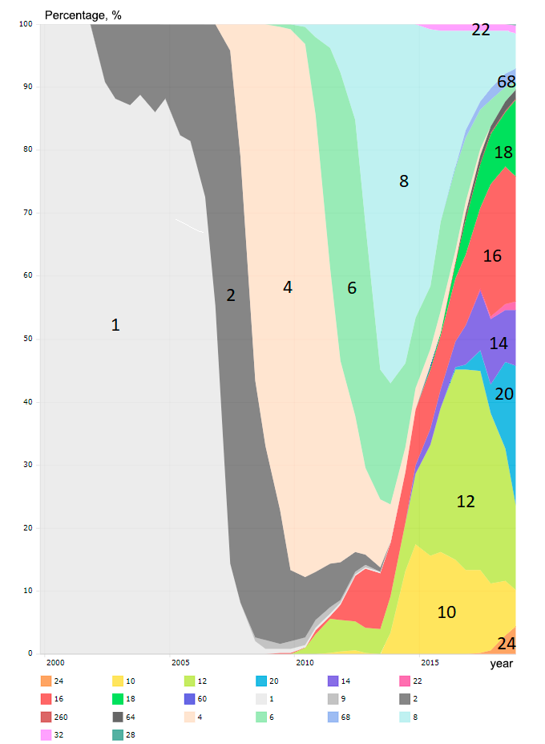
History of SMP-systems development
Number of occupied cores during supercomputers creation
According to top500.org
Notes:
Frequency of using processors with different number of cores when creating supercomputers
2 – Hyperthreading adding, some registers were duplicated. Hyperthreading – not a good thing. Extra threads are created, and they bother each other.
We can assume, that market of common computers will replicate this distribution with lag in some number of years.
So you can predict the future =)
QUESTION: how many cores do you have on your computer?

Slide 16
What contributes to the development of parallel computing
Theoretical limited growth in performance of non-parallel computers.
Sharp reduction in the cost of multiprocessor (parallel) computing systems.
1 x Cray T90: 1.8 Gflops = $2,5 million (1995)
8 х IBM SP2: 2.1 GFlops = $0.5 million (~2000)
Appearance of a multi-core processor building paradigm.
According to materials of Prof. V.P. Gergel’ (2001)
Notes:
Moore’s law was working practically as-is till 2003. Now it is not true.

Slide 17
What slows down the development of parallel computing (1)
Marvin Minsky's hypothesis (1971): acceleration of a parallel system is proportional to the binary logarithm of the number of processors.
Gordon Moore’s law (1975): the number of transistors in a dense integrated circuit doubles about every 18 months.
Herb Grosch’s law (1953): computer performance increases as the square of the cost.
Difficult to learn the principles of parallel programming.
According to materials of Prof. V.P. Gergel’ (2001)
Notes:
Minsky's hypothesis: acceleration of a parallel system is proportional to the binary logarithm of the number of processors.
Depends on hardware, task and program.
Moore's Law: the number of transistors in a dense integrated circuit doubles about every 18 months.
Grosch’s law: The performance of a computer increases in proportion to the square of its cost.
Difficult to learn the principles of parallel programming.

Slide 18
What slows down the development of parallel computing (2)
Gene Amdahl's law (1967): any program has a non-parallelized part.
Non-universality (not cross-platform) of parallelism: while programming you should take into account characteristic features of concrete parallel systems.
Existing software is oriented on sequential computers.
According to materials of Prof. V.P. Gergel’ (2001)
Notes:
Non-universality is not so important now. For example, OpenCL.
Existing software is also not some important now.

Slide 19
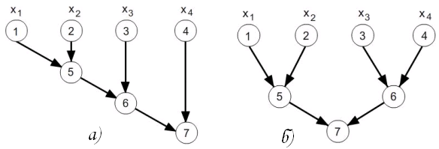
Sequential and cascading summation
Example of paralleling an algorithm (1)
According to materials of Prof. V.P. Gergel’ (2001)
Notes:
There is a requirement to summarize 4 elements.
Computer with one-core processor will calculate this for 3 CPU cycles.
Two-core processor will calculate this for 2 CPU cycles.
QUESTION: how many cores will work to summarize result #5 and result #6?
So the problem is: you computer can perform 2 times faster, but effect is 1.5 times only.

Slide 20
Example of paralleling an algorithm (2)
Search for the maximum element of an array
According to materials of Prof. V.P. Gergel’ (2001)
Notes:
The first split: white and grey areas correspond to each processor.
Within each area we can find the max element.
Finally there is a task just to compare 2 elements, so we practically have 2 times performance improvement.
The second split: white and grey areas also correspond to each processor.
From the first view, there is no difference.
But the problem is in cache, because more than one element will be copied from RAM to cache. There will be a sequence of adjacent element (= neighboring element). This means that everything that was loaded from RAM is useful for each core.
It very important not to increase the number of processors and cores only, but other components (especially size of cache memory) too.

Slide 21
Example of paralleling an algorithm (3)
Parallel sorting:
Split the source array into two parts.
Sort each part independently from its processor.
Perform merging of the sorted pieces.
Computational complexity:
С₁*N*N → С₁*N/2*N/2 + С₂*N
Возможно почти четырёхкратное ускорение на двухъядерной системе!
Notes:
You can use the following general approach despite of specific algorithm.
Computational complexity (= computational cost)
Assume the simplest bubble sort. It has average cost of N^N, where N – is array size.
But if we split array by 2 parts, computational complexity will be much less.
C₁ and C₂ – are some constant, depends on computer.
QUESTION: do we need to multiply С₁*N/2*N/2 by 2 as we have 2 processor?
No, time for sorting of each part will be the same as 2 processors will work in parallel. This task will be in lab.

Slide 22
Performance indicators of parallel programs
p – number of available calculators (cores, processors)
V – average speed of program execution (arbitrary units of work per second)
S(p) = V(p) / V(1) – parallel speedup
E(p) = S(p) / p = V(p) / [p * V(1)] – parallel efficiency
Notes:
In contrast to the concept of the value of acceleration used in physics as an increase in speed per unit time, in programming, parallel acceleration is understood to be a dimensionless quantity that reflects the increase in the speed of parallel program execution on a given number of processors compared to a single-processor system.
So we can emphasize and measure 2 elements:
p = 1,2,…,n, where n – is the number of available processors (cores) on the multiprocessor hardware platform used for testing. The described approach allows you to artificially limit the number of processors (cores) used in the program, because at any time, a parallel program can be executed no more than p calculators/computing devices.
V(p) is the average speed of program execution on p processors (cores), expressed in arbitrary units of work per second (W/s). Examples of W/S can be the number of summed matrix elements, the number of image points processed by the filter, the number of bytes written to the file, etc.
S(p) – parallel speedup / parallel acceleration
It is believed that the value of S(p) can never exceed p, which on the intuitive level sounds reasonable and truthful, because with an increase in the number of employees, for example, four times it is not possible to get the job done five times faster. However, some changes in cache can return some fantastic results in very specific tasks.
Although the value of parallel acceleration is dimensionless, its analysis is not always possible without information on the value of p. For example, suppose in some experiment that S(p) = 10. Without knowing the value of p, we can only say that with parallel execution the program began to work 10 times faster. However, if at the same time p = 1000, this acceleration cannot be considered a good achievement, since in other conditions, it was possible to achieve an almost 1000-fold increase in the speed of work and not spend such impressive resources on a poorly parallelized task.
On the contrary, with a value of p = 11, one could consider the value S (p) = 10 to be quite acceptable. This problem led to the need to determine another indicator of the effectiveness of a parallel program, which would allow us to obtain some estimate of the parallelization efficiency taking into account the number of processors (cores). This quantity is E(p) – parallel efficiency.
Average program execution speed V(p) can be measured by the following two nonequivalent methods:
Amdahl Method: calculate V(p), fixing the amount of work performed (we change the execution time of the program for various).
Gustafson-Barsis Method: calculate V(p), fixing the time of the test program (we changes the amount of work done for different p).

Slide 23

Amdahl’s law
w(p) – arbitrary total units of work
t(p) – runtime w using p processors
k – paralleling fraction / portion of parallel instructions
Notes:
Allows you to roughly estimate the highest speedup.
1)Take time on one processor.
2)Take time on p processors.
Assumption: each computer instruction requires the same time
Ideal time k * t(1) / p
When evaluating the efficiency of parallelization of a program that performs a fixed amount of work, the speed of execution can be expressed as follows:
where:
w is arbitrary total units of work contained in the program
t(p) – runtime w using p processors
k – is the coefficient of parallelism of the program, by which we define the fraction of the time during which perfectly parallelized code is executed inside the program.
Then the expression for parallel acceleration will take the form:
This law is known after the name of the American scientist Gene Amdahl, who proposed this expression in 1967. Until now, this law is fundamental in the specialized literature on parallel computing, because allows you to get a theoretical upper limit for the speed of execution of a given program during parallelization.
An important assumption of Amdahl's law is the idealization of the physical meaning of the quantity k. It consists in the assumption that a perfectly parallelized code will give a linear increase in speed when p changes from 0 to +infinity.

Slide 24

Gustafson–Barsis's law
.
w(p) – arbitrary total units of work, performed by the program in the time t
Notes:
Amdahl measures the highest possible speedup.
But if you are working with some supercomputer you need to think about the time-cost ratio, especially if you need to buy time on such supercomputer.
When evaluating the efficiency of parallelization of a certain program running a fixed time, the speed of execution can be expressed as follows:
where w(p) – is the total amount of work that the program manages to complete during t when using p processors.
This formula can also have some amount of parallel work (k) and some amount of non-paralleled work (1-k).
John Gustafson and Edwin Barsis formulated in 1988.

Slide 25
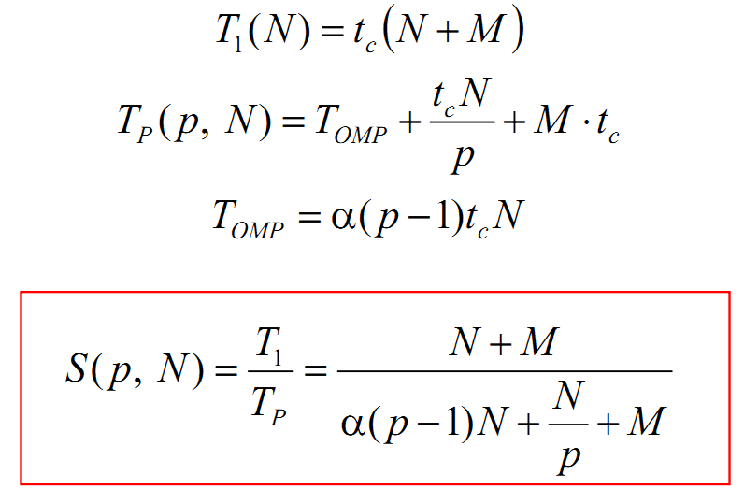
Modification of the Amdahl' Law (by Prof. A.V. Boukhanovsky)
N – number of paralleled instructions, M – number of non-paralleled instructions,
t_{c} – single instruction operation time, p – number of available calculators,
T_{i} – program execution time during usage of i parallel threads on i-calculators,
α – scaling factor
Notes:
Adding overhead costs
Each parallel calculator requires creation of multiple threads

Slide 26
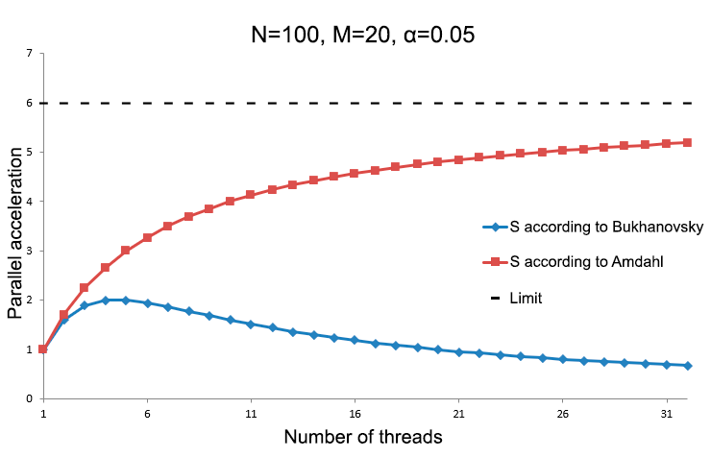
Comparison with Amdahl
Notes:
Even if you buy a lot of new processors you can’t reach limit.

