Slide 1
Parallel Computing Academic year – 2020/21, spring semester Computer science Lecture 2
Lecturer, instructor:
Balakshin Pavel Valerievich
(pvbalakshin@itmo.ru; pvbalakshin@hdu.edu.cn)
Assistant:
TBD
(TBD@hdu.edu.cn)

Slide 2
A typical scenario of a parallel programmer's work
Write a single threaded program.
Stop.
Try automatic paralleling.
Stop.
Try parallel libraries and data structures.
Stop.
Profile the application, estimate the maximum achievable paralleling effect.
Stop.
Parallelize bottlenecks and frequently called functions.
The goal of parallel programming is to avoid parallel programming!
Notes:
Please try to avoid using parallel programming.
First you need to ask the reason of parallel computing usage.
7, 9 – install profiler and check. Otherwise, you will spend to much time.
Assume that you have lab 10 minutes length and you improve the function, that runs for 2 seconds.
After the fix of the first bottle neck, go ahead with the next one.

Slide 3
Parallel programming terminology
Process – the most heavyweight mechanism used for parallelization. Each process has its own independent address spaces, so data synchronization between processes is slow and complicated. May include several threads of execution.
Thread – runs independently of other threads, but has a common address space with other threads into the same process. At this level data synchronization mechanisms are used.
Fiber – lightweight thread of execution. Like threads, fiber has a common address space, however, it uses joint multitasking instead of preemptive one. All fibers work on one core, unlike threads, which can work on different kernels.
Notes:
Various parallelization technologies are used to organize parallel computing:
Process – the most heavyweight mechanism used for parallelization. Each process has its own independent address space, so data synchronization (common variables) between processes is long and complicated, also can require big computational performance and specific technologies. May include several threads of execution.
Thread – (execution thread) it runs independently of other threads, but has a common address space with other threads into the same process. At this level data synchronization mechanisms are used (will be discussed further).
Fiber – lightweight thread of execution. Like threads, fiber has a common address space, however, it uses joint multitasking instead of preemptive one. The OS does not switch the context from one thread to another, instead, the main thread itself allocates time or the child fiber to work, or is blocked logically (that is, the programmer controls the fiber life cycle). In other words, fibers are created by threads as child sub-thread. Also, all fibers work on one core, unlike threads, which can work on different kernels.
1)Assume that you have 2 processes: each of them has its own separate data segment, code segment, stack segment, etc.
2)Only 1 process is running. Within this process there is a possibility to create multiple threads, for ex. 2 threads. Code segment, data segment – are the same. While stack segments are different. So if one thread has changed some variable, 2nd thread automatically can use its new value. In addition, context switching between threads in the same process typically occurs faster than context switching between processes.
As an analogy, process execution flows can be compared to several chefs working together. They all cook the same dish, read the same cookbook with the same recipe and follow its instructions, and not necessarily all of them read on the same page.
3)Thread can create either additional threads, or fibers. Fibers will work concurrent, but not parallel. So assume that you program has 3 main functions: summarize elements of some big array, record results to some destination file and produce some status information about percentage of completed work. You can run each function in a sequence, but in this case your code will be huge, overcomplicated and not-eloquent (means not so professional).
Moreover it is no so difficult to move those functions to thread level in case of computer upgrade. You will need to handle a little with data synchronization and use shared variables.

Slide 4
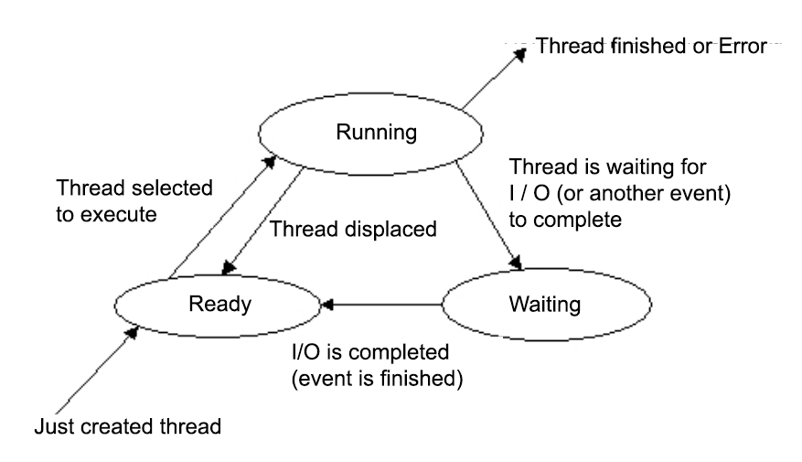
Thread lifecycle
4
Notes:
Assume that you create a program that creates 10 thread and run it on 10-cores computer.
Later you have to execute this program on lower machine with 2 cores.
OS will set 2 thread for execution (“Running”), as we have 2 cores available. Other 8 threads will be set up for “Ready” state and will wait for thread to be displaced (preempted).
You will not know with thread will be selected to be executed. OS will do this automatically.
QUESTION: what's wrong with this approach?
Each launch of a parallel program has a different result. Different thread were displaced.

Slide 5
Parallel programming terminology (2)
Source of definition | Thread-safe | Reentrant / reentrable
Qt | Inside the function all common variables are addressed strictly sequentially, but not in parallel (thread-safe is reentrant but not vice versa). | Function is called by several threads at the same time, correct operation is gua-ranteed only if the threads do not use shared data.
Linux | The function shows the correct results, even if called by several threads at the same time. | The function shows the correct results, even if It recalled internally.
POSIX | ? | The function shows correct results even if it is called by several threads at the same time.
Notes:
Unfortunately, you have to review some of your programming concepts, ideas and behaviors during this course.
Global variables visible from everywhere – is it bad because of race condition or race hazard.
2 concepts: Thread-safe and reentrant/reentrable. We will use Linux-based concept.
In your lab there should be no global variables, no static variables.
POSIX: no explanation for thread-safe
Qt: assume that you have a function that invoke and change some global variable in the middle. There is a strict restriction to run this specific part of the function in parallel threads. OS will not allow 2 or more threads to overwrite value of some global variable at the same time.
Then assume that function that have a pointer as an input parameter. From the first point of view there will be no issues during parallel execution in case of global variables absence. But we can have race condition if multiple instances take the same pointer. For better understanding you can imagine that you have 2 functions A and B that invoke some small function F(*x) inside.
Linux: you can read, but it is easy to check examples.

Slide 6
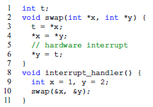
Not thread-safe, not reentrant
Notes:
Somewhere (on line 5) interrupt handler call swap function again.
Global variable t will be overwritten by the new values of x.
And when you come back to initial function y became 1, not x.
Conclusion:
1)not allow to run from multiple threads – not thread-safe;
2)not allow to invoke (call) from itself – not reentrant.

Slide 7
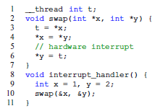
Thread-safe, not reentrant
Notes:
Multiple languages have their own ways how to mark variable as thread.
In GCC this is __tread safe.
Assume that you have 5 cores, and the start of your program compiler creates 5 copies of that variable for each thread.
QUESTION: How many threads will be created on computer with 16 cores after the start of the program above?
The same, 16.
Conclusion:
Still not reentrant as there no way to correct call function from itself. There will be no another copy of the variable t. Each thread don’t know and don’t care about other threads and variables in other threads.
But there is some tricky situation. Function and it’s interrupted copy will not be thread-safe.

Slide 8
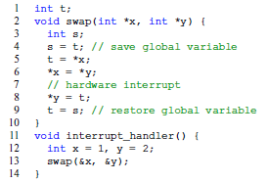
Not thread-safe, reentrant
Notes:
Add local variable s.
Conclusion:
1)not allow to run from multiple threads – not thread-safe.

Slide 9
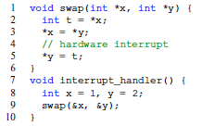
Thread-safe, reentrant
Notes:
No global variables, use local variables

Slide 10
Hardware parallelism types
According to S. Akhter “Multi-Core Programming”
Notes:
The more duplicated blocks – the better productivity you got.
All examples are presented in Intel computers.
Hyper-threading is an evil for parallel programming (wrong idea about the number of calculators, shared memory cache, increase not more than 30%, etc.). It is very important to think how tasks will be handled on physical level.
Before start of the program OS validates the number of CPUs. Then creates runnable threads equal to this number.
Threads are waiting and wasting time to switch between them, because from the OS perspective the system represents two logical processor.
So you need to spend additional time to increase real CPU time usage and avoid computer dead time. Even if you play with priority of the threads, average common thread with middle priority will work faster that high-priority thread.

Slide 11
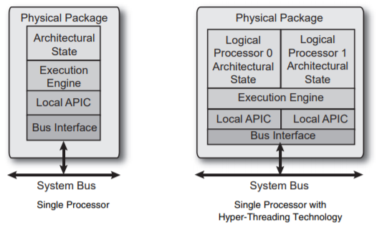
Hyperthreading
According to S. Akhter “Multi-Core Programming”
Notes:
Advanced Programmable Interrupt Controller

Slide 12
Multithreading on single-processor systems vs. multiprocessor systems
On a single-processor (single-core) system you can use thread priorities to arrange their access to the processor (on a multi-processor system you cannot do it).
On a single-processor system you need to pack structures more tightly to optimize the memory cache, and on a multi-core system you need to cut them by the size of the cache string to prevent False Sharing.
Notes:
Single-core system will work fine using time concurrency between threads. Threads with higher priorities will be executed faster.
This is known “standard hacks”.
Current machines with multiple cores are working differently.
In order not to have computer dead time OS will assign low-priority threads to waiting cores, so some low-priority thread will be executed faster than you want. For example it will use some not generated/calculated data.
Need to remember that idea of threads is not to order the execution, but to divide the executable resources in the necessary proportion.

Slide 13
Parallel programming problems
Measuring parallel efficiency.
Instability of floating point calculation results.
Race conditions.
Mutual interlocks.
The ABA problem.
Inversion of priorities.
Load Balancing (LJF).
Scalability.
False sharing (+ hardware optimization).

Slide 14
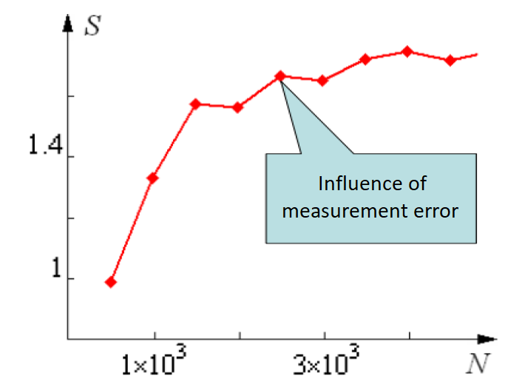
Problems measuring parallel speedup
Reasons:
1. Background load presence.
2. Random nature of the algorithm.
According to materials of Prof. A.V. Boukhanovsky
Notes:
Measuring the runtime of a program in C is not a difficult problem, however, in parallel programming, a number of specific difficulties arise in performing this operation. Not all functions suitable for measuring the running time of a sequential program are suitable for measuring the running time of a multithreaded program.
OS update
Some class of algorithms with random branching.

Slide 15
Measurement of parallel program execution time
Universal tools:
Unix utility time (measures the total execution of a program without possibility of any detail).
C-function clock (does not take into account idle time).
C-function ctime (not reenterable, see not cross-platform alternative to ctime_r).
C-function gettimeofday, clock_gettime.
Specialized tools:
Library function omp_get_wtime (maybe the function omp_get_wtick will need to be used).
Notes:
Software legacy is important issue for time measurement. A lot of languages (like C) was created long before parallel computing creation.
For example, if you use the ctime or localtime functions in a single-threaded program to measure the operating time of a section of code, they will successfully cope with the task. However, after parallelizing this part of the code, it is possible that hard to identify problems arise with incorrect time measurement, because both of these functions have an internal static variable, which, when trying to change it simultaneously by several threads, can take an unpredictable value.
Another standard C-function clock also cannot be used to measure the execution time of multithreaded programs. However, the reason for this is not the lack of reenterability, but the features of the way this function calculates the elapsed time: clock returns the number of processor ticks that were executed when the program was running in total with all its threads. Obviously, this amount remains almost unchanged when the program executes with a different number of threads (”almost”, since the overhead costs of creating, deleting and managing threads are proposed to be considered insignificant in order to simplify the presentation). As a result, it turned out that a satisfactory cross-platform solution for thread-safe time measurement with high accuracy (up to microseconds) by means of pure C language does not exist yet. However, the problem can be solved using third party libraries, choosing those that have an implementation on the target platforms.
The OpenMP system, which is implemented in the vast majority of modern compilers for all modern operating systems, stands out among such libraries. OpenMP has two functions for measuring time: omp_get_wtime and omp_get_wtick, which can be used in C-programs, if you include the omp.h header file and specify the necessary key during compilation (for example, in gcc this is the key ”-fopenmp”).
Most of special libraries already have embedded time measurement functions.

Slide 16
Measurement of parallel program execution time (2)
Solutions:
Use thread-safe reentrant functions (for example rand_r instead of rand).
Measure the time several times and then:
1) take minimum sampling/measurement OR
2) calculate the confidence interval.
Notes:
Another interesting point in measuring the running time of a parallel program is the method by which the researcher excludes various random errors from measurements that inevitably arise during an experiment in a running operating system, which can start the update or optimization process without notifying the user. The generally accepted way in which the researcher conducts N experiments with a parallel program, without changing the initial data. It turns out N time measurements, which in the general case will be different due to various random factors affecting the experiment. Further, one of the following methods is most often used:
1)Among N measurements, the smallest is chosen and it is used as the final result. This method does not impose requirements on the form of the law of distribution of measurement errors. In addition, for large N, the choice of the minimum measurement will make it possible to exclude from the experiment all the background influences of the operating system and to obtain as an result an accurate measurement of the operating time of the program under ideal conditions.
2)Consider all N measurements is calculated confidence interval, e.g., using Student’s method. Confidence interval will show you real situation. But this method gives the correct result only if the measurement errors are distributed according to the normal law. This is most often the case, therefore, the application of the method is justified and allows you to get additional information about the possible use of the tested program in living conditions of a running OS.

Slide 17
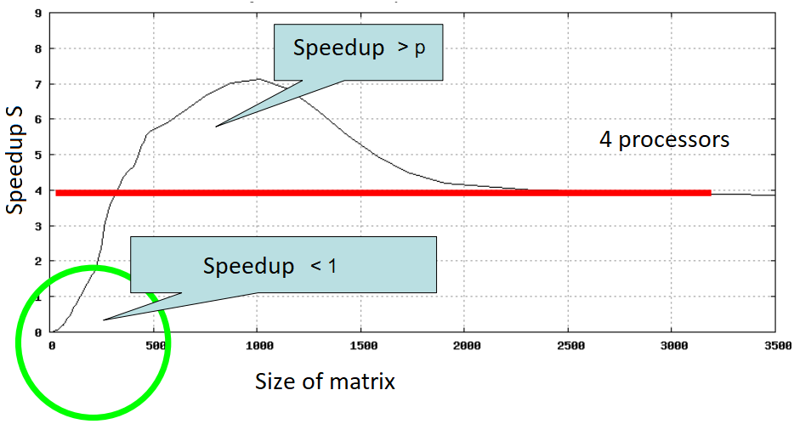
Subunit and super linear speedups
Possible reasons:
Overhead costs (i.e. 1000 division instructions).
Caching effects.
Paralleling algorithm error.
According to materials of Prof. A.V. Boukhanovsky
Notes:
QUESTION: Do you know cache-miss?
Thread creation is similar to 1000 division instructions.
New cores also added FAST cache memory, this is very important. This lead to cache-miss minimization.

Slide 18
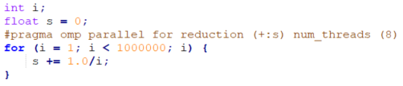
Changing the results of floating point calculations
1 thread: s = 14.357357
8 threads: s = 14.393189
Diff: 0.25%
Notes:
QUESTION: Do you know cache-miss?
Assume we have a+b+c+… or a*b*c… Order is important.

