Slide 1
Parallel Computing Academic year – 2020/21, spring semester Computer science Lecture 3
Lecturer, instructor:
Balakshin Pavel Valerievich
(pvbalakshin@itmo.ru; pvbalakshin@hdu.edu.cn)
Assistant:
Liang Tingting
(liangtt@hdu.edu.cn)

Slide 2
Goals of parallel programming usage
Increasing computational speed.
Improving responsiveness of the user interface.
Providing high fault-tolerance of application modules when neighboring modules fail.
Improving source code structure (reducing dependencies between program modules).
Notes:
Most common, most comprehensible (clear).
WinSCP (https://en.wikipedia.org/wiki/WinSCP) blocks everything on UI during execution of the operation. Solution: 1st thread – copy, 2nd thread – UI.
Multiple tabs in browser. At least unique thread for each tab, or even process. Old browsers did this.
Assume that there is a one big function to represent data in all tabs of a browser. Typical example of bad/spaghetti code (https://en.wikipedia.org/wiki/Spaghetti_code). Try to think ahead!

Slide 3
Conditions for successful automatic parallelization
Only for-cycles (not while, do, etc.) with the number of iterations calculated in runtime.
No dependencies between different iterations.
Absence of conditional changes of the variables to be used after the loop inside the loop.
Sufficient number of iterations and/or sufficient duration of each iteration.
Absence of function calls within the loop ("side effects", use inline and restricted).
Notes:
1. You should always have possibility to count number of iterations in order to divide them by number of threads properly. While – unknown number, but for is ok.
2. Assume that you have some array B calculated from array A. B[x_1] is calculated from A[x_0]. Until A[x_0] is calculated, B[x_1] can not be calculated.
It is impossible to predict which task will be assign to which thread. So, thread, which is waiting for some 1st iteration, can’t work with it when there is no 0th element. Thus such for-loop can not be parallelized automatically.
3. Assume that there is if condition within the for-loop. And further actions depends on result of that condition. GCC compiler can’t parallelize this, however some version of Intel can.
4. Think about overhead costs for thread creation. This is useless for iterations with small execution duration.
5. Most of compilers will not parallelize for-loops with any functions (ex. sin/cos) inside, as those functions can do so dramatic actions, can change global variables.
- To exclude side effect inline functions can fix the situation (https://stackoverflow.com/questions/23257384/is-there-any-difference-when-compilers-implements-c-inline-function-in-different)
- To exclude side effect and intersection of data ranges in memory use restrict modificator in functions can be used (https://gcc.gnu.org/onlinedocs/gcc-4.6.4/gcc/Restricted-Pointers.html, https://en.wikipedia.org/wiki/Restrict)

Slide 4


Main approaches to parallelization
Data parallelization (decomposition).
Instruction parallelization.
Parallelization of information flows.
Notes:
1. The programmer finds in the program an array of data whose elements the program sequentially processes in some func function. Then the programmer tries to break this data array into blocks that can be processed in func independently of each other. Then the programmer starts several threads at once, each of which executes func, but at the same time processes data blocks different from other flows in this function. Ex.: Two janitors sweep half a sidewalk each first, then paint half a fence each.
2. The programmer finds in the program sequentially called functions, the process of which does not affect each other (such functions do not change common global variables, and the results of one are not used by the other). Then the programmer starts these functions in parallel threads. Ex.: while the first janitor sweeps the sidewalk, the second one paints the whole fence at the same time.
QUESTION: why is incorrect?
3. A program is a set of functions that can be performed, and several functions can expect the result of the previous ones. In this case, each core performs the function for which the data is already ready. Ex.: The first janitor sweeps the sidewalk, the second one paints the part of the fence that is near the swept part of the sidewalk.
One work a little bit faster.

Slide 5
Data parallelization
All cores (threads) execute the same set of instructions at the same time; only the input data for these instructions differ.
Array A
A[0] |  |  |  |  |  |  |  |  | A[9] | A[10] |  |  |  |  |  |  |  |  | A[19]
Core 1
for (i = 0; i <= 9; i++) {
A[i] = i * sin (i*Pi/2);
}
Core 2
for (i = 10; i <= 19; i++) {
A[i] = i * sin (i*Pi/2);
}
Notes:
Some huge array, easy to split for 2 threads.
Job is the same.
All cores (threads) execute the same set of instructions at the same time; only the input data for these instructions differ. In this example, a common set of instructions is marked in green.

Slide 6
Instruction parallelization
All cores simultaneously execute different unrelated instruction sets; the data sets can both match (blue example) and differ (green example).
A program fragment:
1. Replicate matrices A and B.
2. Reverse the sign of matrix C elements.
3. Find the maximal element of matrix C.
4. Find the minimum element of matrix C.
Sequential execution | Parallel execution
2
4
1
2
3
4
t
1
3
t
Notes:
Matrices A, B and C are independent.
From the first view, 1 and 2 are split using data parallelization.
However there is no possibility to run anything on 2nd thread (tasks 3 or 4) as task 2 is still running.
Tasks 3 and 4 can be executed in parallel as they are just read the data.

Slide 7
Parallelization of information flows
Cores pass data processing results through the chain to each other (until the core results appear, all downstream cores can't start working).
A program fragment:
1. Multiply matrices A and B, write the result into matrix C.
2. Reverse the sign of matrix C elements.
3. Find the maximal element of matrix C.
4. Find the minimum element of matrix C. (if there is 3rd core)
Sequential execution | Parallel execution
2
4
1
2
3
4
t
1
3
t
4
Notes:
Task #2 can be started until the end of task #1, but with some delay.
Tasks #3 and #4 can be started until the end of task #2, but with some delay.
There is no dependency between task #3 and task #4. They can be run in any order.

Slide 8
Specifics of paralleling methods
When paralleling by tasks, there is a high probability of idle time of unloaded cores.
The data paralleling method is very well scaled but potentially more often it calls False Sharing.
The method of information flows paralleling has an unrecoverable initial delay.
Notes:
We already checked that tasks can has different time of execution.
During data parallelization you can create program just once and then compiler will split data by number of cores.
Always need to have some idle/downtime.

Slide 9
False sharing of cache lines
The essence of the problem: read and write operations by different threads of different variables located in the same cache string lead to unnecessary waiting for cache string rebooting for the reading stream through the fault of the writing stream.
Solutions:
Spacing variables in memory
Creating local copies of variables before they are used in the thread
9
Notes:
Each CPU has it’s own cache. Also they have shared cache.
Some local variables. From the first point of view, there is no intersection.
Processor can’t work with bytes in memory. It copies lines of memory. 64 bytes in one iteration (since Pentium III). Otherwise bus between CPU and RAM will be used ineffective.
Initially due to data, code and time localization it was good. As soon as we got 1+ processor we got an issue.
CPU 0 override some cache line.
CPU 1 has a question: is this line is still actual?
Thus CPU 1 should wait for memory refresh.
https://en.wikipedia.org/wiki/False_sharing
https://software.intel.com/content/www/us/en/develop/articles/avoiding-and-identifying-false-sharing-among-threads.html
Solutions:
Add array with 0 values.

Slide 10
Structure of Lab #1
Generate M1
Generate M2
Map M1 (no dependencies)
Map M2 (there is dependency)
Merge M1 and M2 into M2
Sort M2
Bring M2 to one number (a cycle with conditions inside iterations)
Notes:
1 and 2 - Instruction parallelism (NOT data parallelism!), all array elements are generated in each own thread (2 threads in total).
QUESTION: what will happened if we have 8 cores? Can we anyway try to split arrays M1 and M2 by parts to allocate all cores?
rand_r (&seed) command generates 1st element of array. 2nd one will depend on the 1st value. So each next value depends on a previous one.
But if you split for multiple threads, the sorting, or any other functions can have different behavior.
It is better to have the same seed for all iterations to have the possibility to analyze result of the lab. But for real data generation you can use any seed.
On the first lab compiler should not understand, that task 1 and task 2 are not intersected: 1 to A and A to 10*A. Also compiler will no parallelize any loop if it has any function inside.
3 – data parallelism, no dependencies, can be executed on all threads.
4 – no parallelization by compiler because of dependency.
5 – data parallelism, you can assign combination of i-element to each thread.
6 – most risky step, no way to do this with the help of compiler, manual only not it the first lab.
7 – GCC can’t parallelize (because of if command, especially when within this if construction you will change some variable that will be used after the loop), ICC – can.
Overall:
1)Each stage helps you to understand a small piece of parallel programming.
2)After the first lab you should slightly hate automatic program parallelization.

Slide 11
Paralleling libraries
AMD Performance Library (Framewave)
Intel Integrated Performance Primitives (IPP), Intel Math Kernel Library
Sun MediaLib
ATLAS (Automatically Tuned Linear Algebra Software): MATLAB, Mathematica, Octave, …
…
Conflicts: https://www.agner.org/forum/viewtopic.php?t=6
Notes:
Library automatically analyze your hardware, creates necessary number of threads and use you hardware as much as possible.
Some of them are paid, don’t need to be used!
Read license agreement, some of them are paid, but free for students.
AMD Framewave a little bit outdated, but commonly used opensource lib.
https://www.agner.org/forum/viewtopic.php?t=6

Slide 12
Hints for Lab #2
Download already compiled library (https://sourceforge.net/projects/framewave/files/framewave-releases/Framewave%201.3.1/FW_1.3.1_Lin64.tar.gz/download) or (https://fossies.org/linux/misc/old/FW_1.3.1_Lin64.tar.gz/index_t.html).
Unpack the downloaded archive to any convenient directory.
Create environment variable FW_HOME, containing path to unpacked library.
Run the script:
FW_LIB=$FW_HOME/lib; for file in $(ls -1 $FW_LIB); do ln –sf
$FW_LIB/$file $FW_LIB/$(echo $file | sed 's/.1.3.1//'); ln –sf
$FW_LIB/$file $FW_LIB/$(echo $file | sed 's/.3.1$//'); done
Use keys -I${FW_HOME} and -L${FW_HOME}/lib/ to compile (and link).
Change LD_LIBRARY_PATH to launch the compiled program:
export LD_LIBRARY_PATH=$FW_HOME/lib
Add required header files to your code: #include <fwBase.h>
Notes:
Script from the step 4 will create symbolic links to all .so libraries, for correct linking and execution.

Slide 13
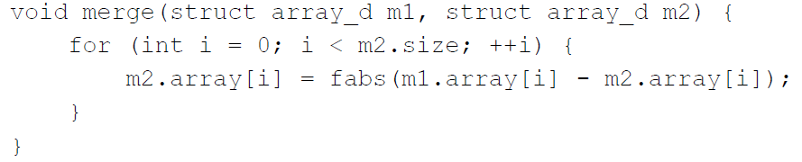
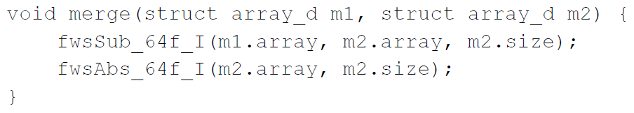
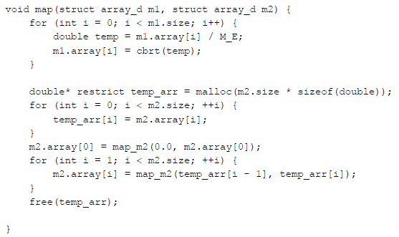
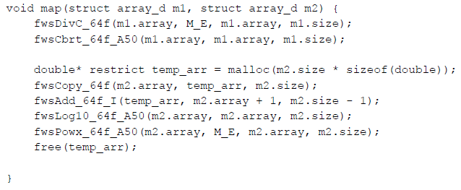
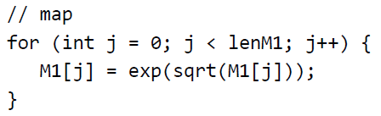
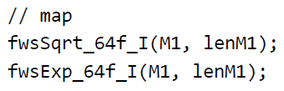
Hints for Lab #2 (2)

Slide 14
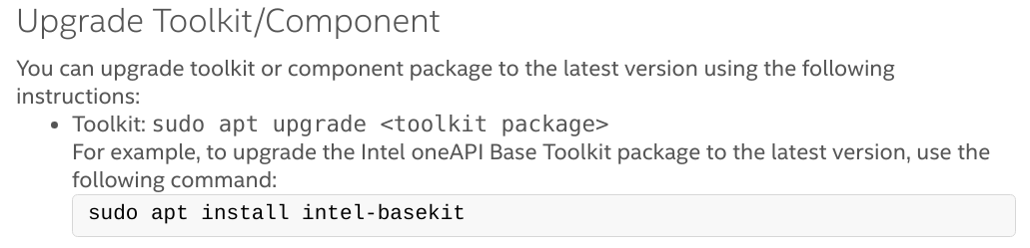
Hints for Lab #2 (3)
Follow the instructions for your operation system: (https://software.intel.com/content/www/us/en/develop/tools/oneapi/base-toolkit/download.html).
Download extended version for IPP:
Apply environment for ICC (Linux):
. /opt/intel/oneapi/setvars.sh
Use IPP documentation: (https://software.intel.com/content/dam/develop/external/us/en/documents/ipps.pdf)
Notes:
n.

Slide 15
Hints for Lab #2 (4)
void map_M1(float *array, int size){
for (int i=0; i < size; i++){
array[i] = exp(sqrt(array[i]));
}
}
void map_M1(float *array, int size){
ippsSqrt_32f(array, array, size);
ippsExp_32f(array, array, size);
}
void map_M2(float *array, int size){
float array_copy[size];
for (int i=0; i < size; i++){
array_copy[i] = array[i];
}
float past = array_copy[0];
for (int j=1; j<size; j++){
array[j] = abs(sin(array_copy[j]+past));
past = array_copy[j];
}
}
void map_M2(float *array, int size){
float array_copy[size];
ippsCopy_32f(array, array_copy, size);
array_copy[0] = 0;
ippsAdd_32f_I(array_copy, array, size);
ippsSin_32f_A21(array, array, size);
ippsAbs_32f(array, array, size);
}

