Slide 1




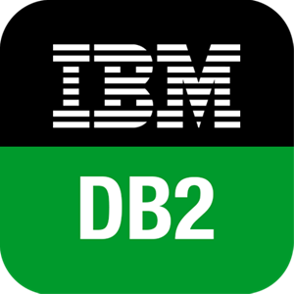

HTTP(S)
Rest API
System Users
ReactJS User Portal
SQL Queries
HTTP(S)
Rest API
NodeJS Server
DB2 DB Service
System Admin
ReactJS Admin Portal

