Slide 1
NLP checkpoint 1
NTHU黃少與他的狗🐶
影片：https://drive.google.com/file/d/1y3xkvG-ytLsZ5fkpdYs-byNw9fYyYi7y/view

Slide 2
Datasets

Slide 3
Dataset Overview
Input Features
question_title: Short description of the question.
question_body: Detailed description (may contain code blocks, images, LaTeX).
answer: The response provided by a user
Target Labels
Dimensions: 30 different labels for each Q&A pair.
Value Range: Continuous values between 0 and 1.
Notes:
Topic 4 目標是讓 AI 像人類一樣評估問答品質。這是一個多標籤回歸任務，輸入包含標題、內文與回答 ，需預測幫助性、清晰度等 30 個主觀分數 。資料涵蓋技術與生活等多領域 ，最終以 Spearman 相關係數評估預測排序的準確性 。

Slide 4
Data Difficulties 1
1. High-Dimensional & Subjective Labels
Subjectivity
  Target scores (e.g., helpfulness, clarity) are subjective and generated by human raters.
  Problem: High label noise (Annotator Bias).
Target Correlation
  Predicting 30 distinct labels simultaneously.
  Observation: Some labels are highly correlated (e.g., answer_helpful vs. answer_relevance), while others are sparse.
  Problem: Needs a model capable of capturing inter-label dependencies.
Notes:
首先面臨的是標籤的主觀性挑戰。這 30 個預測目標源自人類評分，存在明顯的標註偏差 (Bias) 與雜訊 。此外，標籤間具有複雜的相依性，例如『回答幫助性』與『相關性』往往高度連動，模型必須能有效捕捉這些內在關聯，而非僅將每個分數視為獨立任務來預測。

Slide 5
Data Difficulties 2
2. Unstructured & Mixed-Modality Input
Noisy Text Structure
  Inputs contain HTML tags (<div>, <p>), Code snippets (def function():), and LaTeX equations.
  Problem: Standard BERT tokenizers may split code keywords meaningfully, or get distracted by HTML tags, losing semantic focus.
Long Sequence Length
  Combined length of Title + Question Body + Answer often exceeds 512 tokens (BERT limit).
  Problem: Truncation leads to information loss (e.g., the key part of the answer might be at the end).
Notes:
第二是輸入資料的非結構化。文本中充斥著 HTML 標籤、程式碼片段與數學公式，這些雜訊容易干擾 BERT 模型的語意理解 。此外，問答總長度經常超過 512 tokens 的限制，若直接截斷，常導致位於段落末尾的關鍵回答資訊遺失，因此需要設計更有效的長文本處理策略。

Slide 6
Data Difficulties 3
3. Distribution & Metric Mismatch
Label Distribution
  Most scores are not normally distributed; many are clustered around specific values (e.g., 0, 0.5, 1.0) or heavily skewed.
  Problem: Regression models (using MSE Loss) tend to predict the "mean," failing to capture the ranking nuances.
Optimization Challenge
  Metric: Spearman's Correlation (Ranking-based).
  Loss: MSE / BCE (Value-based).
  Problem: Improving Loss does not always improve the Leaderboard score (Gap between training objective and evaluation metric).
Notes:
最後是優化目標的落差。標籤數據分佈極度不均，常集中在特定數值，導致模型傾向預測安全的平均值。更關鍵的是，訓練用的 MSE Loss 與競賽評測的 Spearman 排序指標 存在本質差異，這意味著單純降低 Loss，並不保證能直接提升最終的 Leaderboard 排名。

Slide 7
Kaggle Code Analysis

Slide 8
Preprocess
 | A (inference) | B (labelling)
Strategy | Manually cleans and structures data to maximize signal. | Relies on the model (BERT) to figure out patterns from raw text.
Cleaning | Masks numbers, expands contractions and spaces punctuation. | Passes raw text directly to the tokenizer.
Long Text | Cuts out the middle of long texts to keep the intro and conclusion. | Cuts off the end of the text. Risks losing the answer if the question body is too long.
Metadata | Extracts URL domains (netloc) and one-hot encodes them as separate tabular features. | Appends Category and Hostname as text at the end of the input string.
Input Format | [CLS] Title [SEP] Body [SEP] Answer [SEP] | Title [SEP] Body [SEP] Answer [SEP] Category [SEP] Host.
Notes:
(第一部分：清理資料) 「第一步我們要做的是『資料清洗』。簡單說，就是把標題、內文跟回答這三個欄位整理乾淨。 原始資料通常滿髒的，裡面會夾雜一堆 Tab 鍵、亂七八糟的換行，或是多餘的空格。我們的做法很直接：把這些雜訊全部拿掉，統一變成一個簡單的空格。 另外，我們也會把頭尾多餘的空白修剪掉。這樣做的好處是，模型才不會浪費算力去讀一堆沒意義的『空氣』，可以直接專注在真正的內容上。」
(第二部分：把資料串起來) 「清乾淨之後，第二步就是『串接』。 因為 BERT 這個模型沒辦法一次讀三個分開的欄位，它需要的是一整條連續的文字流。所以，我們得把剛剛整理好的標題、內文跟回答全部串在一起，變成一個長句子丟給它。」
(第三部分：關鍵的分隔線) 「但這邊有個重點：如果只是單純把文字全部黏在一起，模型會搞不清楚問題是在哪裡結束、回答又是從哪裡開始的。 為了解決這個問題，我們會插入一個特殊的記號，叫做 [SEP] token。 大家可以把它想像成一條『分界線』。它很明確地告訴模型：『問題講完了喔，接下來是回答』，這樣訓練的時候才不會語意錯亂。」

Slide 9
Model A
1. Enhanced Architecture
Backbone Upgrade: Likely employs RoBERTa or a customized BERT variant.
Advantage: Optimized pre-training (removing NSP loss) provides better contextual understanding for Q&A tasks than standard BERT.
Dropout Regularization: Includes Dropout layers before the final classification head to prevent overfitting on the relatively small dataset.
2. Advanced Pooling & Optimization
Pooling Strategy: Moves beyond [CLS] to Mean/Average Pooling
  Computes the average of all token embeddings in the sequence (torch.mean(hidden_states, dim=1)).
  Benefit: Captures global context and reduces noise from individual tokens.
Loss Function: Implements BCEWithLogitsLoss.
  Combines a Sigmoid layer and the BCELoss in one single class.
  Provides more numerical stability during backpropagation compared to separating Sigmoid and BCELoss.
Notes:
「接著是 Code 2，它展示了完整的訓練架構。相比 Baseline，它通常採用 RoBERTa 並引入 Dropout 防止過擬合。最關鍵的差異在於使用 Mean Pooling (平均池化)，綜合考量所有 tokens 的語意，而非單點採樣，這能更完整捕捉長文本特徵。同時使用 BCEWithLogitsLoss 函數，提升了多標籤回歸任務在訓練時的數值穩定性。」

Slide 10
Model B
1. Backbone Selection
Model Type: Utilizes a standard BERT-base-uncased (or similar Transformer) model.
Purpose: Acts purely as a feature extractor to convert tokenized input (Question + Answer) into dense vectors.
Inference Mode: Loads pre-trained weights directly, skipping the training overhead.
2. Advanced & Pooling
Token Aggregation: Relies on the [CLS] Token Strategy.
  Extracts the first token's hidden state to represent the entire sequence.
  Limitation: The [CLS] token acts as a bottleneck, often struggling to capture detailed semantics in longer texts (512+ tokens).
Output Layer:
  A simple Linear Layer
  Maps the 768-dim BERT embedding to the 30 target scores required by the competition.
  Uses Sigmoid Activation to ensure outputs are constrained between 0 and 1.
Notes:
首先分析 Code 1，這是一個標準的推論 Baseline。它載入預訓練的 BERT-base 模型，採用最簡單的 [CLS] Token 池化策略，直接用第一個 token 代表整篇問答的語意。雖然結構簡單且推論速度快，但這種單點壓縮的方式，容易遺失長文本中的細節資訊。最後透過全連接層輸出 30 個分數，並用 Sigmoid 確保數值落在 0 到 1 之間。」

Slide 11
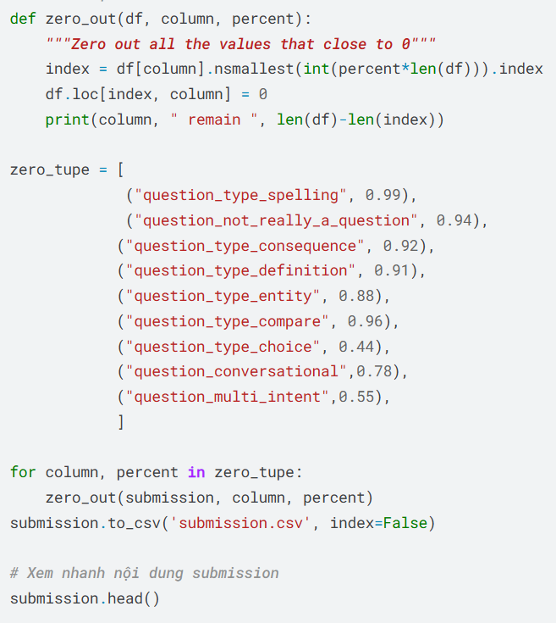
Postprocess
CodeA Sort all prediction scores in the column from smallest to largest, select the bottom X%, and force those bottom entries to be changed to 0.

Slide 12
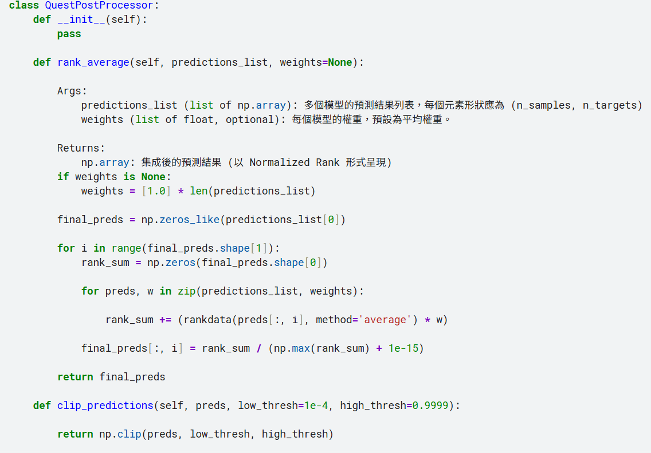
1. The Scenario
Imagine a teacher who is very strict and only gives three possible grades: 0, 50, or 100.This is your Ground Truth.
2. The Problem
Your AI model is trying to predict these grades, but it is too precise.
For Student A, it predicts: 49.9
For Student B, it predicts: 50.1
Because 50.1 > 49.9, the AI thinks "Student B is better than Student A."However, in reality, both students actually received the same grade (50). The AI has created a false ranking.
3. The Solution (Snap-to-Grid)
We force the AI's predictions to "snap" to the nearest valid grade.We change 49.9 ->50, 50.1 -> 50

Slide 13
Our Method

Slide 14
Preprocessing
The preprocess consists of two parts. The first part goes through the three main text columns and replaces tabs, double spaces and new lines with a single space. It also removes spaces from the start and end of a text. We then construct the input string by stitching the pieces of data into one single sequence. After doing so, a special marker [SEP] is inserted so that the model does not get confused about where the question ends and where the answer starts.
Notes:
(第一部分：清理資料) 「第一步就是把標題、內文跟回答這三個欄位整理一下，讓它們規格統一。 原始資料通常滿亂的，裡面會夾雜一堆 Tab 鍵、亂跳的換行，或是重複的空格。我們的做法很乾脆：把這些雜訊全部清掉，統一換成一個簡單的空格。 另外，頭尾多餘的空白我們也會切掉。這樣模型可以直接專注在真正的內容上。」
(第二部分：把資料串起來) 「資料清乾淨之後，第二步就是『拼接』。 因為像 BERT 這種模型，沒辦法一次吃三個分開的欄位，它要的是一整串連續的文字流。所以，我們得把剛剛整理好的那些資料全部串起來，變成一個長句子丟給它。」
(第三部分：關鍵的分隔線) 「如果只是單純把文字全部黏在一起，模型會搞不清楚問題是在哪裡講完、回答又是從哪裡開始的。 為了解決這個問題，我們會塞一個特殊的記號進去，叫做 [SEP] token。它很清楚地跟模型說：『問題到這裡結束喔，接下來是回答』，這樣訓練的時候才不會語意錯亂。」

Slide 15
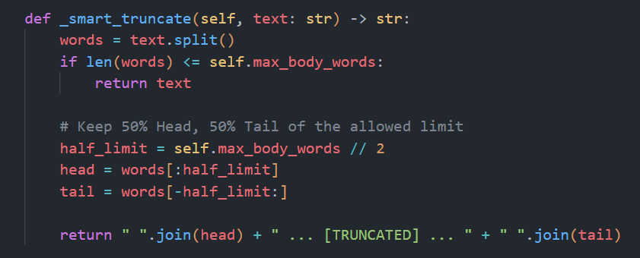
Preprocessing Fix
Fix1: We modified the preprocess part to use Python's html library to decode symbols and regex to remove tags of input consisting of html.
Fix2: We replaced the math formulas in the input with a placeholder [MATH] so that the model does not have to read LaTeX equations like $\frac{x}{y}$.
Fix3: If the body is too long, the answer gets cut off by the tokenizer. We fix this by keeping 50% of the the head and tail and cutting off the middle is the input is too long.
Notes:
1. 清理 HTML 雜訊 「第一點，我們處理了 HTML 的問題。 原本的資料裡頭充滿了那種亂七八糟的網頁標籤跟編碼符號。我們的做法是用 Python 的工具把這些符號解碼，再用正規表示式 (Regex) 把標籤全部『洗』乾淨，讓文字變回人看得懂的樣子。」
2. 簡化數學公式 「第二點是簡化數學公式。 那些複雜的 LaTeX 算式很容易讓模型『暈船』，反而學不到東西。所以我們直接用一個簡單的 [MATH] 標記把所有公式換掉。這樣做可以讓模型知道『喔，這邊原本有個公式』，但不用卡在那邊硬要讀懂它。」
3. 聰明的截斷策略 「最後，我們搞定了長度爆掉的問題。 之前如果問題寫太長，最後面的『回答』就會直接被切掉。我們改用一種『留頭留尾』的策略：如果不夠放，我們就把中間那一塊切掉，只留開頭跟結尾。最重要的是，這樣才能確保最後面的『回答』一定有位子，會被模型看到。」

Slide 16
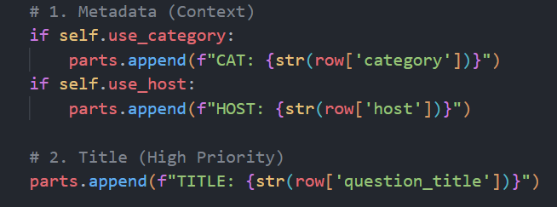
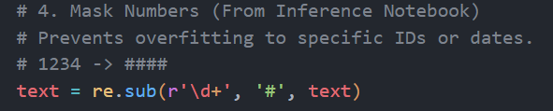
Preprocessing Fix
Fix4: We also masked the numbers to preven overfittingto specific data or IDs.
Fix5: Contraction expansion added to make the model not see words such as we’re and we are as different words.
Fix6: Classifying the metadata allowed the model to get a better idea at what category the question is in.
Notes:
1. 遮蔽數字 (Masking Numbers) 「第一點，我們把數字給『遮蔽』掉了。 在技術問答裡，像 User ID 或是時間戳記這種數字，通常都是雜訊，沒什麼實質意義。我們把它們全部換成通用的代號，這樣模型才不會去死記那些隨機的數字，而是被強迫去理解真正的上下文。」
2. 還原縮寫 (Expanding Contractions) 「第二點是把『縮寫還原』。 像 we're 跟 we are 意思明明一樣，但在電腦眼裡，它們是完全不同的 Token。我們把這些縮寫全部還原成完整的寫法，讓語法規格統一，這樣模型學起來會輕鬆很多。
3. 標記元數據 (Classifying Metadata) 「最後一點，我們對 metadata（元數據）做了明確的分類標記。 以前可能只是丟一堆文字給模型，現在我們會清楚地標上類別——像是『文學』或『科技』。這就像是給模型一個『課前提示』(Hint)，讓它在還沒開始讀題目之前，就先心裡有數，知道這題大概是在講哪個領域。」

Slide 17
Postprocessing

Slide 18
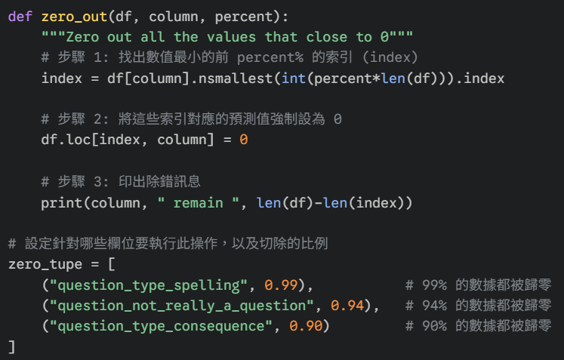
Sample Postprocess Code
Sort all prediction scores in the column from smallest to largest, select the bottom X%, and force those bottom entries to be changed to 0.

Slide 19
Why it works？
Because we use Spearman's to rank
Ex.
ground truth = A:0、B:0、C:0、D:0.5、E:1.0
output = A:0.0001、B:0.0003、C:0.0002、D:0.4、E:0.9
output after post process: A:0、B:0、C:0、D:0.4、E:0.9
true ranking: ABC, D, E
predicted ranking(bofore post process): A, B, C, D, E
predicted ranking(after post process): ABC, D, E

Slide 20
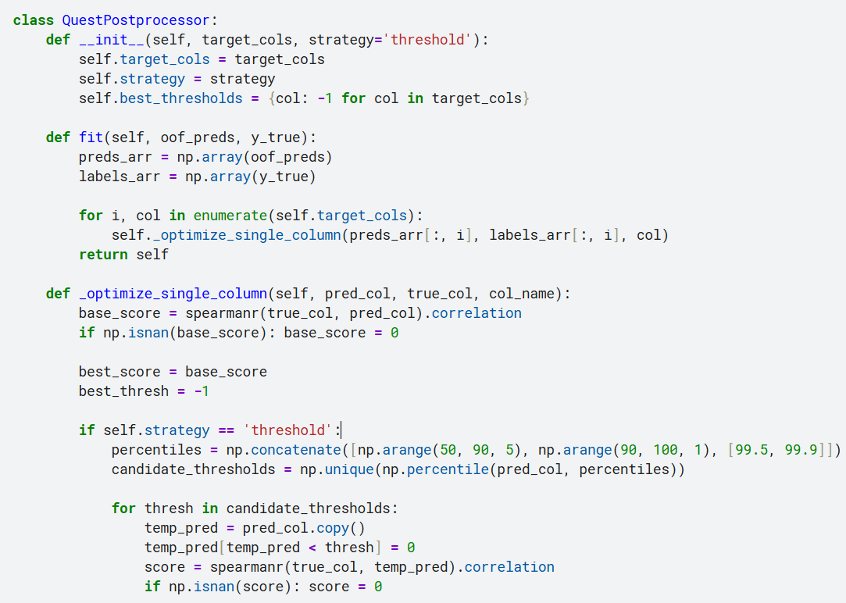
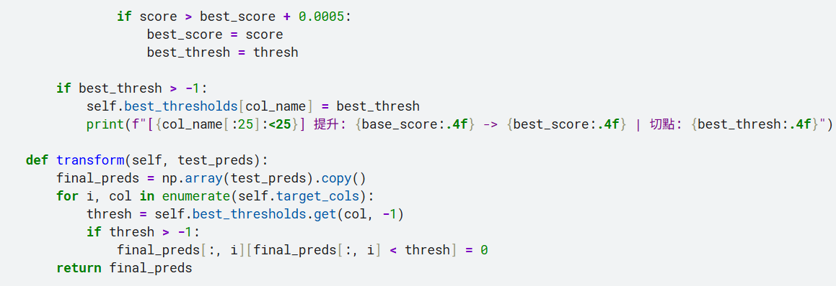
Our thoughts
Identify an optimal cutoff point (e.g., 0.05) and forcibly set all prediction values below it to 0 to restore tied rankings. (The original code directly cut at the 99th percentile.
We use the OOF data generated from cross-validation.
We run experiments using the OOF predictions and the true labels.
The computer then automatically runs a trial-and-error loop.”
  「cutting at 0.01 ，how much is the Spearman ？」 -> 0.35
  「cutting at 0.02 ，how much is the Spearman ？」 -> 0.38
  「cutting at 0.05 ，how much is the Spearman ？」 -> 0.42 (too high!)
  「cutting at 0.10 ，how much is the Spearman ？」 -> 0.40 (It cut too much, and the score started to drop.)

Slide 21
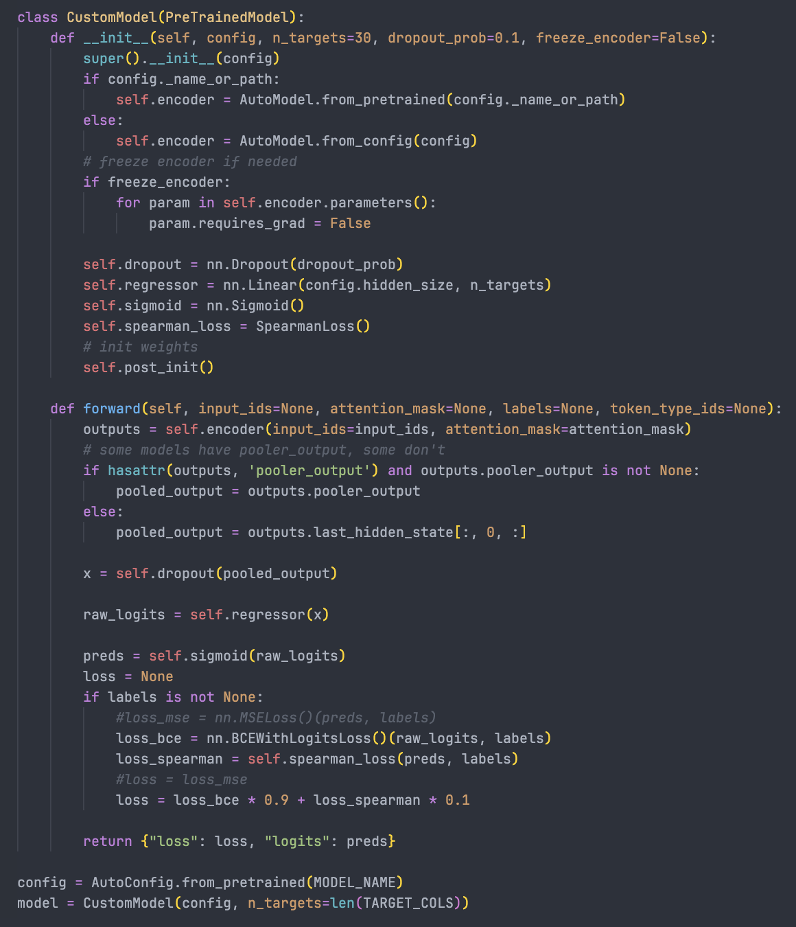
Model design
We started with a very simple pre-trained model with a regression head as our baseline
We use ModernBeert as pretrained model for its effectiveness
We used MSE loss at first, then transitioned to a weighted combination of BCE and Spearman loss

Slide 22
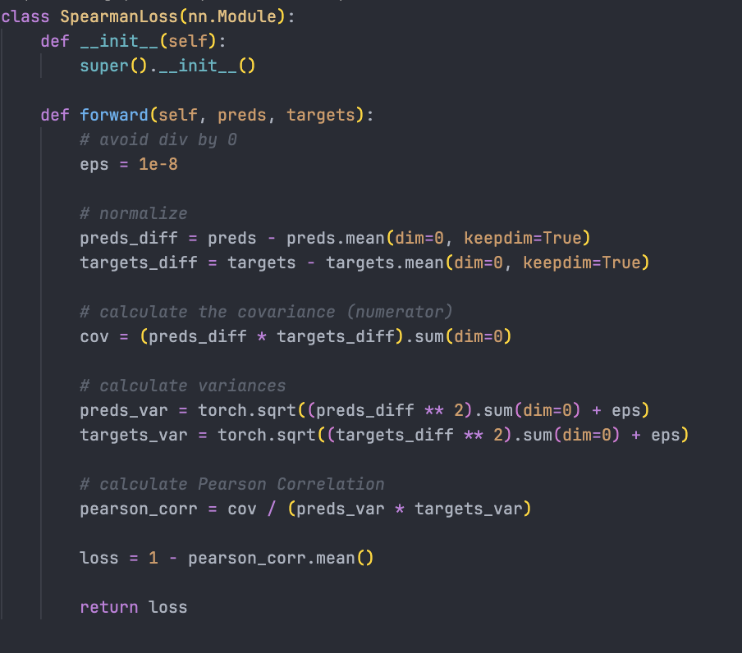
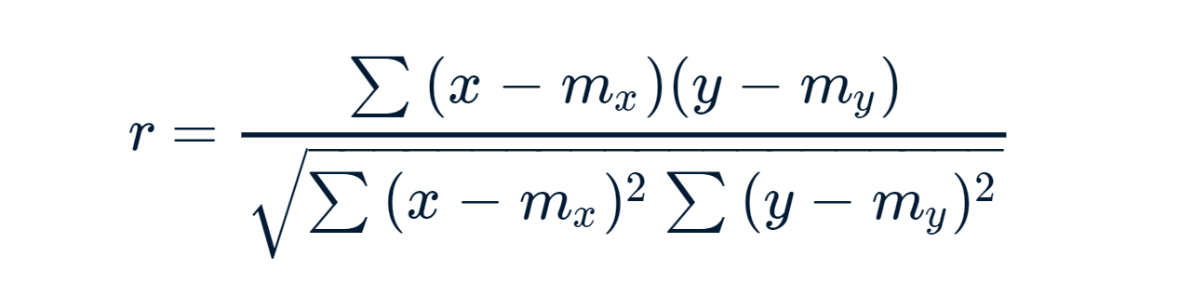
Model design
If Spearman correlation is our evaluation metric, why not use it as our loss function?
Spearnman isn’t differentiable, so we use Pearson correlation to approximate
Slightly improves performance, but bigger gains come from pre/post-processing

Slide 23
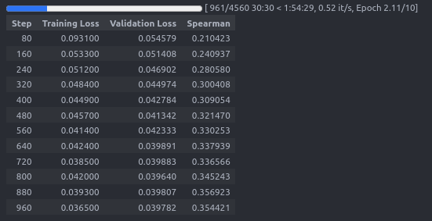
Initial Results
Minimal pre-processing
MSE as loss function
Modern-bert base model
Trained until overfitting
Baseline Spearman Rho was 0.37 before any optimization steps

Slide 24
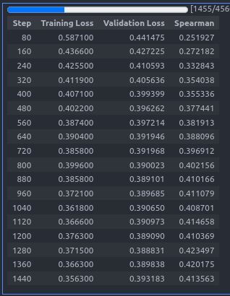
Improved results
We introduced post-processing techniques that exploit the characteristics of human rated data
We modified the truncation strategy from standard (first N tokens) to head-tail (first N/2 + last N/2)
Replaced MSE with a hybrid of Binary Cross Entropy and Differentiable Spearman (Pearson) loss
Reached Spearman Rho of 0.43

Slide 25
Ideas to be implemented
Domain-specific Masked Language Modeling (MLM) fine-tuning
  Fine-tune BERT with Masked Language Modeling on StackExchange data
  Teaches model domain vocabulary before classification task
Pseudo-labeling
  Train multiple models on labeled data
  Use ENSEMBLE of models to generate pseudo-labels for scraped data
  Train final model on combined (labeled + pseudo-labeled) data
Distilled knowledge (LLM-as-Judge)
  Use SOTA model (GPT-4/Gemini) to evaluate QA pairs
  Generate reasoning/scores for each pair
  Append to input OR use as features OR use as pseudo-labels
  Train BERT on this enriched dataset

