Slide 1
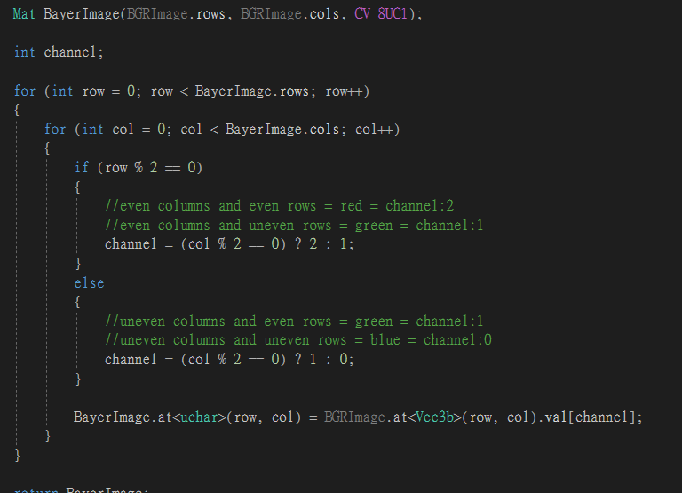

Slide 2



Slide 3



Slide 4
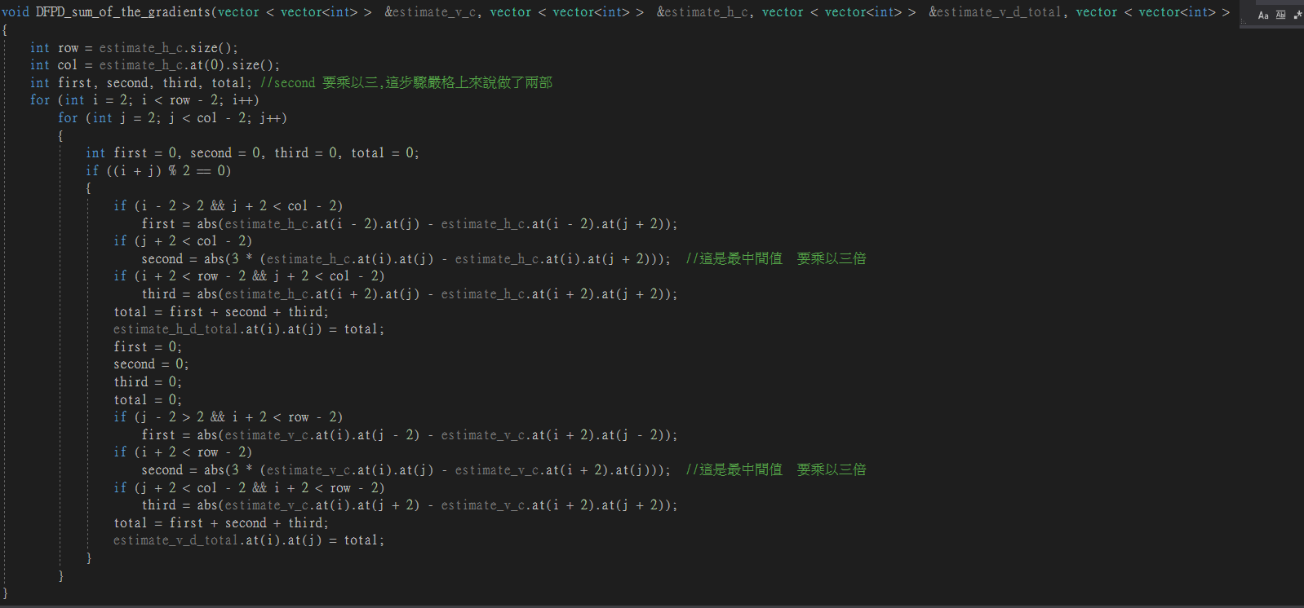


Slide 5




Slide 6




Slide 7




Slide 8
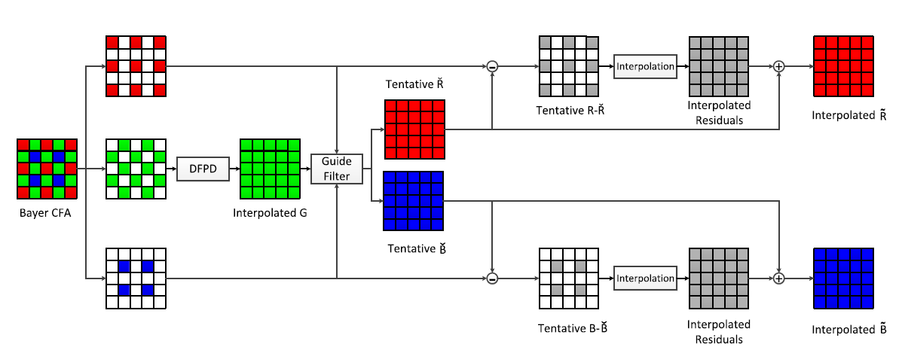
Introduction

Slide 9
Introduction

Slide 10
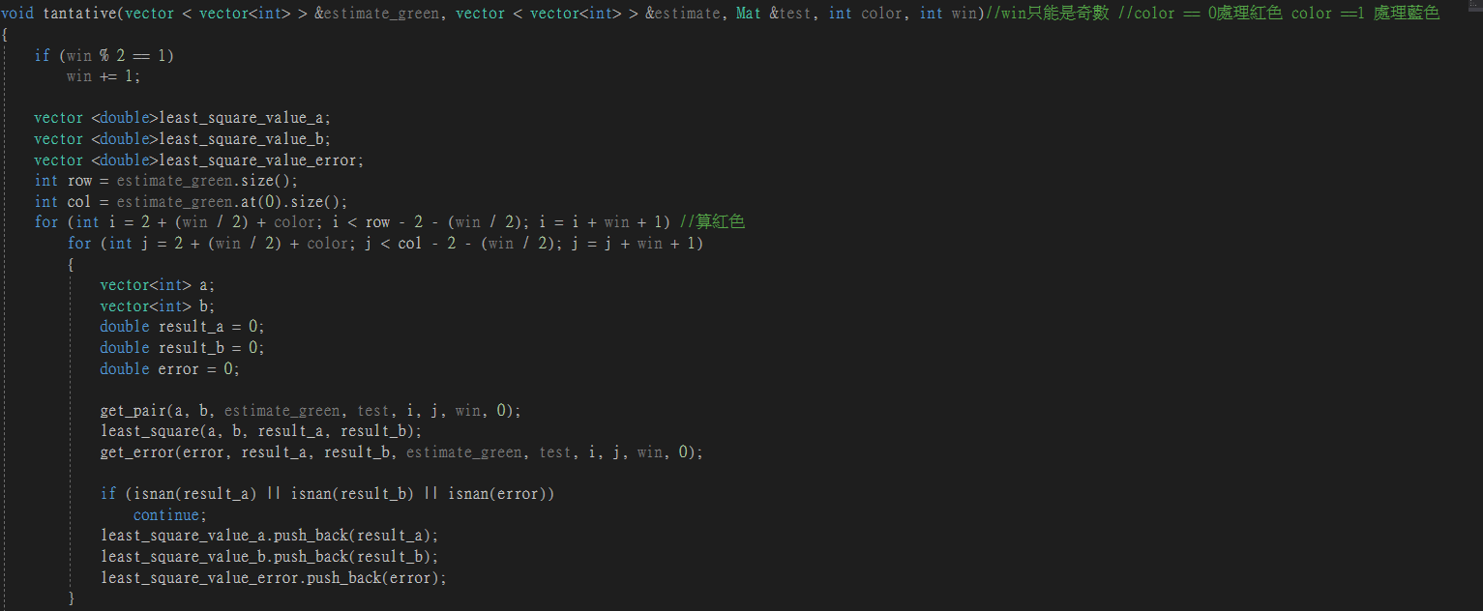


Slide 11
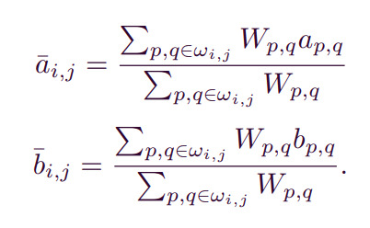


tantative

Slide 12
Introduction

Slide 13


Slide 14
Introduction

Slide 15


Slide 16
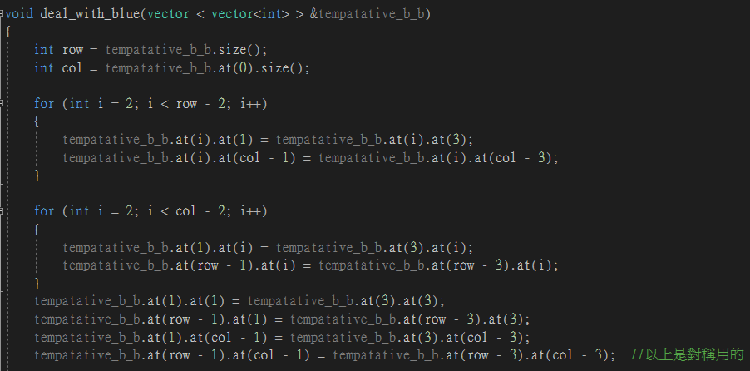

Slide 17

deal_with_blue

Slide 18
Introduction

Slide 19


Slide 20


Slide 21
