Slide 1
A Hybrid Demosaicking Algorithm for Area Scan
Industrial Camera Based on Fuzzy Edge
Strength and Residual Interpolation
M10815095彭政嘉

Slide 2
Introduction
There are mainly two types of industrial cameras, the lines can camera and area scan camera.
The area scan cameras are normally integrated in a single sensor covered by the Bayer color filter array for RGB signal capturing

Slide 3
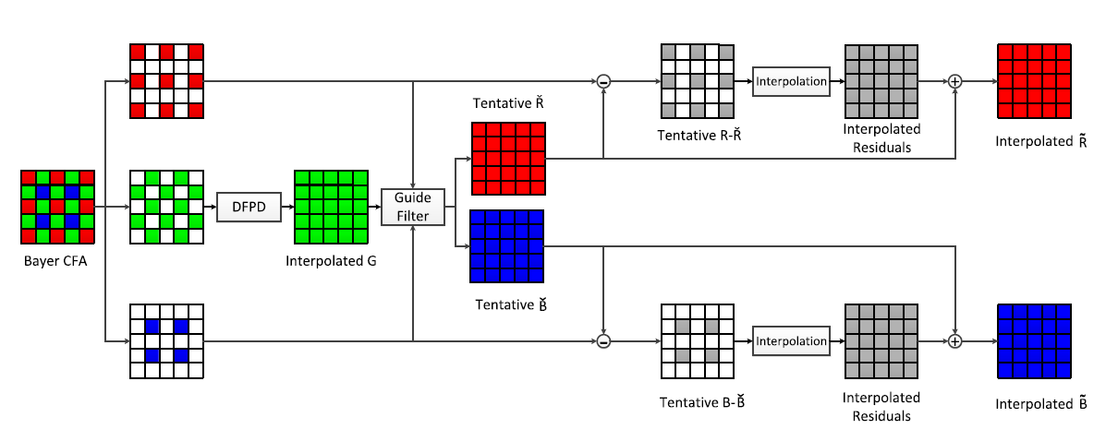
Introduction

Slide 4
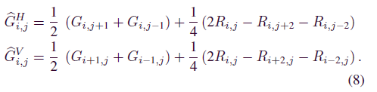

Interpolation of the G Channel With DFPD Algorithm
Calculate G的horizontal and vertical interpolation,然後要去判斷用哪個數值
Calculate two chrominance values,垂直and 水平

Slide 5
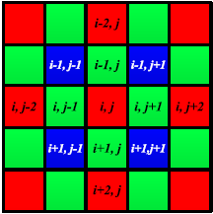

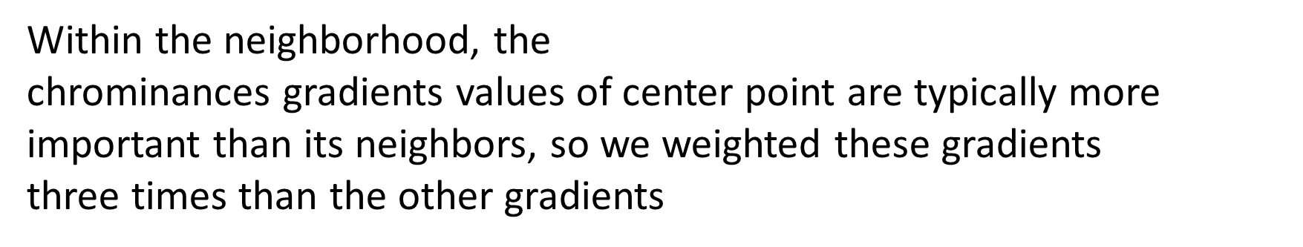
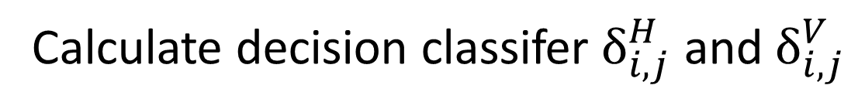
Calculate decision classifer $δ_{i,j}^{H}$ and $δ_{i,j}^{V}$

Slide 6
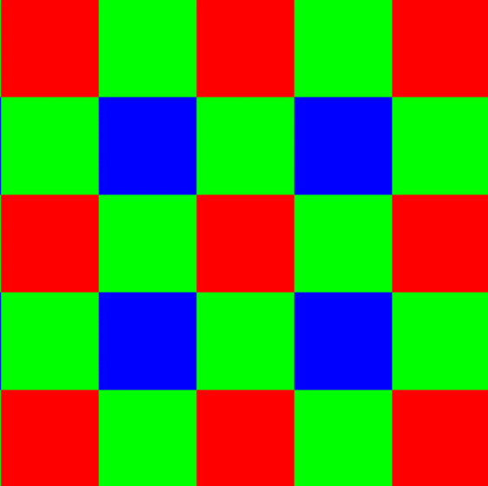
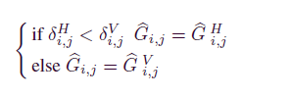
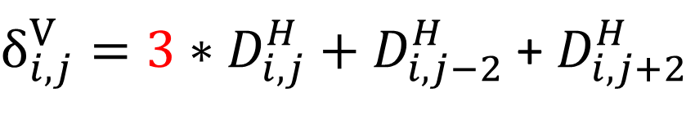

1
$δ_{i,j}^{H}{=3∗D}_{i,j}^{H}$ ${+ D}_{i−2,j}^{H}$ + $D_{i+2,j}^{H}$
1
3
1
${δ_{i,j}^{V}=3∗D}_{i,j}^{H}$ ${+ D}_{i,j−2}^{H}$ + $D_{i,j+2}^{H}$
1

Slide 7

Refining G channel with Fuzzy edge strength Interpolation
smooth textured areas Thresold k>1
k=3
the PSNR value improves about 0.3db

Slide 8


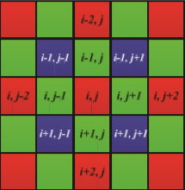
edge strength for point(i,j) within a 3x3 neighborhood
The fuzzy membership of the pixel P_{i,j}

Slide 9


fuzzy averaging of the interpolating pixels within the neighborhood
Then the G value at R sampling location is calculated based on the color differential correlation.

Slide 10
Experimental Result
數據樣本
IMAX dataset and Kodak dataset
客觀指標
CPSNR(Color Peak signal-to-noise ratio)
and SSIM(structural similarity index)
主觀指標
放大區域的細節進行視覺上的比較

Slide 11
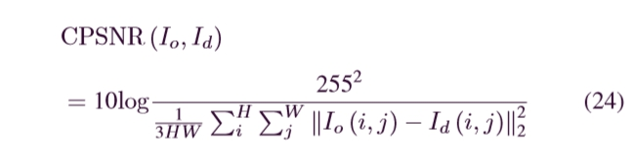
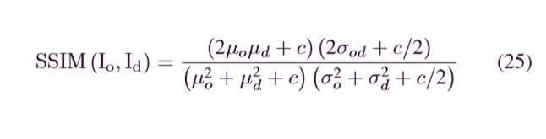
Experimental Result
CPSNR
SSIM

Slide 12
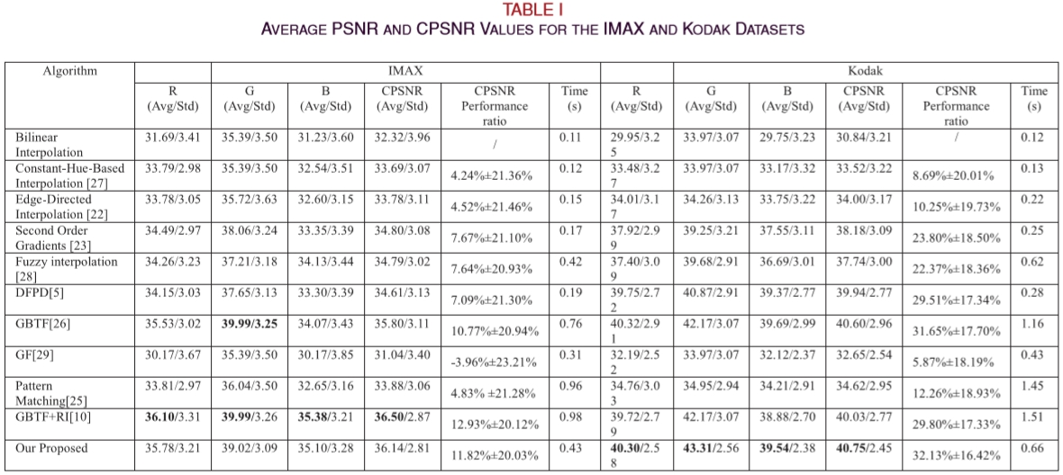

Slide 13
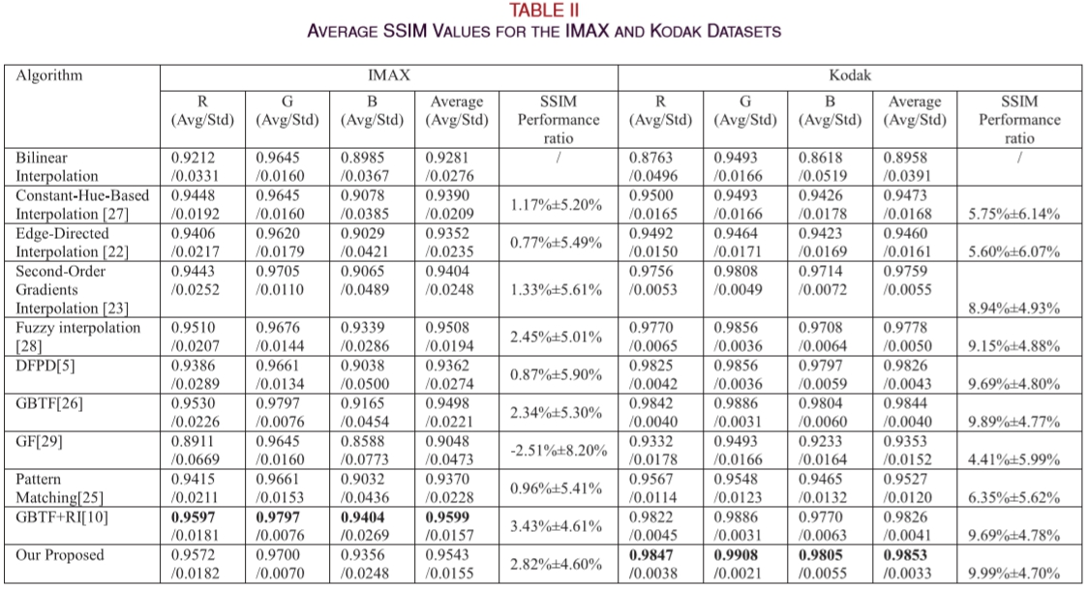

Slide 14
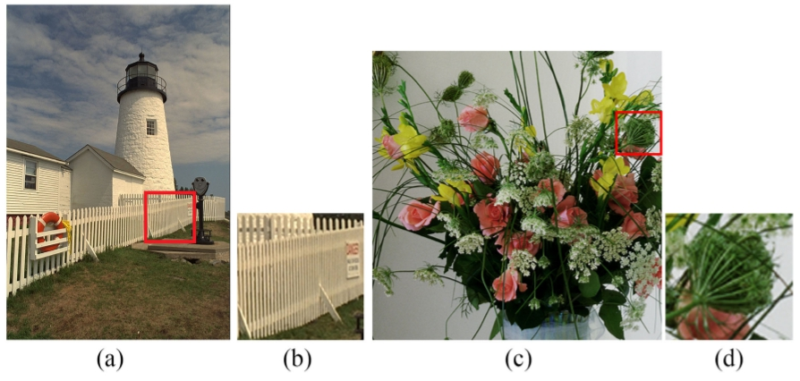
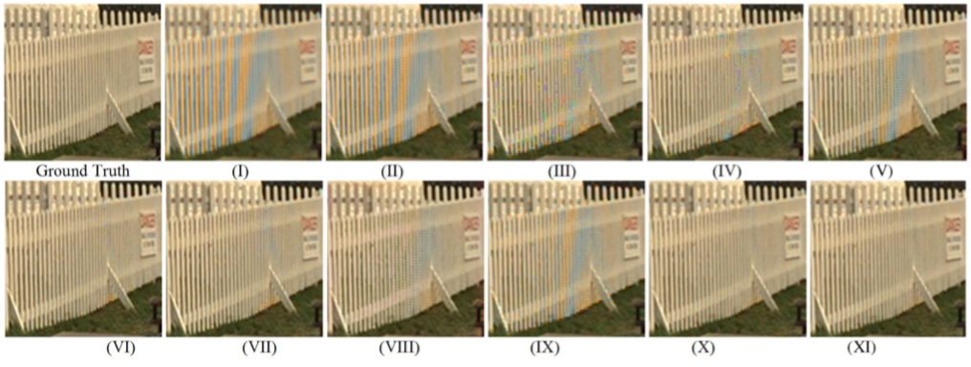

Slide 15
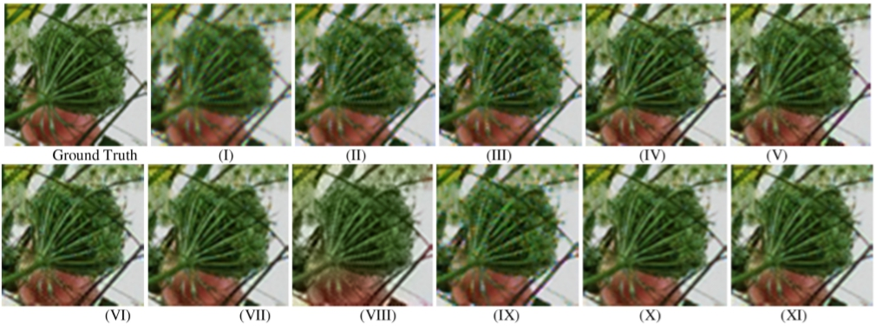

Slide 16
Conclusion
In this article, we proposed a fast and edge-preserving demosaicking algorithm for industrial area scan camera with Bayer CFA
We ﬁrst employ DFPD algorithm and fuzzy edge strength tore store G channel that well preserves the image edges, and then apply the RI tore cover R and B channels.
We compared with the proposed method on IMAX and Kodak standard datasets

