Slide 1

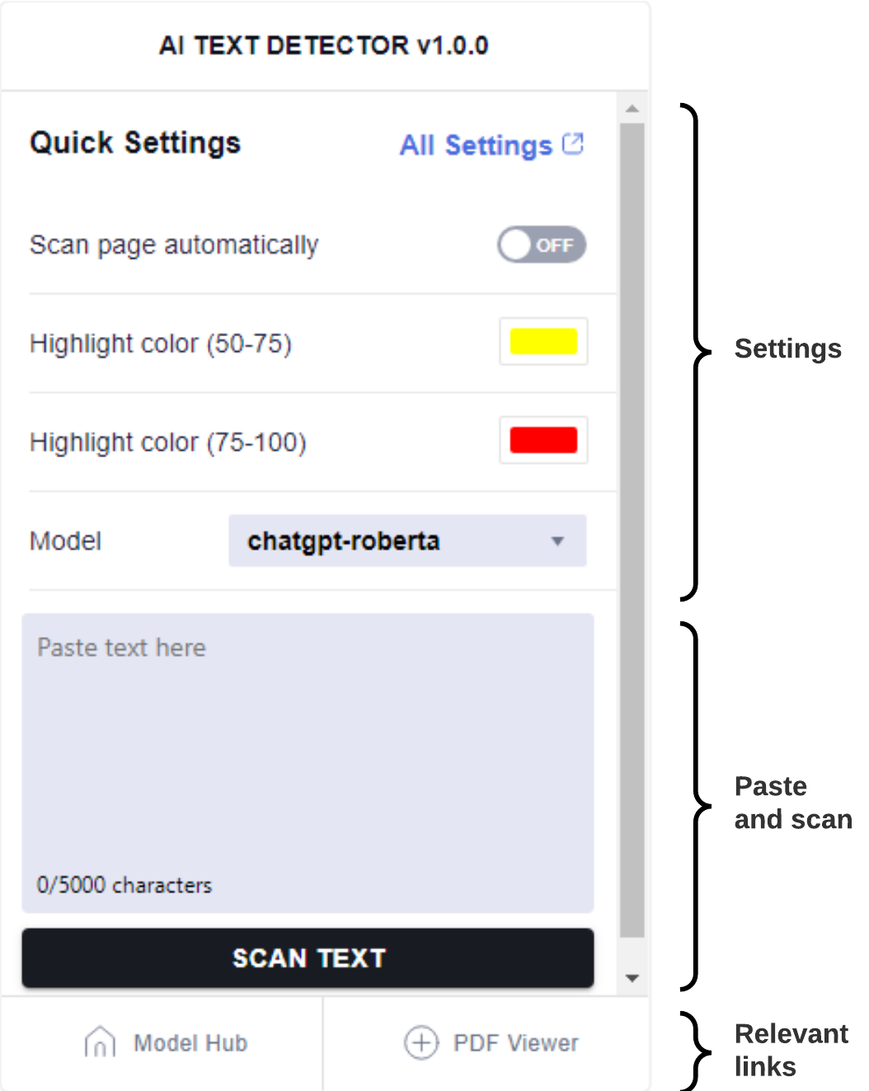
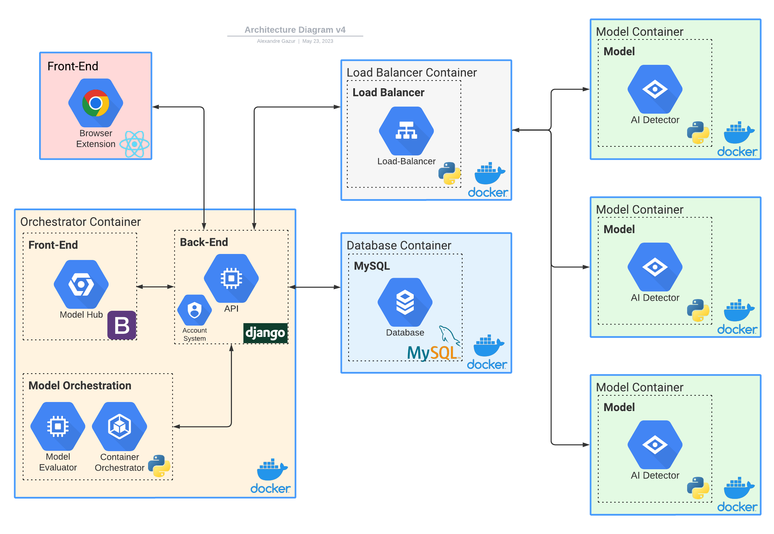
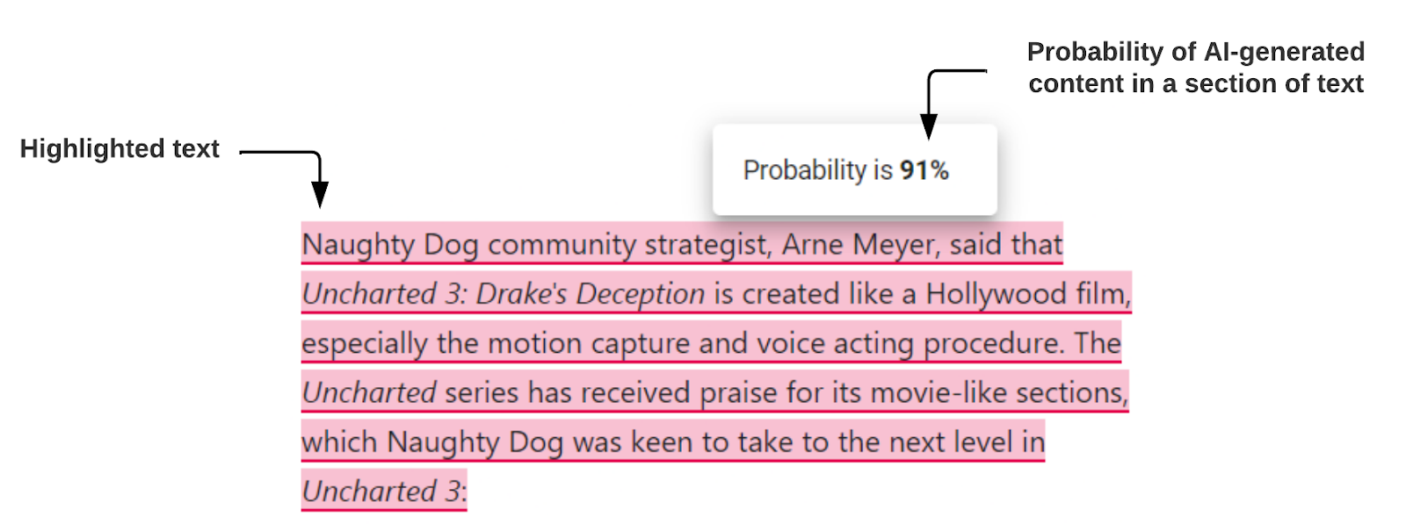







AI Text Detector
Alexandre Gazur, Daniel Ferreira, João Matos, Ricardo Pinto
Orientadores: Prof. Sérgio Aleixo, Tiago Almeida
Projeto em Engenharia Informática, 3º ano, LEI.
2023
Abstract
The rapid advancement of powerful AI technology has brought forth various challenges, including the emergence of AI-generated text that often blurs the line between human-authored and machine-generated content. In this project, we propose a browser extension aimed at detecting AI-generated text in web pages and PDFs. The extension integrates with Model Hub, a web-based platform, allowing users to submit their AI text detection models and use them within the extension. This project contributes to AI transparency and enables informed decision-making in an era of increasing AI-generated information.
Fig 3 - Popup of the extension. .
Popup interface with a range of customizable options (Fig. 3)
Integration with Model Hub: Our centralized repository for AI text detection models
Access to a variety of models on Model Hub
Flexible architecture adaptable to new use cases
Scalability with docker and container orchestration
Open REST API
High usability score (SUS score of 92.2) after testing
Conclusion The project achieved its goals by successfully developing a feature-rich browser extension that surpasses existing solutions. The flexibility of our architecture ensures adaptability to future advancements in NLP and ML. It demonstrated high usability and promising market potential. It was a valuable experience that fostered professional growth and solidified our expertise in software development.
Technologies
Fig 1 - Software Architecture
Results
Chrome extension available on popular web browsers
Scans web pages, selected text, and copied content
Detects AI-generated content from Web pages and PDFs (Fig. 2).
Customizable colors to highlight AI-generated text
Full page analysis with a global scanning button
Fig 2 – Example of highlighted text and score

