Slide 1
DEPARTAMENTO DE ELETRÓNICA, TELECOMUNICAÇÕES E INFORMÁTICA
UNIVERSIDADE DE AVEIRO
APRESENTAÇÃO DE PROJETO DE INFORMÁTICA
DETEÇÃO DE TEXTO SINTÉTICO
2022-2023
ALEXANDRE LIMA GAZUR | 102751
DANIEL JORGE BERNARDO FERREIRA | 102885
RICARDO JORGE SANTOS PINTO | 103078
JOÃO RICARDO PAÇO MATOS | 103182

Slide 2
CONTEXT AND PROBLEM
AI text generators – ChatGPT
Many advantages but also disadvantages
Quick access to knowledge
Work aid
Lack of human touch
Trustworthy?
Misinformation
Misunderstanding
Non relevant output
Limited knowledge

Slide 3



STATE OF THE ART
ORIGINALITY.AI
GPTZero
OpenAI
Plagiarism checking
Bad usability
Unreliable detection
Clipboard-exclusive
File uploads
Character limits
Good detection
Clipboard-exclusive
Same as GPTZero
Unreliable detection
Clipboard-exclusive

Slide 4
GOALS
AI text detector (real time) as a browser extension
For any web user
Better web surfing experience
PDF documents
Flexible AI text detectors management
Project website

Slide 5


COLLABORATION AND COMMUNICATION
GitHub for version control and collaboration
Monorepo structure for project organization
Discord server for online communication
Weekly team meetings on Discord
Held in-person reunions with mentors
No project management tool used

Slide 6
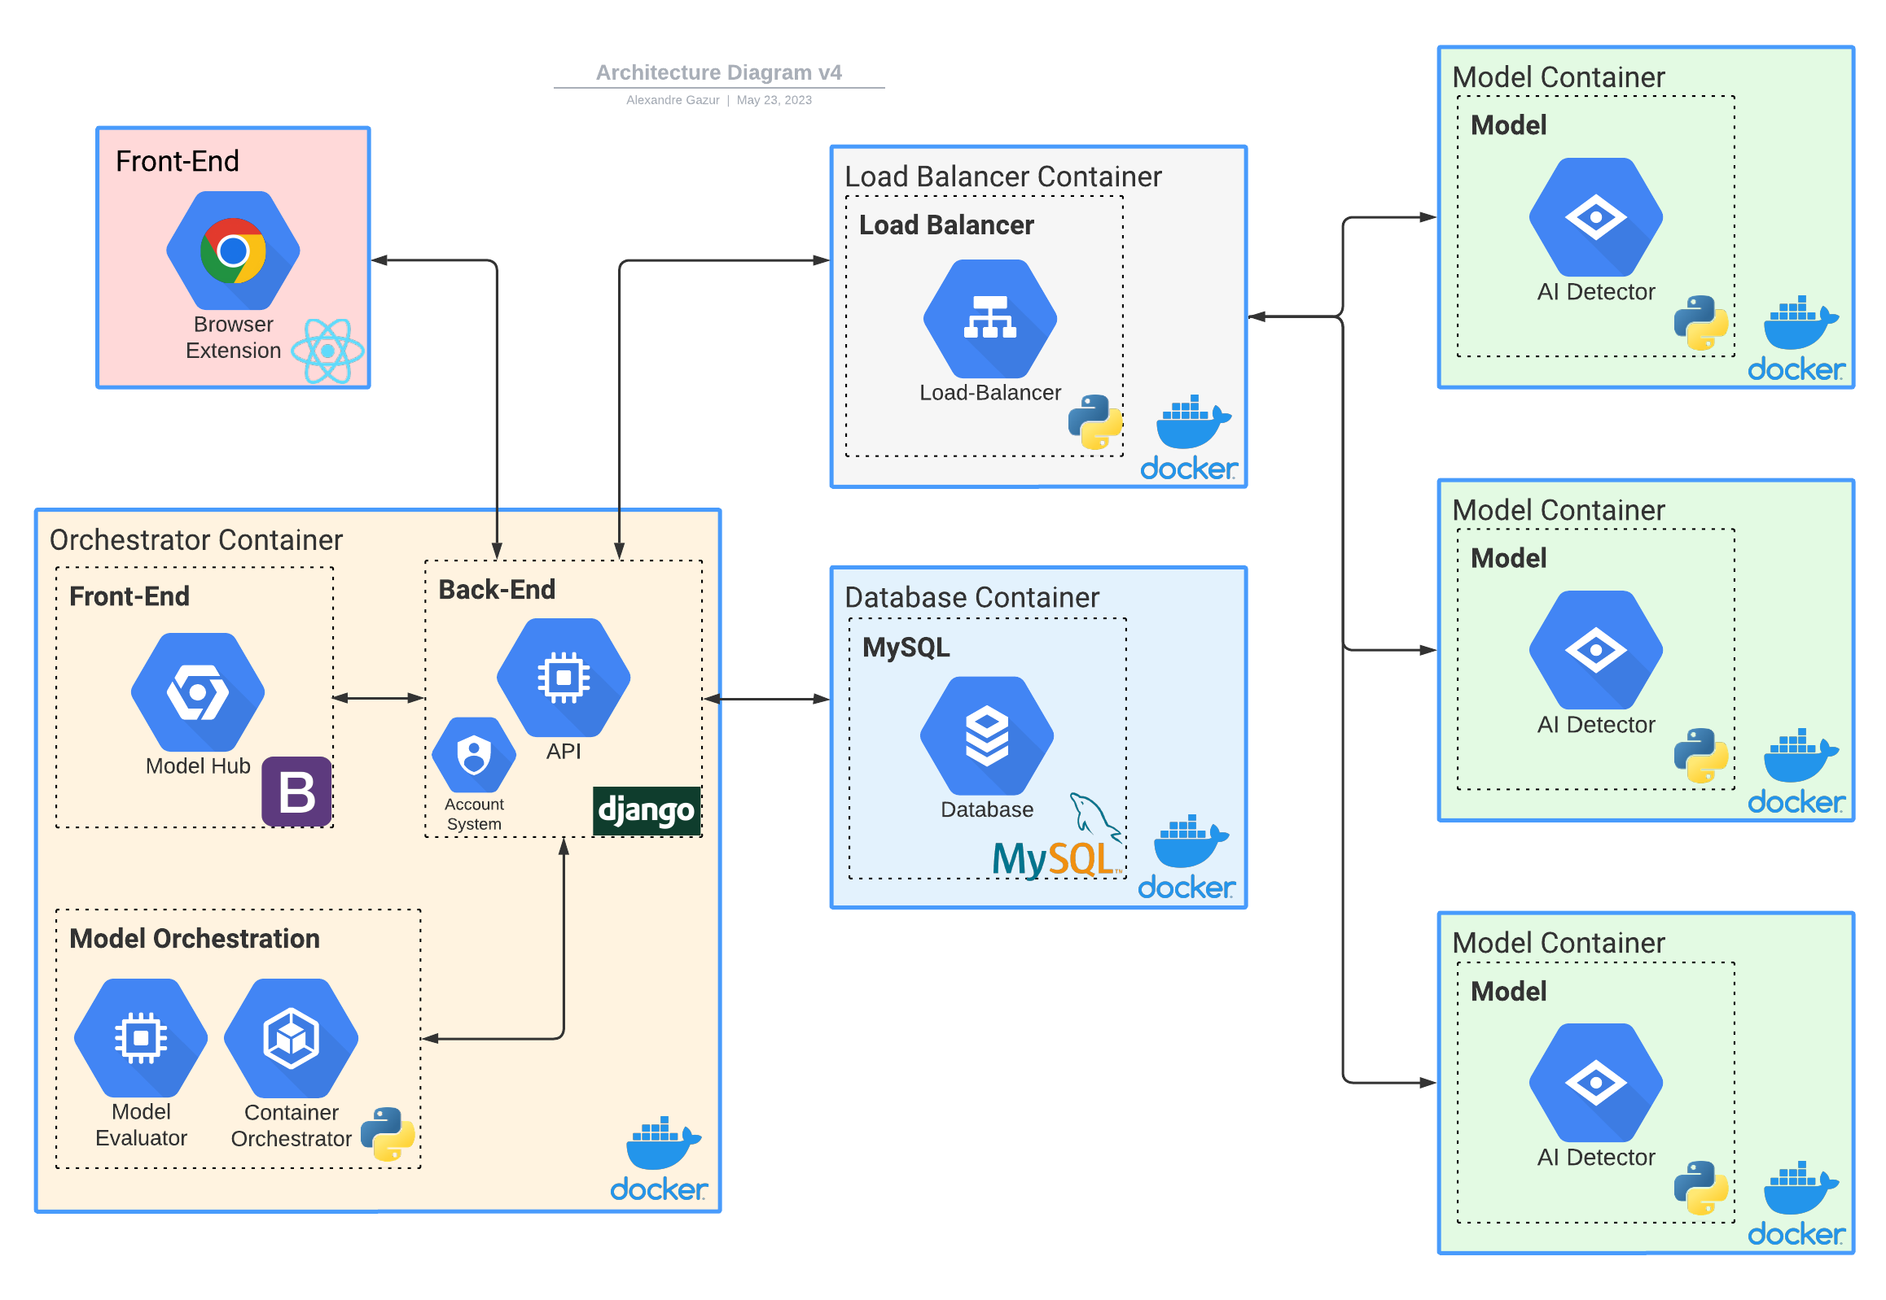
ARCHITECTURE

Slide 7


DEPLOYMENT
Available in the
Chrome Web Store
Provided by
IEETA

Slide 8
DEPLOYMENT DETAILS
aaaa
bbbb

Slide 9
DEMO

Slide 10
USABILITY TESTS
Usability evaluated with System Usability Scale (SUS)
User feedback gathered through narrative approach
8 participants, primarily students from University of Aveiro
Varied expertise: 88% intermediate/advanced, 12% beginners
Non-representative sample (friends/family)
Valuable insights gained

Slide 11
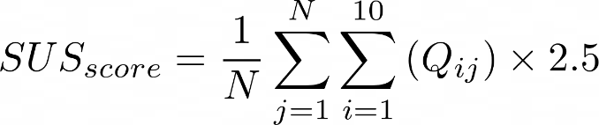
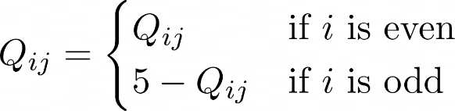
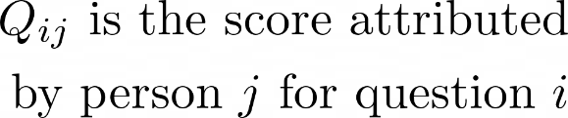

USABILITY SCORE
Statement | 1 | 2 | 3 | 4 | 5
I think that I would like to use this system frequently | 0 | 3 | 2 | 1 | 2
I found the system unnecessarily complex | 8 | 0 | 0 | 0 | 0
I thought the system was easy to use | 0 | 0 | 0 | 0 | 8
I think that I would need the support of a technical person to be able to use this system | 7 | 1 | 0 | 0 | 0
I found the various functions in the system were well integrated | 0 | 0 | 0 | 2 | 6
I thought there was too much inconsistency in this system | 4 | 4 | 0 | 0 | 0
I would imagine that most people would learn to use the system very quickly | 0 | 0 | 0 | 0 | 8
I found the system very cumbersome to use | 8 | 0 | 0 | 0 | 0
I felt very confident using the system | 0 | 0 | 0 | 2 | 6
I needed to learn a lot of things before I could get going with this system | 6 | 2 | 0 | 0 | 0
where:

Slide 12
USER FEEDBACK
Positive feedback with little criticism
Refine Model Hub Web platform design; add new features
No concerns about functionality and features
Add "AI" label to percentage results for clarity
New metrics: AI/human text count, model identification

Slide 13
LESSONS LEARNED
Communication is crucial for success
Estimation is challenging; expect surprises
Additional team members need consideration
Assign tasks based on expertise
Set realistic deadlines; ensure compliance
Seek advice from mentors, teammates
Prioritize functional solutions over perfection
Understand code; consider dependencies
Test production build for errors
Build healthy relationships for collaboration

Slide 14
LIMITATIONS
FUTURE WORK
PDF analysis: sentence-by-sentence
Default models are English only
Better PDF analysis
Rewrite extension using Svelte
Improve Model Hub
More default models
Expand text analysis capabilities
Usability tests with target user base
Commercialize the application?

