Slide 1
DEPARTAMENTO DE ELETRÓNICA, TELECOMUNICAÇÕES E INFORMÁTICA
UNIVERSIDADE DE AVEIRO
APRESENTAÇÃO DE PROJETO DE INFORMÁTICA - ELABORATION
TextSpot AI
2022-2023
ALEXANDRE LIMA GAZUR | 102751
DANIEL JORGE BERNARDO FERREIRA | 102885
RICARDO JORGE SANTOS PINTO | 103078
JOÃO RICARDO PAÇO MATOS | 103182

Slide 2
Goals
AI text detector (real time) as a browser extension
For any web user
Better web surfing experience
PDF documents
Flexible - language models and metrics
Website showing our work

Slide 3
Functional requirements
Downloadable via web - Chrome Web Store
Overall evaluation of current website or PDF
Highlight suspicious parts of web page or PDF
UI/UX Design
Turn off/on
Set threshold probability(ies) for highlighting
Select language models / metrics
Pick highlighting color
LM devs can add their LM / metrics

Slide 4
Non-functional requirements
Performance: efficient and fast even with large text
Reliability: AI and language models quality
Accurate detection
Reduced false positives/negatives
Usability: ⚠️
Extension settings
Intuitive UI
Compatibility: Chromium-based browsers and more
Flexibility: ⚠️
Addition/removal of language models / metrics
Privacy: respect and assert privacy of user's data
Maintenance: clean code, issue tracking

Slide 5



State of art
Originality.AI
GPTZero
OpenAI
Plagiarism checking
Bad usability
Mediocre detection
File uploads
Character limits
Good detection
Same as GPTZero
Horrible detection

Slide 6
Actors
Regular User
(most features)
Admin
(all permissions)
External LM Developer
Journalists, Researchers, Social Media Users, Teachers, Students, etc.
Our team (4).
Can accept/refuse and enable/disable LMs and metrics
Can add their LM / metrics

Slide 7
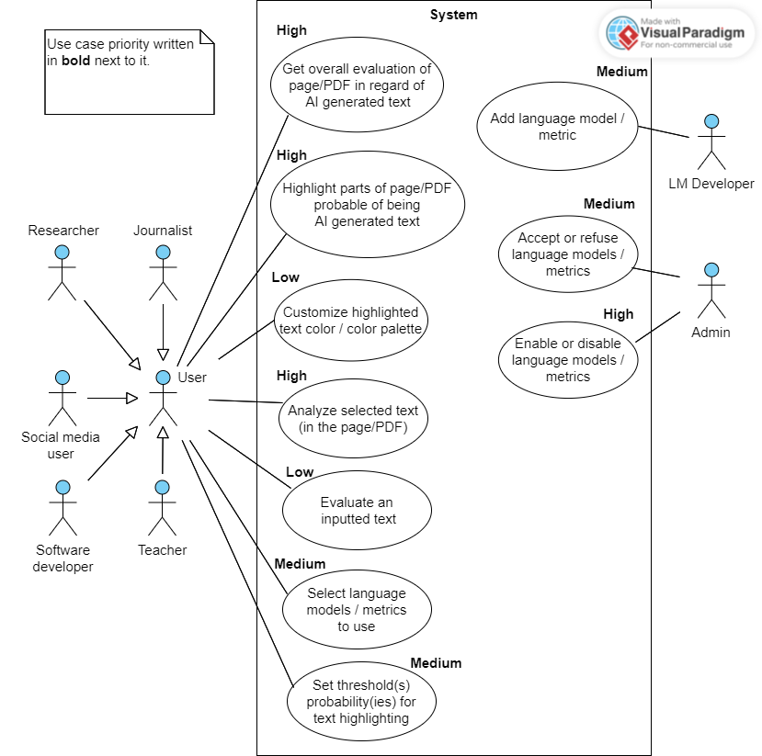
Use cases diagram

Slide 8
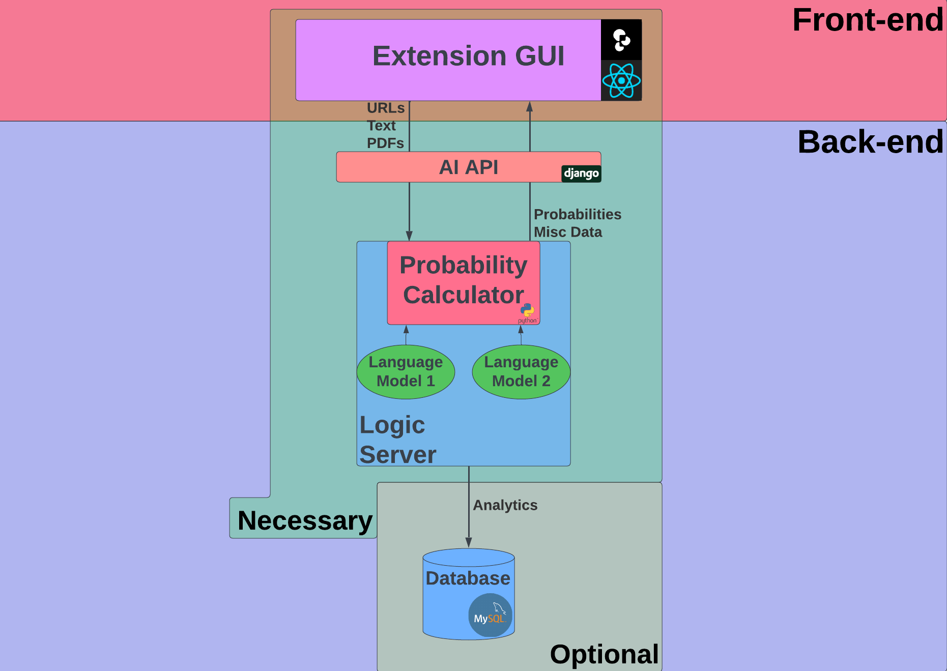
Architecture

Slide 9
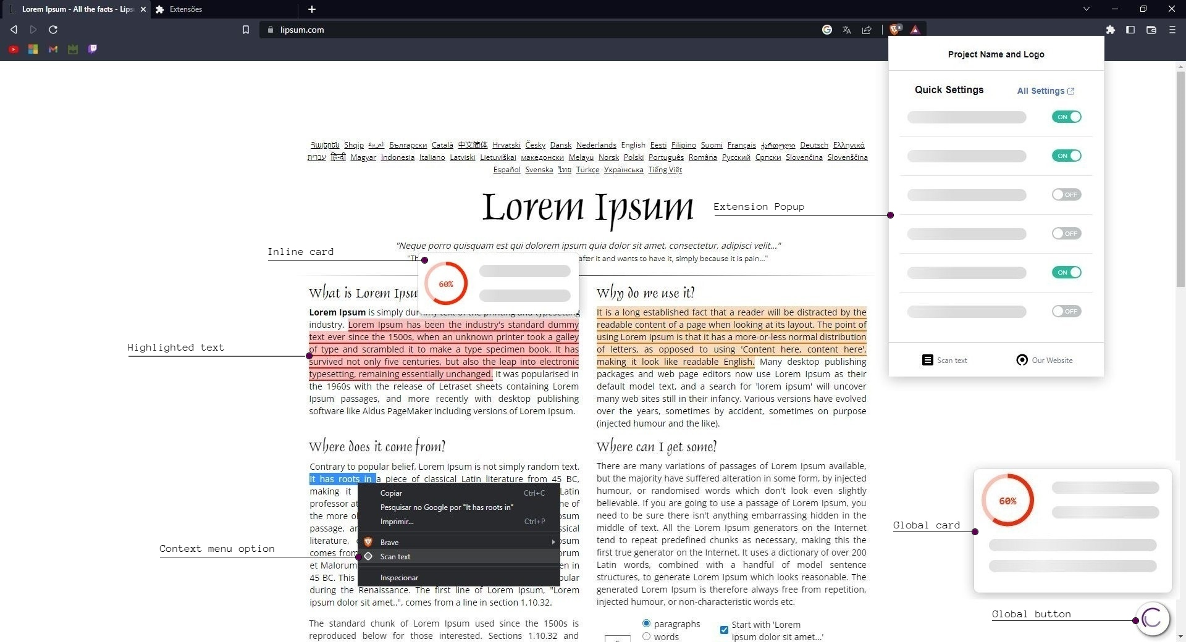
Mock-up

Slide 10
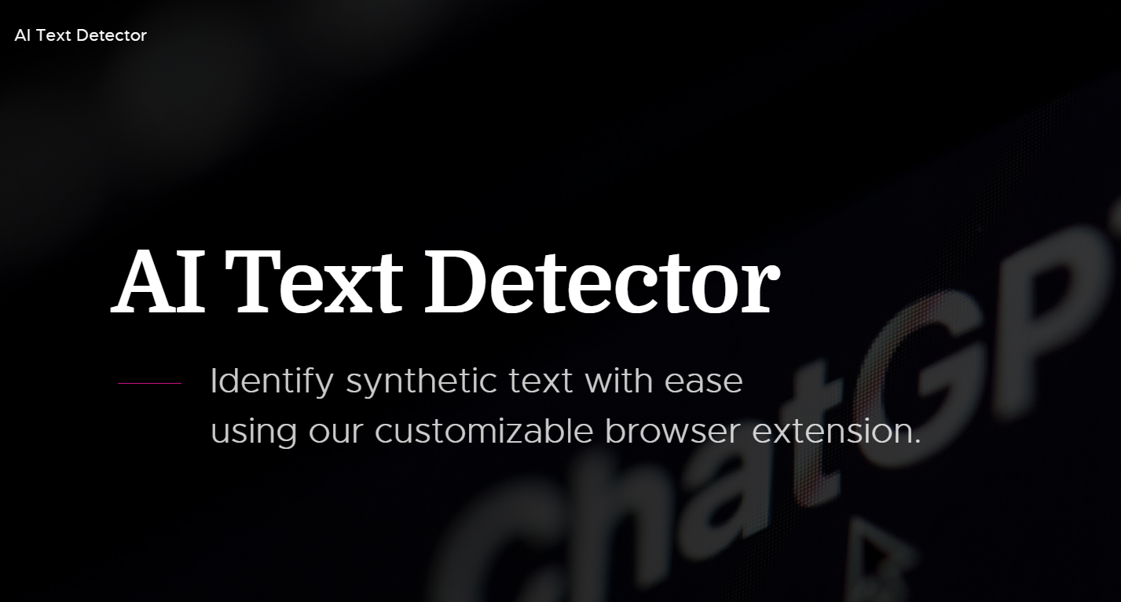
Project Website

