Slide 1
DEPARTAMENTO DE ELETRÓNICA, TELECOMUNICAÇÕES E INFORMÁTICA
UNIVERSIDADE DE AVEIRO
APRESENTAÇÃO DE PROJETO DE INFORMÁTICA – PROTOTYPE
DETEÇÃO DE TEXTO SINTÉTICO
2022-2023
ALEXANDRE LIMA GAZUR | 102751
DANIEL JORGE BERNARDO FERREIRA | 102885
RICARDO JORGE SANTOS PINTO | 103078
JOÃO RICARDO PAÇO MATOS | 103182

Slide 2
Context and problem
AI text generators – ChatGPT
Many advantages but also disadvantages
Quick access to knowledge
Work aid
Lack of human touch
Trustworthy?
Misinformation
Misunderstanding
Non relevant output
Limited knowledge

Slide 3
Goals
AI text detector (real time) as a browser extension
For any web user
Better web surfing experience
PDF documents
Flexible - language models and metrics
Website showing our work

Slide 4



State of art
Originality.AI
GPTZero
OpenAI
Plagiarism checking
Bad usability
Unreliable detection
File uploads
Character limits
Good detection
Same as GPTZero
Unreliable detection

Slide 5
Actors
Regular User
(most features)
Admin
(all permissions)
External LM Developer
Journalists, Researchers, Social Media Users, Teachers, Students, etc.
Our team.
Can enable/disable LMs and metrics
Can add their LM / metrics

Slide 6
Architecture

Slide 7
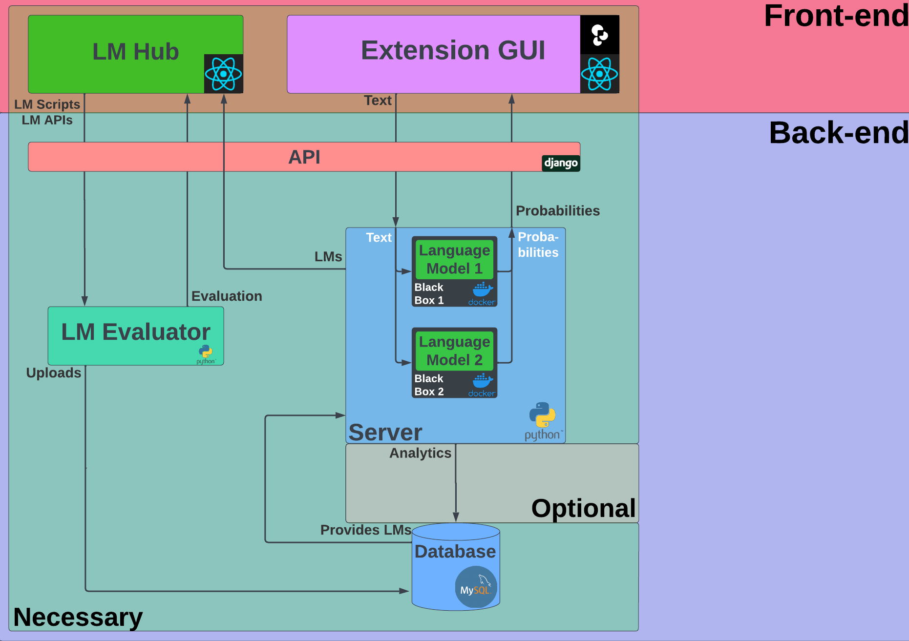

Slide 8
Prototype

