Slide 1

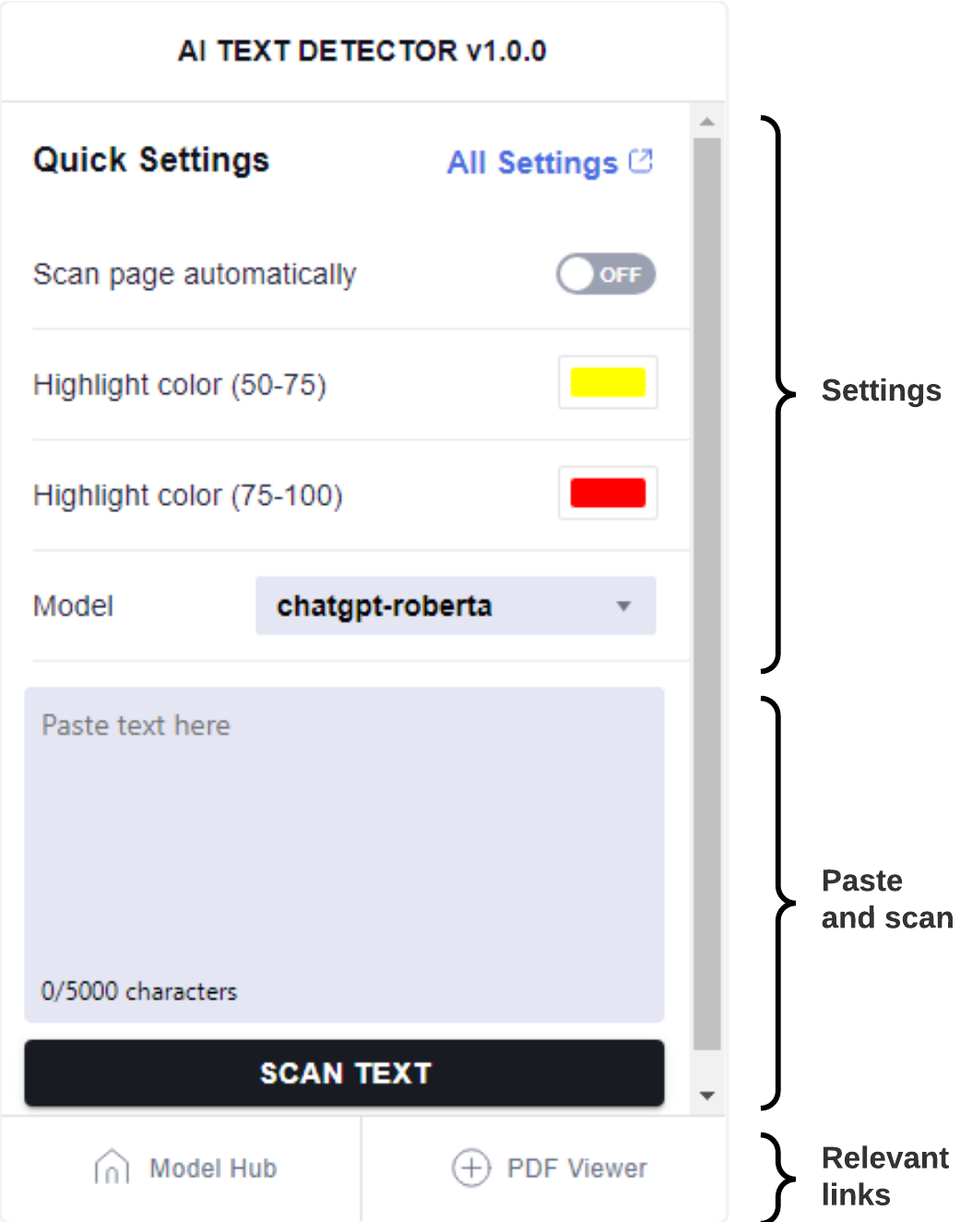
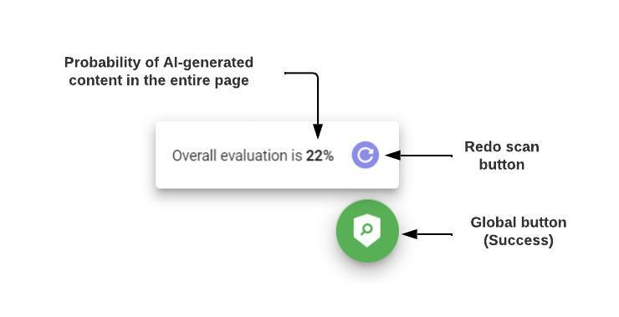







Cor Preta para títulos:
RGB(0,0,0)
Tipos (de letra):
Títulos e destaques 🡪 Roboto Medium
Corpo do texto 🡪 Roboto Light
(evitar o uso de bold; usar Roboto Medium em alternativa)
FORMATO OBRIGATÓRIO: A2
Título numa linha (preferível) ou duas (se necessário).
AI Text Detector
Alexandre Gazur, Daniel Ferreira, João Matos, Ricardo Pinto
Orientadores: Prof. Sérgio Aleixo, Tiago Almeida
Última linha:
designação da unidade curricular, ou
grau, para as dissertações/teses, e.g.: Mestrado em Engenharia Informática
Projeto em Engenharia Informática, 3º ano, LEI.
2023
Abstract
The rapid advancement of powerful AI technology has brought forth various challenges, including the emergence of AI-generated text that often blurs the line between human-authored and machine-generated content. In this project, we propose a browser extension aimed at detecting AI-generated text in web pages and PDFs. The extension integrates with Model Hub, a web-based platform, allowing users to submit their AI text detection models and use them within the extension. This project contributes to AI transparency and enables informed decision-making in an era of increasing AI-generated information.
Área para o logo do projeto/trabalho, se aplicável. Deve ficar delimitado pelo quadrado indicado pelas guias.
(activar a visualização das guias)
Língua sugerida:
Português ou inglês.
Fig 2- Popup of the extension. .
For further customization, the extension provides a popup interface that offers various settings options (Fig. 2)
The popup interface also allows for PDF analysis, enabling users to scan AI-generated content within PDF documents seamlessly.
In addition to its core functionality, our project includes a Model Hub platform. This platform serves as a centralized repository for users to upload, explore, and share AI models.
It offers a REST API that allows developers to access the AI detection functionality and integrate it into their own applications or services.
Conclusion Our system demonstrates exceptional flexibility in the realm of model selection, addition, and removal, owing to the robustness of our Model Hub and backend architecture. Furthermore, the containerization of our entire infrastructure empowers effortless scalability, allowing us to efficiently accommodate increasing demands without compromising performance or stability.
Technologies
Coluna vertical (à esquerda) deve ficar vazia
Fig 1- Full-page scan components.
Implementation
The extension offers seamless integration into popular web browsers, enabling users to scan web pages, selected text, or copied content for AI-generated elements.
It provides multiple scanning options to cater to users' needs. It allows for comprehensive page scanning, enabling users to analyze an entire web page for AI-generated content.
Users can also choose to scan specific sections of text, ensuring a targeted analysis of selected content. Additionally, the extension facilitates the scanning of copied text, making it convenient to detect AI-generated content from various sources.
To enhance user experience, the extension highlights detected AI-generated text using customizable colors. This visual cue enables users to quickly identify and differentiate between AI-generated and human-written content. Furthermore, the extension features a global button for effortless page scanning, allowing users to initiate the analysis with a single click (Fig. 1) .
Produção do PDF da versão final:
atenção à qualidade das imagens originais: pelo menos 300dpi (cores) ou 600dpi (escala de cinzentos).
o Office 2021 permite exportar PDF (File>Export>Create PDF). Selecionar: Optimize for Printing
Conferir que o PDF produzido tem a qualidade pretendida: fazer zoom a 400% e confirmar o aspeto dos elementos do poster.
Procurar que o corpo fique alinhado pela guia, nas duas colunas.

