Slide 1

AI Text Detector Prototype
Alexandre Gazur (102751) Daniel Ferreira (102885) Ricardo Pinto (103078)

Slide 2
Context and problem
AI text generators – ChatGPT
Many advantages but also disadvantages
Quick access to knowledge
Work aid
Lack of human touch
Trustworthy?
Misinformation
Misunderstanding
Non relevant output
Limited knowledge

Slide 3
Goals
AI text detector as a Chrome browser extension
For any web user
Better web surfing experience
PDF documents
Flexible - language models
Website showing our work

Slide 4



State of art
Originality.AI
GPTZero
OpenAI
Plagiarism checking
Bad usability
Mediocre detection
File uploads
Character limits
Good detection
Same as GPTZero
Horrible detection

Slide 5
Actors
Regular User
(most features)
Admin
(all permissions)
External LM Developer
Journalists, Researchers, Social Media Users, Teachers, Students, etc.
Our team.
Can enable/disable LMs and metrics
Can add their LM / metrics

Slide 6
Main requirements
Overall evaluation of web page or PDF
Highlight suspicious parts of web page or PDF
Select any text and analyze it
Intuitive UI with settings
LM flexibility (add/remove) – LM Hub
Usability, flexibility, reliability, performance

Slide 7
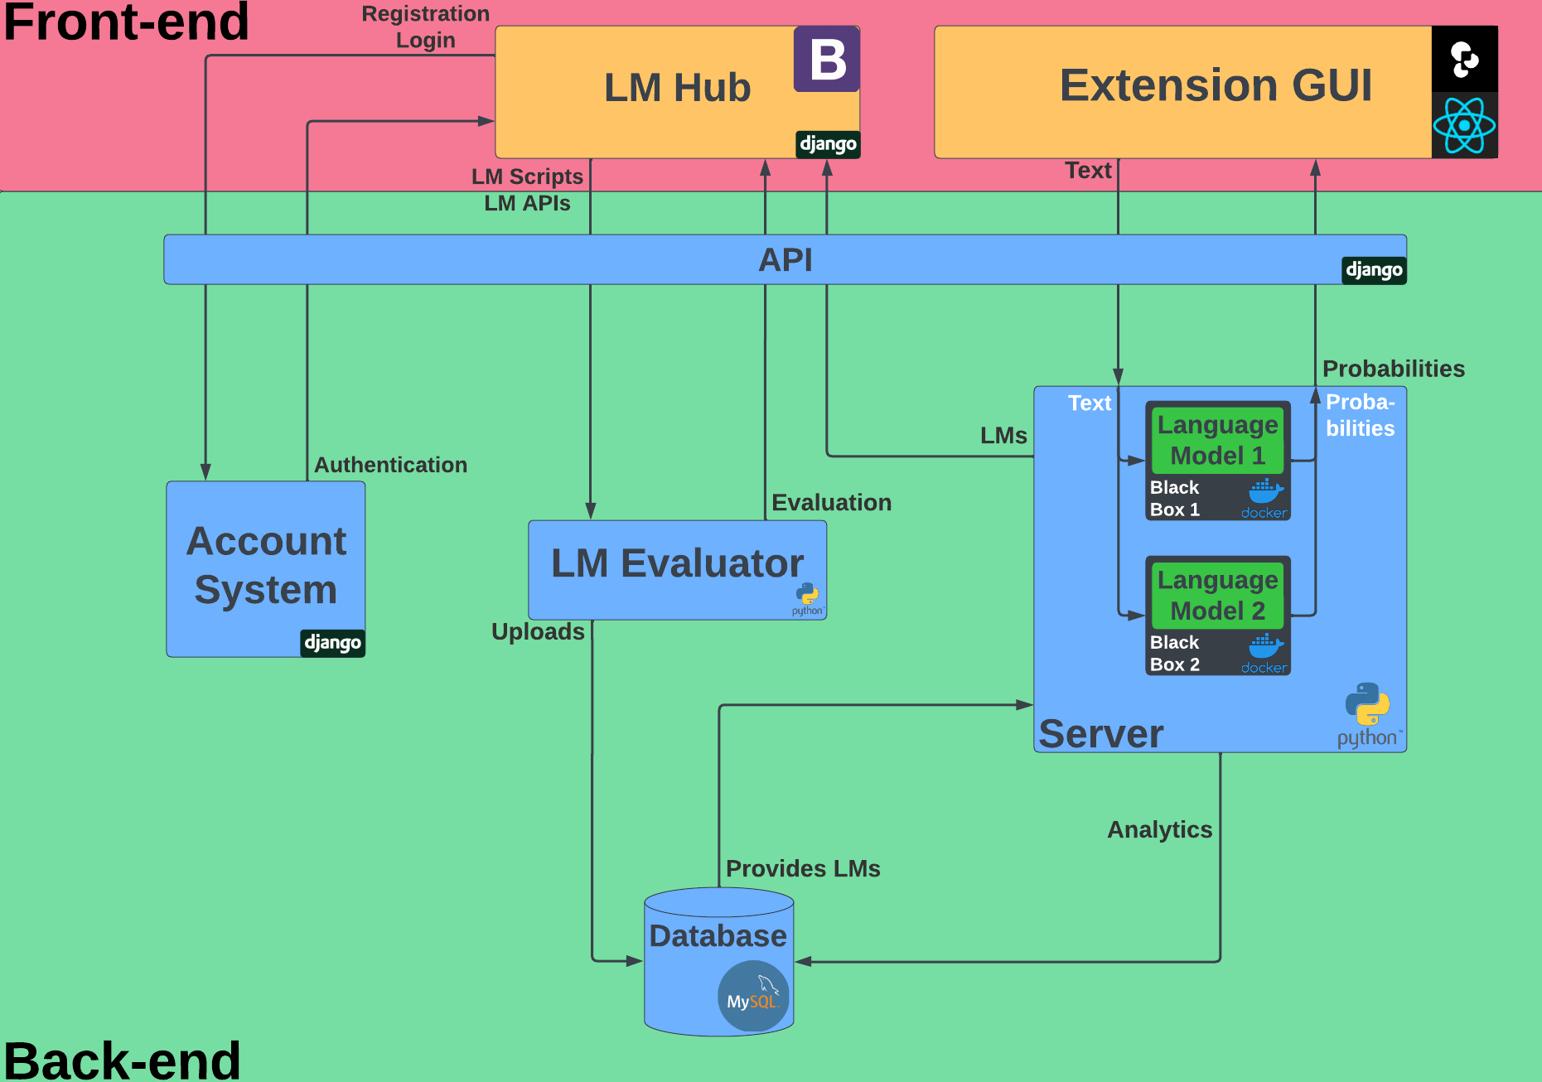

Slide 8
Project website and prototype

