Slide 1
TextSpot AI - Elaboration
AI Text Detector
Alexandre Gazur (102751)
Daniel Ferreira (102885)
Ricardo Pinto (103078)
João Matos (103182)

Slide 2
Goals
AI text detector (real time) as a browser extension
For any web user
Better web surfing experience
PDF documents
Flexible - language models and metrics
Website showing our work
2

Slide 3
Functional requirements
Downloadable via web - Chrome
Overall evaluation of web page or PDF
Highlight suspicious parts of web page or PDF
UI
Turn off/on
Set threshold probability(ies) for highlighting
Select language models / metrics
LM devs can add their LM / metrics
3

Slide 4
Non functional requirements
Performance: efficient and fast even with large text
Reliability: AI and language models quality
Accurate detection
Reduced false positives/negatives
Usability: extreme importance
Extension definitions
Intuitive uI
Compatibility: Chrome
Flexibility: extreme importance
Addition/removal of language models / metrics
Security: respect and assert privacy of user's data
Maintenance: clean code, issue tracking
4

Slide 5
Actors
User – most features
Journalists
Researchers
Teachers
Social media users
Students
LM dev – can add their LM / metrics
Admin – all permissions
Our team (4)
Accept/refuse and enable/disable LMs and metrics
5

Slide 6
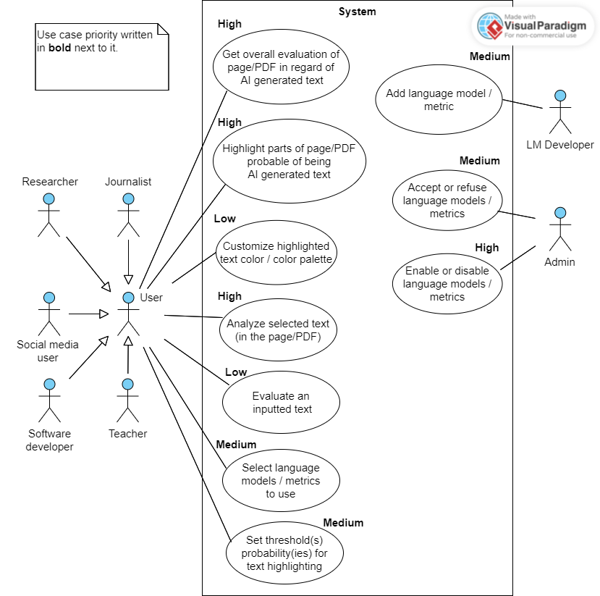
6

Slide 7
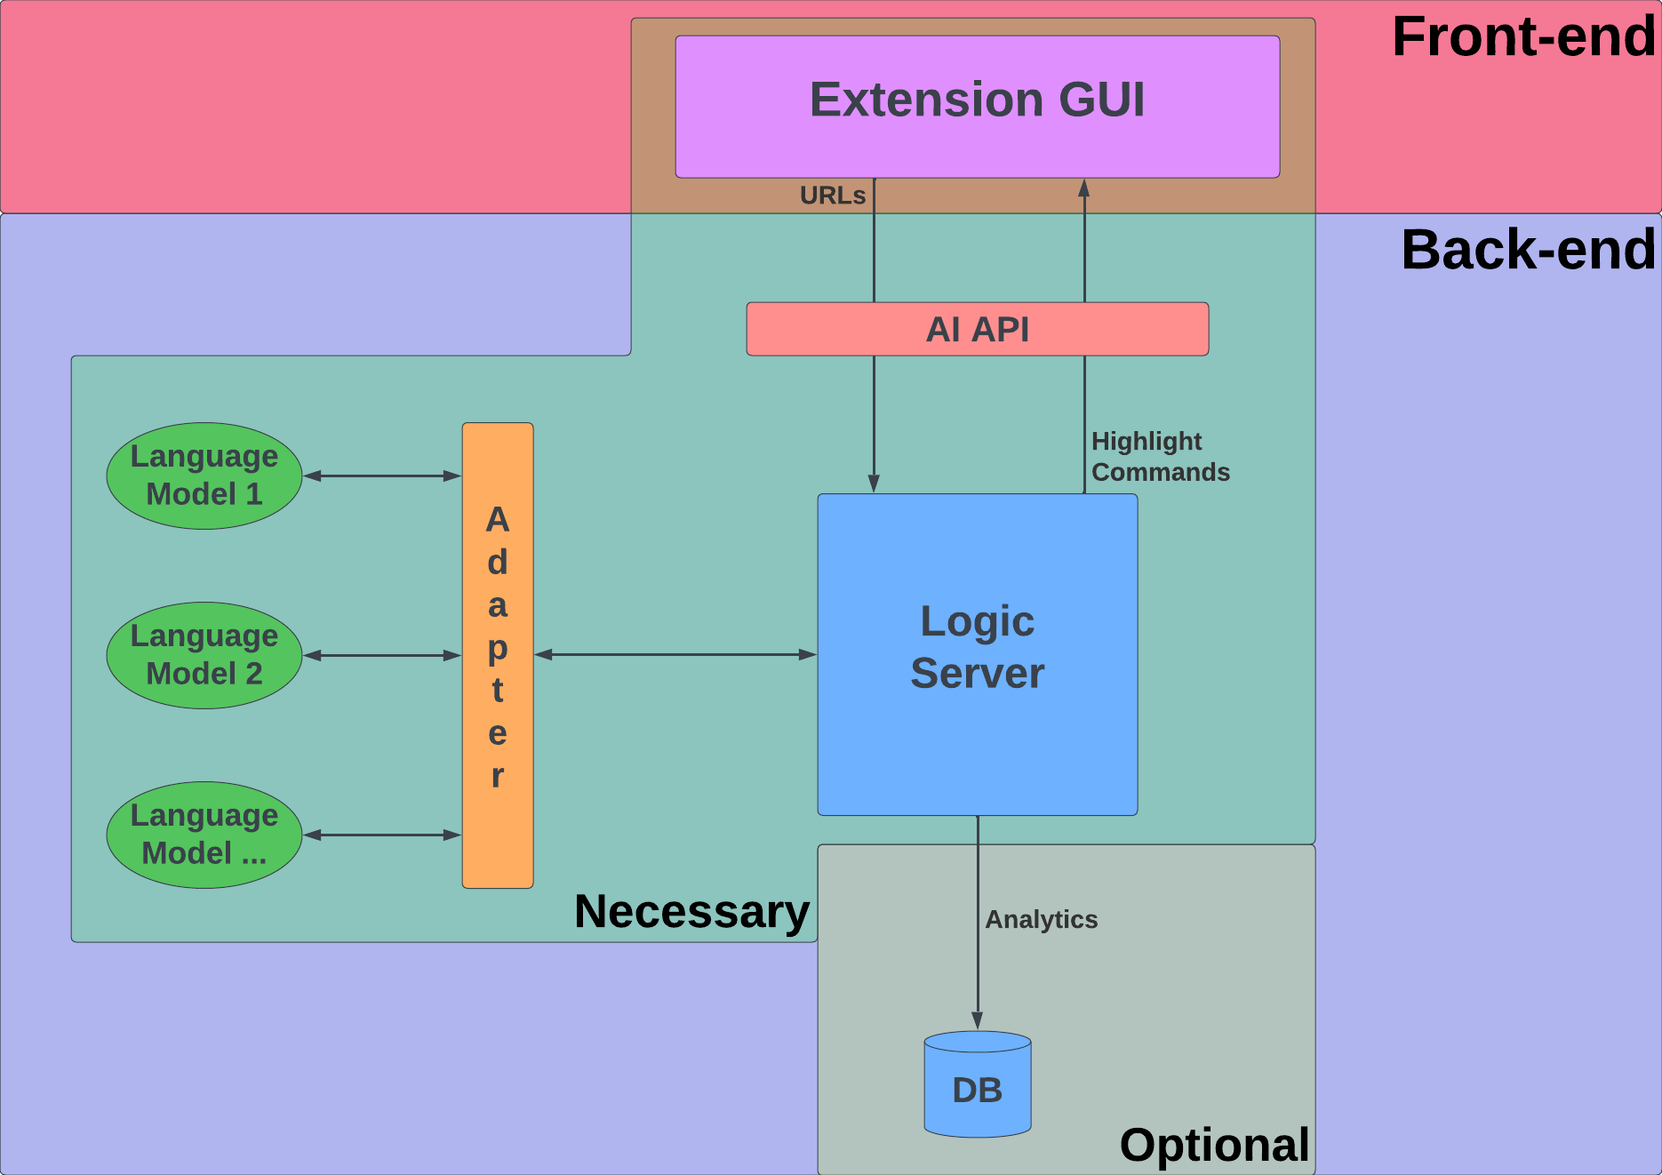
7

