Slide 1

AI Text Detector Prototype
Alexandre Gazur (102751) Daniel Ferreira (102885) Ricardo Pinto (103078)

Slide 2
Context and problem
AI text generators – ChatGPT
Many advantages but also disadvantages
Quick access to knowledge
Work aid
Lack of human touch
Trustworthy?
Misinformation
Misunderstanding
Non relevant output
Limited knowledge

Slide 3



State of art
Originality.AI
GPTZero
OpenAI
Plagiarism checking
Bad usability
Unreliable detection
File uploads
Character limits
Good detection
Same as GPTZero
Unreliable detection

Slide 4
Functional requirements
Downloadable - Chrome
Overall evaluation of current website or PDF
Highlight suspicious parts of web page or PDF
Select any text and analyze it
UI/UX Design
Turn off/on
Select language models
Select threshold probabilities
Pick highlight color(s)
Upload LMs – LM Hub

Slide 5
Non functional requirements
Usability
UI
Extension settings
LM Hub
Performance
Efficient and fast even on long web pages and PDFs
Reliability
Accurate detection
Reduced false positives and negatives
Flexibility
LMs addition and removal

Slide 6
Actors
Regular User
(most features)
Admin
(all permissions)
External LM Developer
Journalists, Researchers, Social Media Users, Teachers, Students, etc.
Our team.
Can enable/disable LMs and metrics
Can add their LM / metrics

Slide 7
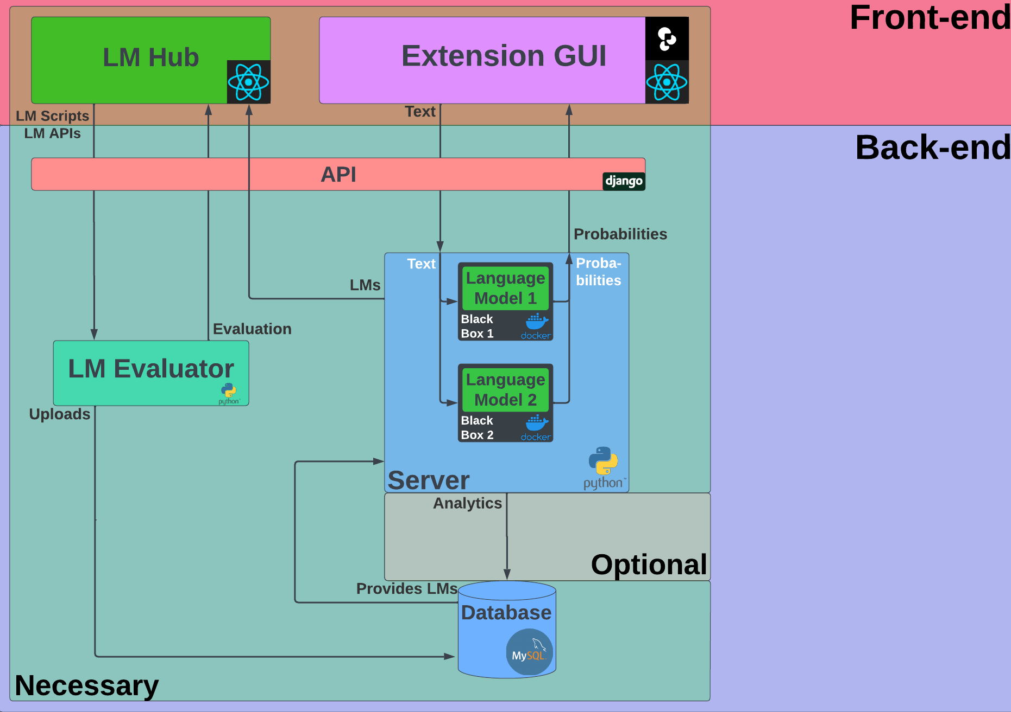

Slide 8
Methods
Github
Discord
OpenUP
Inception
Elaboration
Construction
Transition

Slide 9
Project website and prototype

