Slide 1
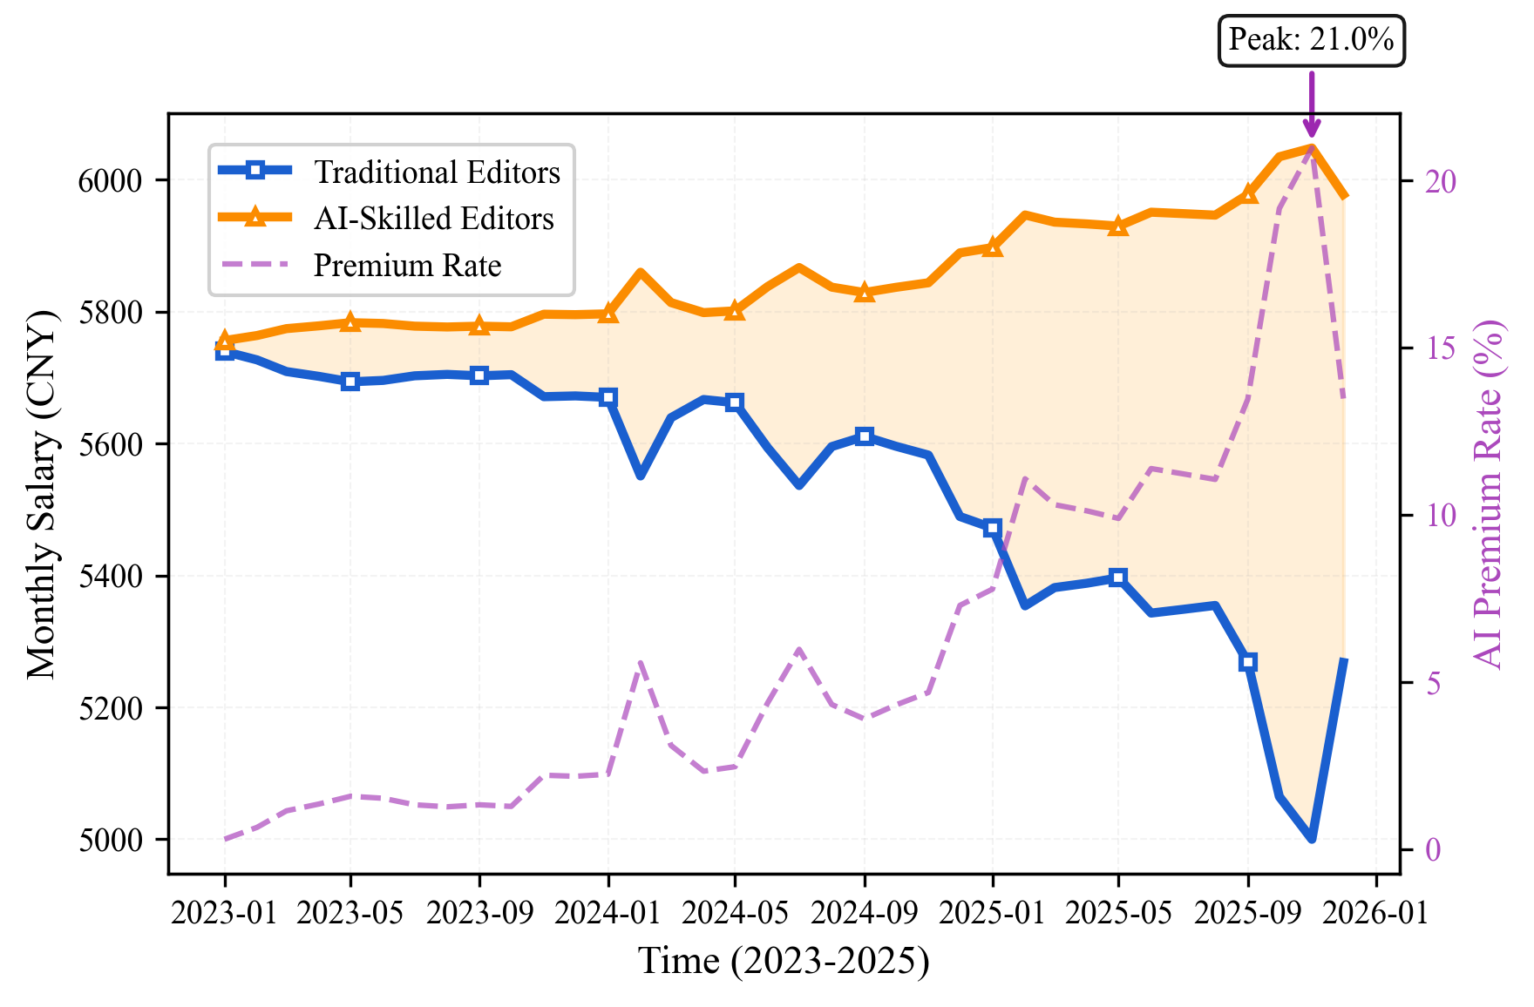
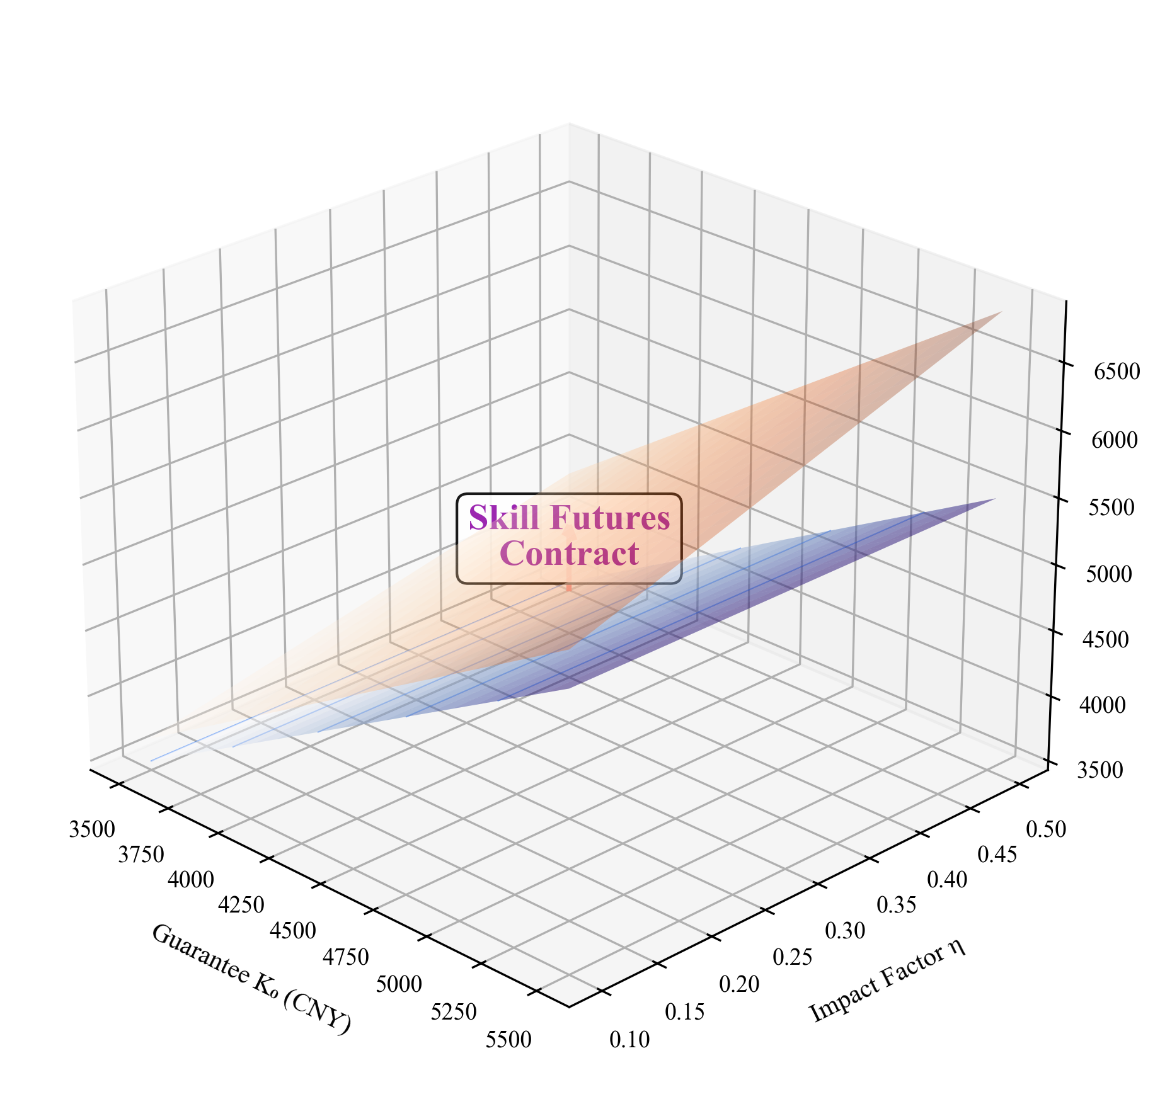
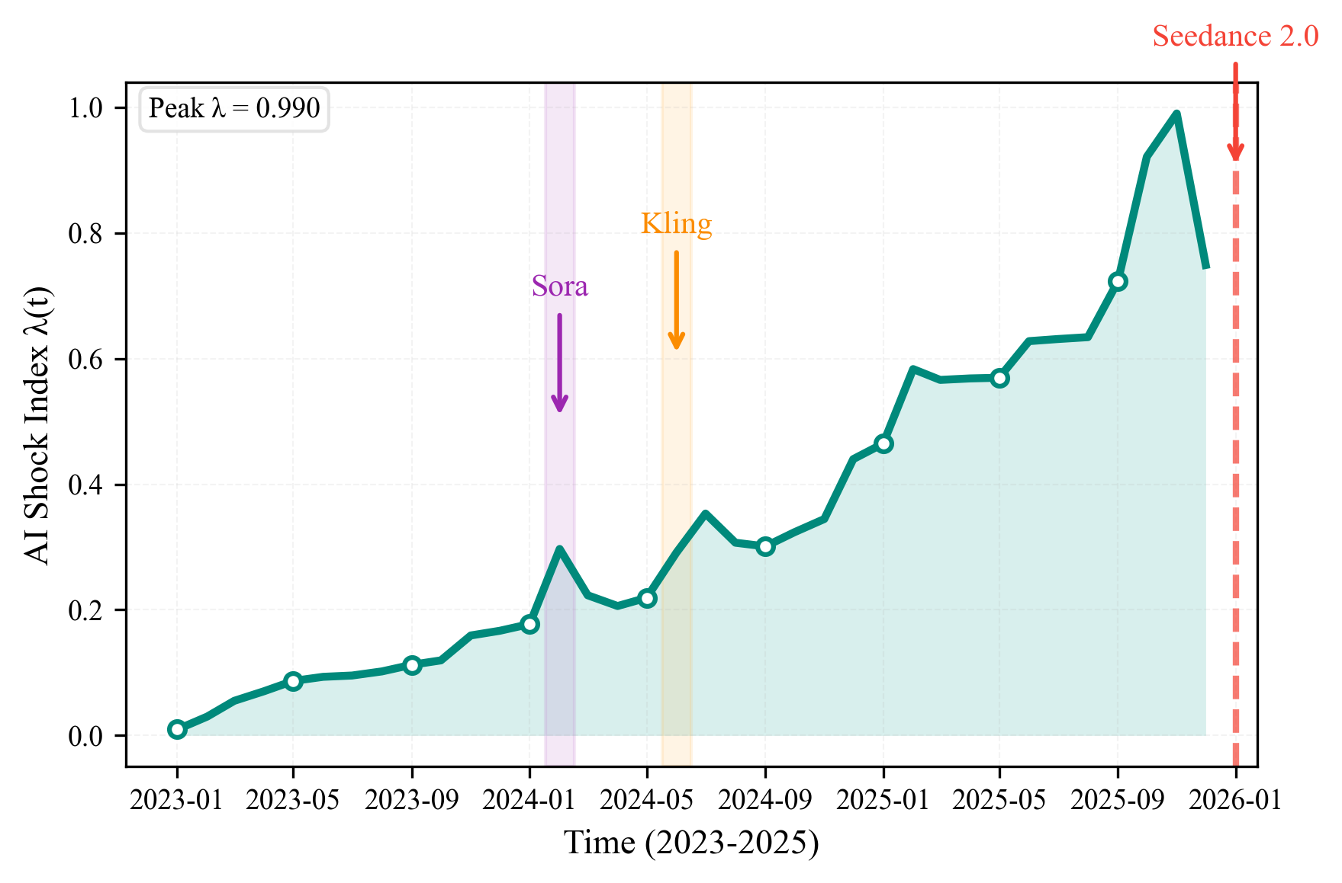
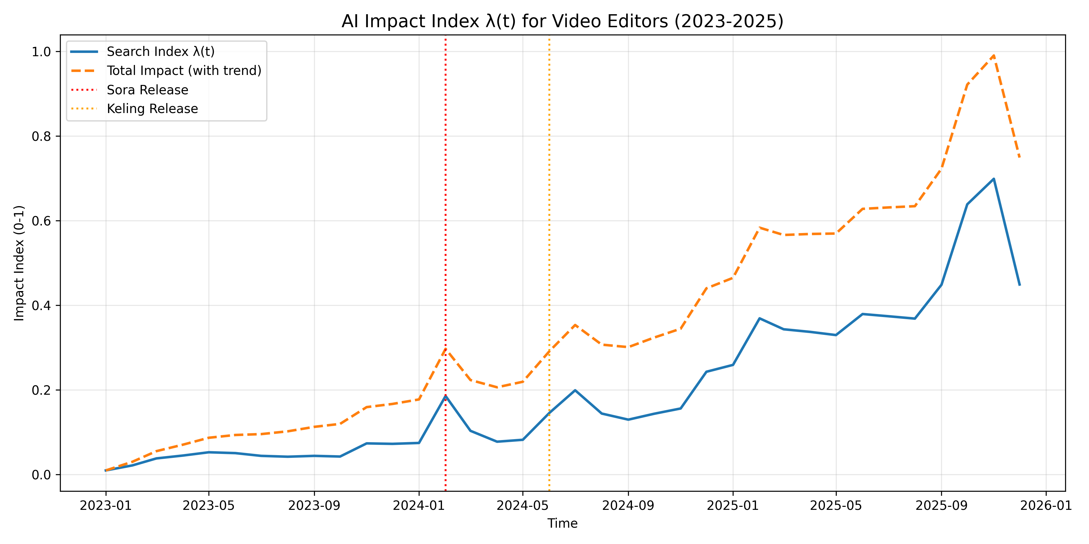
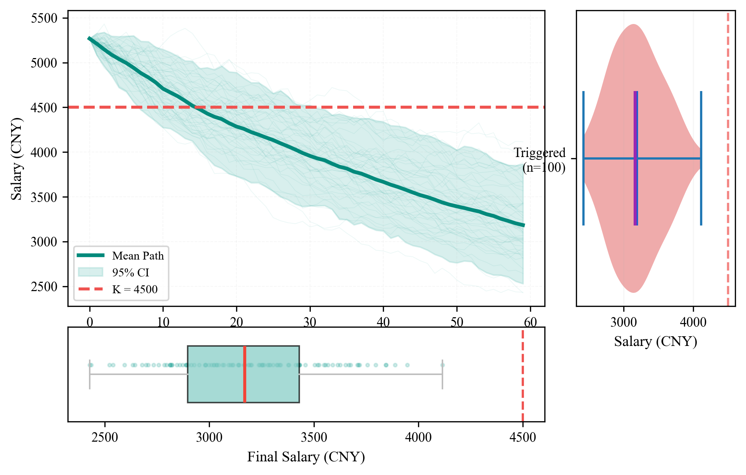
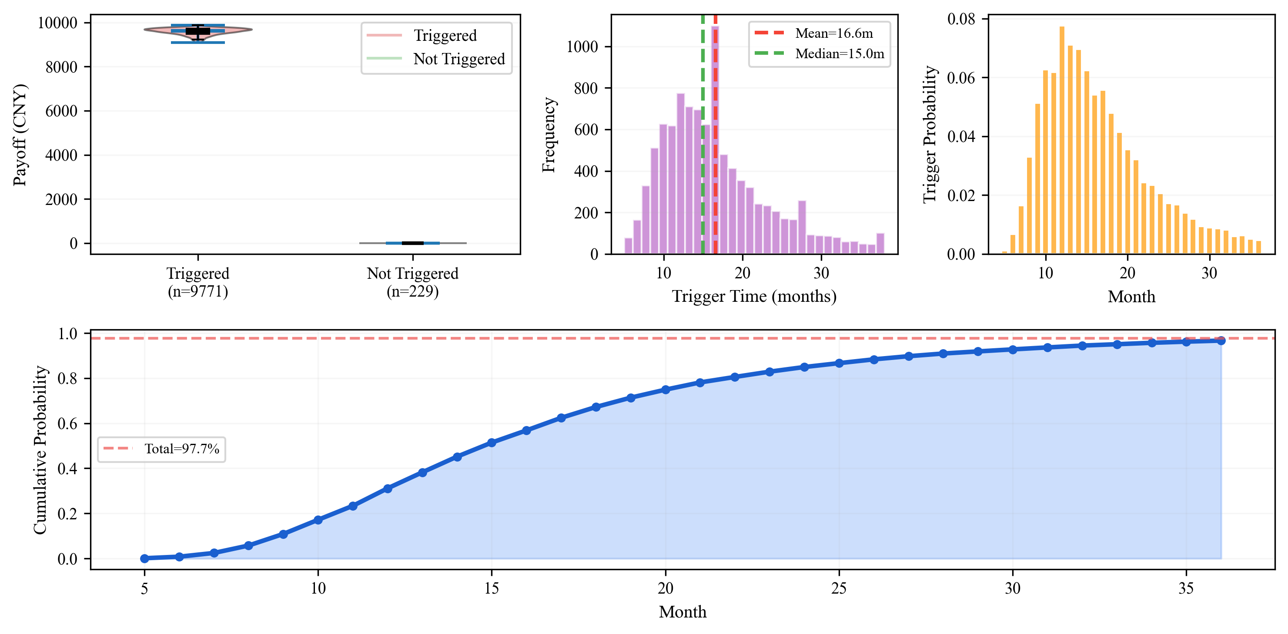
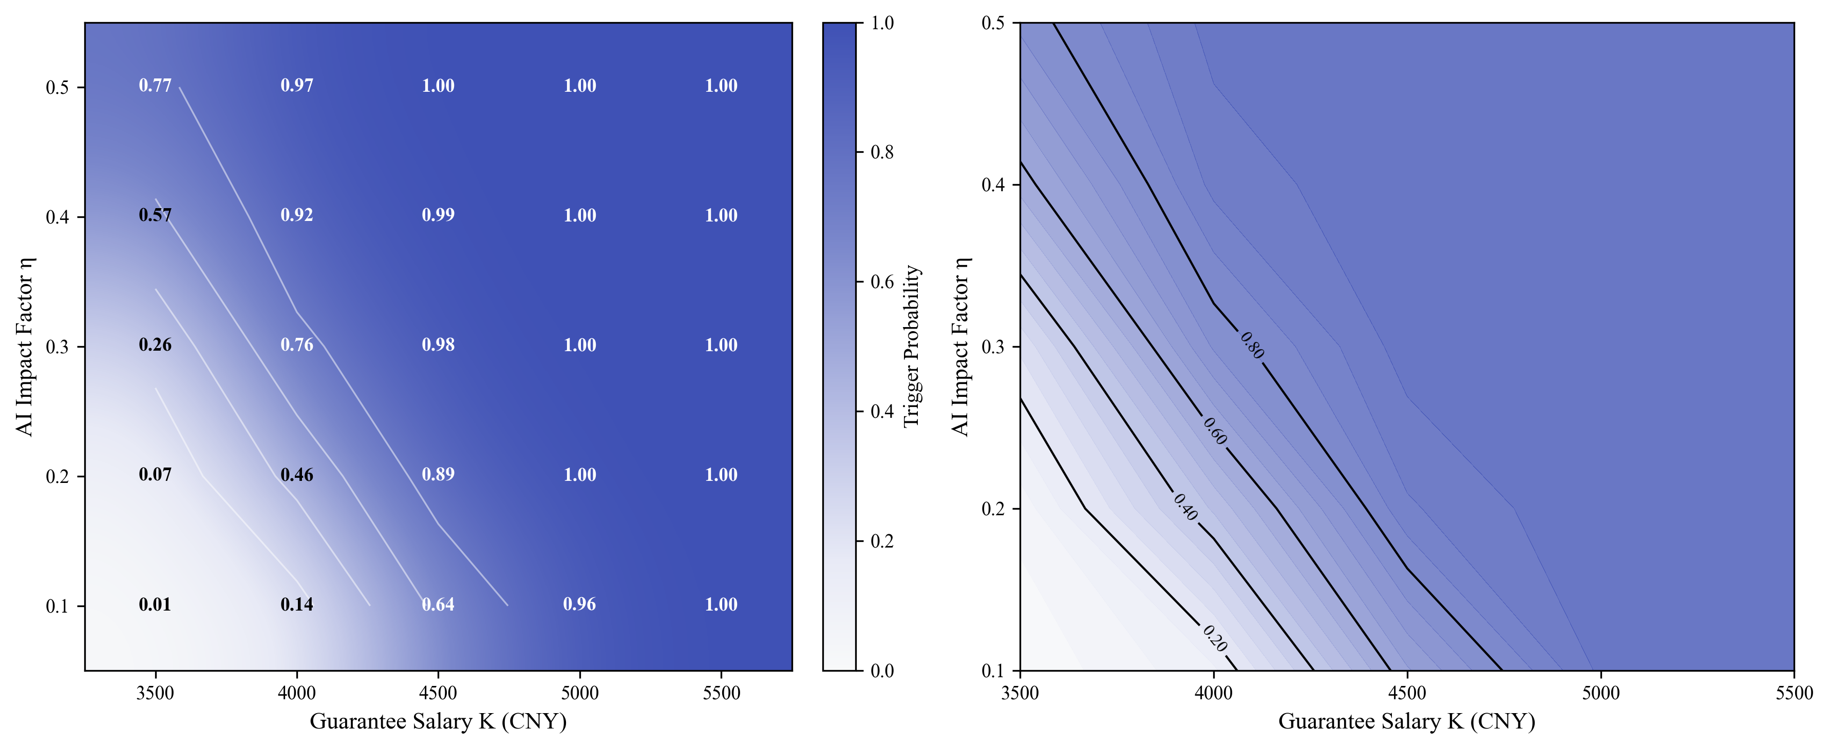
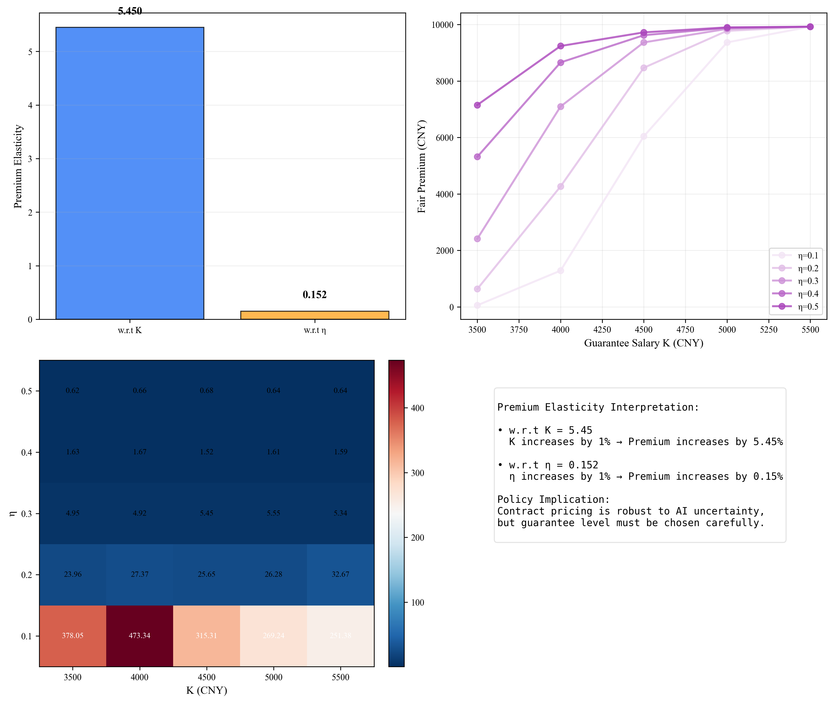
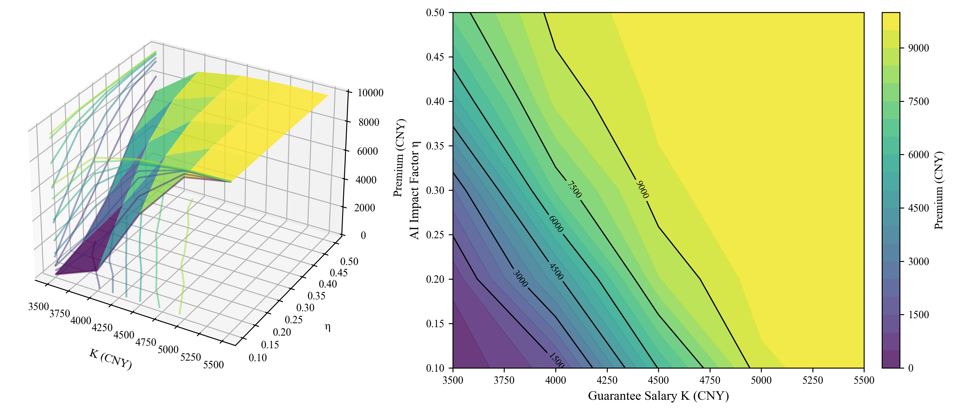
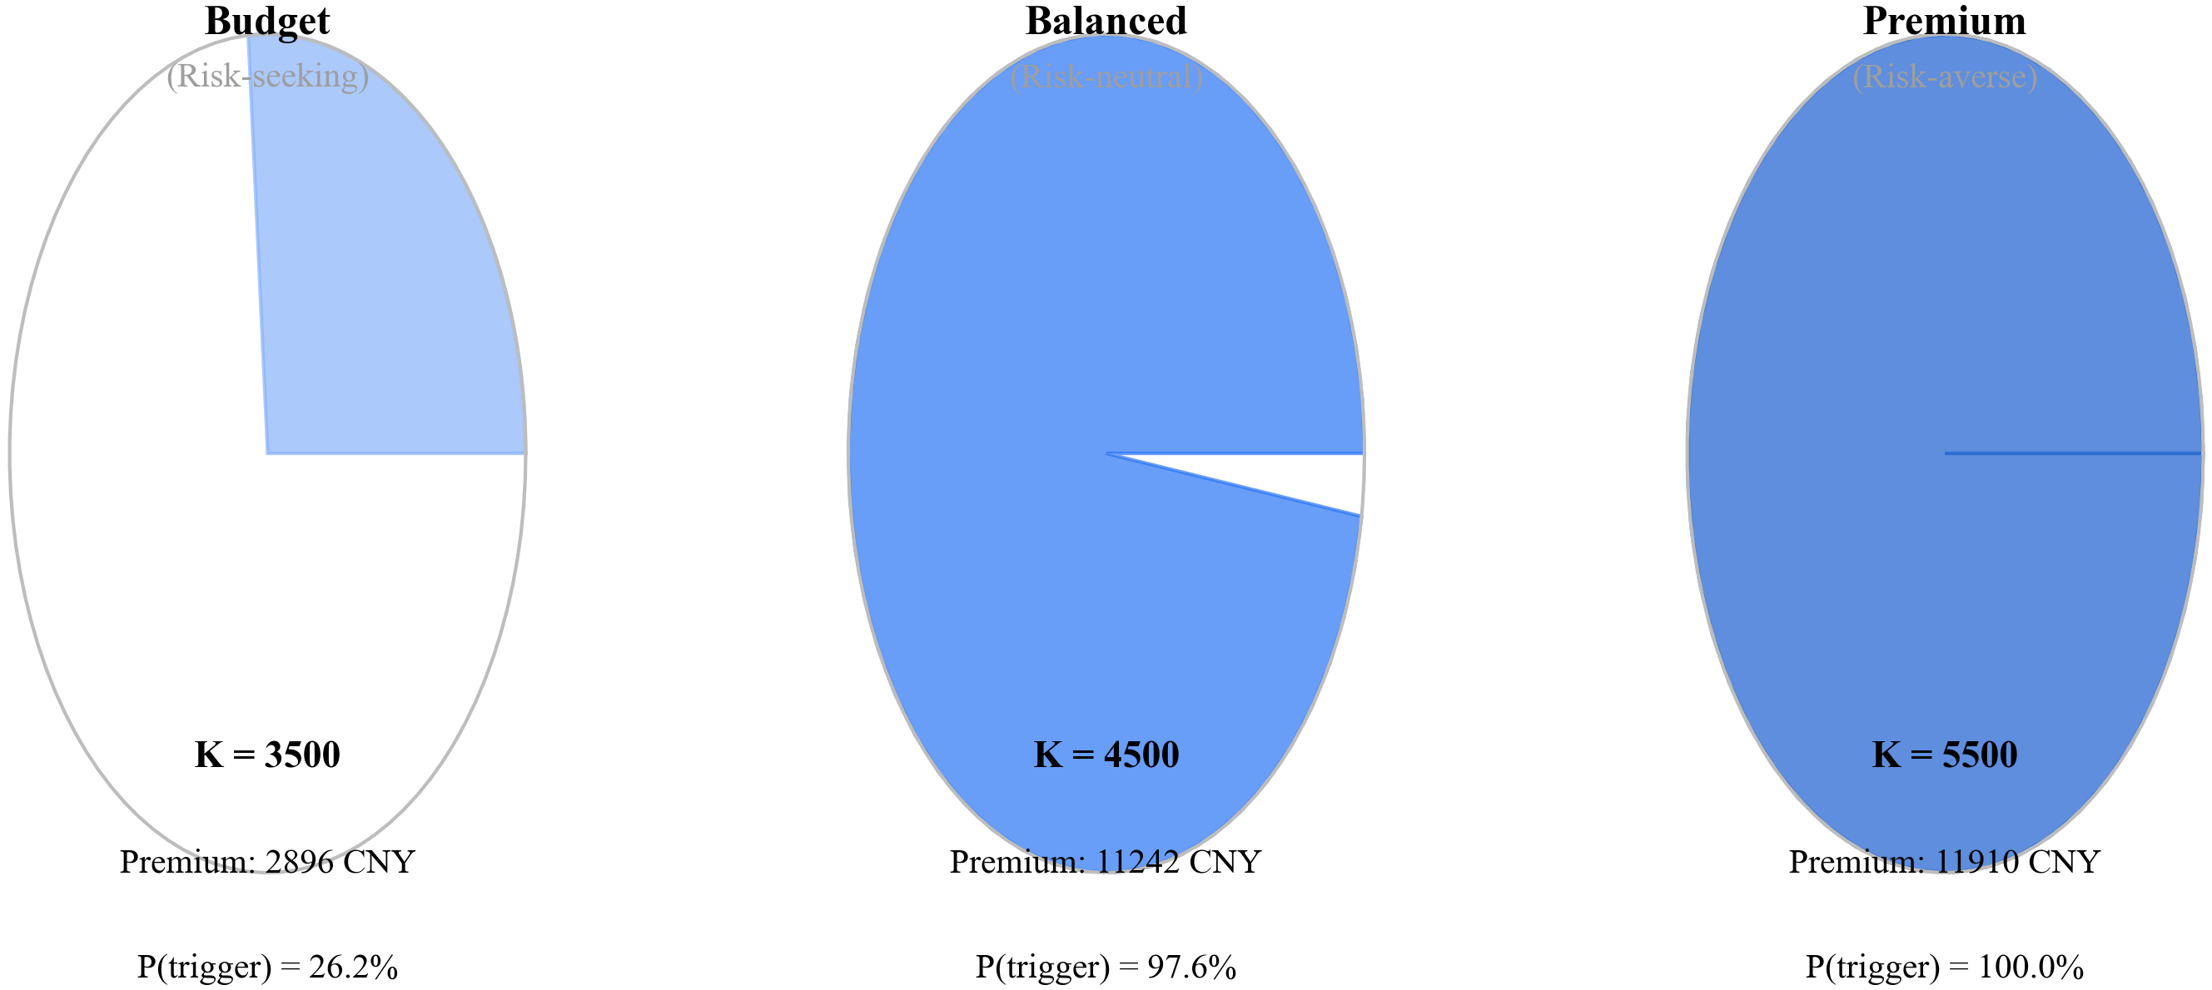
AI shock index
Salary Comparison
Contract Mechanism
AI shock index surges after major model releases
peaking in late 2025
Dynamic guarantee function
K(t) = K₀[1-γλ(t)]
visualized in 3D
AI skill premium widens
from 0.3% to 21%,
traditional editor
wages decline.
Step 2
Scheme Design
(Innovation Layer)
Step 1 Problem Recognition (Background Level)
Monte Carlo simulation
Trigger analysis
Sensitivity Heatmap
Sensitivity: K drives trigger probability, η has moderate impact
10,000 Monte
Carlo paths:
97.7% fall below
guarantee
threshold
Step 3 Method Validation (Methodology Layer)
Step 4
Result Analysis
(Insight Layer)
Step 5 Practical Application
(Output Layer)
3D Premium Surface
Fair premium surface: elasticities of 5.45 (K) and 0.15 (η)
Contract Design
Premium elasticity
Three contract designs:
Budget (K=3500), Balanced (K=4500), Premium (K=5500)
5.45 w.r.t K, 0.15
w.r.t η - pricing robust to AI uncertainty

