Slide 1
Graph link prediction
Dmitry Denisenko, Aliya Janabekova, Ilia Nasedkin, Ilya Osokin, Artem Pimkin
Skoltech 2018

Slide 2
Plan
Introduction, problem
Naive approach
Spectral clustering
Results
Discussion

Slide 3
Problem
Statement:
Dataset:
Applications:
Predict probability of connection between two nodes, using prior knowledge about the graph structure and/or statistical analysis
Adjacency matrix
Sparse
Zeros and ones
Graph restoration
Advising new friends in social networks

Slide 4
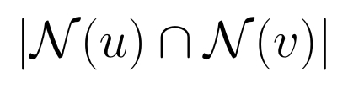
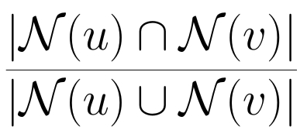
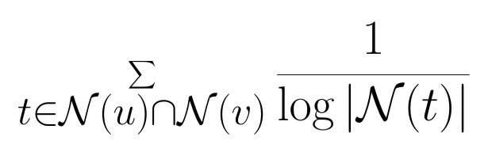
Assumptions
Common Friends:
Jaccard’s Coefficient:
Adamic-Adar Score:

Slide 5
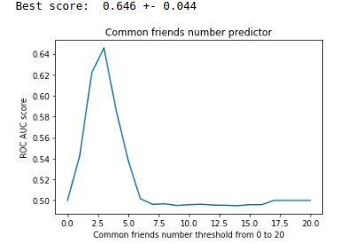
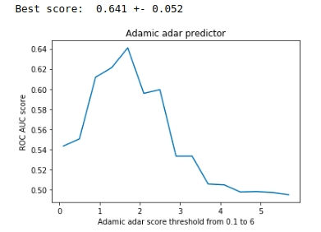
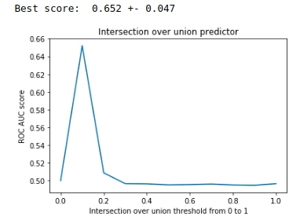
Results

Slide 6
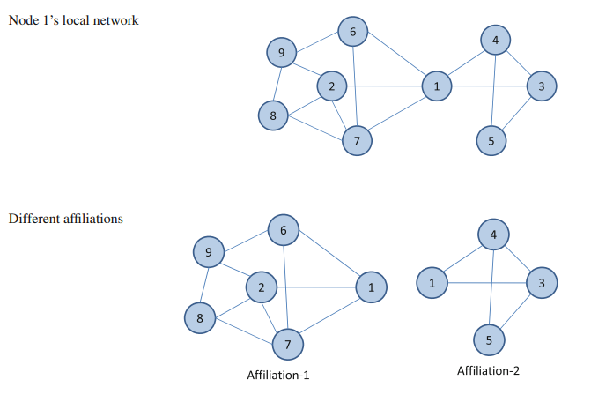
Spectral graph partition

Slide 7




Relaxation
Leveraging social media networks for classification: https://link.springer.com/content/pdf/10.1007%2Fs10618-010-0210-x.pdf

Slide 8
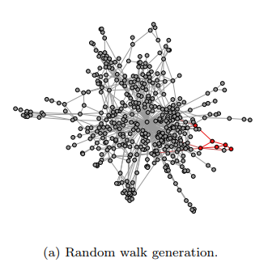
Random walk&word2vec
Random paths are sentences
Apply word2vec as it is
Did not work out :(
Inspired by DeepWalk: Online Learning of Social Representations: http://www.perozzi.net/publications/14_kdd_deepwalk.pdf

Slide 9
Results comparison
ROC AUC for basic approach: 0.652 ± 0.047
ROC AUC for spectral partitioning: 0.887 ± 0.023

Slide 10
Discussion
Spectral approach is better than the heuristical
But for bigger graphs online algorithms (node2vec, etc.) are better
Random walk&word2vec did not succeed

Slide 11
Thank you for your attention!

