Slide 1
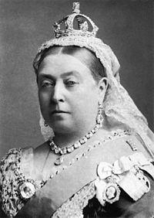
link:
Queen Victoria
wikidata_id:
Q9439
image:
Queen Victoria by Bassano.jpg
sex or gender:
female (Q6581072)
father:
Prince Edward Augustus, Duke of Kent and Strathearn (Q157009)
mother:
Princess Victoria of Saxe-Coburg-Saalfeld (Q58067)
date of birth:
1819-06-24
place of birth:
Kensington Palace (Q207385)
date of death:
1901-02-22
place of death:
Osborne House (Q565155)
wiki_en:
Queen Victoria
label_en:
Queen Victoria
source:
WikiData
Notes:
date of birth (P569) = 1819-06-24
date of death (P570) = 1901-02-22
place of birth (P19) = Kensington Palace (Q207385)
monogram (P1543) = Royal Monogram of Queen Victoria of Great Britain.svg
sex or gender (P21) = female (Q6581072)
signature (P109) = Queen Victoria Signature.svg
place of death (P20) = Osborne House (Q565155)
father (P22) = Prince Edward Augustus, Duke of Kent and Strathearn (Q157009)
mother (P25) = Princess Victoria of Saxe-Coburg-Saalfeld (Q58067)

Slide 2
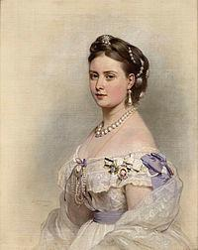
link:
Victoria, Princess Royal
wikidata_id:
Q116728
image:
Victoria, Princess Royal.jpg
sex or gender:
female (Q6581072)
father:
Albert, Prince Consort (Q152245)
mother:
Queen Victoria (Q9439)
date of birth:
1840-12-21
place of birth:
Buckingham Palace (Q42182)
date of death:
1901-09-05
place of death:
Schlosshotel Kronberg (Q510121)
wiki_en:
Victoria, Princess Royal
label_en:
Victoria, Princess Royal
source:
WikiData
Notes:
sex or gender (P21) = female (Q6581072)
place of death (P20) = Schlosshotel Kronberg (Q510121)
father (P22) = Albert, Prince Consort (Q152245)
mother (P25) = Queen Victoria (Q9439)
date of birth (P569) = 1840-12-21
date of death (P570) = 1901-09-05
place of birth (P19) = Buckingham Palace (Q42182)

Slide 3
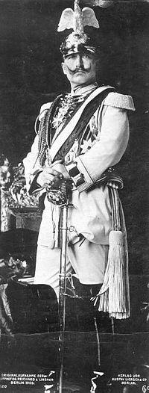
link:
Wilhelm II
wikidata_id:
Q2677
image:
Wilhelm II. 1905.jpeg
sex or gender:
male (Q6581097)
father:
Friedrich III of Germany (Q58600)
mother:
Victoria, Princess Royal (Q116728)
date of birth:
1859-02-27
place of birth:
Berlin (Q64)
date of death:
1941-07-04
place of death:
Netherlands (Q55)
wiki_en:
Wilhelm II, German Emperor
label_en:
Wilhelm II
source:
WikiData
Notes:
monogram (P1543) = Imperial Monogram of Kaiser Wilhelm II.svg
sex or gender (P21) = male (Q6581097)
place of death (P20) = Netherlands (Q55)
signature (P109) = Wilhelm II, German Emperor Signature-.svg
father (P22) = Friedrich III of Germany (Q58600)
mother (P25) = Victoria, Princess Royal (Q116728)
date of birth (P569) = 1859-02-27
date of death (P570) = 1941-07-04
place of birth (P19) = Berlin (Q64)

Slide 4
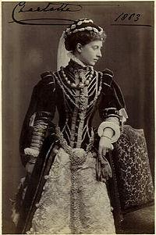
link:
Princess Charlotte of Prussia
wikidata_id:
Q58670
image:
Charlotte von Preussen 1883.jpg
sex or gender:
female (Q6581072)
father:
Friedrich III of Germany (Q58600)
mother:
Victoria, Princess Royal (Q116728)
date of birth:
1860-07-24
place of birth:
Berlin (Q64)
date of death:
1919-11-01
place of death:
Baden-Baden (Q4100)
wiki_en:
Princess Charlotte of Prussia
label_en:
Princess Charlotte of Prussia
source:
WikiData
Notes:
date of birth (P569) = 1860-07-24
monogram (P1543) = Royal Monogram of Charlotte, Duchess of Saxe-Meiningen.svg
sex or gender (P21) = female (Q6581072)
place of death (P20) = Baden-Baden (Q4100)
father (P22) = Friedrich III of Germany (Q58600)
mother (P25) = Victoria, Princess Royal (Q116728)
date of death (P570) = 1919-11-01
place of birth (P19) = Berlin (Q64)

Slide 5
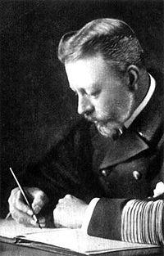
link:
Prince Henry of Prussia
wikidata_id:
Q57569
image:
Prince Albert Wilhelm Heinrich of Prussia.jpg
sex or gender:
male (Q6581097)
father:
Friedrich III of Germany (Q58600)
mother:
Victoria, Princess Royal (Q116728)
date of birth:
1862-09-14
place of birth:
Berlin (Q64)
date of death:
1929-05-20
place of death:
Q881820
wiki_en:
Prince Henry of Prussia (1862–1929)
label_en:
Prince Henry of Prussia
source:
WikiData
Notes:
sex or gender (P21) = male (Q6581097)
place of death (P20) = Q881820
father (P22) = Friedrich III of Germany (Q58600)
mother (P25) = Victoria, Princess Royal (Q116728)
date of birth (P569) = 1862-09-14
date of death (P570) = 1929-05-20
place of birth (P19) = Berlin (Q64)

Slide 6
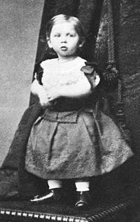
link:
Prince Sigismund of Prussia
wikidata_id:
Q2800847
image:
Sigismund (1).jpg
sex or gender:
male (Q6581097)
father:
Friedrich III of Germany (Q58600)
mother:
Victoria, Princess Royal (Q116728)
date of birth:
1864-10-15
place of birth:
Neues Palais in Potsdam (Q677383)
date of death:
1866-07-18
place of death:
Neues Palais in Potsdam (Q677383)
wiki_en:
Prince Sigismund of Prussia (1864–1866)
label_en:
Prince Sigismund of Prussia
source:
WikiData
Notes:
date of birth (P569) = 1864-10-15
sex or gender (P21) = male (Q6581097)
place of death (P20) = Neues Palais in Potsdam (Q677383)
father (P22) = Friedrich III of Germany (Q58600)
mother (P25) = Victoria, Princess Royal (Q116728)
place of birth (P19) = Neues Palais in Potsdam (Q677383)
date of death (P570) = 1866-07-18

Slide 7
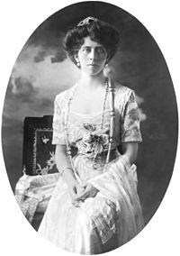
link:
Princess Viktoria of Prussia
wikidata_id:
Q60382
image:
Viktória schaumburg–lippei hercegné.jpg
sex or gender:
female (Q6581072)
father:
Friedrich III of Germany (Q58600)
mother:
Victoria, Princess Royal (Q116728)
date of birth:
1866-05-12
place of birth:
Potsdam (Q1711)
date of death:
1929-12-13
place of death:
Bonn (Q586)
wiki_en:
Princess Viktoria of Prussia
label_en:
Princess Viktoria of Prussia
source:
WikiData
Notes:
date of birth (P569) = 1866-05-12
sex or gender (P21) = female (Q6581072)
place of death (P20) = Bonn (Q586)
father (P22) = Friedrich III of Germany (Q58600)
mother (P25) = Victoria, Princess Royal (Q116728)
date of death (P570) = 1929-12-13
place of birth (P19) = Potsdam (Q1711)

Slide 8
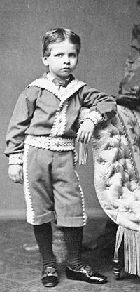
link:
Prince Waldemar of Prussia
wikidata_id:
Q3026877
image:
Prince Waldemar of Prussia.jpg
sex or gender:
male (Q6581097)
father:
Friedrich III of Germany (Q58600)
mother:
Victoria, Princess Royal (Q116728)
date of birth:
1868-03-10
place of birth:
Kronprinzenpalais (Q530930)
date of death:
1879-04-27
place of death:
Neues Palais in Potsdam (Q677383)
wiki_en:
Prince Waldemar of Prussia (1868–1879)
label_en:
Prince Waldemar of Prussia
source:
WikiData
Notes:
date of birth (P569) = 1868-03-10
sex or gender (P21) = male (Q6581097)
place of death (P20) = Neues Palais in Potsdam (Q677383)
father (P22) = Friedrich III of Germany (Q58600)
mother (P25) = Victoria, Princess Royal (Q116728)
date of death (P570) = 1879-04-27
place of birth (P19) = Kronprinzenpalais (Q530930)

Slide 9
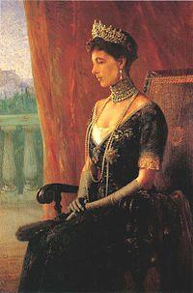
link:
Sophia of Prussia
wikidata_id:
Q155822
image:
Queen Sofia of Greece.jpg
sex or gender:
female (Q6581072)
father:
Friedrich III of Germany (Q58600)
mother:
Victoria, Princess Royal (Q116728)
date of birth:
1870-07-14
place of birth:
Potsdam (Q1711)
date of death:
1932-02-13
place of death:
Frankfurt (Q1794)
wiki_en:
Sophia of Prussia
label_en:
Sophia of Prussia
source:
WikiData
Notes:
date of birth (P569) = 1870-07-14
sex or gender (P21) = female (Q6581072)
place of death (P20) = Frankfurt (Q1794)
signature (P109) = Signature of Sophia of Prussia (Queen of the Hellenes).jpg
father (P22) = Friedrich III of Germany (Q58600)
mother (P25) = Victoria, Princess Royal (Q116728)
date of death (P570) = 1932-02-13
place of birth (P19) = Potsdam (Q1711)

Slide 10
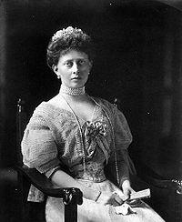
link:
Princess Margaret of Prussia
wikidata_id:
Q61338
image:
Margit of Prussia.jpg
sex or gender:
female (Q6581072)
father:
Friedrich III of Germany (Q58600)
mother:
Victoria, Princess Royal (Q116728)
date of birth:
1872-05-22
place of birth:
Potsdam (Q1711)
date of death:
1954-02-22
place of death:
Schönberg (Q2258753)
wiki_en:
Princess Margaret of Prussia
label_en:
Princess Margaret of Prussia
source:
WikiData
Notes:
date of birth (P569) = 1872-05-22
sex or gender (P21) = female (Q6581072)
place of death (P20) = Schönberg (Q2258753)
father (P22) = Friedrich III of Germany (Q58600)
mother (P25) = Victoria, Princess Royal (Q116728)
date of death (P570) = 1954-02-22
place of birth (P19) = Potsdam (Q1711)

Slide 11
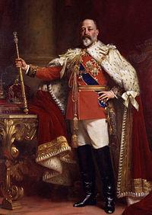
link:
Edward VII
wikidata_id:
Q20875
image:
Edward VII in coronation robes.jpg
sex or gender:
male (Q6581097)
father:
Albert, Prince Consort (Q152245)
mother:
Queen Victoria (Q9439)
date of birth:
1841-12-09
place of birth:
Buckingham Palace (Q42182)
date of death:
1910-06-06
place of death:
Buckingham Palace (Q42182)
wiki_en:
Edward VII
label_en:
Edward VII
source:
WikiData
Notes:
monogram (P1543) = Royal Monogram of King Edward VII of Great Britain.svg
sex or gender (P21) = male (Q6581097)
signature (P109) = EdwardVII Signature.svg
place of death (P20) = Buckingham Palace (Q42182)
father (P22) = Albert, Prince Consort (Q152245)
mother (P25) = Queen Victoria (Q9439)
date of birth (P569) = 1841-12-09
date of death (P570) = 1910-06-06
place of birth (P19) = Buckingham Palace (Q42182)

Slide 12
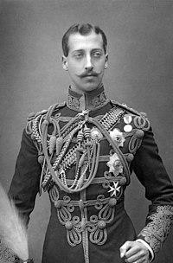
link:
Prince Albert Victor, Duke of Clarence and Avondale
wikidata_id:
Q159670
image:
Prince Albert Victor, Duke of Clarence (1864-1892).jpg
sex or gender:
male (Q6581097)
father:
Edward VII (Q20875)
mother:
Alexandra of Denmark (Q152260)
date of birth:
1864-02-08
place of birth:
Frogmore Estate (Q6679988)
date of death:
1892-02-14
place of death:
Sandringham House (Q935116)
wiki_en:
Prince Albert Victor, Duke of Clarence and Avondale
label_en:
Prince Albert Victor, Duke of Clarence and Avondale
source:
WikiData
Notes:
sex or gender (P21) = male (Q6581097)
place of death (P20) = Sandringham House (Q935116)
father (P22) = Edward VII (Q20875)
mother (P25) = Alexandra of Denmark (Q152260)
date of birth (P569) = 1864-02-08
date of death (P570) = 1892-02-14
place of birth (P19) = Frogmore Estate (Q6679988)

Slide 13
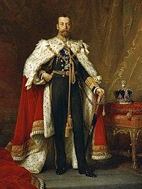
link:
George V
wikidata_id:
Q269412
image:
King George V 1911 color-crop.jpg
sex or gender:
male (Q6581097)
father:
Edward VII (Q20875)
mother:
Alexandra of Denmark (Q152260)
date of birth:
1865-07-03
place of birth:
Marlborough House (Q565532)
date of death:
1936-02-20
place of death:
Sandringham House (Q935116)
wiki_en:
George V
label_en:
George V
source:
WikiData
Notes:
monogram (P1543) = Dual Cypher of King George V and Queen Mary of Great Britain.svg
sex or gender (P21) = male (Q6581097)
signature (P109) = George V Signature.svg
place of death (P20) = Sandringham House (Q935116)
father (P22) = Edward VII (Q20875)
mother (P25) = Alexandra of Denmark (Q152260)
date of birth (P569) = 1865-07-03
date of death (P570) = 1936-02-20
place of birth (P19) = Marlborough House (Q565532)

Slide 14
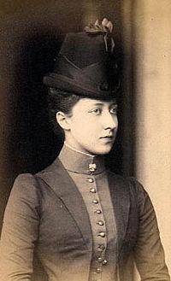
link:
Louise, Princess Royal
wikidata_id:
Q233516
image:
Louise Princess Royal.jpg
sex or gender:
female (Q6581072)
father:
Edward VII (Q20875)
mother:
Alexandra of Denmark (Q152260)
date of birth:
1867-03-20
place of birth:
London (Q84)
date of death:
1931-02-04
place of death:
London (Q84)
wiki_en:
Louise, Princess Royal
label_en:
Louise, Princess Royal
source:
WikiData
Notes:
date of birth (P569) = 1867-03-20
sex or gender (P21) = female (Q6581072)
place of death (P20) = London (Q84)
father (P22) = Edward VII (Q20875)
mother (P25) = Alexandra of Denmark (Q152260)
date of death (P570) = 1931-02-04
place of birth (P19) = London (Q84)

Slide 15
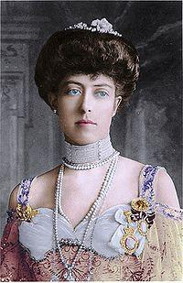
link:
Princess Victoria of the United Kingdom
wikidata_id:
Q234542
image:
Pss Victoria of UK colour.jpg
sex or gender:
female (Q6581072)
father:
Edward VII (Q20875)
mother:
Alexandra of Denmark (Q152260)
date of birth:
1868-08-06
place of birth:
Marlborough House (Q565532)
date of death:
1936-01-03
place of death:
Coppins (Q1777752)
wiki_en:
Princess Victoria of the United Kingdom
label_en:
Princess Victoria of the United Kingdom
source:
WikiData
Notes:
date of birth (P569) = 1868-08-06
sex or gender (P21) = female (Q6581072)
place of death (P20) = Coppins (Q1777752)
father (P22) = Edward VII (Q20875)
mother (P25) = Alexandra of Denmark (Q152260)
date of death (P570) = 1936-01-03
place of birth (P19) = Marlborough House (Q565532)

Slide 16
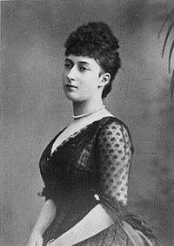
link:
Maud of Wales
wikidata_id:
Q154423
image:
1869 Maud.jpg
sex or gender:
female (Q6581072)
father:
Edward VII (Q20875)
mother:
Alexandra of Denmark (Q152260)
date of birth:
1869-12-26
place of birth:
Marlborough House (Q565532)
date of death:
1938-12-20
place of death:
Sandringham House (Q935116)
wiki_en:
Maud of Wales
label_en:
Maud of Wales
source:
WikiData
Notes:
monogram (P1543) = Royal Monogram of Queen Maud of Norway.svg
sex or gender (P21) = female (Q6581072)
place of death (P20) = Sandringham House (Q935116)
father (P22) = Edward VII (Q20875)
mother (P25) = Alexandra of Denmark (Q152260)
date of birth (P569) = 1869-12-26
date of death (P570) = 1938-12-20
place of birth (P19) = Marlborough House (Q565532)

Slide 17
link:
Prince Alexander John
wikidata_id:
Q12738554
sex or gender:
male (Q6581097)
father:
Edward VII (Q20875)
mother:
Alexandra of Denmark (Q152260)
date of birth:
1871-05-06
date of death:
1871-05-07
label_en:
Prince Alexander John
source:
WikiData
Notes:
date of birth (P569) = 1871-05-06
sex or gender (P21) = male (Q6581097)
father (P22) = Edward VII (Q20875)
mother (P25) = Alexandra of Denmark (Q152260)
date of death (P570) = 1871-05-07

Slide 18
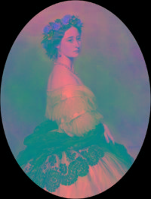
link:
Princess Alice of the United Kingdom
wikidata_id:
Q155566
image:
Princess Alice 1861.png
sex or gender:
female (Q6581072)
father:
Albert, Prince Consort (Q152245)
mother:
Queen Victoria (Q9439)
date of birth:
1843-05-25
place of birth:
London (Q84)
date of death:
1879-01-14
place of death:
Darmstadt (Q2973)
wiki_en:
Princess Alice of the United Kingdom
label_en:
Princess Alice of the United Kingdom
source:
WikiData
Notes:
sex or gender (P21) = female (Q6581072)
place of death (P20) = Darmstadt (Q2973)
father (P22) = Albert, Prince Consort (Q152245)
mother (P25) = Queen Victoria (Q9439)
date of birth (P569) = 1843-05-25
date of death (P570) = 1879-01-14
place of birth (P19) = London (Q84)

Slide 19
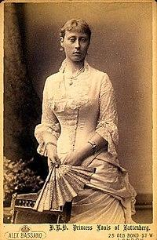
link:
Princess Victoria of Hesse and by Rhine
wikidata_id:
Q57658
image:
Victoria Hesse 1863.jpg
sex or gender:
female (Q6581072)
father:
Louis IV, Grand Duke of Hesse (Q164498)
mother:
Princess Alice of the United Kingdom (Q155566)
date of birth:
1863-05-05
place of birth:
Windsor Castle (Q42646)
date of death:
1950-10-24
place of death:
London (Q84)
wiki_en:
Princess Victoria of Hesse and by Rhine
label_en:
Princess Victoria of Hesse and by Rhine
source:
WikiData
Notes:
date of birth (P569) = 1863-05-05
sex or gender (P21) = female (Q6581072)
place of death (P20) = London (Q84)
father (P22) = Louis IV, Grand Duke of Hesse (Q164498)
mother (P25) = Princess Alice of the United Kingdom (Q155566)
date of death (P570) = 1950-10-24
place of birth (P19) = Windsor Castle (Q42646)

Slide 20
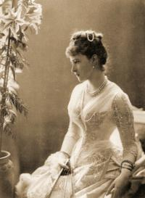
link:
Princess Elisabeth of Hesse and by Rhine
wikidata_id:
Q58063
image:
Elizaveta Federovna.gif
sex or gender:
female (Q6581072)
father:
Louis IV, Grand Duke of Hesse (Q164498)
mother:
Princess Alice of the United Kingdom (Q155566)
date of birth:
1864-12-01
place of birth:
Darmstadt (Q2973)
date of death:
1918-08-18
place of death:
Alapayevsk (Q103212)
wiki_en:
Princess Elisabeth of Hesse and by Rhine (1864–1918)
label_en:
Princess Elisabeth of Hesse and by Rhine
source:
WikiData
Notes:
date of birth (P569) = 1864-12-01
sex or gender (P21) = female (Q6581072)
place of death (P20) = Alapayevsk (Q103212)
signature (P109) = Signature of Grand Duchess Elizabeth Fyodorovna of Russia, née Her Grand Ducal Highness Princess Elisabeth Alexandra Luise Alice of Hesse and by Rhine.jpg
father (P22) = Louis IV, Grand Duke of Hesse (Q164498)
mother (P25) = Princess Alice of the United Kingdom (Q155566)
date of death (P570) = 1918-08-18
place of birth (P19) = Darmstadt (Q2973)

Slide 21
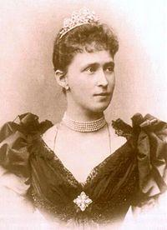
link:
Princess Irene of Hesse and by Rhine
wikidata_id:
Q233990
image:
Irene hesse1.jpg
sex or gender:
female (Q6581072)
father:
Louis IV, Grand Duke of Hesse (Q164498)
mother:
Princess Alice of the United Kingdom (Q155566)
date of birth:
1866-08-11
place of birth:
Darmstadt (Q2973)
date of death:
1953-12-11
place of death:
West Germany (Q713750)
wiki_en:
Princess Irene of Hesse and by Rhine
label_en:
Princess Irene of Hesse and by Rhine
source:
WikiData
Notes:
date of birth (P569) = 1866-08-11
sex or gender (P21) = female (Q6581072)
place of death (P20) = West Germany (Q713750)
father (P22) = Louis IV, Grand Duke of Hesse (Q164498)
mother (P25) = Princess Alice of the United Kingdom (Q155566)
date of death (P570) = 1953-12-11
place of birth (P19) = Darmstadt (Q2973)

Slide 22
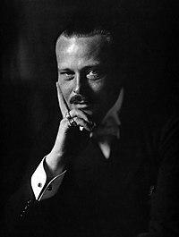
link:
Ernest Louis, Grand Duke of Hesse
wikidata_id:
Q57507
image:
Ernst Ludwig von Hessen 1905 Foto Jacob Hilsdorf.jpeg
sex or gender:
male (Q6581097)
father:
Louis IV, Grand Duke of Hesse (Q164498)
mother:
Princess Alice of the United Kingdom (Q155566)
date of birth:
1868-12-25
place of birth:
Darmstadt (Q2973)
date of death:
1937-11-09
place of death:
Schloß Wolfsgarten (Q881056)
wiki_en:
Ernest Louis, Grand Duke of Hesse
label_en:
Ernest Louis, Grand Duke of Hesse
source:
WikiData
Notes:
date of birth (P569) = 1868-12-25
sex or gender (P21) = male (Q6581097)
place of death (P20) = Schloß Wolfsgarten (Q881056)
father (P22) = Louis IV, Grand Duke of Hesse (Q164498)
mother (P25) = Princess Alice of the United Kingdom (Q155566)
date of death (P570) = 1937-11-09
place of birth (P19) = Darmstadt (Q2973)

Slide 23
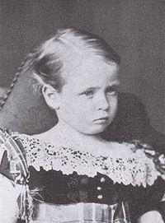
link:
Prince Friedrich of Hesse and by Rhine
wikidata_id:
Q2562528
image:
Frederico de hesse.JPG
sex or gender:
male (Q6581097)
father:
Louis IV, Grand Duke of Hesse (Q164498)
mother:
Princess Alice of the United Kingdom (Q155566)
date of birth:
1870-11-07
place of birth:
Darmstadt (Q2973)
date of death:
1873-06-29
place of death:
German Empire (Q43287)
wiki_en:
Prince Friedrich of Hesse and by Rhine
label_en:
Prince Friedrich of Hesse and by Rhine
source:
WikiData
Notes:
date of birth (P569) = 1870-11-07
sex or gender (P21) = male (Q6581097)
place of death (P20) = German Empire (Q43287)
father (P22) = Louis IV, Grand Duke of Hesse (Q164498)
mother (P25) = Princess Alice of the United Kingdom (Q155566)
date of death (P570) = 1873-06-29
place of birth (P19) = Darmstadt (Q2973)

Slide 24
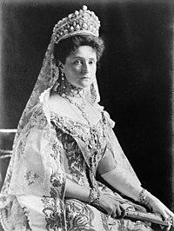
link:
Alexandra Fyodorovna rusa
wikidata_id:
Q152094
image:
Alexandra Fyodorovna LOC 01137u.jpg
sex or gender:
female (Q6581072)
father:
Louis IV, Grand Duke of Hesse (Q164498)
mother:
Princess Alice of the United Kingdom (Q155566)
date of birth:
1872-07-06
place of birth:
Darmstadt (Q2973)
date of death:
1918-08-17
place of death:
Yekaterinburg (Q887)
wiki_en:
Alexandra Feodorovna (Alix of Hesse)
label_en:
Alexandra Fyodorovna rusa
source:
WikiData
Notes:
monogram (P1543) = Imperial Monogram of Empress Alexandra Feodorovna (1872-1918) of Russia, Variant.svg
sex or gender (P21) = female (Q6581072)
place of death (P20) = Yekaterinburg (Q887)
signature (P109) = Alexandra Feodorovna Signature.svg
father (P22) = Louis IV, Grand Duke of Hesse (Q164498)
mother (P25) = Princess Alice of the United Kingdom (Q155566)
date of birth (P569) = 1872-07-06
date of death (P570) = 1918-08-17
place of birth (P19) = Darmstadt (Q2973)

Slide 25
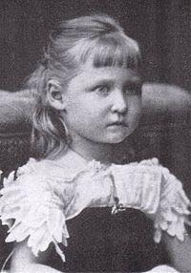
link:
Princess Marie of Hesse and by Rhine
wikidata_id:
Q1208045
image:
Maria de Hesse.jpeg
sex or gender:
female (Q6581072)
father:
Louis IV, Grand Duke of Hesse (Q164498)
mother:
Princess Alice of the United Kingdom (Q155566)
date of birth:
1874-06-24
place of birth:
Darmstadt (Q2973)
date of death:
1878-12-16
place of death:
Darmstadt (Q2973)
wiki_en:
Princess Marie of Hesse and by Rhine (1874–1878)
label_en:
Princess Marie of Hesse and by Rhine
source:
WikiData
Notes:
date of birth (P569) = 1874-06-24
sex or gender (P21) = female (Q6581072)
place of death (P20) = Darmstadt (Q2973)
father (P22) = Louis IV, Grand Duke of Hesse (Q164498)
mother (P25) = Princess Alice of the United Kingdom (Q155566)
date of death (P570) = 1878-12-16
place of birth (P19) = Darmstadt (Q2973)

Slide 26
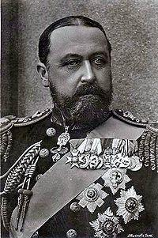
link:
Alfred, Duke of Saxe-Coburg and Gotha
wikidata_id:
Q158143
image:
Alfred-sachsen-coburg-gotha.jpg
sex or gender:
male (Q6581097)
father:
Albert, Prince Consort (Q152245)
mother:
Queen Victoria (Q9439)
place of birth:
Windsor Castle (Q42646)
date of death:
1900-08-30
place of death:
Schloss Rosenau (Q449510)
wiki_en:
Alfred, Duke of Saxe-Coburg and Gotha
label_en:
Alfred, Duke of Saxe-Coburg and Gotha
source:
WikiData
Notes:
sex or gender (P21) = male (Q6581097)
place of death (P20) = Schloss Rosenau (Q449510)
father (P22) = Albert, Prince Consort (Q152245)
mother (P25) = Queen Victoria (Q9439)
date of birth (P569) = [1844-08-06 (Prec.: day [-0 .. +0], PCal: Gregorian), 1844-08-08 (Prec.: day [-0 .. +0], PCal: Gregorian)]
date of death (P570) = 1900-08-30
place of birth (P19) = Windsor Castle (Q42646)

Slide 27
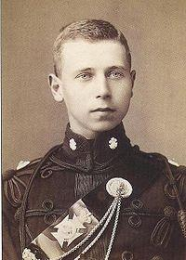
link:
Alfred, Hereditary Prince of Saxe-Coburg and Gotha
wikidata_id:
Q62477
image:
Erbprinz-alfred-von-sachsen-coburg-gotha.jpg
sex or gender:
male (Q6581097)
father:
Alfred, Duke of Saxe-Coburg and Gotha (Q158143)
mother:
Grand Duchess Maria Alexandrovna of Russia (Q158154)
date of birth:
1874-11-15
place of birth:
Buckingham Palace (Q42182)
date of death:
1899-03-06
place of death:
Merano (Q131605)
wiki_en:
Alfred, Hereditary Prince of Saxe-Coburg and Gotha
label_en:
Alfred, Hereditary Prince of Saxe-Coburg and Gotha
source:
WikiData
Notes:
date of birth (P569) = 1874-11-15
sex or gender (P21) = male (Q6581097)
place of death (P20) = Merano (Q131605)
father (P22) = Alfred, Duke of Saxe-Coburg and Gotha (Q158143)
mother (P25) = Grand Duchess Maria Alexandrovna of Russia (Q158154)
date of death (P570) = 1899-03-06
place of birth (P19) = Buckingham Palace (Q42182)

Slide 28
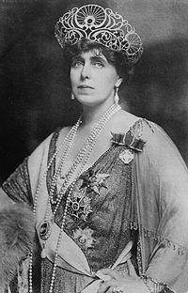
link:
Marie of Romania
wikidata_id:
Q57666
image:
Queen Mary of Romania 2.jpg
sex or gender:
female (Q6581072)
father:
Alfred, Duke of Saxe-Coburg and Gotha (Q158143)
mother:
Grand Duchess Maria Alexandrovna of Russia (Q158154)
date of birth:
1875-11-29
place of birth:
Eastwell Park (Q2540442)
date of death:
1938-08-18
place of death:
Peleș Castle (Q917702)
wiki_en:
Marie of Romania
label_en:
Marie of Romania
source:
WikiData
Notes:
monogram (P1543) = Royal Monogram of Marie of Romania, Variant 2.svg
sex or gender (P21) = female (Q6581072)
signature (P109) = SemnaturaMaria.jpg
place of death (P20) = Peleș Castle (Q917702)
father (P22) = Alfred, Duke of Saxe-Coburg and Gotha (Q158143)
mother (P25) = Grand Duchess Maria Alexandrovna of Russia (Q158154)
date of birth (P569) = 1875-11-29
date of death (P570) = 1938-08-18
place of birth (P19) = Eastwell Park (Q2540442)

Slide 29
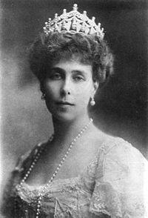
link:
Princess Victoria Melita of Saxe-Coburg and Gotha
wikidata_id:
Q164500
image:
Vitoria Melita.JPG
sex or gender:
female (Q6581072)
father:
Alfred, Duke of Saxe-Coburg and Gotha (Q158143)
mother:
Grand Duchess Maria Alexandrovna of Russia (Q158154)
date of birth:
1876-12-25
place of birth:
Valletta (Q23800)
date of death:
1936-04-02
place of death:
Amorbach (Q474051)
wiki_en:
Princess Victoria Melita of Saxe-Coburg and Gotha
label_en:
Princess Victoria Melita of Saxe-Coburg and Gotha
source:
WikiData
Notes:
date of birth (P569) = 1876-12-25
sex or gender (P21) = female (Q6581072)
place of death (P20) = Amorbach (Q474051)
father (P22) = Alfred, Duke of Saxe-Coburg and Gotha (Q158143)
mother (P25) = Grand Duchess Maria Alexandrovna of Russia (Q158154)
date of death (P570) = 1936-04-02
place of birth (P19) = Valletta (Q23800)

Slide 30
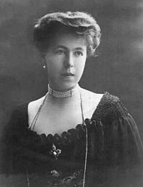
link:
Princess Alexandra of Saxe-Coburg and Gotha
wikidata_id:
Q61345
image:
Princess Alexandra of Hohenlohe.jpg
sex or gender:
female (Q6581072)
father:
Alfred, Duke of Saxe-Coburg and Gotha (Q158143)
mother:
Grand Duchess Maria Alexandrovna of Russia (Q158154)
date of birth:
1878-10-01
place of birth:
Coburg (Q14821)
date of death:
1942-05-16
place of death:
Schwäbisch Hall (Q14910)
wiki_en:
Princess Alexandra of Saxe-Coburg and Gotha
label_en:
Princess Alexandra of Saxe-Coburg and Gotha
source:
WikiData
Notes:
date of birth (P569) = 1878-10-01
sex or gender (P21) = female (Q6581072)
place of death (P20) = Schwäbisch Hall (Q14910)
father (P22) = Alfred, Duke of Saxe-Coburg and Gotha (Q158143)
mother (P25) = Grand Duchess Maria Alexandrovna of Russia (Q158154)
date of death (P570) = 1942-05-16
place of birth (P19) = Coburg (Q14821)

Slide 31
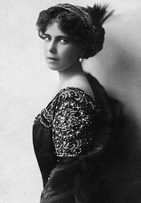
link:
Princess Beatrice of Saxe-Coburg and Gotha
wikidata_id:
Q235597
image:
Beatriceedinburgh1884.jpg
sex or gender:
female (Q6581072)
father:
Alfred, Duke of Saxe-Coburg and Gotha (Q158143)
mother:
Grand Duchess Maria Alexandrovna of Russia (Q158154)
date of birth:
1884-05-20
place of birth:
Eastwell Park (Q2540442)
date of death:
1966-08-13
place of death:
Sanlúcar de Barrameda (Q210887)
wiki_en:
Princess Beatrice of Saxe-Coburg and Gotha
label_en:
Princess Beatrice of Saxe-Coburg and Gotha
source:
WikiData
Notes:
date of birth (P569) = 1884-05-20
sex or gender (P21) = female (Q6581072)
place of death (P20) = Sanlúcar de Barrameda (Q210887)
father (P22) = Alfred, Duke of Saxe-Coburg and Gotha (Q158143)
mother (P25) = Grand Duchess Maria Alexandrovna of Russia (Q158154)
date of death (P570) = 1966-08-13
place of birth (P19) = Eastwell Park (Q2540442)

Slide 32
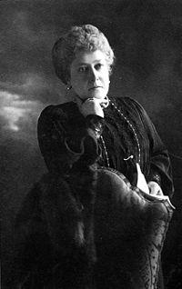
link:
Princess Helena of the United Kingdom
wikidata_id:
Q160539
image:
Helena scan.jpg
sex or gender:
female (Q6581072)
father:
Albert, Prince Consort (Q152245)
mother:
Queen Victoria (Q9439)
place of birth:
Buckingham Palace (Q42182)
date of death:
1923-07-09
place of death:
London (Q84)
wiki_en:
Princess Helena of the United Kingdom
label_en:
Princess Helena of the United Kingdom
source:
WikiData
Notes:
date of birth (P569) = [1846-05-25 (Prec.: day [-0 .. +0], PCal: Gregorian), 1846-05-26 (Prec.: day [-0 .. +0], PCal: Gregorian)]
sex or gender (P21) = female (Q6581072)
place of death (P20) = London (Q84)
father (P22) = Albert, Prince Consort (Q152245)
mother (P25) = Queen Victoria (Q9439)
date of death (P570) = 1923-07-09
place of birth (P19) = Buckingham Palace (Q42182)

Slide 33
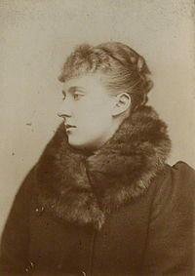
link:
Princess Marie Louise of Schleswig-Holstein
wikidata_id:
Q242876
image:
Princess Marie Louise of Schleswig-Holstein.jpg
sex or gender:
female (Q6581072)
father:
Prince Christian of Schleswig-Holstein (Q677589)
mother:
Princess Helena of the United Kingdom (Q160539)
date of birth:
1872-09-12
place of birth:
Cumberland Lodge (Q1143701)
date of death:
1957-01-08
place of death:
London (Q84)
wiki_en:
Princess Marie Louise of Schleswig-Holstein
label_en:
Princess Marie Louise of Schleswig-Holstein
source:
WikiData
Notes:
date of birth (P569) = 1872-09-12
sex or gender (P21) = female (Q6581072)
place of death (P20) = London (Q84)
father (P22) = Prince Christian of Schleswig-Holstein (Q677589)
mother (P25) = Princess Helena of the United Kingdom (Q160539)
date of death (P570) = 1957-01-08
place of birth (P19) = Cumberland Lodge (Q1143701)

Slide 34
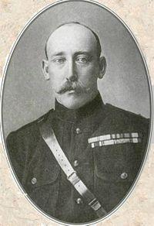
link:
Prince Christian Victor of Schleswig-Holstein
wikidata_id:
Q836119
image:
Christian Victor of Schleswig-Holstein.jpg
sex or gender:
male (Q6581097)
father:
Prince Christian of Schleswig-Holstein (Q677589)
mother:
Princess Helena of the United Kingdom (Q160539)
date of birth:
1867-05-14
place of birth:
Windsor Castle (Q42646)
date of death:
1900-11-29
place of death:
Pretoria (Q3926)
wiki_en:
Prince Christian Victor of Schleswig-Holstein
label_en:
Prince Christian Victor of Schleswig-Holstein
source:
WikiData
Notes:
date of birth (P569) = 1867-05-14
sex or gender (P21) = male (Q6581097)
place of death (P20) = Pretoria (Q3926)
father (P22) = Prince Christian of Schleswig-Holstein (Q677589)
mother (P25) = Princess Helena of the United Kingdom (Q160539)
date of death (P570) = 1900-11-29
place of birth (P19) = Windsor Castle (Q42646)

Slide 35
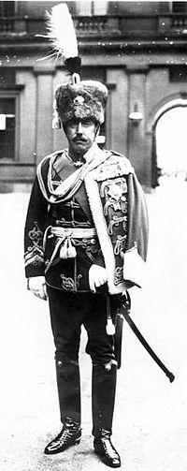
link:
Albert, Duke of Schleswig-Holstein
wikidata_id:
Q701095
image:
Albert, Duke of Schleswig-Holstein, 1914.jpg
sex or gender:
male (Q6581097)
father:
Prince Christian of Schleswig-Holstein (Q677589)
mother:
Princess Helena of the United Kingdom (Q160539)
date of birth:
1869-03-26
place of birth:
Frogmore House (Q564578)
date of death:
1931-05-27
place of death:
Berlin (Q64)
wiki_en:
Albert, Duke of Schleswig-Holstein
label_en:
Albert, Duke of Schleswig-Holstein
source:
WikiData
Notes:
date of birth (P569) = 1869-03-26
sex or gender (P21) = male (Q6581097)
place of death (P20) = Berlin (Q64)
father (P22) = Prince Christian of Schleswig-Holstein (Q677589)
mother (P25) = Princess Helena of the United Kingdom (Q160539)
date of death (P570) = 1931-05-27
place of birth (P19) = Frogmore House (Q564578)

Slide 36
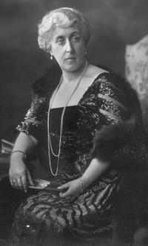
link:
Princess Helena Victoria of Schleswig-Holstein
wikidata_id:
Q204864
image:
Pss Helena Victoria.png
sex or gender:
female (Q6581072)
father:
Prince Christian of Schleswig-Holstein (Q677589)
mother:
Princess Helena of the United Kingdom (Q160539)
date of birth:
1870-06-03
place of birth:
Frogmore House (Q564578)
date of death:
1948-04-13
place of death:
London (Q84)
wiki_en:
Princess Helena Victoria of Schleswig-Holstein
label_en:
Princess Helena Victoria of Schleswig-Holstein
source:
WikiData
Notes:
date of birth (P569) = 1870-06-03
sex or gender (P21) = female (Q6581072)
place of death (P20) = London (Q84)
father (P22) = Prince Christian of Schleswig-Holstein (Q677589)
mother (P25) = Princess Helena of the United Kingdom (Q160539)
date of death (P570) = 1948-04-13
place of birth (P19) = Frogmore House (Q564578)

Slide 37
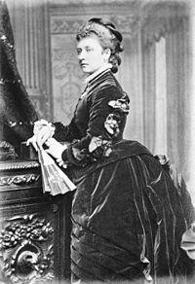
link:
Princess Louise, Duchess of Argyll
wikidata_id:
Q161167
image:
Princess Louise 1901 copy.jpg
sex or gender:
female (Q6581072)
father:
Albert, Prince Consort (Q152245)
mother:
Queen Victoria (Q9439)
date of birth:
1848-04-18
place of birth:
Buckingham Palace (Q42182)
date of death:
1940-01-03
place of death:
London (Q84)
wiki_en:
Princess Louise, Duchess of Argyll
label_en:
Princess Louise, Duchess of Argyll
source:
WikiData
Notes:
monogram (P1543) = Royal Monogram of Princess Louise of Great Britain.svg
sex or gender (P21) = female (Q6581072)
place of death (P20) = London (Q84)
father (P22) = Albert, Prince Consort (Q152245)
mother (P25) = Queen Victoria (Q9439)
date of birth (P569) = 1848-04-18
date of death (P570) = 1940-01-03
place of birth (P19) = Buckingham Palace (Q42182)

Slide 38
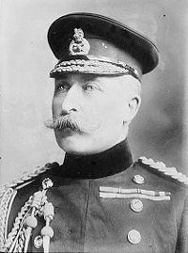
link:
Prince Arthur, Duke of Connaught and Strathearn
wikidata_id:
Q160558
image:
Duke of Connaught and Strathearn.jpg
sex or gender:
male (Q6581097)
father:
Albert, Prince Consort (Q152245)
mother:
Queen Victoria (Q9439)
date of birth:
1850-06-01
place of birth:
Buckingham Palace (Q42182)
date of death:
1942-02-16
place of death:
Bagshot Park (Q582085)
wiki_en:
Prince Arthur, Duke of Connaught and Strathearn
label_en:
Prince Arthur, Duke of Connaught and Strathearn
source:
WikiData
Notes:
sex or gender (P21) = male (Q6581097)
place of death (P20) = Bagshot Park (Q582085)
father (P22) = Albert, Prince Consort (Q152245)
mother (P25) = Queen Victoria (Q9439)
date of birth (P569) = 1850-06-01
date of death (P570) = 1942-02-16
place of birth (P19) = Buckingham Palace (Q42182)

Slide 39

link:
Princess Margaret of Connaught
wikidata_id:
Q158173
image:
Margaret of Connaught.png
sex or gender:
female (Q6581072)
father:
Prince Arthur, Duke of Connaught and Strathearn (Q160558)
mother:
Princess Louise Margaret of Prussia (Q235435)
date of birth:
1882-02-15
place of birth:
Bagshot Park (Q582085)
date of death:
1920-06-01
place of death:
Stockholm (Q1754)
wiki_en:
Princess Margaret of Connaught
label_en:
Princess Margaret of Connaught
source:
WikiData
Notes:
date of birth (P569) = 1882-02-15
sex or gender (P21) = female (Q6581072)
place of death (P20) = Stockholm (Q1754)
father (P22) = Prince Arthur, Duke of Connaught and Strathearn (Q160558)
mother (P25) = Princess Louise Margaret of Prussia (Q235435)
date of death (P570) = 1920-06-01
place of birth (P19) = Bagshot Park (Q582085)

Slide 40
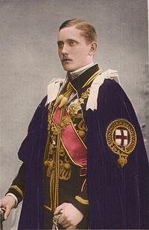
link:
Prince Arthur of Connaught
wikidata_id:
Q519332
image:
Prince Arthur of Connaught colour.jpg
sex or gender:
male (Q6581097)
father:
Prince Arthur, Duke of Connaught and Strathearn (Q160558)
mother:
Princess Louise Margaret of Prussia (Q235435)
date of birth:
1883-02-13
place of birth:
Windsor Castle (Q42646)
date of death:
1938-10-12
place of death:
London (Q84)
wiki_en:
Prince Arthur of Connaught
label_en:
Prince Arthur of Connaught
source:
WikiData
Notes:
date of birth (P569) = 1883-02-13
sex or gender (P21) = male (Q6581097)
place of death (P20) = London (Q84)
father (P22) = Prince Arthur, Duke of Connaught and Strathearn (Q160558)
mother (P25) = Princess Louise Margaret of Prussia (Q235435)
date of death (P570) = 1938-10-12
place of birth (P19) = Windsor Castle (Q42646)

Slide 41
link:
Princess Patricia of Connaught
wikidata_id:
Q256951
sex or gender:
female (Q6581072)
father:
Prince Arthur, Duke of Connaught and Strathearn (Q160558)
mother:
Princess Louise Margaret of Prussia (Q235435)
date of birth:
1886-04-17
place of birth:
Buckingham Palace (Q42182)
date of death:
1974-02-12
place of death:
Surrey (Q23276)
wiki_en:
Princess Patricia of Connaught
label_en:
Princess Patricia of Connaught
source:
WikiData
Notes:
date of birth (P569) = 1886-04-17
sex or gender (P21) = female (Q6581072)
place of death (P20) = Surrey (Q23276)
father (P22) = Prince Arthur, Duke of Connaught and Strathearn (Q160558)
mother (P25) = Princess Louise Margaret of Prussia (Q235435)
date of death (P570) = 1974-02-12
place of birth (P19) = Buckingham Palace (Q42182)

Slide 42
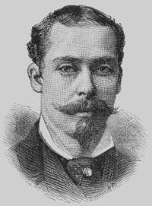
link:
Prince Leopold, Duke of Albany
wikidata_id:
Q160541
image:
Prince Leopold, Duke of Albany - Project Gutenberg eText 13103.jpg
sex or gender:
male (Q6581097)
father:
Albert, Prince Consort (Q152245)
mother:
Queen Victoria (Q9439)
date of birth:
1853-05-07
place of birth:
Buckingham Palace (Q42182)
date of death:
1884-04-28
place of death:
Cannes (Q39984)
wiki_en:
Prince Leopold, Duke of Albany
label_en:
Prince Leopold, Duke of Albany
source:
WikiData
Notes:
date of birth (P569) = 1853-05-07
sex or gender (P21) = male (Q6581097)
place of death (P20) = Cannes (Q39984)
father (P22) = Albert, Prince Consort (Q152245)
mother (P25) = Queen Victoria (Q9439)
date of death (P570) = 1884-04-28
place of birth (P19) = Buckingham Palace (Q42182)

Slide 43
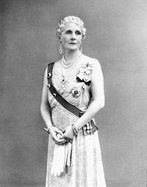
link:
Princess Alice, Countess of Athlone
wikidata_id:
Q235521
image:
Princèse Alice d'Albany.jpeg
sex or gender:
female (Q6581072)
father:
Prince Leopold, Duke of Albany (Q160541)
mother:
Princess Helena of Waldeck and Pyrmont (Q60747)
date of birth:
1883-03-25
place of birth:
Windsor Castle (Q42646)
date of death:
1981-02-03
place of death:
Kensington Palace (Q207385)
wiki_en:
Princess Alice, Countess of Athlone
label_en:
Princess Alice, Countess of Athlone
source:
WikiData
Notes:
date of birth (P569) = 1883-03-25
sex or gender (P21) = female (Q6581072)
place of death (P20) = Kensington Palace (Q207385)
father (P22) = Prince Leopold, Duke of Albany (Q160541)
mother (P25) = Princess Helena of Waldeck and Pyrmont (Q60747)
date of death (P570) = 1981-02-03
place of birth (P19) = Windsor Castle (Q42646)

Slide 44
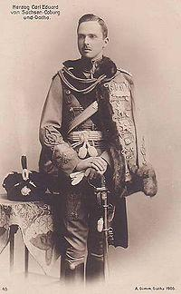
link:
Charles Edward, Duke of Saxe-Coburg and Gotha
wikidata_id:
Q160467
image:
Carl Eduard Sachsen Coburg und Gotha.jpg
sex or gender:
male (Q6581097)
father:
Prince Leopold, Duke of Albany (Q160541)
mother:
Princess Helena of Waldeck and Pyrmont (Q60747)
date of birth:
1884-08-19
place of birth:
Esher (Q637482)
date of death:
1954-04-06
place of death:
Coburg (Q14821)
wiki_en:
Charles Edward, Duke of Saxe-Coburg and Gotha
label_en:
Charles Edward, Duke of Saxe-Coburg and Gotha
source:
WikiData
Notes:
sex or gender (P21) = male (Q6581097)
place of death (P20) = Coburg (Q14821)
father (P22) = Prince Leopold, Duke of Albany (Q160541)
mother (P25) = Princess Helena of Waldeck and Pyrmont (Q60747)
date of birth (P569) = 1884-08-19
date of death (P570) = 1954-04-06
place of birth (P19) = Esher (Q637482)

Slide 45
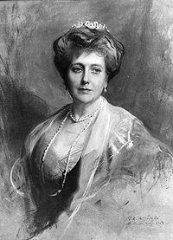
link:
Princess Beatrice of the United Kingdom
wikidata_id:
Q158140
image:
Laszlo - Princess Henry of Battenberg.jpg
sex or gender:
female (Q6581072)
father:
Albert, Prince Consort (Q152245)
mother:
Queen Victoria (Q9439)
date of birth:
1857-05-14
place of birth:
Buckingham Palace (Q42182)
date of death:
1944-11-26
place of death:
Brantridge Park (Q2547961)
wiki_en:
Princess Beatrice of the United Kingdom
label_en:
Princess Beatrice of the United Kingdom
source:
WikiData
Notes:
date of birth (P569) = 1857-05-14
monogram (P1543) = Royal Monogram of Princess Beatrice of Battenberg.svg
sex or gender (P21) = female (Q6581072)
place of death (P20) = Brantridge Park (Q2547961)
father (P22) = Albert, Prince Consort (Q152245)
mother (P25) = Queen Victoria (Q9439)
date of death (P570) = 1944-11-26
place of birth (P19) = Buckingham Palace (Q42182)

Slide 46
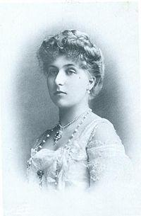
link:
Victoria Eugenie of Battenberg
wikidata_id:
Q160001
image:
VictoriaEugenia.jpg
sex or gender:
female (Q6581072)
father:
Prince Henry of Battenberg (Q444347)
mother:
Princess Beatrice of the United Kingdom (Q158140)
date of birth:
1887-11-24
place of birth:
Balmoral Castle (Q42049)
date of death:
1969-05-15
place of death:
Lausanne (Q807)
wiki_en:
Victoria Eugenie of Battenberg
label_en:
Victoria Eugenie of Battenberg
source:
WikiData
Notes:
date of birth (P569) = 1887-11-24
sex or gender (P21) = female (Q6581072)
place of death (P20) = Lausanne (Q807)
father (P22) = Prince Henry of Battenberg (Q444347)
mother (P25) = Princess Beatrice of the United Kingdom (Q158140)
date of death (P570) = 1969-05-15
place of birth (P19) = Balmoral Castle (Q42049)

Slide 47
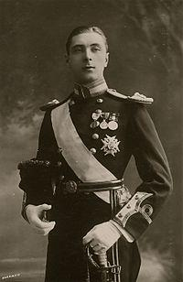
link:
Alexander Mountbatten, 1st Marquess of Carisbrooke
wikidata_id:
Q337477
image:
Alexander of Battenberg, Marquess of Carisbrooke.jpg
sex or gender:
male (Q6581097)
father:
Prince Henry of Battenberg (Q444347)
mother:
Princess Beatrice of the United Kingdom (Q158140)
date of birth:
1886-12-23
place of birth:
Windsor Castle (Q42646)
date of death:
1960-03-23
place of death:
Kensington Palace (Q207385)
wiki_en:
Alexander Mountbatten, 1st Marquess of Carisbrooke
label_en:
Alexander Mountbatten, 1st Marquess of Carisbrooke
source:
WikiData
Notes:
date of birth (P569) = 1886-12-23
sex or gender (P21) = male (Q6581097)
place of death (P20) = Kensington Palace (Q207385)
father (P22) = Prince Henry of Battenberg (Q444347)
mother (P25) = Princess Beatrice of the United Kingdom (Q158140)
date of death (P570) = 1960-03-23
place of birth (P19) = Windsor Castle (Q42646)

Slide 48
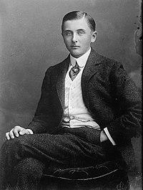
link:
Lord Leopold Mountbatten
wikidata_id:
Q2205590
image:
Prince Leopod Mountbatten 05363v.jpg
sex or gender:
male (Q6581097)
father:
Prince Henry of Battenberg (Q444347)
mother:
Princess Beatrice of the United Kingdom (Q158140)
date of birth:
1889-06-21
place of birth:
Windsor Castle (Q42646)
date of death:
1922-05-23
place of death:
Kensington Palace (Q207385)
wiki_en:
Lord Leopold Mountbatten
label_en:
Lord Leopold Mountbatten
source:
WikiData
Notes:
date of birth (P569) = 1889-06-21
sex or gender (P21) = male (Q6581097)
place of death (P20) = Kensington Palace (Q207385)
father (P22) = Prince Henry of Battenberg (Q444347)
mother (P25) = Princess Beatrice of the United Kingdom (Q158140)
date of death (P570) = 1922-05-23
place of birth (P19) = Windsor Castle (Q42646)

Slide 49
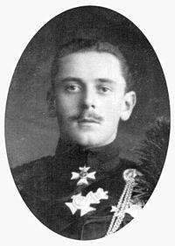
link:
Prince Maurice of Battenberg
wikidata_id:
Q2351869
image:
1891 Maurice-04.JPG
sex or gender:
male (Q6581097)
father:
Prince Henry of Battenberg (Q444347)
mother:
Princess Beatrice of the United Kingdom (Q158140)
date of birth:
1891-11-03
place of birth:
Balmoral Castle (Q42049)
date of death:
1914-11-27
place of death:
Ypres (Q102728)
wiki_en:
Prince Maurice of Battenberg
label_en:
Prince Maurice of Battenberg
source:
WikiData
Notes:
date of birth (P569) = 1891-11-03
sex or gender (P21) = male (Q6581097)
place of death (P20) = Ypres (Q102728)
father (P22) = Prince Henry of Battenberg (Q444347)
mother (P25) = Princess Beatrice of the United Kingdom (Q158140)
date of death (P570) = 1914-11-27
place of birth (P19) = Balmoral Castle (Q42049)

