Slide 1
PGY630: Quantitative methods for biomedical research Image processing: Connected components Kenneth S. Campbell, PhD

Slide 2
Objectives
Recognize the difference between different types of connected components (or “blobs” as they are often called)
Explain what a labeled image is
List some of the properties that can be used to describe a connected component
Recognize that blobs can be filtered according to their properties
Recall that the watershed algorithm can be used to separate touching blobs

Slide 3
4 and 8 connected blobs in 2D
8 connected blob
(MATLAB default)
4 connected blob
4 connected blobs must join at edges; 8 connected blobs can join at corners

Slide 4
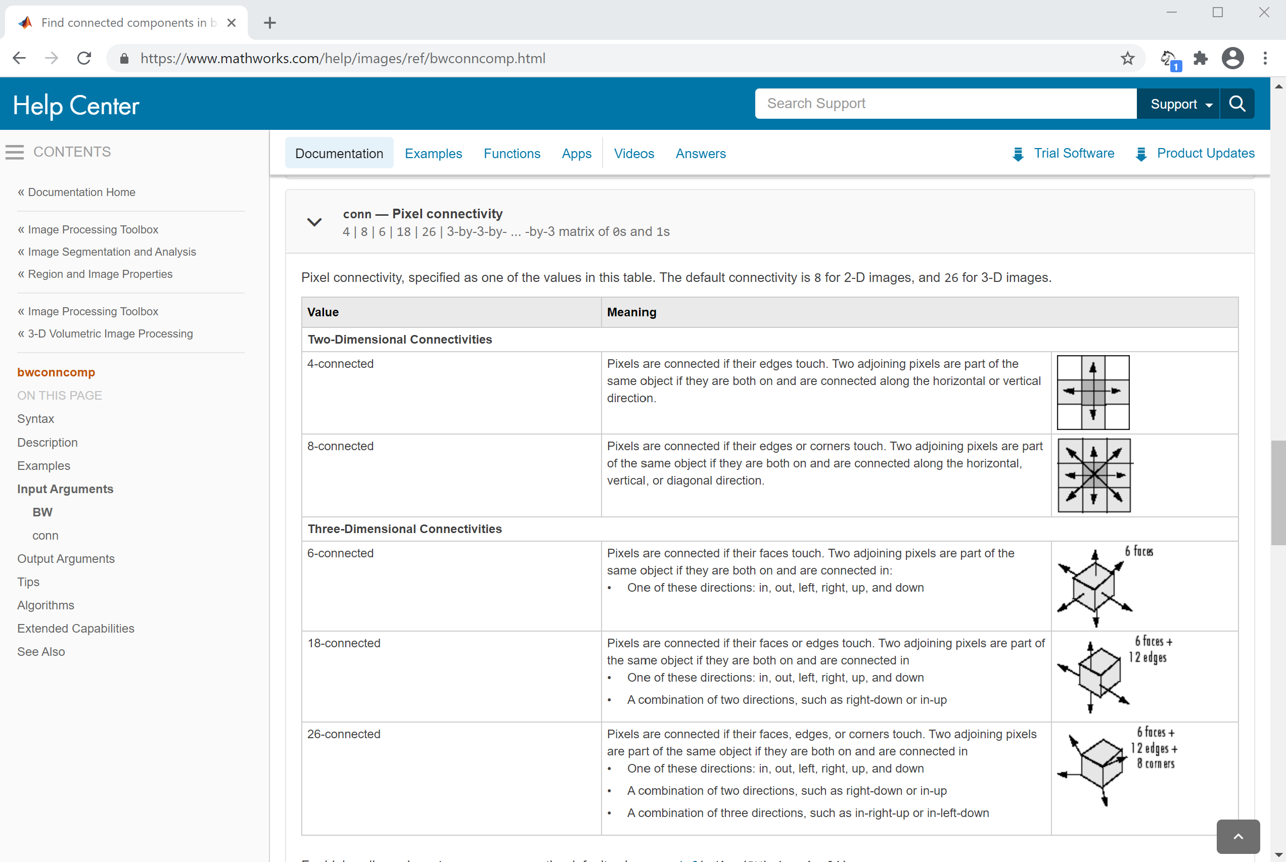
Connected components in 2D and 3D

