Slide 1
Modular Ontology Modeling with Ontology Design Patterns
Nazifa Karima
Adila A. Krisnadhi

Slide 2
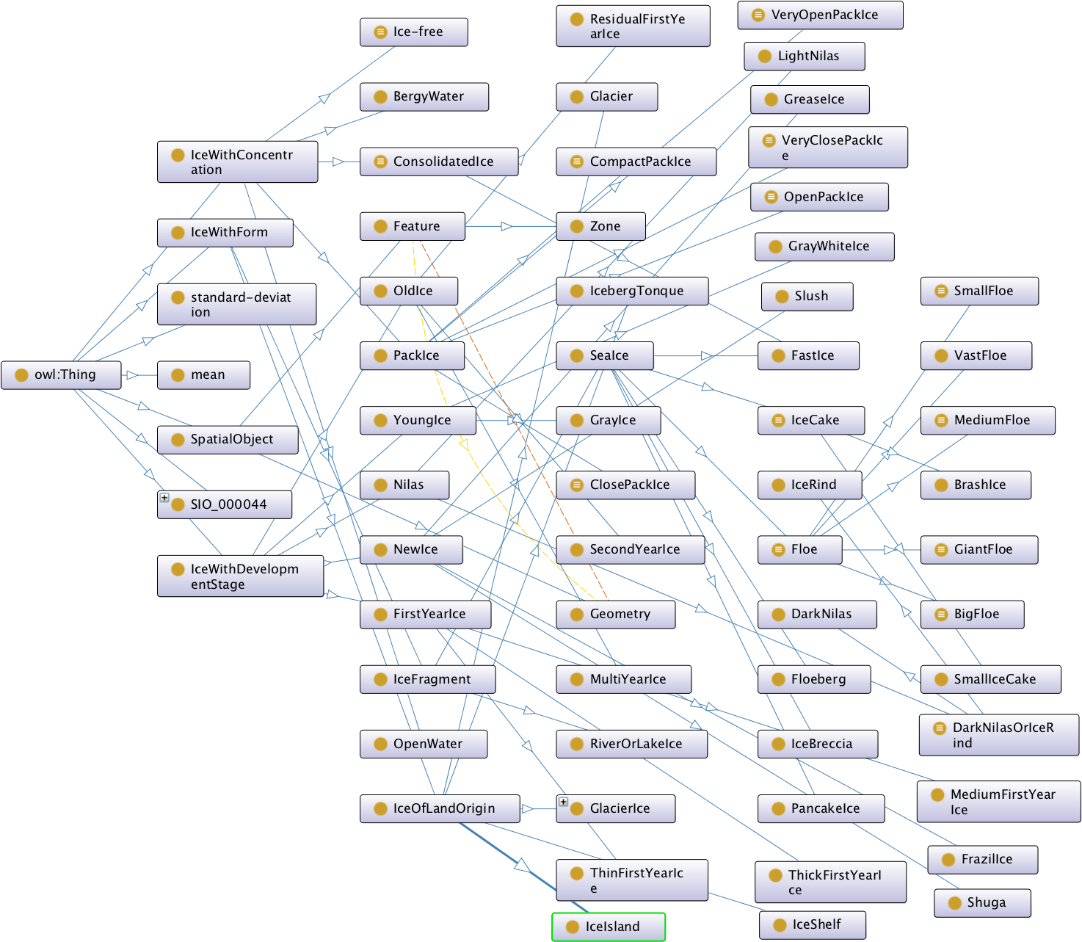
SeaIce Ontology (Non modularized)
Notes:
Mention the problem with this picture. 1.a) Hard to understand as it’s just class hierarchy. So we can’t figure out how the data is related to each-other. (querying)
1.b) If someone wants to populate the ontology with new data, the hierarchy doesn’t help much because it doesn’t convey the meaning behind the terms in the hierarchy. (population)
2. Hard to find reusable components.
3. Integration 4. Impose ontological commitments that may not be acceptable by all parties.
5. Brittle — costly/hard to extend, carelessly extending may cause the whole thing breaks.

Slide 3
How do we make sense of this ontology?
Divide it into modules
Find relations among these modules provided by the ontology

Slide 4
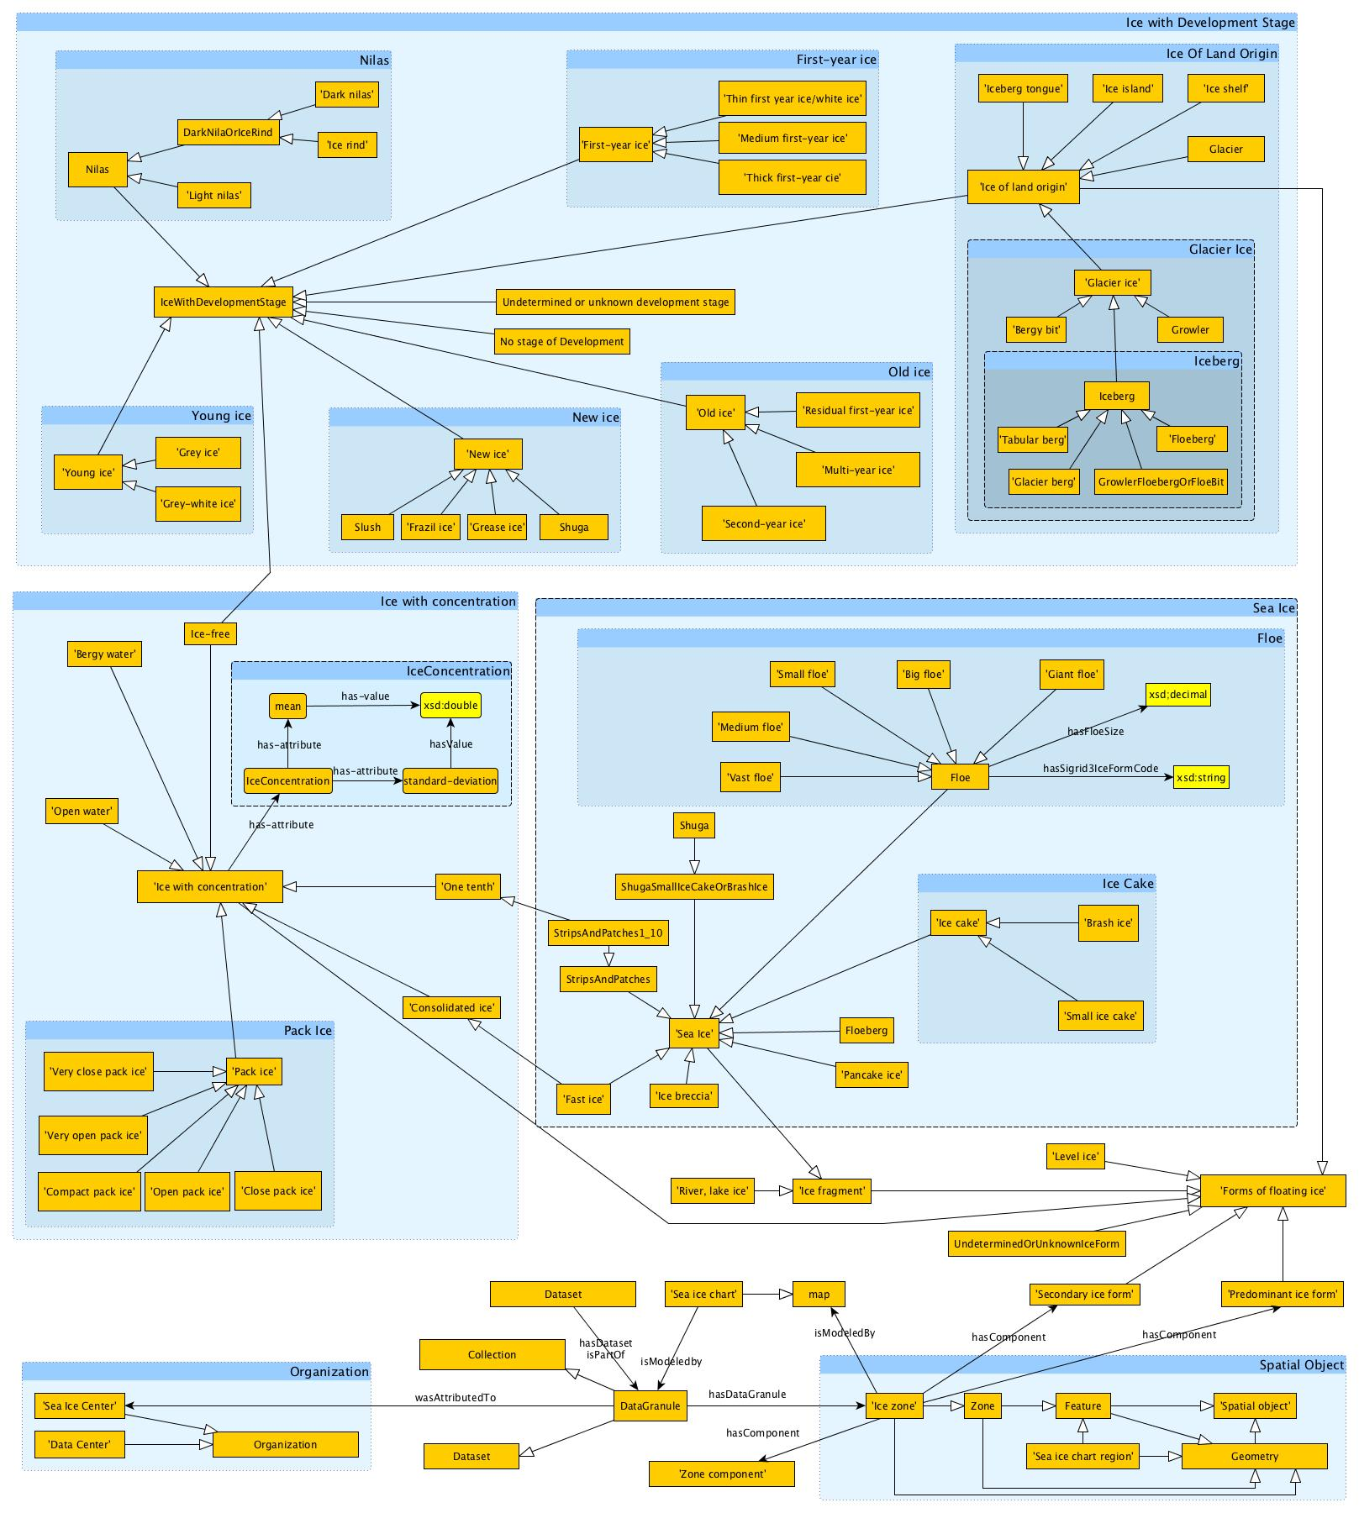
SEAICE
SeaIce ontology divided into 17 modules
Notes:
So, first we look into the most dominant type of relationships namely the subclassOf relationship. After modularizing following this line of thought we found 17 modules. But this doesn’t help us much when we want to populate this ontology with new data. Or in other words, annotate data with this ontology. Beyond that, not so much helpful in querying either because we mainly only have class names. If you want to understand what’s behind these class names then we need to look into the annotations and/or need to be the domain experts.
To properly populate this ontology we need relations among the classes/modules. So the question is now, how do we get the relations?

Slide 5
Ontology Design Pattern
So how do we get the relations?
Look into the Object Properties
Look into Data Properties
Look into axioms involving these properties
Look into the annotations for all entities in the ontology
Consult domain experts/original developers of the ontology
Notes:
One or a combination of these steps might yield fruitful result. After finding these relations how do we consolidate them into one or several ‘reusable modules’?

Slide 6
Ontology Design Pattern
Ontology design pattern (ODP): A (“reusable”) solution of a frequently
occurring modeling problem in the domain and can act as a building block of a more complex ontology.
Content pattern (CP): An ODP that models a particular generic notion in a particular domain.

Slide 7
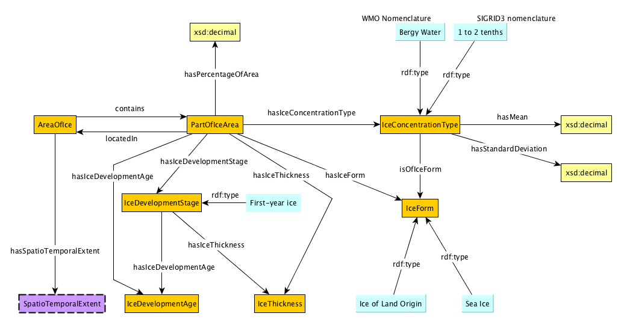
SEAICE
Pattern-1: Pattern for “Ice with Development Stage”

Slide 8
Ontology Design Pattern can also be used to build a ‘good’ ontology from scratch.

Slide 9
Principle #1: Small >>> Large
Smallness usually implies simplicity
Principle #2: Modular >>> monolithic
Easier to use as building blocks.
Highly extendible
Easily understandable
Principle #3: Be aware of multiple perspectives.
Strike a balance between fostering interoperability vs. allowing semantic heterogeneity.
e.g., street is a connection between two places, but also a separation that cuts a habitat into pieces.
Principle #4: Add human-readable annotations
Improve understandability.

Slide 10
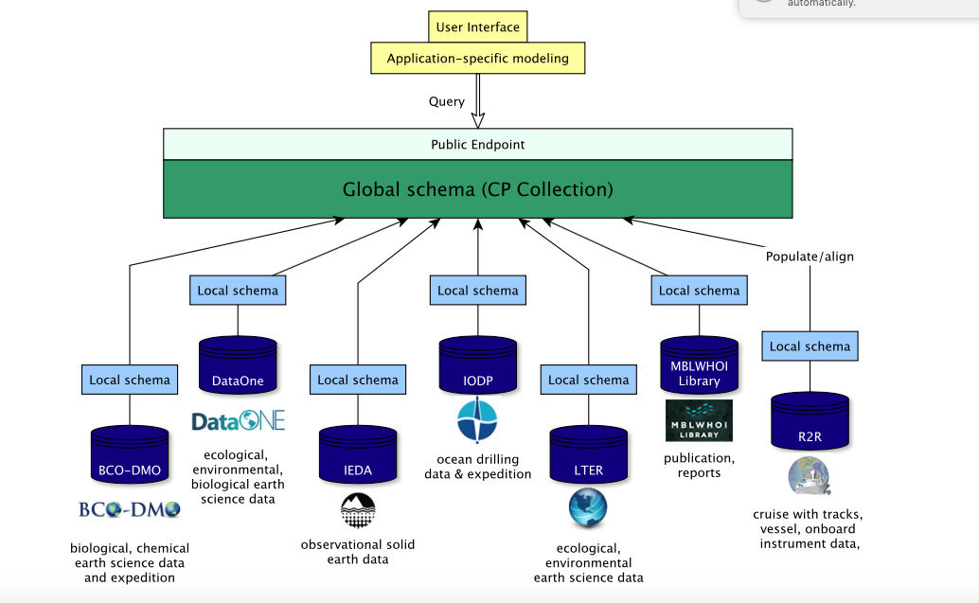
GeoLink Architecture

Slide 11
Modeling Workflow

Slide 12
GeoLink Modular Ontology

Slide 13
Cruise CP

Slide 14
Cruise Trajectory

Slide 15
Acknowledgements
ESIP Testbed Project
Wright State: Pascal Hitzler, Nazifa Karima, Adila Krisnadhi
Notre Dame of Maryland University: Tom Narock
Ronin Institute: Ruth Duerr
GeoLink (funded by NSF through EarthCube)
LDEO: Robert Arko, Peng Ji, Suzanne Carbotte, Kerstin Lehnert
WHOI: Cynthia Chandler, Adam Shepherd, Peter Wiebe, Lisa Raymond, Audrey Mickle
UCSB: Krzysztof Janowicz, Yingjie Hu, Matthew Jones, Bryce Mecum, Mark Schildhauer
Notre Dame of Maryland University: Tom Narock
Wright State University: Pascal Hitzler, Adila Krisnadhi, Michelle Cheatham, Nazifa Karima
Consortium of Ocean Leadership: Douglas Fils

