Slide 1
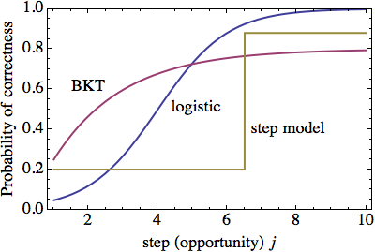
Applying Three Models of Learning to Individual Student Log Data
Brett van de Sande
Arizona State
University
Notes:
Looking a an outline of my talk...

Slide 2
Outline
Motivation: modeling individual student log data
Three models: BKT, logistic, and step function
The Akaike Information Criterion
Compare 3 models to student log data
Notes:
Results from earlier work suggest need for improving help-giving policies, but that doing it by hand is too inefficient and error prone.
One ingredient we will need is to determine when students learn a skill. Discuss models of learning.

Slide 3
Motivation: modeling individual student log data
Want to know if a particular help given to the student, or a particular student activity, resulted in learning
Compare individual student log data to a model of learning
Which model?
Given sufficient log data, can we talk about a model fitting individual student log data better than another model?

Slide 4
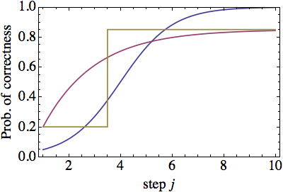
Three models: BKT, logistic, and step function
Bayesian Knowledge Tracing (BKT):
  3 parameters
  1-P(S)-A e^{-β j}
Logistic model:
  2 parameters
  1/(1+exp(-β(j-j0)))
Step model
  3 parameters
  If j<L then g else s
Notes:
2X2 policy choices, randomly choose default behavior vs. change and then choose from 2X2.
Normally use external post-test but typically very far away from the point where policy choice was made.
In this case we have an outcome that is close to the point where the policy choice was made.
Lasted 1 week, 120 hours of log data.
Problems with getting students started. Conclusion: intro problems were optional (so no one did them), students started up in middle of course with hard problems.

Slide 5
Aside on Bayesian Knowledge Tracing (BKT)
BKT is two distinct forms:
Hidden Markov mode (HMM) form: Model is fit to aggregate student log data using RSS or maximum likelihood
Knowledge tracing algorithm form: model parameters are given, algorithm applied to individual student, with updates based on student performance
The HMM model can be solved exactly:
  Exponential: 1-P(S)-A e^{-β j}
  Function of three parameters, explaining the “identifiability problem” (Beck & Chang)
See JEDM article for details
Notes:
2X2 policy choices, randomly choose default behavior vs. change and then choose from 2X2.
Normally use external post-test but typically very far away from the point where policy choice was made.
In this case we have an outcome that is close to the point where the policy choice was made.
Lasted 1 week, 120 hours of log data.
Problems with getting students started. Conclusion: intro problems were optional (so no one did them), students started up in middle of course with hard problems.

Slide 6
The Akaike Information Criterion (AIC)
AIC for model A is defined as:
AICA = -2 log(LA) + 2 K
where K is number of model parameters
Distance between given model and true (complicated) model that actually produced the data
Akaike weight
wA = C exp(-AICA/2)
Relative probability that model A is closest to the correct model
For us: wstep + wlogit + wBKT = 1

Slide 7
Compare 3 models to student log data
Student log data from summer 2011, St. Anselm college, 2 semester intro physics course, using Andes tutor system
For each student & KC, sequence of correct/incorrect:
0010110110111
Correct=correct answer on first try, no hints
Choose sequences length ≥10, 267 total sequences
For each student-KC sequence, fit all three models & find Akaike weights wstep, wlogit, wBKT
Notes:
2X2 policy choices, randomly choose default behavior vs. change and then choose from 2X2.
Normally use external post-test but typically very far away from the point where policy choice was made.
In this case we have an outcome that is close to the point where the policy choice was made.
Lasted 1 week, 120 hours of log data.
Problems with getting students started. Conclusion: intro problems were optional (so no one did them), students started up in middle of course with hard problems.

Slide 8
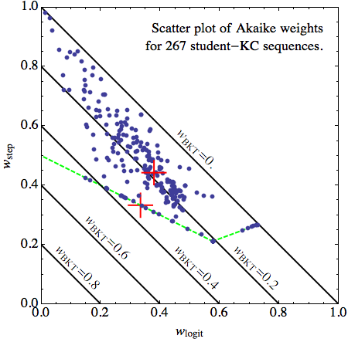
Which model is best?
Step is weakly favored over logit
Step and logit both strongly favored over BKT
line is wstep=tw=BKT
Cross at wstep=wlogitw=BKT=1/3
Notes:
2X2 policy choices, randomly choose default behavior vs. change and then choose from 2X2.
Normally use external post-test but typically very far away from the point where policy choice was made.
In this case we have an outcome that is close to the point where the policy choice was made.
Lasted 1 week, 120 hours of log data.
Problems with getting students started. Conclusion: intro problems were optional (so no one did them), students started up in middle of course with hard problems.

Slide 9
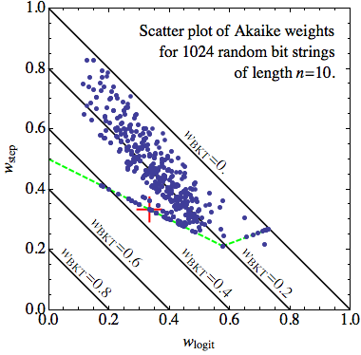
Too good to be true?
Would expect some points to favor BKT
Generate all 1024 bit strings of n=10 steps:
0011100011
All 3 models should fit this data set equally well, since the all contain true model (P=1/2).
Should see weights centered at:
wBKT = wlogit = wstep = 1/3
Instead, see same qualitative behavior as before!
Notes:
2X2 policy choices, randomly choose default behavior vs. change and then choose from 2X2.
Normally use external post-test but typically very far away from the point where policy choice was made.
In this case we have an outcome that is close to the point where the policy choice was made.
Lasted 1 week, 120 hours of log data.
Problems with getting students started. Conclusion: intro problems were optional (so no one did them), students started up in middle of course with hard problems.

Slide 10
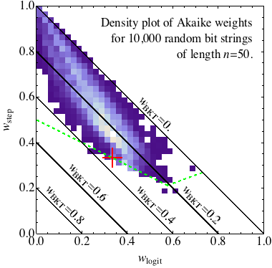
Small n effect?
AIC strictly valid in large n limit, while many student sequences are short
Generate 10,000 bit strings of length n=50 steps:
01010101111011100011010101011110111000111100111111
Get the same thing:
Notes:
2X2 policy choices, randomly choose default behavior vs. change and then choose from 2X2.
Normally use external post-test but typically very far away from the point where policy choice was made.
In this case we have an outcome that is close to the point where the policy choice was made.
Lasted 1 week, 120 hours of log data.
Problems with getting students started. Conclusion: intro problems were optional (so no one did them), students started up in middle of course with hard problems.

Slide 11
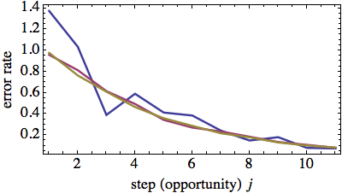
Contrast with fitting to aggregate data
For data averaged over N students (e.g. error rate), curve becomes smoother as we add more students
Correct curve emerges as N → ∞
Model with same curve is correct model
There can be a “best fit” among competing models (chi-squared statistic).

Slide 12
Conclusions
Find that AIC weakly favors the step model over the logistic and both are strongly favored over BKT
Even if we use BKT (for some choice of parameters) to generate the sequences, we can always find parameters such that the step function fits the data better!
Interpretation: when fitting models individual student data, we cannot make conclusions about what model is “correct” in the usual sense, but can only talk about what model fits in the sense of being “close” to the data
If we are interested in determining the effectiveness of help given or of an action taken by the student, we are more interested in being “close” to the data.
Notes:
2X2 policy choices, randomly choose default behavior vs. change and then choose from 2X2.
Normally use external post-test but typically very far away from the point where policy choice was made.
In this case we have an outcome that is close to the point where the policy choice was made.
Lasted 1 week, 120 hours of log data.
Problems with getting students started. Conclusion: intro problems were optional (so no one did them), students started up in middle of course with hard problems.

