Slide 1
"Always code as if the guy who ends up maintaining your code will be a violent psychopath who knows where you live."
Martin Golding.

Slide 2

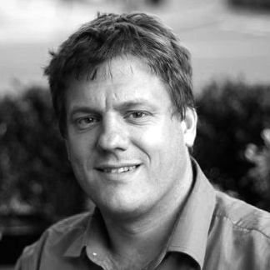

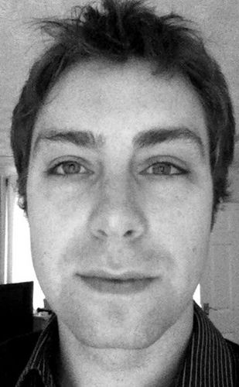
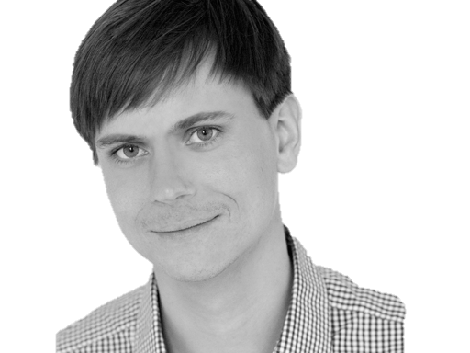

@riverglide
@andypalmer
@antonymarcano
@jmrtn
@pro_cessor

Slide 3

Ψ

Slide 4
Managerbrokerdispatcher interfaceimpl

Slide 5
http://www.classnamer.com/

Slide 6
CheckedGraphContext Stateles ErrorCorrectingMessageGeneratorsRecordGenerator

Slide 7
Clean code *
*The book!

Slide 8
intentionrevealing
Use
Names
ABSICHTSVERMITTELNDE

Slide 9
DEsinformation
Vermeide

Slide 10
aussagekräftige
Erzeuge
Unterschiede

Slide 11
Suchbare
Verwende
Namen

Slide 12
aussprechbare
Verwende
Namen

Slide 13
private Date genymdhms

Slide 14
private Date generationTimestamp

Slide 15
/// <summary> /// Gets or sets. /// Used for Ewiomc. /// </summary> /// <remarks> /// Used internally by the bl. /// </remarks> public string Vdewgvgwid { get; set; } WTF? Ich geh heim.

Slide 16
Klassennamen
Aussage
kräftig

Slide 17
“Classes and objects should have noun or noun phrase names like customer, WikiPage, Account, and Addressparser. Avoid words like manager, Processor,, Data, or Info in the Name of a class. A class Name should not be a verb.”

Slide 18
“Classes and objects should have noun or noun phrase names like customer, WikiPage, Account, and Addressparser. Avoid words like manager, Processor,, Data, or Info in the Name of a class. A class Name should not be a verb.”

Slide 19
“Classes and objects should have noun or noun phrase names like customer, WikiPage, Account, and Addressparser. Avoid words like manager, Processor,, Data, or Info in the Name of a class. A class Name should not be a verb.”

Slide 20
“Classes and objects should have noun or noun phrase names like customer, WikiPage, Account, and Addressparser. Avoid words like manager, Processor,, Data, or Info in the Name of a class. A class Name should not be a verb.”

Slide 21
“Classes and objects should have noun or noun phrase names like customer, WikiPage, Account, and Addressparser. Avoid words like manager, Processor, Data, or Info in the Name of a class. A class Name should not be a verb.”

Slide 22
WAR
UM?

Slide 23
Deinen feind
Kenne
Und respektiere ihn.

Slide 24
Weasel Words

Slide 25
“I can suck melancholy out of a song, as a weazel sucks eggs.”
Shakespeare, as you like it, ii. 5..

Slide 26
Taxonomie
Klassifikation
Ordnung

Slide 27
Hungarian
Party Hats
Philo
sophers

Slide 28
Double int long string

Slide 29
pWindow cCustomers

Slide 30
[DllImport("user32.dll")] static extern bool CloseWindow(IntPtr hWnd);

Slide 31
[DllImport("user32.dll", SetLastError=true)] static extern IntPtr CreateWindowEx( WindowStylesEx dwExStyle, string lpClassName, string lpWindowName, WindowStyles dwStyle, int x, int y, int nWidth, int nHeight, IntPtr hWndParent, IntPtr hMenu, IntPtr hInstance, IntPtr lpParam);

Slide 32
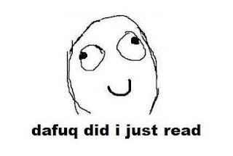

Slide 33
public int SumIntegersUpTo(int bound) { return Enumerable.Range(1, bound).Sum(); }

Slide 34
private readonly ICanStartAndStop _counter; private readonly Wristwatch _wristwatch; private Brush _color; private double _fontSize; private bool _isRunning = false; private TimeSpan _timeLeft;

Slide 35
Hungarian
Party Hats
Philo
sophers

Slide 36
for(int i = 0; i < customers.Count; i++) { Customer theCustomer = customers[i]; ... }

Slide 37
foreach(var customer in customers) { ... }

Slide 38
MehrfachEn
Hilfsmittel zur
Vergabe des selben Namens

Slide 39
my

Slide 40
THE

Slide 41
AN

Slide 42
IT

Slide 43
Hungarian
Party Hats
Philo
sophers

Slide 44
Data

Slide 45
Info

Slide 46
Function

Slide 47
Infra structure

Slide 48
System

Slide 49
Process

Slide 50
Model

Slide 51
Engine

Slide 52
Resource

Slide 53
Vanity
Details

Slide 54
IMPORTANCE
Eitle Wichtigtuer
Aufgeblasen!

Slide 55
Flexible

Slide 56
Extended

Slide 57
Super

Slide 58
ABSTRACT

Slide 59
Optimized

Slide 60
General

Slide 61
Core

Slide 62
Simplicity
Die Schönheit liegt
im Auge des Betrachters

Slide 63
Basic

Slide 64
Easy

Slide 65
Special

Slide 66
new

Slide 67
Simple

Slide 68
Vanity
Details

Slide 69
Shape
Mit Förmchen spielen…
Details

Slide 70
List Query Array Dictionary VIEW

Slide 71
BehaviorAL
Benimm dich!
Details

Slide 72
Dynamic Lazy Local Constant Global

Slide 73
Test
Klappts?
Details

Slide 74
MOCK Stub Fake

Slide 75
DynamicMOCK STricktmock

Slide 76
Mocks
Sind keine Stubs.

Slide 77
var stubUserRepository = MockRepository.GenerateStub<IUserRepository>(); stubUserRepository.Stub(x => x.GetUserByName("ayende")).Return(theUser);

Slide 78
Roles
Patterns

Slide 79
Eager
PoEAA
Lazy
GoF
Charity
DDD

Slide 80
Entwurfsmuster
Design Patterns
Sind keine Lösung

Slide 81
Rather than “a general reusable solution to a commonly occurring problem”, I currently think of design patterns as a shared vocabulary for discussing the observable commonalities between two or more solutions, after they’ve emerged.

Slide 82
Rather than “a general reusable solution to a commonly occurring problem”, I currently think of design patterns as a shared vocabulary for discussing the observable commonalities between two or more solutions, after they’ve emerged.

Slide 83
Rather than “a general reusable solution to a commonly occurring problem”, I currently think of design patterns as a shared vocabulary for discussing the observable commonalities between two or more solutions, after they’ve emerged.

Slide 84
Rather than “a general reusable solution to a commonly occurring problem”, I currently think of design patterns as a shared vocabulary for discussing the observable commonalities between two or more solutions, after they’ve emerged.

Slide 85
Rather than “a general reusable solution to a commonly occurring problem”, I currently think of design patterns as a shared vocabulary for discussing the observable commonalities between two or more solutions, after they’ve emerged.

Slide 86
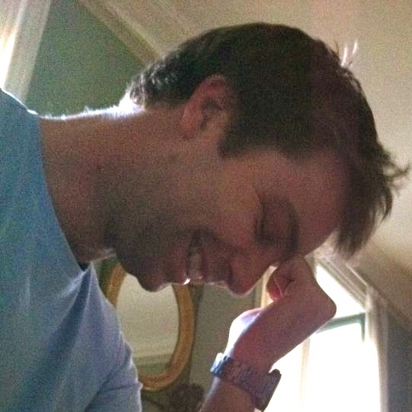
https://twitter.com/#!/jmrtn http://jmrtn.com/notes/2012/02/17/design-patterns.html

Slide 87
Simple First
Paradigm-Commitment
Abstraction Segregation
Domain Relationship
Listening and Learning
Languages
Binary Dependency
Domain Language
Shared Under-standing
Eloquence
Patterns aren’t solutions
Weasel Word Removal

Slide 88
DomänenBEZUG
Wenn du darüber sprichst…
…ist es wahrscheinlich wichtig

Slide 89
Domänensprache
Ubiquitous Language
Gegen Babylonische Sprachverwirrung

Slide 90
REPOSITORY

Slide 91
public class CustomerRepository { IEnumerable<Customer> GetCustomersByYearOfBirth(DateTime yearOfBirth) { } }

Slide 92
public class CustomerRepository { IEnumerable<Customer> GetByYearOfBirth(DateTime yearOfBirth) { } }

Slide 93
public class Customers { IEnumerable<Customer> GetByYearOfBirth(DateTime yearOfBirth) { } }

Slide 94
public class Customers { IEnumerable<Customer> BornIn(DateTime yearOfBirth) { } }

Slide 95
Systemische Metapher Klare Namen

Slide 96
Running
Never Touch a
System

Slide 97
Running
Never Change a
System

Slide 98
Changing
Always run a
System

Slide 99
The blind men and the elephant http://en.wikisource.org/wiki/The_poems_of_John_Godfrey_Saxe/The_Blind_Men_and_the_Elephant Elephant http://inquiry111westminster.wikispaces.com/Blind%20men%20and%20an%20elephant Inspired by and using the fonts suggested at http://www.labnol.org/software/tutorials/advice-select-best-fonts-for-powerpoint-presentation-slides/3355/

Slide 100
Blind men and the elephant John Godfrey Saxe

Slide 101
It was six men of Indostan To learning much inclined, Who went to see the Elephant (Though all of them were blind), That each by observation Might satisfy his mind.

Slide 102
The First approached the Elephant, And happening to fall Against his broad and sturdy side, At once began to bawl: "God bless me!—but the Elephant Is very like a wall!"

Slide 103
The Second, feeling of the tusk, Cried:"Ho!—what have we here So very round and smooth and sharp? To me 't is mighty clear This wonder of an Elephant Is very like a spear!"

Slide 104
The Third approached the animal, And happening to take The squirming trunk within his hands, Thus boldly up and spake: "I see," quoth he, "the Elephant Is very like a snake!"

Slide 105
The Fourth reached out his eager hand, And felt about the knee. "What most this wondrous beast is like Is mighty plain," quoth he; "'T is clear enough the Elephant Is very like a tree!"

Slide 106
The Fifth, who chanced to touch the ear, Said: "E'en the blindest man Can tell what this resembles most; Deny the fact who can, This marvel of an Elephant Is very like a fan!"

Slide 107
The Sixth no sooner had begun About the beast to grope, Than, seizing on the swinging tail That fell within his scope, "I see," quoth he, "the Elephant Is very like a rope!"

Slide 108
And so these men of Indostan Disputed loud and long, Each in his own opinion Exceeding stiff and strong, Though each was partly in the right, And all were in the wrong!

Slide 109
So, oft in theologic wars The disputants, I ween, Rail on in utter ignorance Of what each other mean, And prate about an Elephant Not one of them has seen!

Slide 110
Blue
Rgb,
0,183,255
Orange,
Rgb,
255,116,0
Green,
Rgb
0,219,0
Magenta,
#FF00FF
Light Gray,
Rgb, 191,191,191
Dark Gray,
Rgb,
64,64,64

