Slide 1

Keystroke Dynamics
June 28, 2009
Supervisor: Dr. Iman EL-Azab
Group Members
Mahmoud Fathy
Mohamed Sami
Mohamed Talaat

Slide 2
Agenda
Introduction
Keystroke dynamics for
  Static Verification
  Dynamic Verification
Theoretical / Technical Background
Initial Exploration
Demo
Results
Conclusions
Future Work

Slide 3
Introduction
Biometrics refers to methods for uniquely recognizing humans based upon one or more intrinsic physical or behavioral traits.
  Voice Scan, Signature Scan, Keystroke Dynamics, Manner of walking, running , finger print , etc.
With the increasing of sensitive information systems and network intruders the trends of protecting the sensitive data
  The problem is to provide high level of security authentication and better user identification.
  Usernames and passwords can be stolen and can be guessed using brute force attack algorithms.
  Keystrokes biometrics provide user identification with cheap cost.

Slide 4
Introduction (Cont)
Keystroke dynamics is a biometric based on assumption that different people type in uniquely characteristic manners
  Conceptually close to signature recognition.
  Keystrokes dynamics used to describe the unique typing pattern of users
History :
  1985 Umphress and Williams made a digraph for latencies between the captured keystrokes.
  1988 Williams and Leggett extended their previous study.
  1990 Leggett et alia took the concept of the keystroke stroke dynamics into dynamic environment testing verification.
  2000 Haider et alia discussed the approaches of analyzing user keystroke pattern.

Slide 5
Features
Often used
  Latency between keystrokes
  Duration of keystroke, hold-time
Seldom used
  Overall typing speed
  Frequency of errors
  Keystroke pressure
  Habit of using additional keys (numpad…)
  Capital letters (order of releasing shift and letter)
  Force of hitting keys (special keyboard needed)
Global or per keystroke/key-pair statistics

Slide 6
Features (Cont)
Measuring features :
Measuring easy
  Key Press and Release events
  Timing them trivial
Challenges
  Users with widely differing typing skills
  Affected by alertness (sleepy, drunk, …)
  Injuries
  Holding coffee cup or phone at one hand
  Changing to different keyboard

Slide 7
Verification
Verification mode to validate the user’s inputs to their generated stored profiles
Static Verification
  User authenticated at log-in time
  Keystroke dynamics measured when user writes username and password
Dynamic Verification
  Used for continuous user authentication
  A background process watching the user

Slide 8
Static Verification
User identity is only verified only one time at login
  Passwords are often easy to guess or find out
Motivation for keystroke dynamics
  Not enough for attacker to know username and password
  Expensive to add key-cards or other biometric systems
  Solution: Use keystroke dynamics

Slide 9

Dynamic Verification
Background process continuously identifying user
  Not too sensitive, but still recognize users fast
  allows detecting unauthorized ones to use the system even if they successfully logged in

Slide 10
Theoretical / Technical Background
  Source Data Used :
  Collect different types of information during user session such as :
  latencies between successive keystrokes.
  keystroke duration.
      create unigraph and digraph.
  keystroke pressure.
      need special keyboard ,so we lose the advantage of keystroke biometrics which don’t need a special hardware.

Slide 11
Theoretical / Technical Background
Static versus Dynamic Identity Verification :
  Static Verification :
  Compare keystrokes characteristics with a reference pre-constructed template .
  Only one time at login .
  Dynamic Verification :
  continuous identity verification.

Slide 12
Theoretical / Technical Background
Search Space for Keystroke Template Comparison :
  Against all the referenced profiles in the database.
  To the referenced profile that has the same entered username at login .

Slide 13
Theoretical / Technical Background
Keystroke Analysis Methods :
  fuzzy logic, neural networks and statistical techniques as well as combinations of these approaches.
  statistical methods : Using any distance measure and classification using the Bayes classification algorithm.

Slide 14
Theoretical / Technical Background
Keystroke Analysis Methods :
  Network as an analysis technique is effective but it has a major disadvantage, the neural network must be retrained when a new user is proposed and added to the system database.

Slide 15
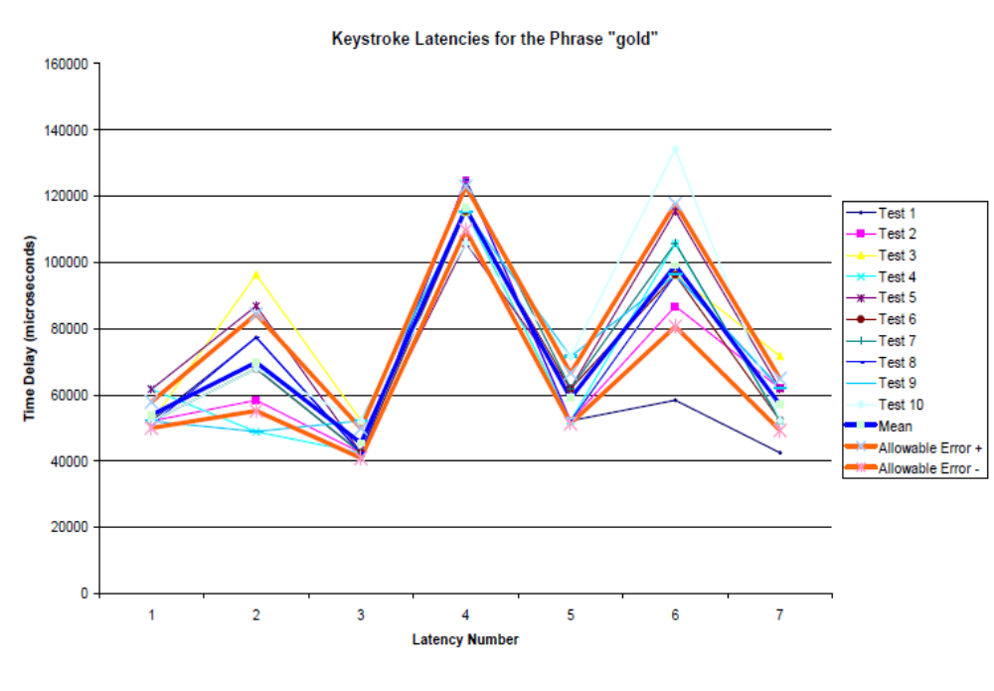
Initial Exploration
Timing Issues

Slide 16
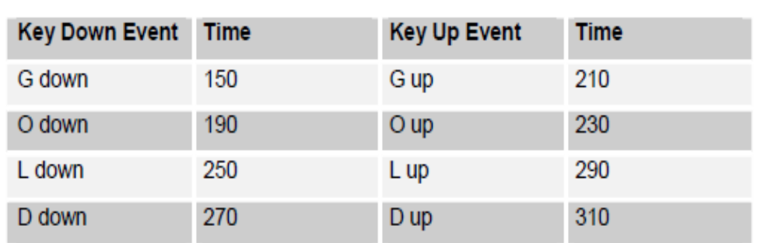
Initial Exploration (cont)
Keystroke Logging
  Trace keystrokes.

Slide 17
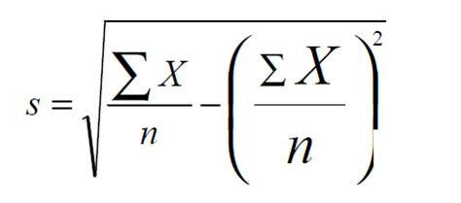
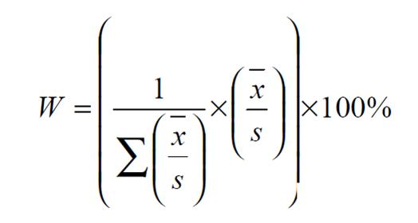

Initial Exploration
Keystroke Verification Algorithm

Slide 18
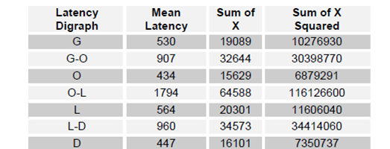
Initial Exploration (cont)

Slide 19
Demo

Slide 20
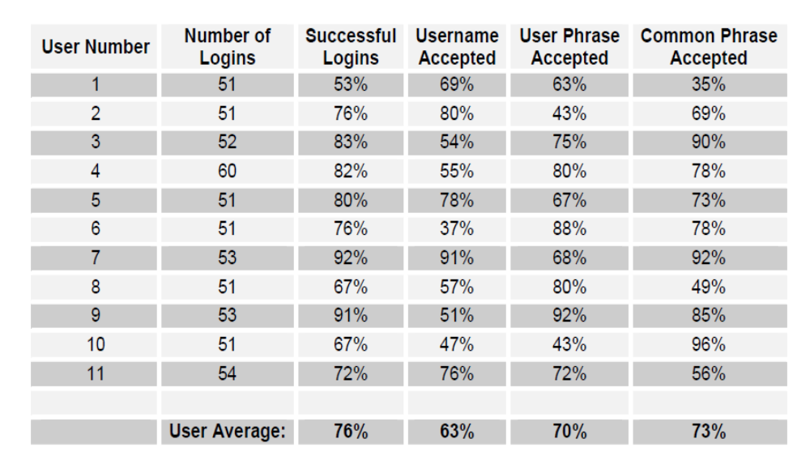
Results

Slide 21
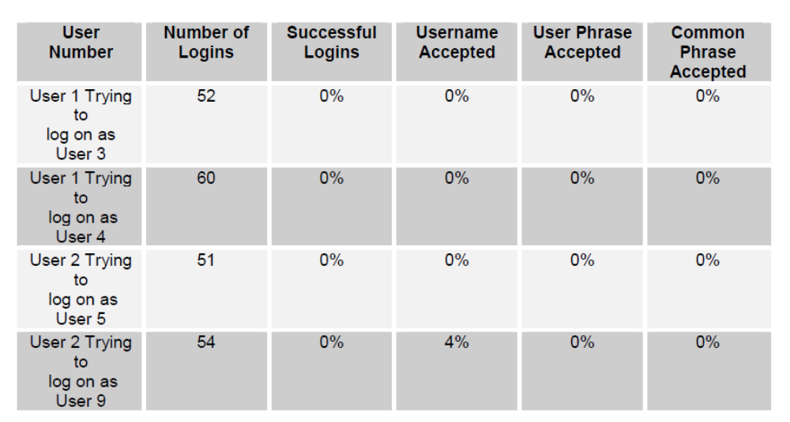
Results(Cont)

Slide 22
Conclusions: Verification
Advantages
Cheap, completely software based
Works quite well in addition to username/password
  Possibly also with PIN-codes
No major changes for users
  Good user acceptance

Slide 23
Conclusions(cont)
Disadvantages
Not a stable biometric
  Affected by almost everything
  “Learning” own password potentially a problem
Hard to implement in “real” computer environments
  Too many different ways to log-in
  Possible to create a keyboard and input a recorded key-sequence as username/password

Slide 24
Conclusions: Identification
Very few scientific studies
Potential uses where un-authorized persons could access computers in open areas
  Better to lock computer when not used and/or use locks in doors

Slide 25
Future Work
Use other analysis techniques like .
      neural networks and fuzzy logic
    More user trial.

Slide 26


